Slide 1

Input Output
ISYS2001, School of Marketing and Management

Slide 2


Slide 3
I acknowledge the traditional custodians of the land on which I work and live, and recognise their continuing connection to land, water and community. I pay respect to elders past, present and emerging.

Slide 4
Today
Getting Help
Handling Exceptions
Validating Input
File Input/Output

Slide 5
Input Output Model
ALGORITHM
INPUTS
OUTPUTS

Slide 6
Six Things
Input
Output
Calculate (Add, multiply, less than etc.)
Store (assignment)
Decide (if-then)
Repeat (for, while)

Slide 7
Core Principles (so far)
Algorithms
  Expressed in structured English (Pseudocode)
  Sequence (must put things in correct order)
  Selection (if-then-else)
  Repetition (while)
Encapsulation (group things)
  Manage complexity
  Data example – lists group values/variables
  Code example – function group expressions

Slide 8
Python
Values (Literals)
Data Types (everything has a datatype)
  str (string)
  int (integer)
  float (real number, decimal number)
  list []
Expressions
  Mathematical operations → evaluates to value
  Relational Operators → Boolean Expressions
  Assignment. Store/save a value to a variable
  if-else (selection)
  Repetition (for)
Functions
  builtins
  import (other packages to extend python)

Slide 9
(Our) Development Environment
Python Notebook
  Code Cells
  Text Cells (Markdown)
  Interactively run cells
  Output in notebook
Workflow
  Edit in notebook
  Frequently save to GitHub

Slide 10
Getting Help
dir([module]) – list function available
help([object]) – list documentation
? And ??
Help others (and your future-self) by using doc string
Online
Note: print() and type() are helpful but relate to the concept of testing. We have been ‘testing’ but will formalise this in later module.

Slide 11
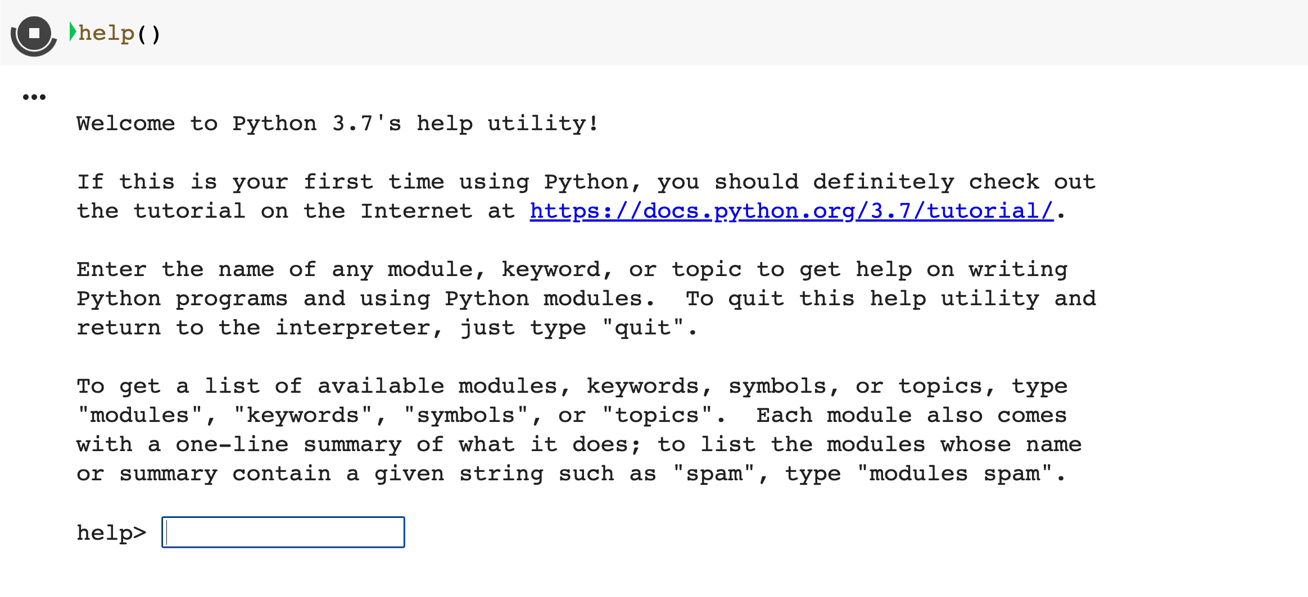

Slide 12
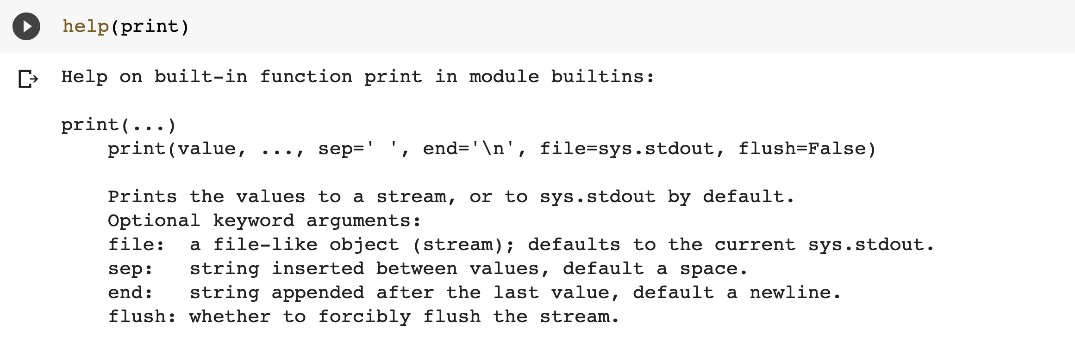

Slide 13
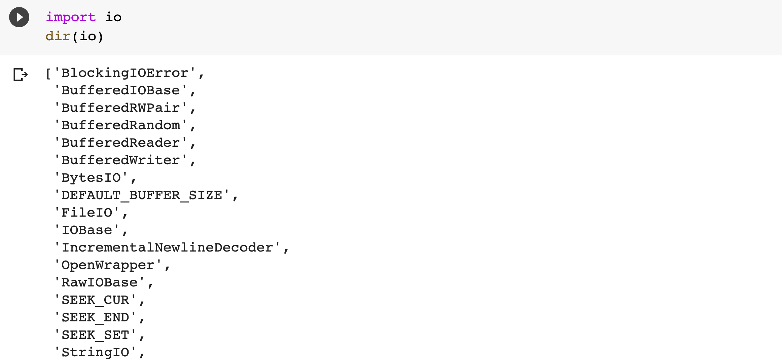

Slide 14
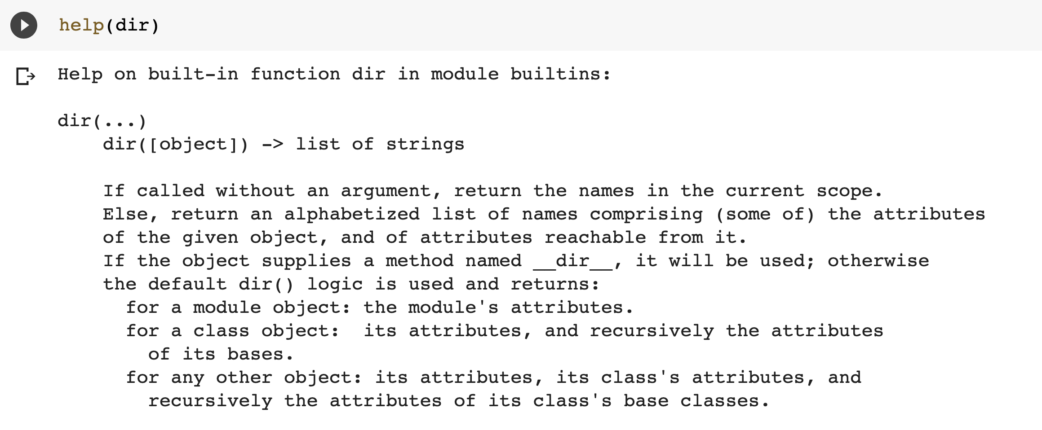

Slide 15
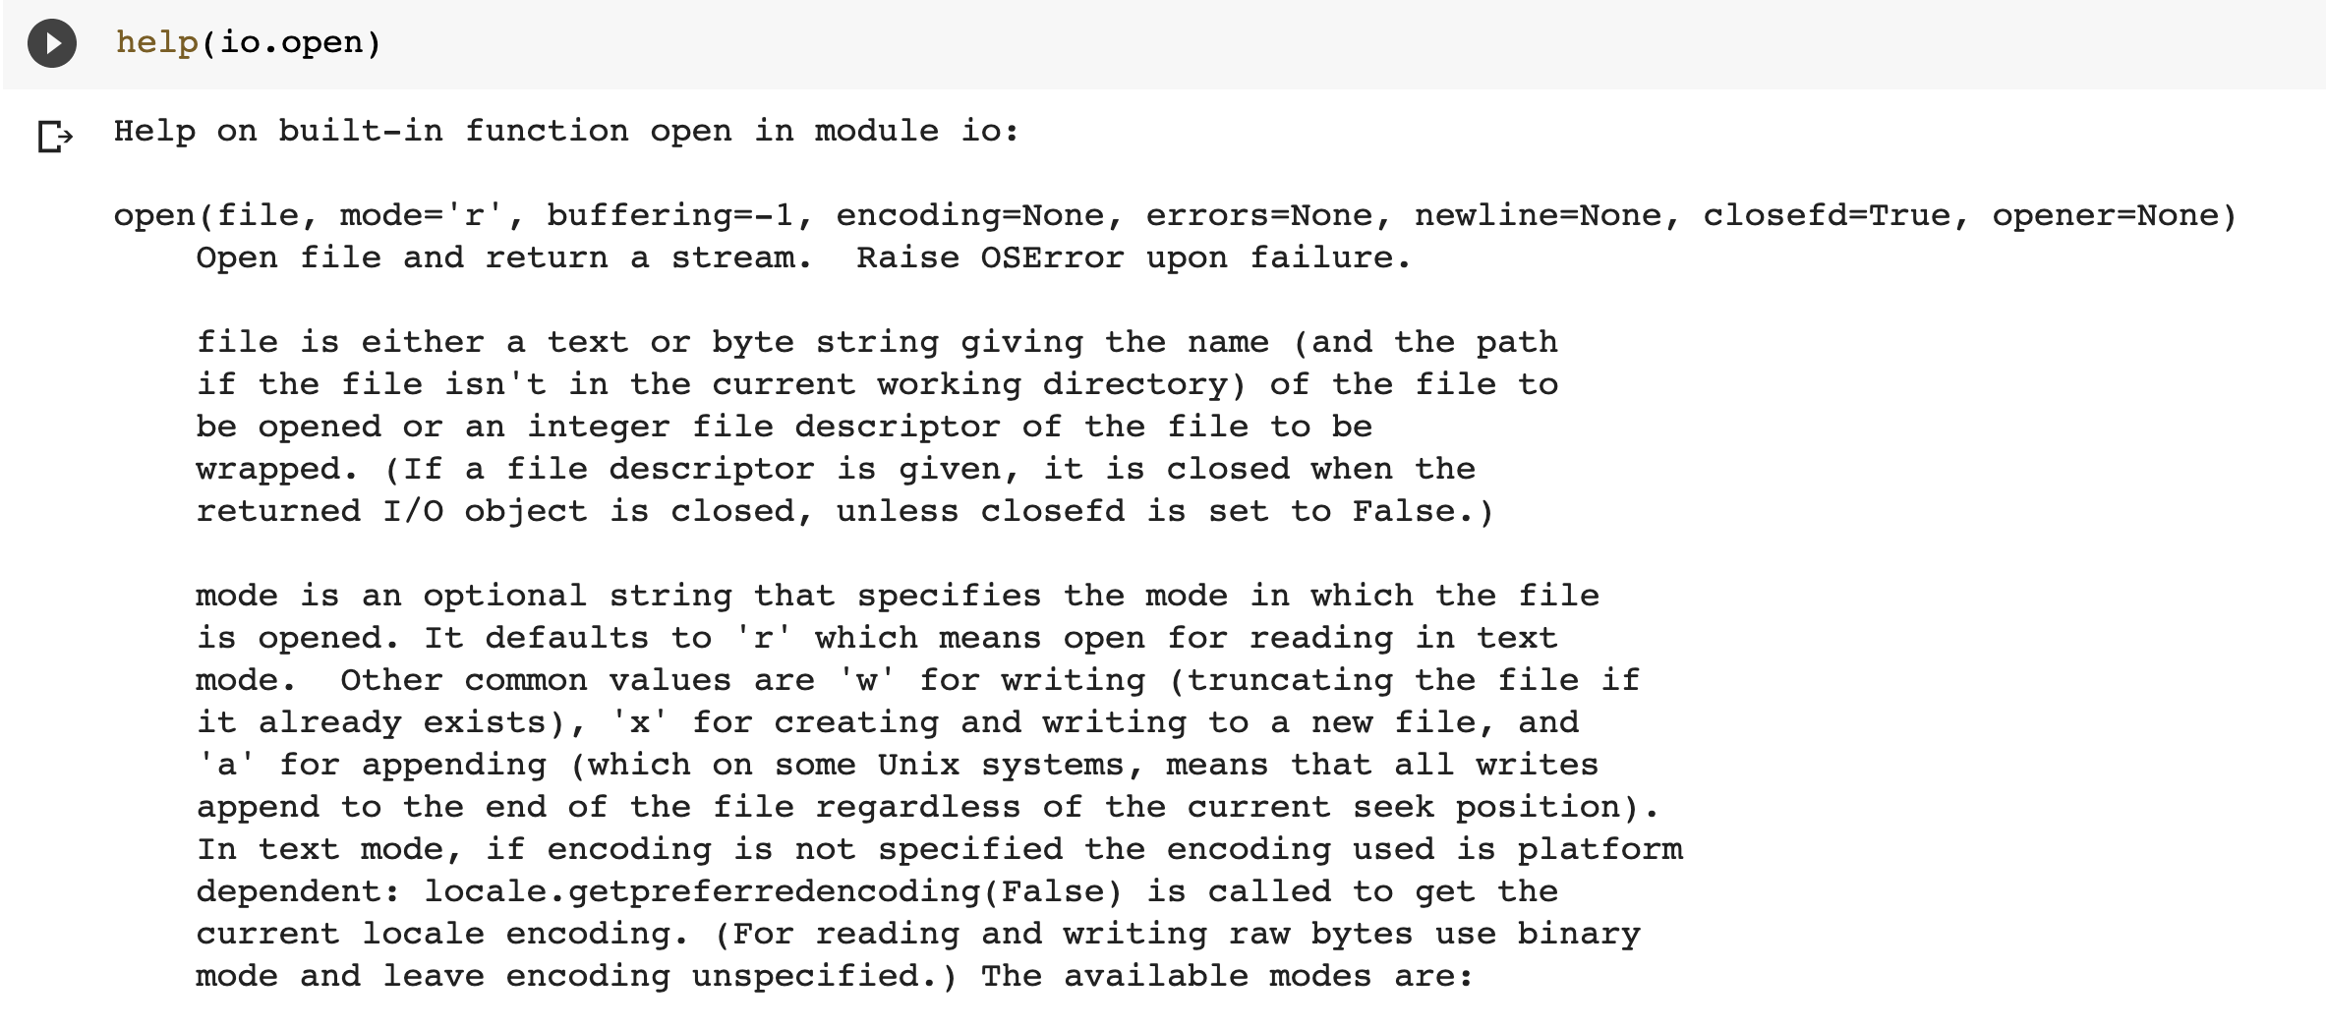

Slide 16
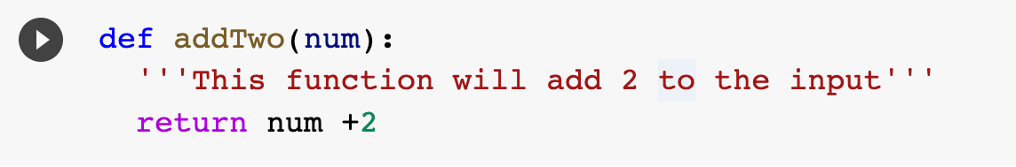
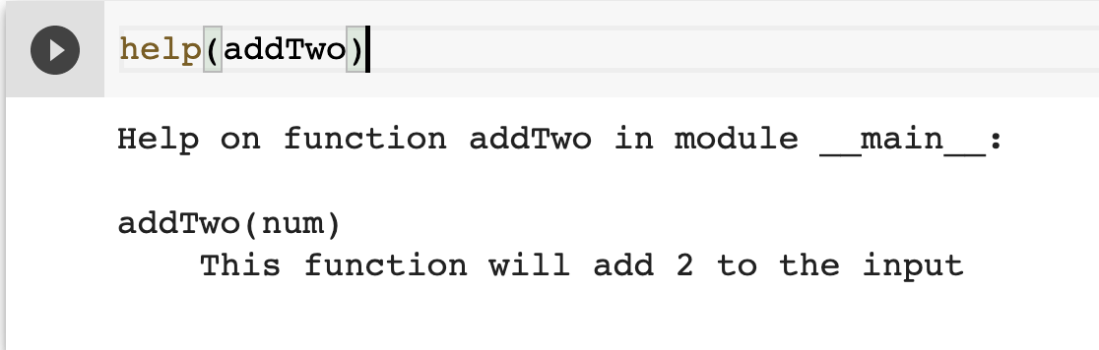

Slide 17
Getting Help
Internet Search
dir([module]) – list function available
help([object]) – list documentation
Add doc string when creating function

Slide 18
Exception
Exception Object:
Description
Traceback

Slide 19
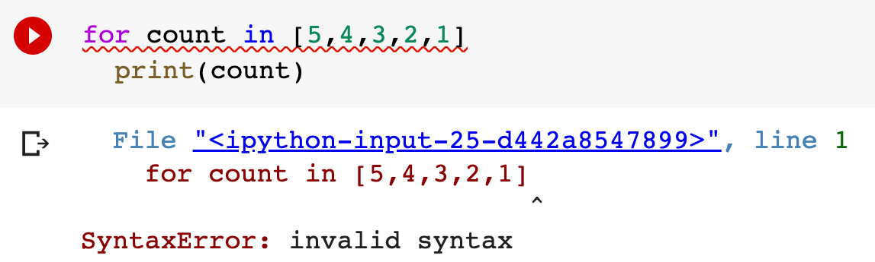

Slide 20
Traceback

Slide 21
Location of error
Traceback

Slide 22
Location of error
Traceback
Description

Slide 23
Location of error
Traceback
Exception Type
Description

Slide 24
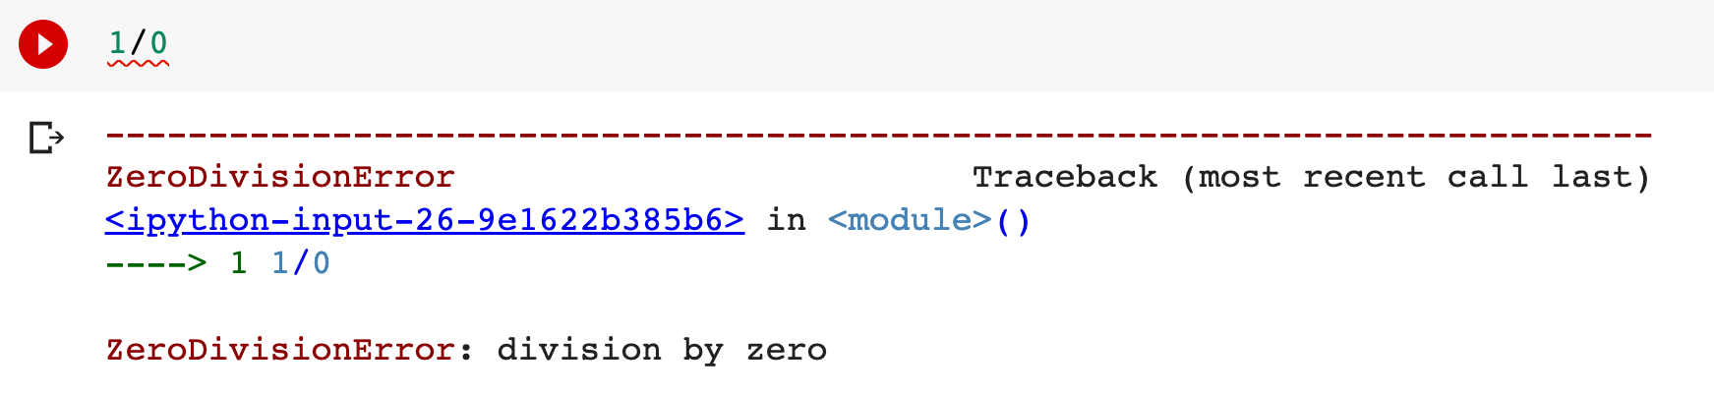

Slide 25
Exception Type

Slide 26
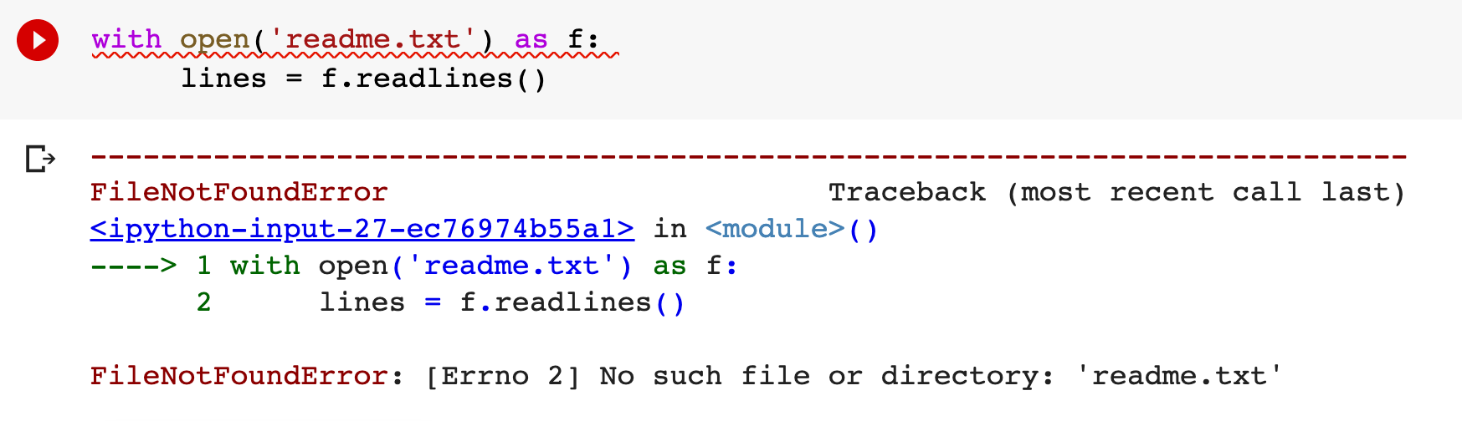

Slide 27
Exception Type

Slide 28
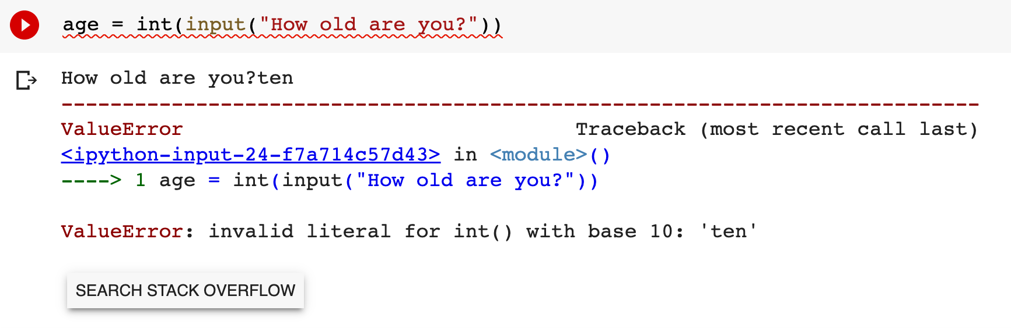

Slide 29
Exception Type

Slide 30
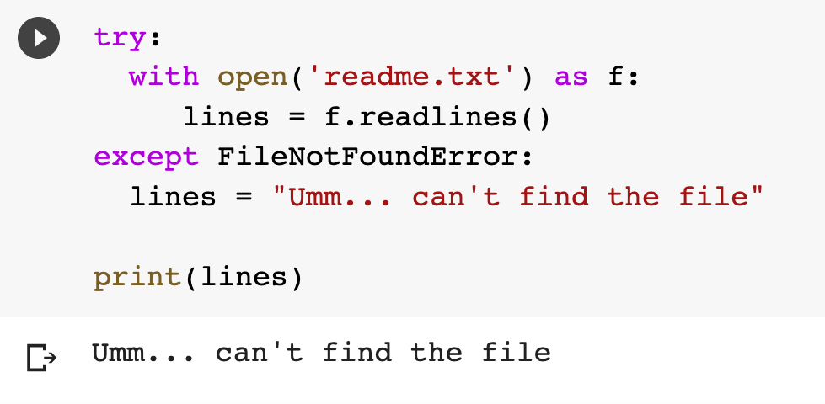

Slide 31
Create a new block to ‘try’ the problem code

Slide 32
Block to run if something goes wrong
Create a new block to ‘try’ the problem code

Slide 33
Block to run if something goes wrong
Create a new block to ‘try’ the problem code
The ‘something’

Slide 34
Error Handling
Exceptions
  SyntaxError (fix, don’t use try/exception)
  ZeroDivisionError
  FileNotFoundError
  ValueError
  Many others
try/except block (simple)
try/except/else/finally (advanced)

Slide 35
(Update) Input Output Model
ALGORITHM
INPUT
OUTPUT
INPUT
INPUT
INPUT

Slide 36
Input validation code verifies that user supplied data, such as text from the input() function, is formatted appropriately.

Slide 37
3 Ways
try/except
isdigit()
PyInputsPlus

Slide 38
while True:
try:
age = int(input('How old are you? '))
break
except ValueError:
print('Please enter a whole number')
print('Your age is: ' + str(age))
#Reference: http://www.easypythondocs.com/validation.html

Slide 39
while True:
age = input('How old are you? ')
if age.isdigit():
break
else:
print('You must enter a valid number')
print('You are ' + str(age))
#Reference: http://www.easypythondocs.com/validation.html

Slide 40
PyInputsPlus
inputStr()
inputNum()
inputChoice()
inputMenu()
inputDatetime()
inputYesNo()
inputBool()
inputEmail()
inputFilepath()
inputPassword()

Slide 41
import pyinputplus as pyip
response = pyip.inputNum()

Slide 42
Input Validation
Don’t trust input
try/except
isdigit()
Module: pyinputplus

Slide 43
Text Files
Plain text
XML
CSV
JSON
Source Code
Binary Files
Compiled Code
App data
Media files
  images
  Audio
  video

Slide 44
open(path_to_file, mode)

Slide 45
Mode | Description
‘r’ | Open a text file for reading text (default)
‘w’ | Open a text file for writing text
‘a’ | Open a text file for appending text

Slide 46
with open('readme.txt') as f:
lines = f.readlines()

Slide 47
The default mode is read
with open('readme.txt') as f:
lines = f.readlines()

Slide 48
with open('readme.txt', 'w') as f:
f.writelines(lines)

Slide 49
Open the file in ‘write’ mode
with open('readme.txt', 'w') as f:
f.writelines(lines)

Slide 50
Working with files
Binary Files
  use packages (next few weeks)
Text File
  with keyword
  open()
  read/write/append

Slide 51
Can you
Get Help with Python
Handle Exceptions
Validate Input
Use Files

