Slide 1
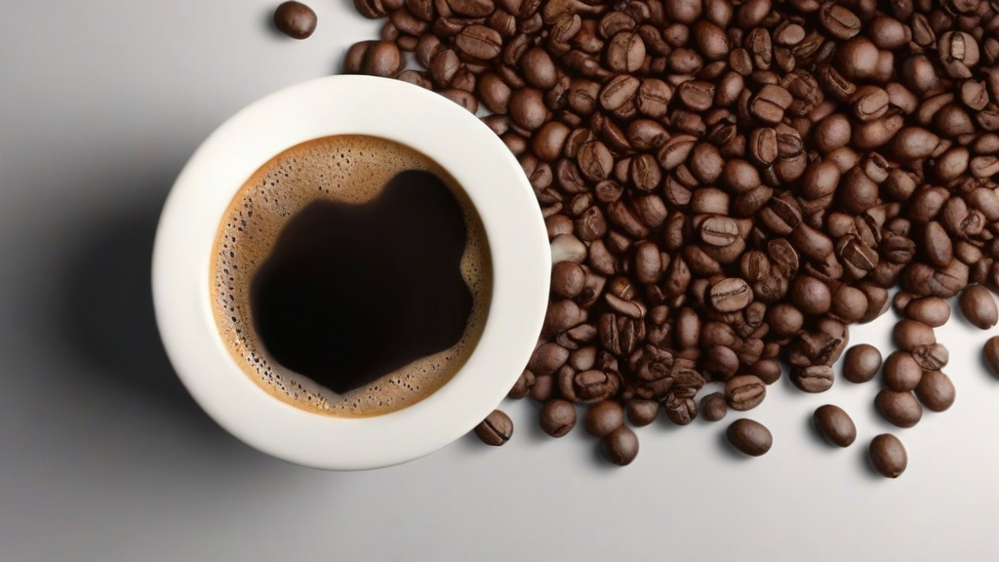
Coffee
• It fuels developers worldwide
• Espresso, filter, or cold brew
Notes:
Now, let's talk about something synonymous with our industry: coffee. It is more than just a beverage; it provides the essential energy needed during deep work and long coding sessions. Whether you prefer an espresso shot, a filtered cup, or a cold brew, it remains a core staple of our daily routine.

Slide 2
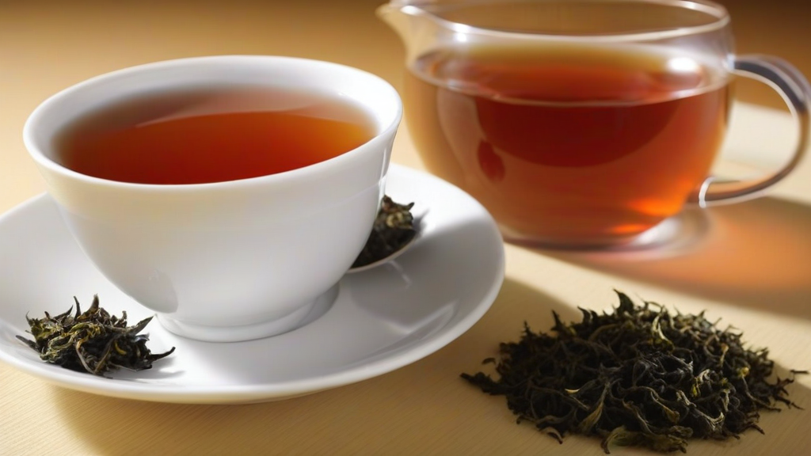
Tea
• The quieter alternative
• Matcha, oolong, earl grey
Notes:
If you’re looking for a gentler alternative to the quick jolt of coffee, tea offers a much steadier experience. Whether you prefer the earthy richness of matcha, the complex profile of an oolong, or the classic floral notes of an Earl Grey, it provides a calmer way to find your focus.

