Slide 1
AI drafts, the academic decides
The tool proposes a rating for each UDL 3.0 consideration, and shows its reasoning
You confirm or override every single one
The AI’s rating and yours are separate fields. Only yours scores
It never has the final word on a pedagogical judgement
Notes:
MICHAEL — 2 min. My section starts here. Open on the principle, not the product; everything after this is evidence for this one line.

Slide 2
Live demonstration
udllens.eduserver.au
One real assessment brief, start to finish
Watch for the moment I disagree with it – and change it
Notes:
MICHAEL — 4 to 5 min. *** LIVE ***
One brief, end to end. Don't narrate every field.
The beat that matters: when the rating appears, disagree with one out loud and change it. That's the whole talk in ten seconds.
FALLBACK: if the room deck is compiled centrally and you can't present from your laptop, play the screen recording. Confirm with Ellen before 10 Aug.
Don't invite the room to follow along — the server rate-limits per IP.

Slide 3
Not a promise – a constraint
What the model may do
Read the brief, rubric and exemplar
Propose a rating per consideration, with its reasoning
Suggest quick wins
What it may not do
Write the final rating, or score anything you haven’t seen
Silently change a rating you set, or store your brief anywhere
Notes:
MICHAEL — 2 min. The transferable bit.
The claim isn't 'we chose to keep a human in the loop' — anyone can say that. It's that the architecture gives the model no path to the final value.

Slide 4
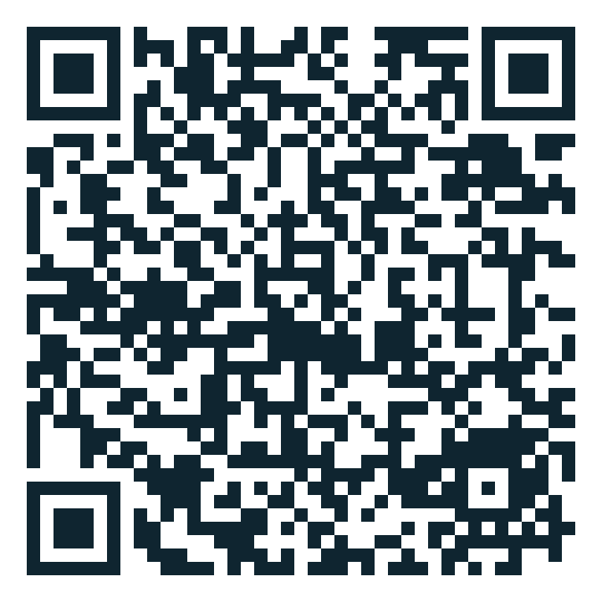
One of these four is invented
7.3 — Nurture joy and play
8.3 — Foster collaboration, interdependence, and collective learning
4.3 — Technology requirements clearly stated
6.5 — Challenge exclusionary practices
classpulse.eduserver.au/join
code A1RHE7

Slide 5
16 of 21 codes were wrong
Luke read the checkpoint data properly in May, and caught it
16 of our 21 UDL codes were wrong
UDL 2.2 leftovers, and codes the model appears to have invented
He spotted it from a single entry: our “3.2 Explicit success criteria and rubric”
CAST’s actual 3.2 says nothing of the kind
Notes:
MICHAEL — 2 min. *** THE HONEST BIT ***
Slow down. Luke caught this, not me and not the tool. Say so out loud — he's standing next to you.
He spotted it from one entry: our '3.2 Explicit success criteria and rubric'.
Source: docs/udl-lens-update-report.md, May 2026.

Slide 6
It didn’t look wrong
What we shipped
What UDL 3.0 actually says
3.2 Explicit success criteria and rubric
1.3 Brief meets accessibility standards
9.2 No assumed socioeconomic advantage
4.3 Technology requirements clearly stated
Highlight patterns and big ideas
Represent diverse perspectives and identities
Develop awareness of self and others
There is no 4.3. Guideline 4 stops at 4.2
Plausible, well formatted, confidently numbered, and wrong.
Notes:
MICHAEL — 2 min. The slide this room will remember.
Not gibberish: plausible, well formatted, correctly numbered, confident, wrong.
Land 4.3 hard. Guideline 4 has only 4.1 and 4.2. There is no 4.3 — the model cited a thing that does not exist, and nothing in the output looked unusual.
If you don't know the domain you cannot catch this by reading carefully. That is the point.

Slide 7
The reset
Stripped back to six – only considerations Luke had verified against CAST
Made the codes checkable – every code now validates against a canonical UDL 3.0 table
Took the pedagogy off the model – the practices are written by someone who teaches
Kept the receipts – the 21-checkpoint version is still in git history
Notes:
MICHAEL — 90 sec. Three responses. The third is the real fix: the model is not qualified to write the pedagogy, and now it doesn't.

Slide 8
It happened again
Two weeks ago, drafting an expansion to more assessment types
UDL 2.2 names again, and two codes that had moved between versions
Caught by the check we built the first time, not by anyone being careful
This isn’t a bug you fix once. It’s a property you design around
Notes:
MICHAEL — 60 sec, and the strongest thing you can say.
Preparing THIS talk, drafting an expansion, the same error class reappeared. Caught by the check we built after the first time — not by anyone being careful.

Slide 9
Where it is now, and what transfers
The prototype today
15 assessment types, 57 UDL 3.0 considerations, all nine guidelines
Every code machine-verified against CAST; live, no login, nothing stored
Mappings drafted – the pedagogy still needs Luke’s sign-off
What transfers
Let AI draft, never decide. Make its claims machine-checkable
Keep domain authorship human. Expect plausible-and-wrong, and design for it
Notes:
MICHAEL — 90 sec, then hand back to Luke.
Numbers current as of this build. Say the mappings still need Luke's sign-off — it's true, and it's the invitation.

