Slide 1
01
ONE-DAY MASTERCLASS
CURTIN EXECUTIVE EDUCATION · DR MICHAEL BORCK
THE
HUMAN
EDGE
Using & delivering AI with judgement.

Slide 2
02
THE PROVOCATION WE'LL SPEND THE DAY ON
“
If the AI is good at running your work, it's good at running everyone else's. Generic competence is the baseline — not the advantage.
SO WHERE DOES YOUR EDGE LIVE?

Slide 3
03
TODAY
One idea. Two scales.
MORNING
AFTERNOON
The judgement, at the level of your own work: the trust tool, RTCF, the two-pass demo.
The same judgement, lifted to delivery: the five differences, human-in-the-loop, the go/no-go.
The trust tool — taught once, reused at project scale

Slide 4
PART ONE
THE AVERAGE,
THE TOOL,
YOUR EDGE.
Personal fluency — the judgement that lasts after the next model ships.

Slide 5
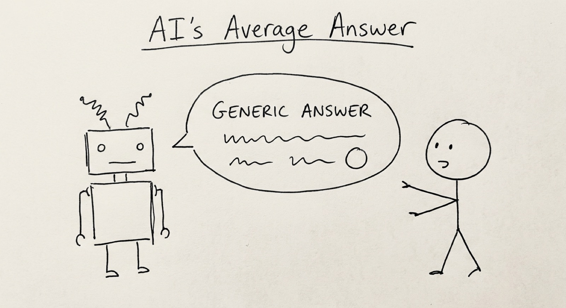
05
WHAT AI ACTUALLY IS
It predicts the next word.
Autocomplete, scaled up. Trained on billions of pages, it learned what tends to follow what. The result looks like understanding. It's pattern-matching.

Slide 6
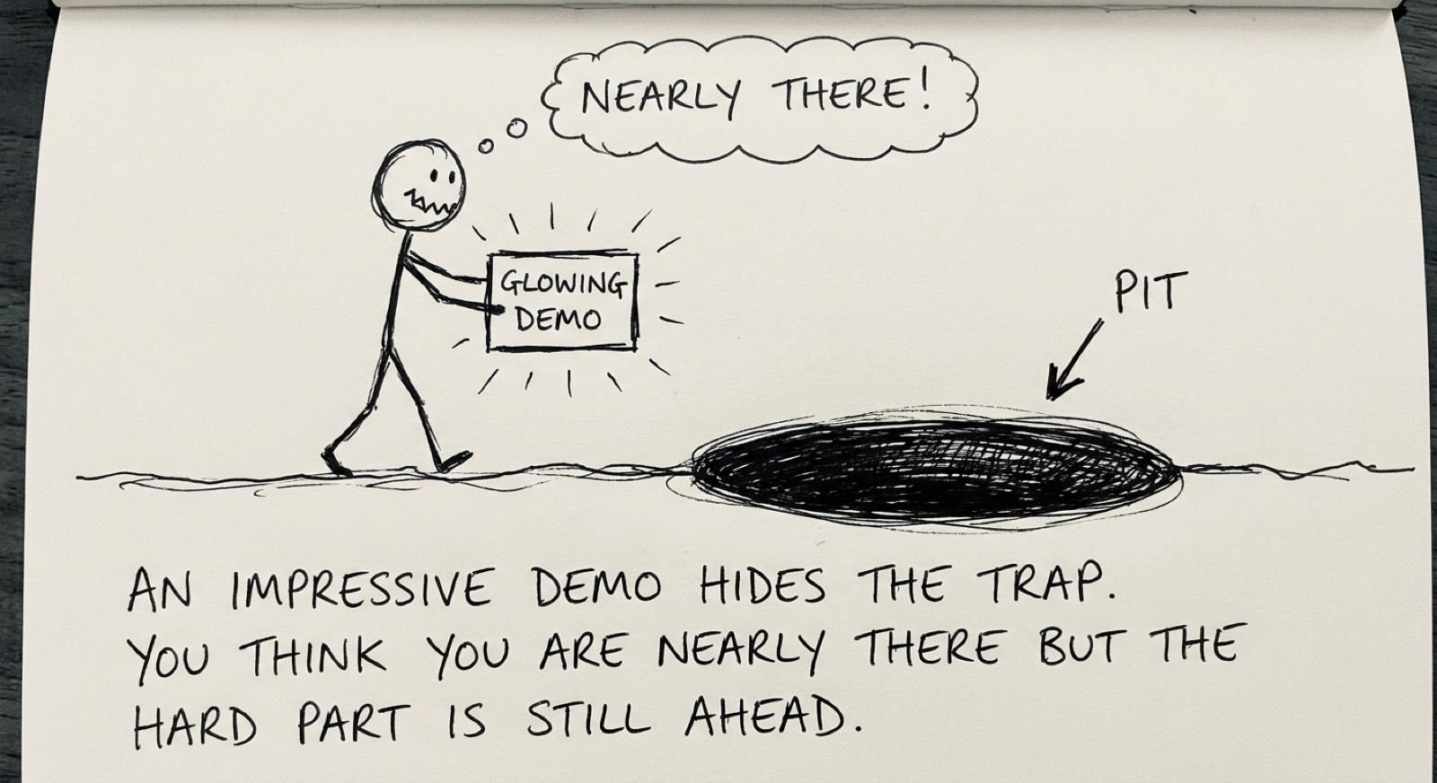
06
THE ONE MENTAL MODEL TO KEEP
A convincing average.
Fluent, plausible, usually about-right. But "about right" and "exactly right" are not the same — and knowing which you need is the whole game.

Slide 7
07
ONCE YOU SEE IT AS AN AVERAGING MACHINE
Brilliant here. Quietly wrong there.
BRILLIANT
UNRELIABLE
Drafting, summarising, formatting, brainstorming, explaining, finding patterns — where "the plausible version" is the answer.
Precise facts, figures, citations, multi-step logic, your context, ethics — where there's one right answer it can't verify.

Slide 8
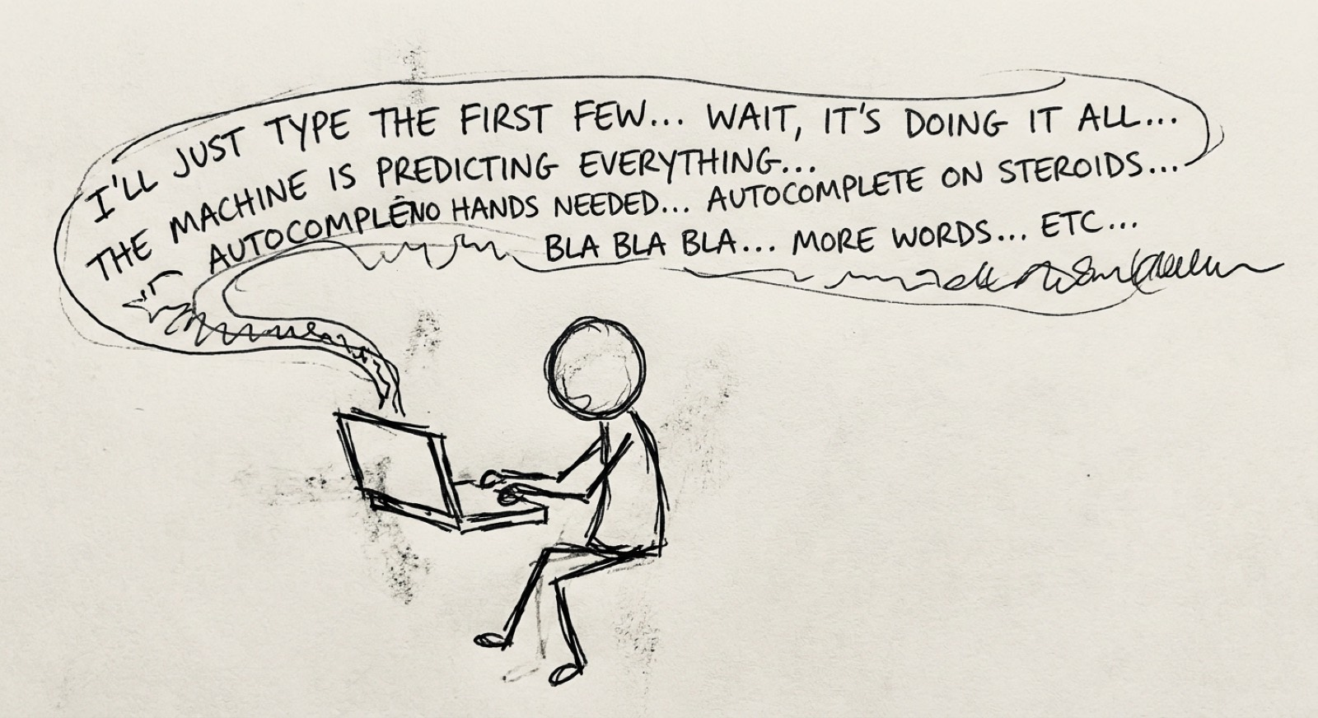
08
NOT A BUG — A PROPERTY
Confident. Wrong. Same polish.
It never says "I don't know." The fluent-but-wrong answer looks identical to the fluent-and-right one. Nothing in the tone warns you.

Slide 9
09
THE SPINE OF THE DAY
The trust tool.
AVERAGE → LEAN IN
PRECISE → HUMAN IN THE LOOP
Low stakes, "about right" is fine. Let AI run; you glance.
High stakes, one right answer. A person owns the decision.
Learned once this morning — reused at project scale this afternoon

Slide 10
10
THE TRUST TOOL, ON REAL TASKS
Average or precise? Small or large?
Drafting an internal email. Average is fine, stakes small — lean in. Board-paper figures. Precision required, stakes large — a human owns every number. Summarising fifty complaints for themes. Lean in for the themes, then skim for the one complaint the AI smoothed away.

Slide 11
11
TALKING TO AI WELL
RTCF — two halves.
R · T · F SCAFFOLDING
C ALWAYS MATTERS
Weaker & self-hosted models need it spelled out. A frontier model infers it from clear writing.
Context is the one thing only you supply. No model manufactures your edge.
The durable skill: being clear about what you want

Slide 12
12
BEFORE & AFTER
Unusable. Then sendable.
Without: "Write an email about the project delay." With RTCF: a senior PM, professional & empathetic, writes a client email explaining a 2-week delay (vendor integration; client values transparency; new date March 15), under 200 words — acknowledge → explain → new date → recommit. Context is where your edge enters.

Slide 13
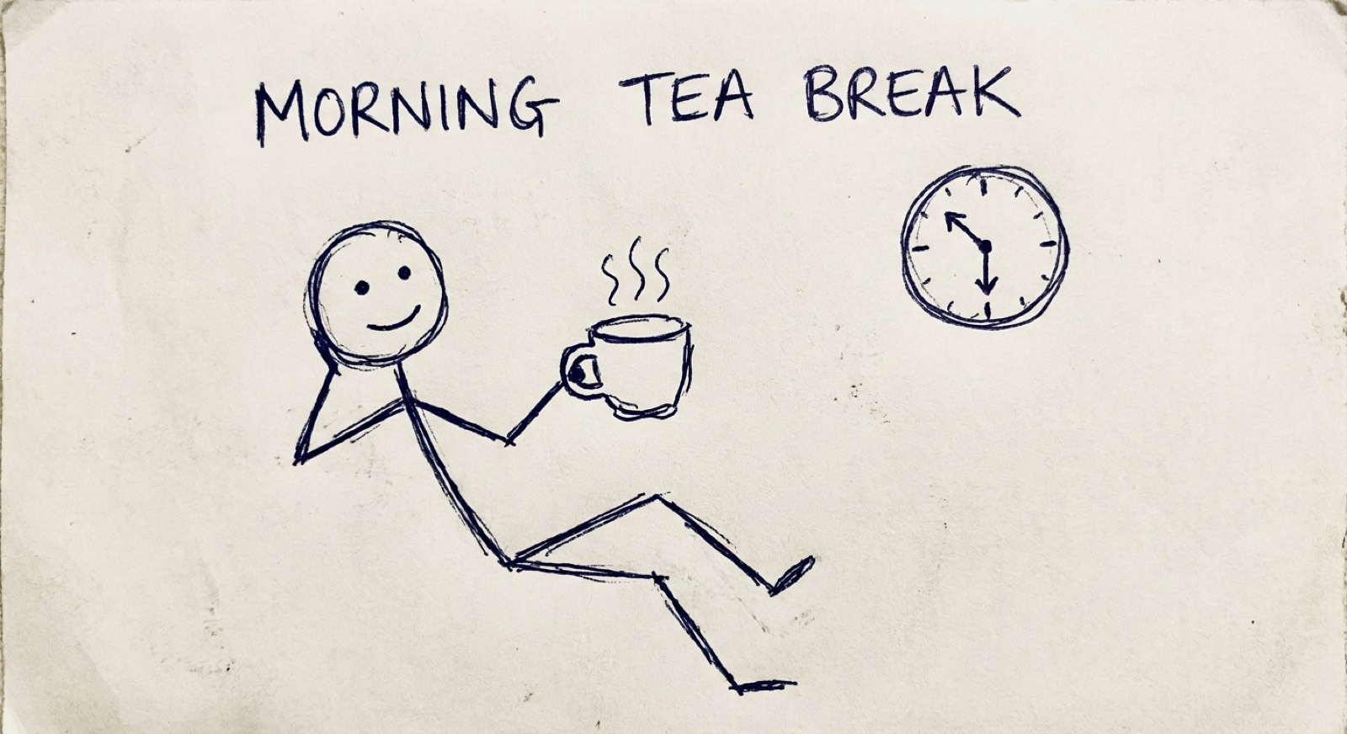
13
THE MONEY MOMENT — LIVE
Add your edge. It gets a soul.
Pass 1: a naive prompt → slick, correct, identical for everyone. Pass 2: layer in what only you hold. Watch the output turn yours.

Slide 14
14
EXERCISE — ON YOUR OWN WORK
Redesign one workflow.
Pick a task you own. List its steps. Judge each with the trust tool — where does AI genuinely help, where must your judgement stay in charge? Redesign so AI handles the average and you keep the high-stakes parts. You leave with something to trial next week.

Slide 15
15
WHERE WE ARE BY LUNCH
A mental model, a grid, a method.
AI produces a convincing average. The trust tool tells you when to lean in. RTCF directs it well — and Context is the part that survives any model. One question for the afternoon: if this is how I trust AI on a single task, how do I trust it across a whole project?

Slide 16
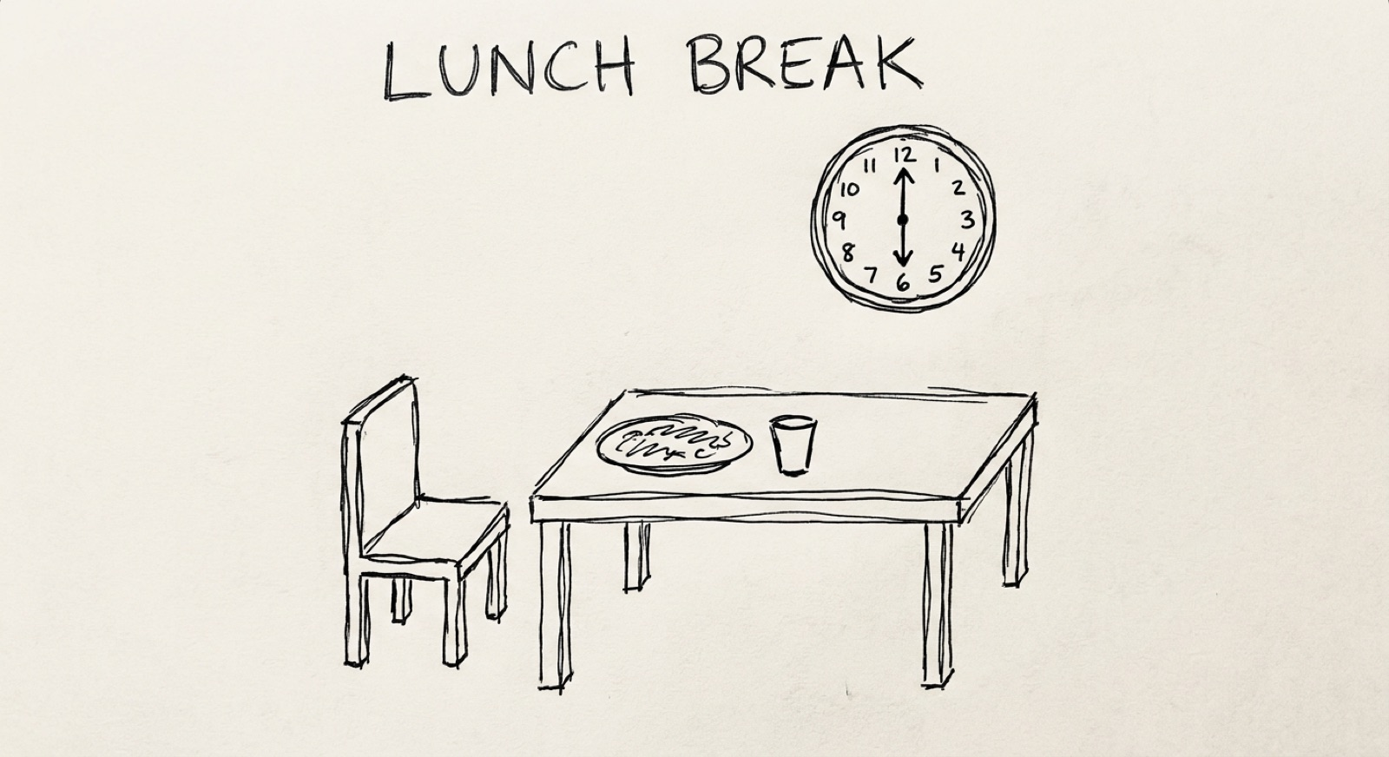
16
10:30
Morning tea
BACK AT 11:00

Slide 17
PART TWO
WHY AI
DELIVERY IS
DIFFERENT.
You're the delivery lead. Ship one funded initiative — without the predictable failures.

Slide 18
18
THE FAIR QUESTION
“
I've delivered projects before. What's actually different about an AI project?
THEY DON'T FAIL MORE OFTEN. THEY FAIL DIFFERENTLY — IN PLACES YOU DIDN'T SEE COMING.

Slide 19
19
FIVE WAYS AI BREAKS THE RULES YOU USUALLY LEAD BY
They fail differently.
01
02
03
"Done" can't be specified.
The demo is a trap.
The data is the uncertainty.
04
05
→
Verification is the product.
Generic competence is the baseline.
So you design the human in.

Slide 20
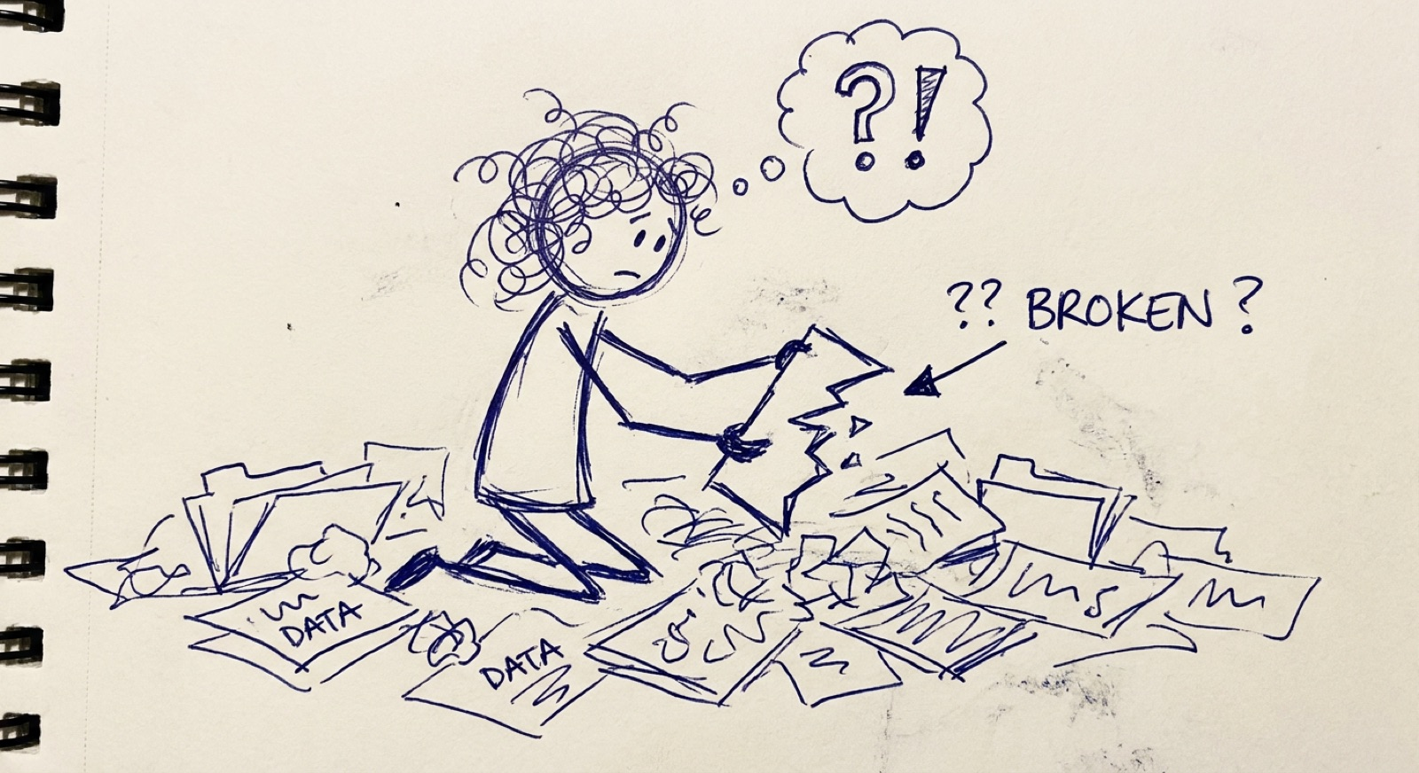
20
DIFFERENCE 01
"Done" won't hold still.
Ask twice, get two answers. There's no single correct output — only a spread. Stop chasing a fixed spec; decide what "good enough" looks like for this use.

Slide 21
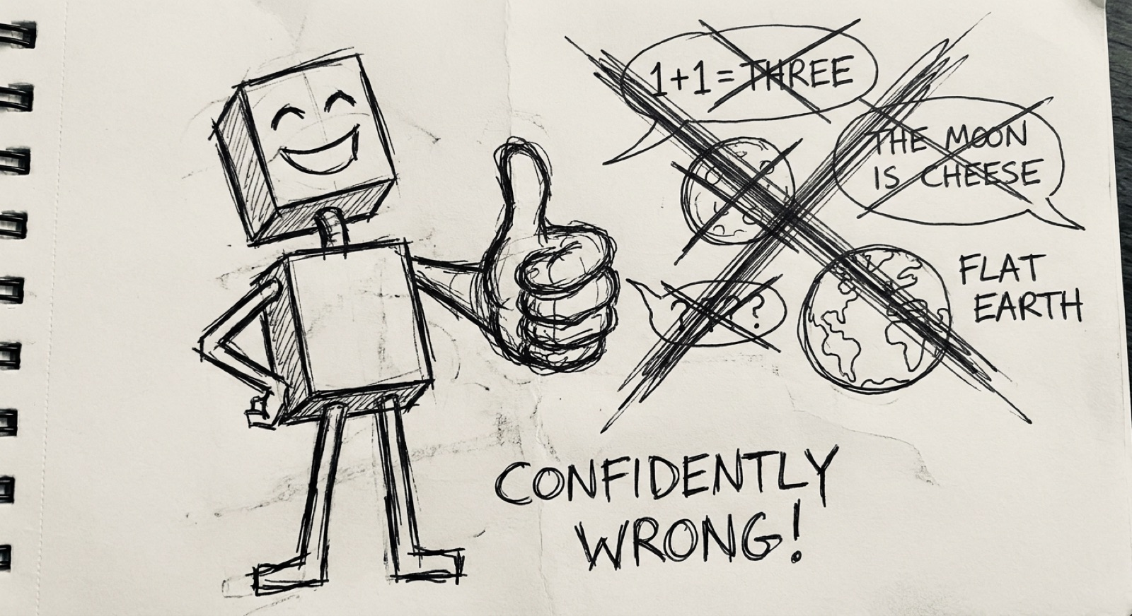
21
DIFFERENCE 02
The demo is a trap.
It shows the happy path. The messy real-world cases are where it falls over. Treat the demo as the start of the hard part — not the end.

Slide 22
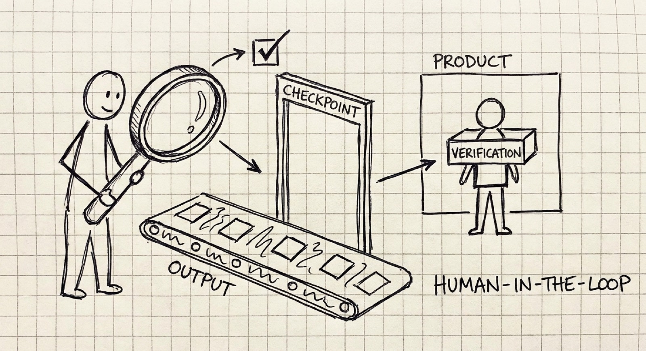
22
DIFFERENCE 03
The data is the uncertainty.
You don't order it; you discover it — its gaps, biases and surprises show up only when you work with it. Run delivery as discovery, and build the learning into the plan.

Slide 23
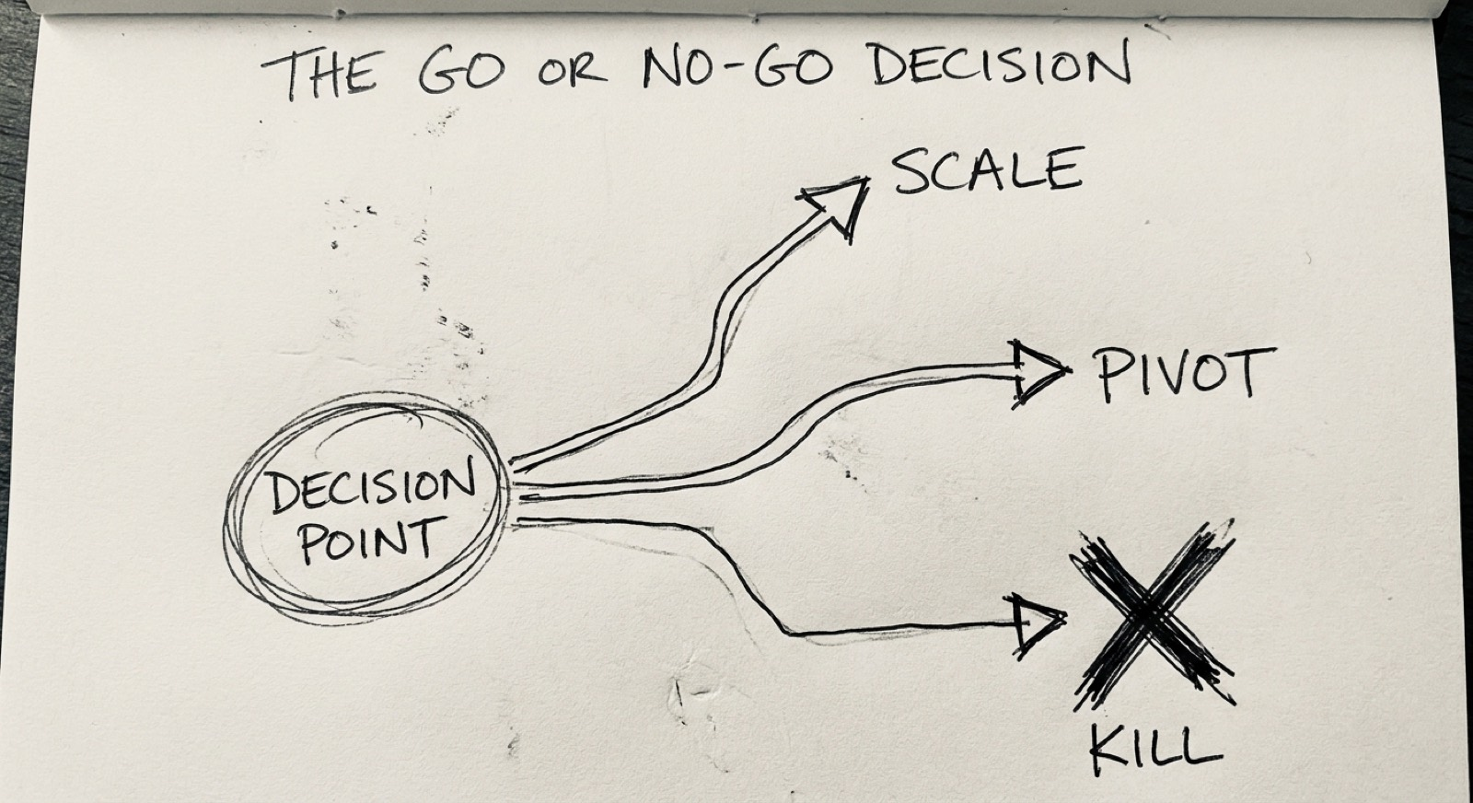
23
DIFFERENCE 04
Verification is the product.
Outputs vary and can be confidently wrong. The value lives in how you check them, and where a human stays in the loop. Design the checking deliberately — make it part of what you ship.

Slide 24
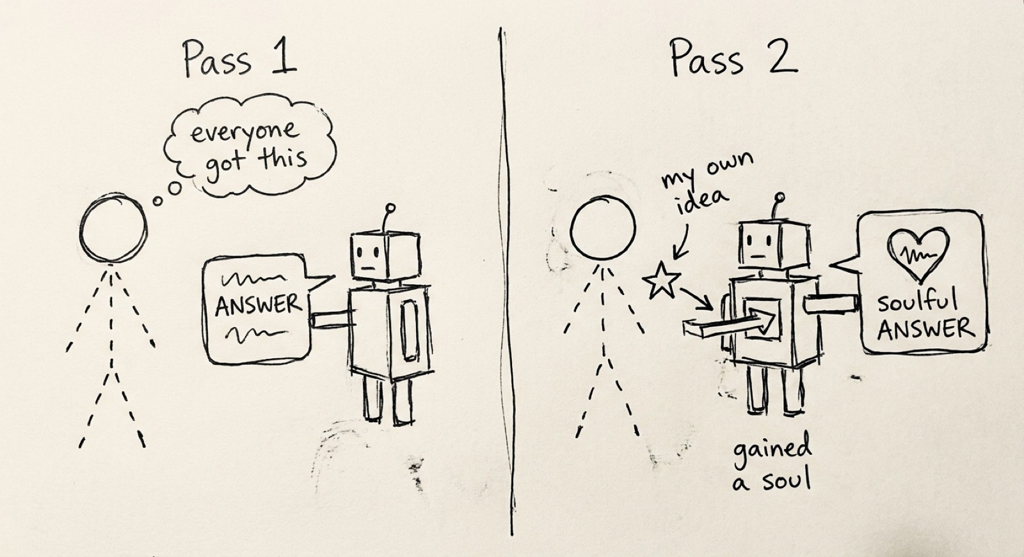
24
DIFFERENCE 05
Generic is the baseline, not the edge.
When every rival runs the same models, the model isn't your advantage — anyone can have it. Compete on the human variation a rival's identical model can't reproduce.

Slide 25
25
THE THREAD THROUGH ALL FIVE
“
AI gives you something fluent and roughly-right, fast — then asks you to decide when roughly-right is good enough, and who checks when it isn't.
A LEADERSHIP QUESTION. WHICH IS WHY IT LANDS ON YOUR DESK.

Slide 26
26
YOUR PROJECT · RETAILFLOW
You're the delivery lead.
The board funded one AI initiative. Ship it without the predictable failures. Carry it through three moves — scoping and stress-testing it by interviewing the RetailFlow team: live chatbots with opinions, who disagree, and won't do your job for you. access code: pilot2024

Slide 27
27
THREE MOVES, ONE PROJECT
Scope. Verify. Decide.
01
02
03
Scope it against reality
Stakeholders & human-in-the-loop
Roadmap & the go/no-go
Interview Data & CIO. Reconcile "move fast" with "the data isn't ready." → objectives, data needs, a defined "good enough."
Interview MD, frontline, CFO. Decide where a human must stay in charge. → stakeholder plan + checkpoint design.
Build the roadmap with gates and a risk register. Then make the call: Scale, Pivot, or Kill.

Slide 28
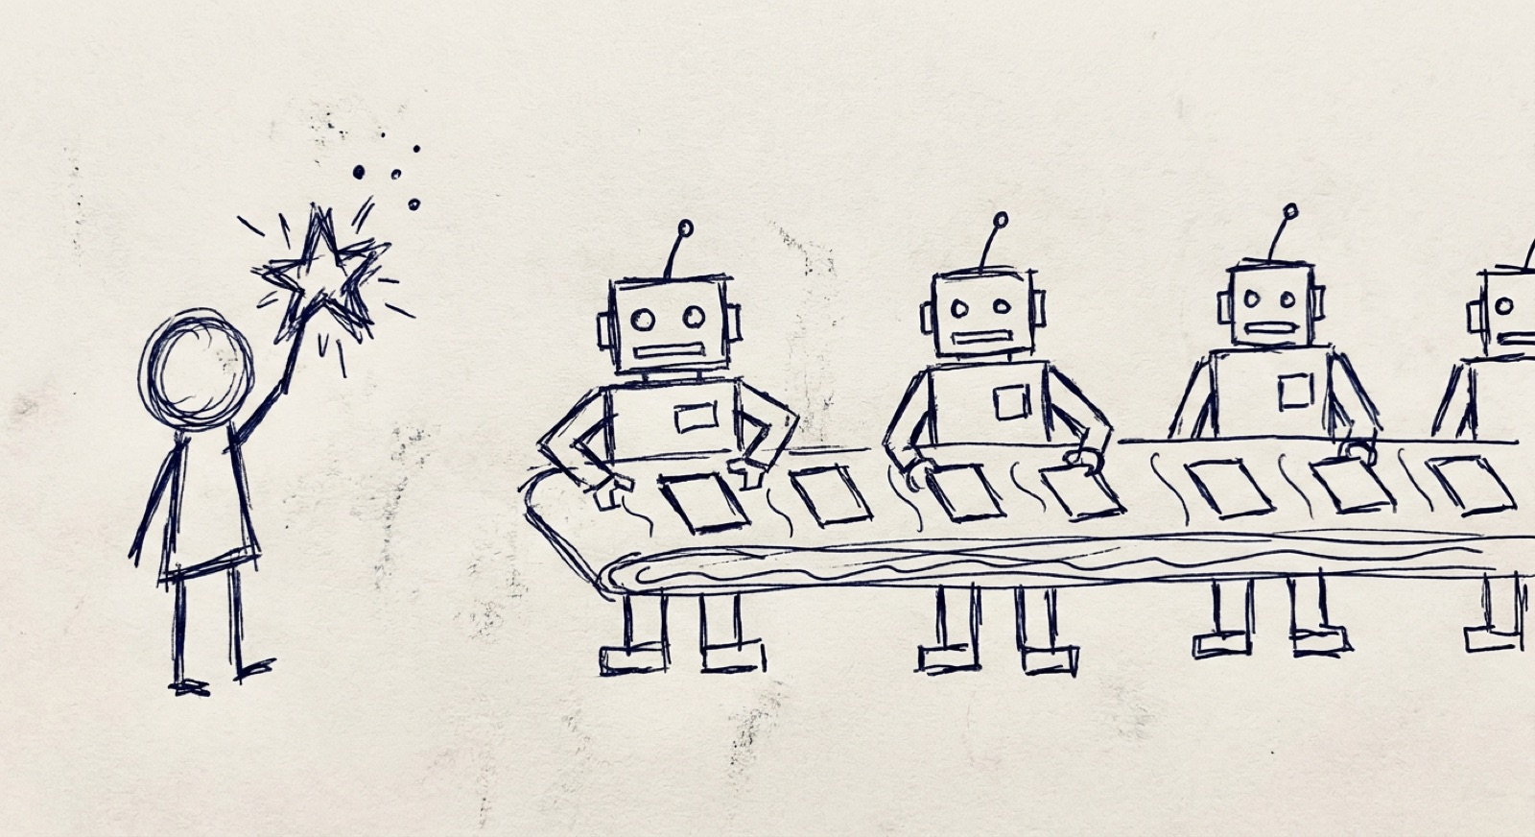
28
12:30
Lunch
BACK AT 1:15

Slide 29
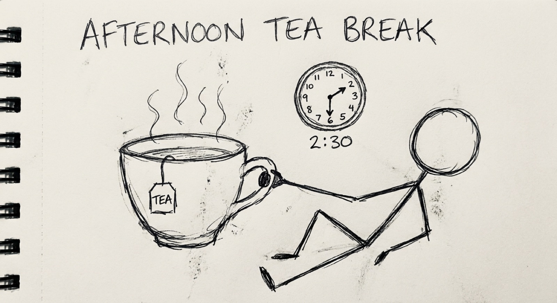
29
THE GO / NO-GO CALL
Scale. Pivot. Kill.
At each gate the question isn't "is it perfect?" — it's whether the evidence justifies continuing. Killing early is success, not failure.

Slide 30
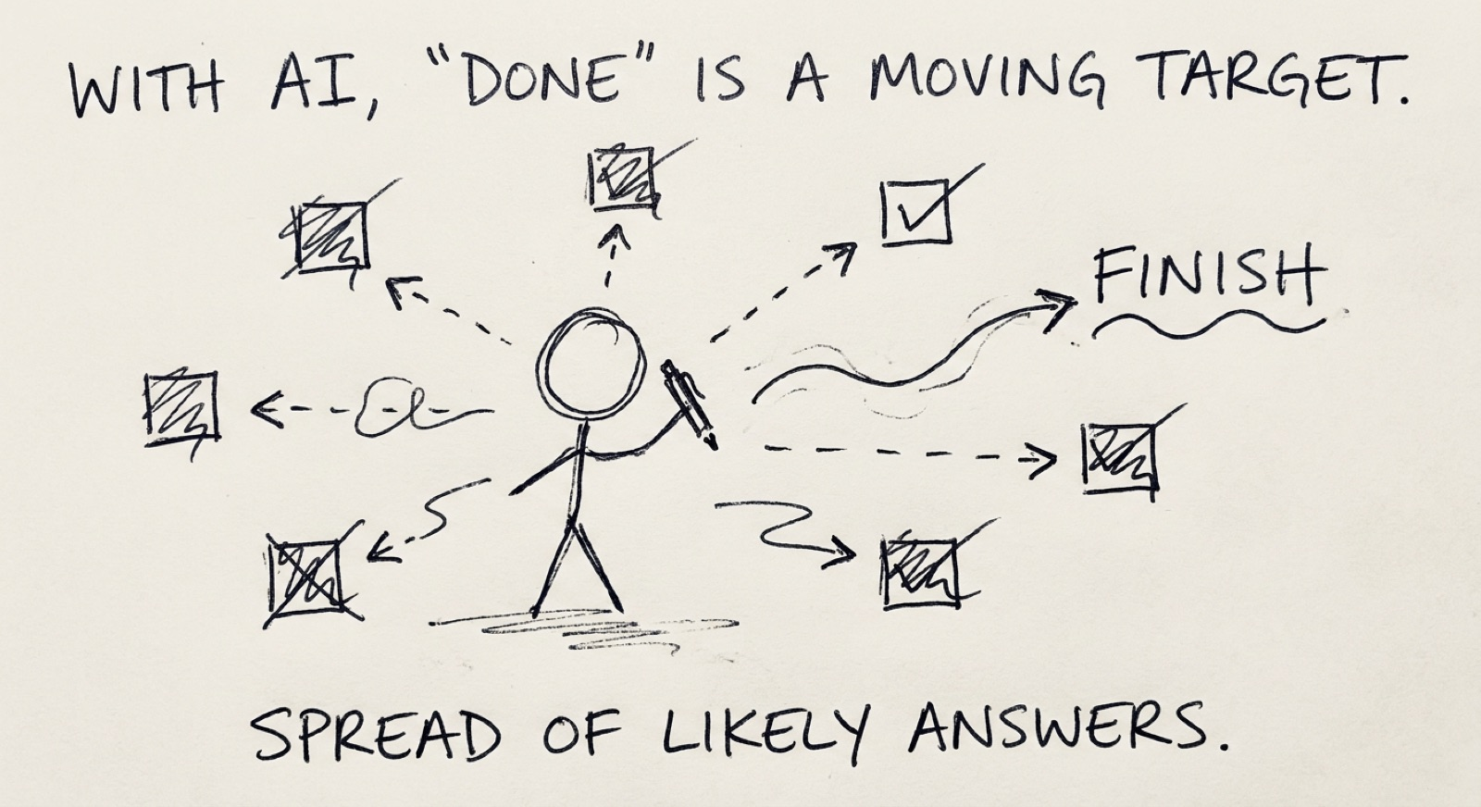
30
2:30
Afternoon tea
BACK AT 3:00

Slide 31
31
WHAT YOU'VE BUILT BY 4:00
A delivery design, not a theory.
SCOPE
ROADMAP
Objectives, data requirements, a defined "good enough."
Milestones and go/no-go gates.
CHECKPOINTS
RISK
A stakeholder plan and human-in-the-loop design.
A register and a Scale / Pivot / Kill call you can defend.

Slide 32
32
BACK TO THE PROVOCATION
The edge is the part the tool can't average.
Averages converge. Your taste, your contrarian calls, your specific customers — that's the variation a rival's identical model can't reproduce.

Slide 33
33
WHAT YOU DO NEXT
Your action plan.
WEEK
MONTH
QUARTER
Trial your redesigned workflow. Run one task through the trust tool first.
Make RTCF a habit. Start one conversation about where a human stays in the loop.
Scope one real initiative — and defend the Scale / Pivot / Kill call.

Slide 34
34
WHAT YOU LEAVE WITH
Tools that don't expire.
DECISION TOOLS
YOUR WORK
The trust tool, RTCF, the five differences, Scale / Pivot / Kill — any platform, any model.
A redesigned workflow and a scoped project design you can act on.
A PLAN
GO DEEPER
Specific commitments for the week, month and quarter.
michael-borck.github.io/the-human-edge — incl. the two-page voice method.

Slide 35
99
THE AI IS YOUR STARTING POINT, NOT YOUR FINISH LINE
STAY THE ONE
HOLDING THE
JUDGEMENT.
michael-borck.github.io/the-human-edge

