Slide 1
Stress Testing Retail Portfolios
Joseph L. Breeden
President & COO
Strategic Analytics Inc.
breeden@strategicanalytics.com
Notes:
Dr. Breeden received his PhD in physics studying chaos theory in astrophysics. He has worked in retail lending portfolio analysis since 1996, including unique experiences with the Mexican Peso Crisis and Asian Economic Crisis. At SA, he invented Dual-time Dynamics, the technology behind SA’s portfolio modeling and forecasting products.
Strategic Analytics delivers innovative analytical software and services that enable their clients to build more profitable and less volatile portfolios. An increasing number of the world's largest banks and finance companies use Strategic Analytics' software for loss and revenue forecasting, stress testing, and to determine economic capital.

Slide 2


Stress Testing
LeMessurier was the structural engineer for the Citibank Tower in Manhattan.
One year after construction, an architecture student conducting a stress test asked some probing questions.
LeMessurier’s investigation led to some uncomfortable realizations…
… remedial action is usually much cheaper than disaster clean-up – just ask New Orleans.

Slide 3
Why Do We Stress-Test?
Regulatory Requirements:
Basel II mandates stress-testing around low-probability events to validate economic capital estimates.
US regulators want similar assurances that portfolios can withstand extended economic downturns.
Better Portfolio Management:
Stresses will occur. Planning for them is profitable.
Reactionary management to sudden stresses is costly.

Slide 4
Basel II Guidelines on Stress Testing
(v) Stress tests used in assessment of capital adequacy
434. An IRB bank must have in place sound stress testing processes for use in the assessment of capital adequacy. Stress testing must involve identifying possible events or future changes in economic conditions that could have unfavourable effects on a bank’s credit exposures and assessment of the bank’s ability to withstand such changes. Examples of scenarios that could be used are (i) economic or industry downturns; (ii) market-risk events; and (iii) liquidity conditions.
435. In addition to the more general tests described above, the bank must perform a credit risk stress test to assess the effect of certain specific conditions on its IRB regulatory capital requirements. The test to be employed would be one chosen by the bank, subject to supervisory review. The test to be employed must be meaningful and reasonably conservative. Individual banks may develop different approaches to undertaking this stress test requirement, depending on their circumstances. For this purpose, the objective is not to require banks to consider worst-case scenarios. The bank’s stress test in this context should, however, consider at least the effect of mild recession scenarios. In this case, one example 93 might be to use two consecutive quarters of zero growth to assess the effect on the bank’s PDs, LGDs and EADs, taking account — on a conservative basis — of the bank’s international diversification.

Slide 5
Basel II Purpose for Stress Testing
Prove that the impact of a recession is less the computed capital level.
All known recessions should be within the bounds of a 99.9% calculation.
Capital is calculated with the Basel II formula assuming the shape of the distribution. Stress tests are scenario-based forecasts using an entirely different mathematical framework.
Cumulative Probability = 99.9%
Probability of Loss (%)
Recession
EL
Expected Loss
UL
Unexpected Loss
Loss Amount ($)

Slide 6
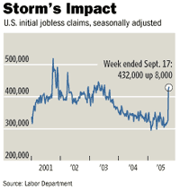
Hurricanes Katrina and Rita
A classic “Operational Risk” under Basel II. Exacerbates oil shock.
Abrupt relocation of banks; branch closures; inability to locate customers. Customers have lost jobs and property
Banks responded by
  Suspending collections to affected consumers
  Lengthening payment grace periods
Portfolio Impacts:
  Immediate: reduced payments and reduced delinquency
  Medium term: rising payments and delinquency
  Longer term: losses will be impacted as consumers loose jobs or walk away from loans for lost autos and homes.

Slide 7
The Housing Bubble
Many localized housing bubbles have developed across the US, driven by
  mortgage income deductions
  easy financing
  low interest rates
Bubbles in some markets (San Fran, Las Vegas), are bursting.
Portfolio Impacts:
  Some mortgages could go underwater, causing homeowners to walk away – but not usually a major problem in retail
  Mortgage charge-off severity rises
  Delinquencies in all product categories rise as consumers can not cash-out their home equity

Slide 8
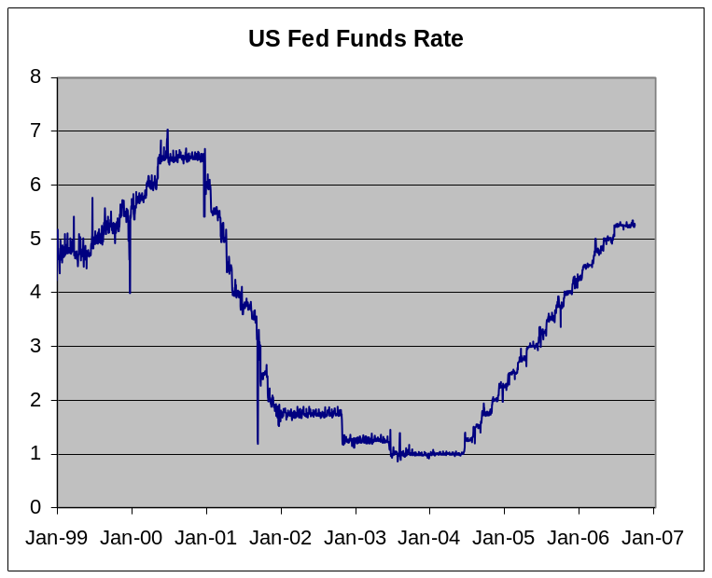
Federal Reserve Raising Rates
The Fed has raised rates 11 consecu- tive times.
In 2000, the Fed raised rates to stop the stock market exuberance.
In 2005, the rate increases are to return to normal levels and stop the housing bubble.
Portfolio Impact:
  Ends the refinancing boom in mortgage.
  Increases payments on ARMS → increases delinquency
  Risks triggering a recession in 2006-2007.

Slide 9
Bankruptcy Law Changes
Recent changes in bankruptcy laws will make it more difficult for consumers to erase their debts.
Portfolio Impacts:
  Near-term surge in bankruptcy filings. Sept 2005 is highest filing month on record.
  Potentially higher loss recovery
  Possibly shifts losses between products. Less ability to erase credit card debt in favor of mortgage debt.

Slide 10
New Minimum Payment Regulations
New banking regulations are increasing minimum payments for credit cards.
Little historical data is available. Initial tests will be critical.
Portfolio Impacts:
  Anecdotal evidence always shows that increasing minimum payments pushes more accounts into bankruptcy and charge-off.
  May impact demographic groups disproportionately.

Slide 11
Global Stresses in 2006
UK – Bankruptcy law changes in 2004 having a major impact.
US – Hang-over from the 2004-2005 mortgage boom.
Taiwan – Reaction to changes in credit card payment regulations
Brazil – Rising currency causing economic slowdown?

Slide 12
No Established Best Practice
There is almost nothing in the academic literature about retail lending stress testing.
Practice varies widely because of the range of models.
Any successful approach must start with a good portfolio forecasting model for retail lending and build in explicit use of scenarios.
Models need to be uniform across product types so that equivalent or related scenarios can be applied throughout.

Slide 13
The Structure of Retail Lending
Stress-testing begins with scenario-based forecasting. Introducing stresses requires creating models that accept scenarios.
One can only stress factors that appear explicitly in the models.
  Study key rates: account delinquency, balance per delinquent account, attrition, payment, fee generation.
  Study the performance components for each rate.

Slide 14
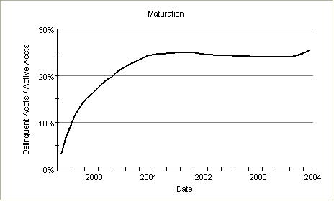
Components of Portfolio Performance
Vintage Lifecycle

Slide 15
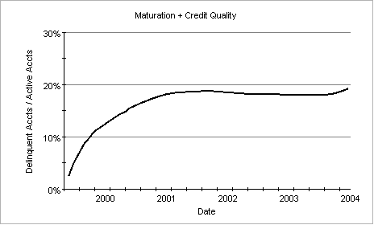
Components of Portfolio Performance
Vintage Lifecycle
Credit Quality

Slide 16
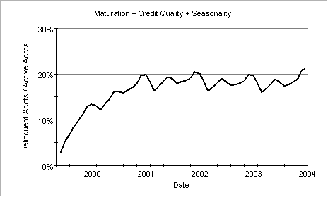
Components of Portfolio Performance
Vintage Lifecycle
Credit Quality
Seasonality

Slide 17
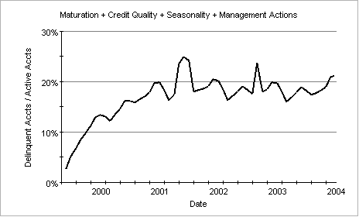
Components of Portfolio Performance
Vintage Lifecycle
Credit Quality
Seasonality
Management Actions

Slide 18
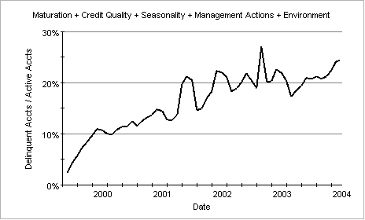
Components of Portfolio Performance
Vintage Lifecycle
Credit Quality
Seasonality
Management Actions
Macroeconomic & Competitive Environment

Slide 19
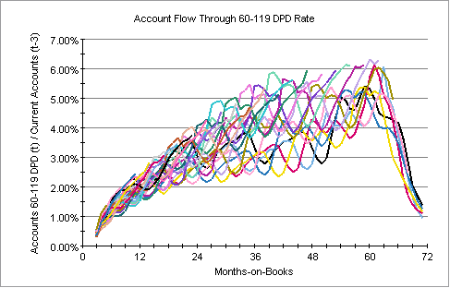
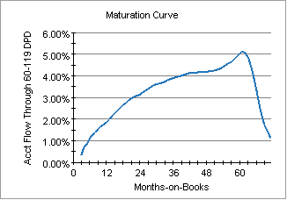
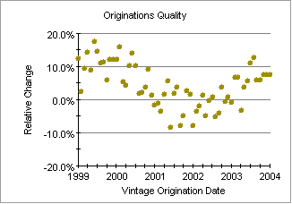
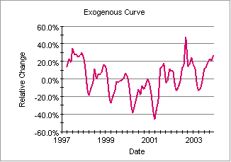
Dual-time Dynamics (DtD)
Patent-pending technology derived from techniques in nonlinear dynamics.
Unparalleled accuracy for quantifying the components driving consumer portfolios.
Vintage Curves

Slide 20
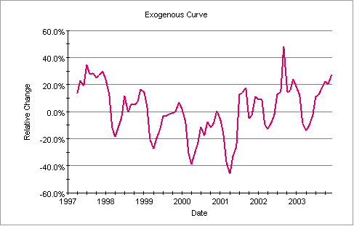
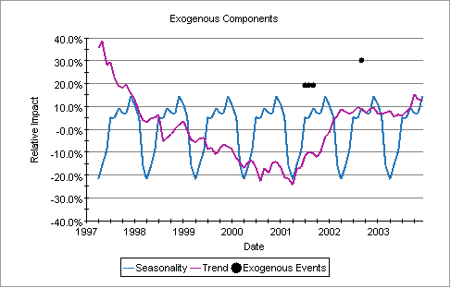
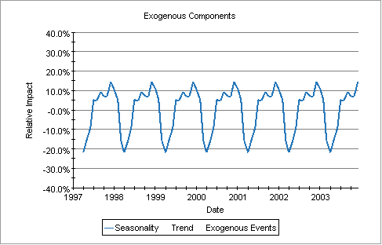
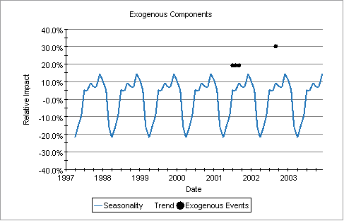
Decomposing the Exogenous Curve
The exogenous curve measures the relative impact of external factors upon intrinsic consumer dynamics
e.g. “20% higher delinquency than would have been expected from the maturation process”
To ascertain cause-and-effect, the exogenous curve is further decomposed into seasonality, trend (usually macroeconomic impact), and events (management actions).

Slide 21
Which Variables
Regulators have expressed an interest in seeing stress tests beyond PD, LGD, EAD.
Choices:
  PD, LGD, EAD – each of these can be impacted by macroeconomic factors.
  Roll rates
  Attrition, account delinquency & charge-off, balance per account, recovery.
  Revenue and profitability

Slide 22
Selecting Macroeconomic Variables
Good choices (stay close to the consumer):
  Unemployment
  CPI
  Interest rates
  Real wages
Poor choices (long delays or difficult-to-create scenarios)
  Consumer sentiment (predictive but difficult to make scenarios)
  Exchange rates
  Balance of trade
  Government budget deficit

Slide 23
Stress Test Model Suggestions
Consider lags between macroeconomic causes and portfolio impacts.
Consider cross-correlations between macroeconomic variables.
Use fewer macroeconomic variables that have intuitive explanations.
  For the typical portfolio with < 7 years of data, expect no more than 3 macroeconomic variables to be included.
  Statistically possible to use more, but nearly impossible to manage against.

Slide 24
Creating Scenarios

Slide 25
Stressing Environmental Impacts
The economy, legislation, and consumer attitudes can all experience long-term changes. These uncontrolled and largely unpredictable changes are what most people think of as stress- testing.
  From peak to trough, the last recession caused a 40% swing in delinquency for many portfolios.
  Consumers have become more relaxed about bankruptcy over the last couple of decades. Possible changes in bankruptcy law in 2002 caused a dramatic increase in bankruptcy.

Slide 26
Start with the Predictable
When creating a forecasting algorithm, explicitly identify those things that are predictable and those that are not.
Predictable:
  Maturation
  Quality of existing accounts
  Seasonality

Slide 27
Set Internal Scenario
Known by other internal groups (management scenario):
  Volume of new bookings
  Mix of new bookings by product type, channel, segment
  Expected quality of new bookings
  Changes in policies (collections, line increase, etc.)
Be realistic—or at least make unrealistic assumptions explicitly.
For Basel II purposes, the existing book is of primary interest, so new bookings can be set to zero.

Slide 28
Add Environmental Scenario
Unknown elements (environmental scenario):
  Macroeconomic environment
  Competitive changes
Creating internally consistent macroeconomic scenarios is not trivial.
  Scenarios for interest rates, inflation, unemployment, etc. must be created in concert.
  Proper macroeconomic scenario design requires a significant level of expertise. Seek advice.
  Scenarios must be intuitively explainable in order to be actionable.

Slide 29
Considering Many Possible Futures

Slide 30
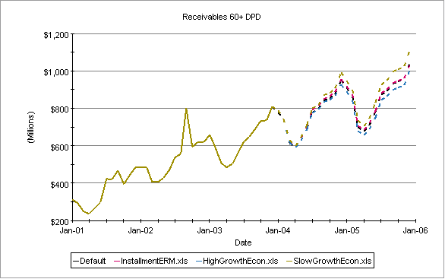
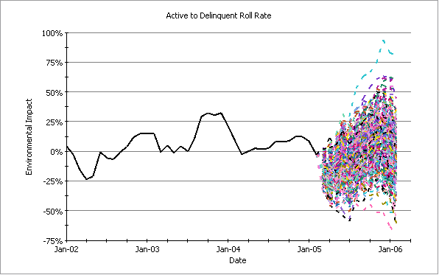
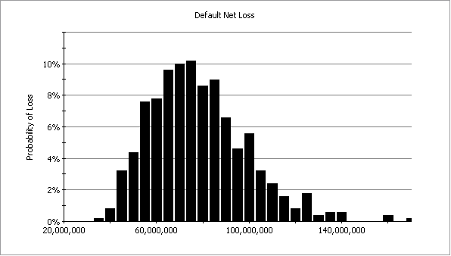
An Approach Tuned to Retail
Nonlinear Decomposition
Scenario-based Forecasting
Monte Carlo Simulation
Economic Capital

Slide 31
The Range of Possibilities
Few if any macroeconomic scenarios have probabilities of occurrence attached. If available, would they represent severity of impact on a retail loan portfolio?
Best case / worst case scenarios need to be quantified more precisely to become actionable.
Statistically generating scenarios provides a way of calibrating these possibilities.

Slide 32
Possible Future Environments
The cumulative probability numbers mean that all possible futures are no worse than the given level — e.g., 70% cumulative probability means that 70% of possible outcomes will be better than this.
Delinquency Exogenous Trend
Higher Losses
90%
80%
70%
60%
2002
2003
2004
2005
50%, Baseline
40%
30%
20%
10%
Lower Losses

Slide 33
Possible Future Losses
Running each scenario through a scenario-based forecasting model gives a range of possible outcomes, shown below.
We can now ask what range of possible outcomes preserves our profit margins.
Charge-off Balances
$
90%
80%
70%
60%
50%, Baseline
40%
30%
20%
10%
2002
2003
2004
2005

Slide 34
Stressing Business Strategy
Business strategy refers to new originations volume and quality, account management (line increases), collections policies, etc.
Greatest risk is setting strategy that gets implemented just before the environment changes. Optimizing policies to yesterday’s environment causes many portfolio disasters.
Stress-testing business strategy amounts to asking how the proposed strategy will perform under a range of environmental stresses. “What percentage of possible futures meets our margin threshold?” All of the previous techniques are combined to measure strategic robustness.

Slide 35
Use Stress Testing to Plan Ahead
The same accounts will perform differently tomorrow than they do today.
Accounts booked today may have peak revenue or delinquency up to several years in the future. Changes in originations criteria today can dominate the portfolio years into the future under a different economic environment.
New accounts originated
Calibration on previous
1-2 years of data
Maturation peak
3-4 years out

Slide 36
Return on Your Stress Testing Investment
To create business value, the stress testing approach created should also be used for
  Regulatory Compliance
  Disaster planning
  Product pricing
  Portfolio optimization
What will the 2007 environment be?
How sensitive is your portfolio / new loan pricing?
Are you prepared?

