Slide 2
Seminar Software Engineering
Code Ownership Patterns: The Evolution of GitHub Actions' YAML Configurations
Michael Dür
December 21, 2023

Slide 3
Importance of code ownership in GA
Code Ownership Patterns: The Evolution of GitHub Actions' YAML Configurations
"Bob's YAML Challenge"
Error: exit code 1
The Scene
The Challenge
The Realization
The Outcome

Slide 4
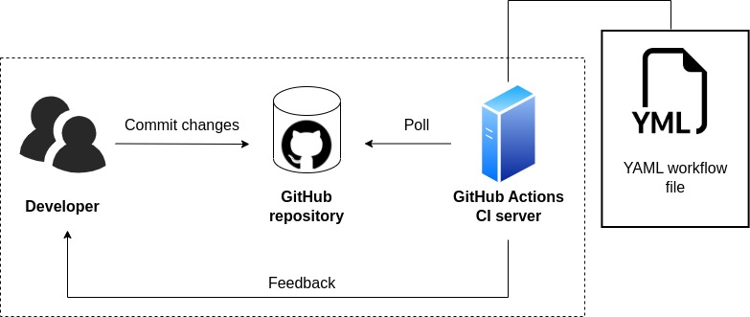
What is GitHub Actions?
Code Ownership Patterns: The Evolution of GitHub Actions' YAML Configurations

Slide 5
Importance of code ownership in GA
Code Ownership Patterns: The Evolution of GitHub Actions' YAML Configurations
Why does it matter?
Expertise Location: Identifying who possesses the deepest understanding of particular files or workflows
Responsibility Assignment: Knowing whom to contact when specific components encounter issues.
Workflow Development: Recognizing who has the expertise to architect and implement new workflows for given tasks

Slide 6
Importance of code ownership in GA
Code Ownership Patterns: The Evolution of GitHub Actions' YAML Configurations
Definition
Definition of code ownership
The owner of a file, is the author with the most commits to this file, in relation to all commits from all authors to this file.
Definition of Evolution
The series of changes in GitHub Actions configuration files (YAML) over time, as shown by commits.

Slide 7
Research Objectives
Code Ownership Patterns: The Evolution of GitHub Actions' YAML Configurations
Better understand the evolution of GitHub Actions configuration files
How many authors developed the system?
Which author developed which part of the system and in which period?
What were the behaviors of the developers?

Slide 8
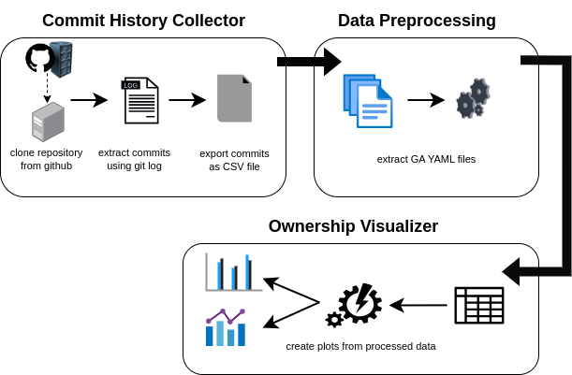
Methodology
Code Ownership Patterns: The Evolution of GitHub Actions' YAML Configurations
Created tool to collect commits from 14 GitHub repositories

Slide 9
Repository | commits | authors | yml commits | yml authors
Azure Docs | 779'876 | 17'351 | 89 | 18
Core | 353'152 | 7'139 | 1'018 | 44
Pytorch | 342'885 | 6'149 | 40'182 | 303
Flutter | 255'656 | 3'114 | 435 | 29
Tensorflow | 197'339 | 6'218 | 334 | 46
VS Code | 161'264 | 4'197 | 1'709 | 99
React Native | 78'949 | 5'173 | 221 | 32
nextJs | 78'900 | 5'467 | 2'434 | 78
React | 45'913 | 3'915 | 133 | 30
Langchain | 39'519 | 3'403 | 976 | 48
Powertoys | 27'167 | 749 | 141 | 21
Keras | 24'293 | 2'321 | 81 | 17
create-react-app | 16'141 | 2'854 | 185 | 38
stable-diffusion-web-ui | 11'157 | 1'117 | 26 | 11
Total | 2'412'211 | 69'167 | 47'960 | 813
Created tool to collect commits from 14 GitHub repositories

Slide 10
Methodology
Code Ownership Patterns: The Evolution of GitHub Actions' YAML Configurations
Analysis
Visualizations showing different aspects:
Commit contribution by file
Commit contribution by author
Commit activity over time
Evolution of single file
Ownership map

Slide 11
Results
Code Ownership Patterns: The Evolution of GitHub Actions' YAML Configurations
Patterns in Ownership Map
Monologue
Periods of single-author contributions
Dialogue
Periods with alternating contributions between multiple authors
Parallel Contributions
Periods where one author contributes to multiple files at around the same time

Slide 12
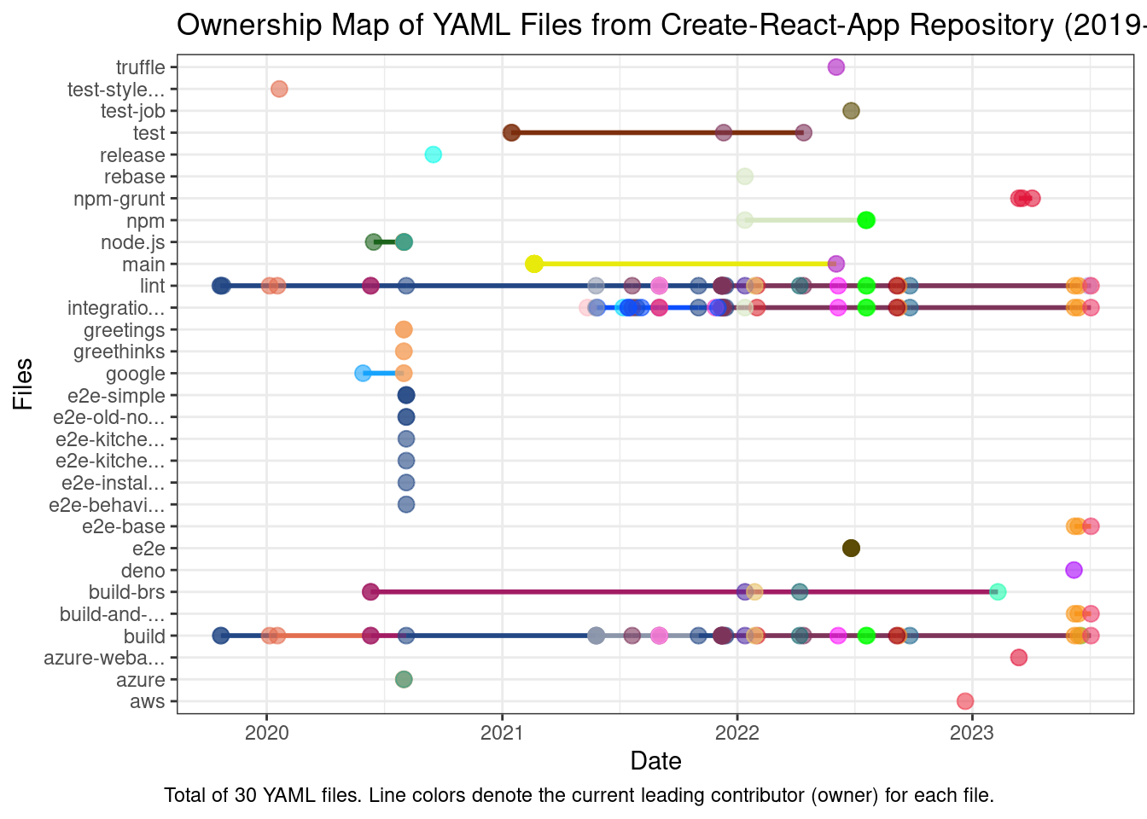
Results
GA Workflow Code Ownership
Monologue
Created tool to collect commits from 14 GitHub repositories
Dialogue
Parallel Contributions

Slide 13
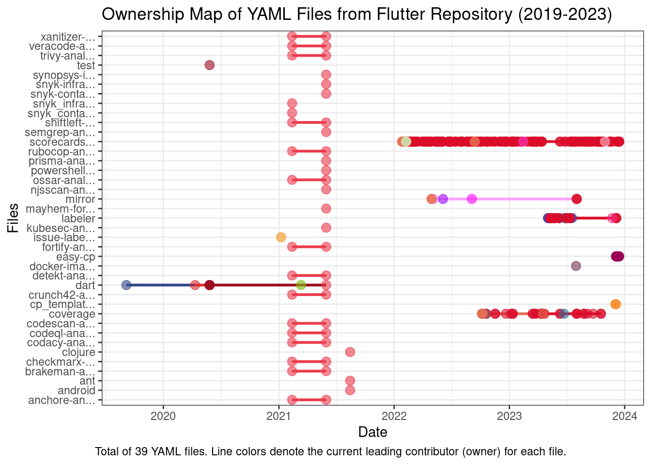
Results
GA Workflow Code Ownership
Monologue
Created tool to collect commits from 14 GitHub repositories
Dialogue
Parallel Contributions

Slide 14
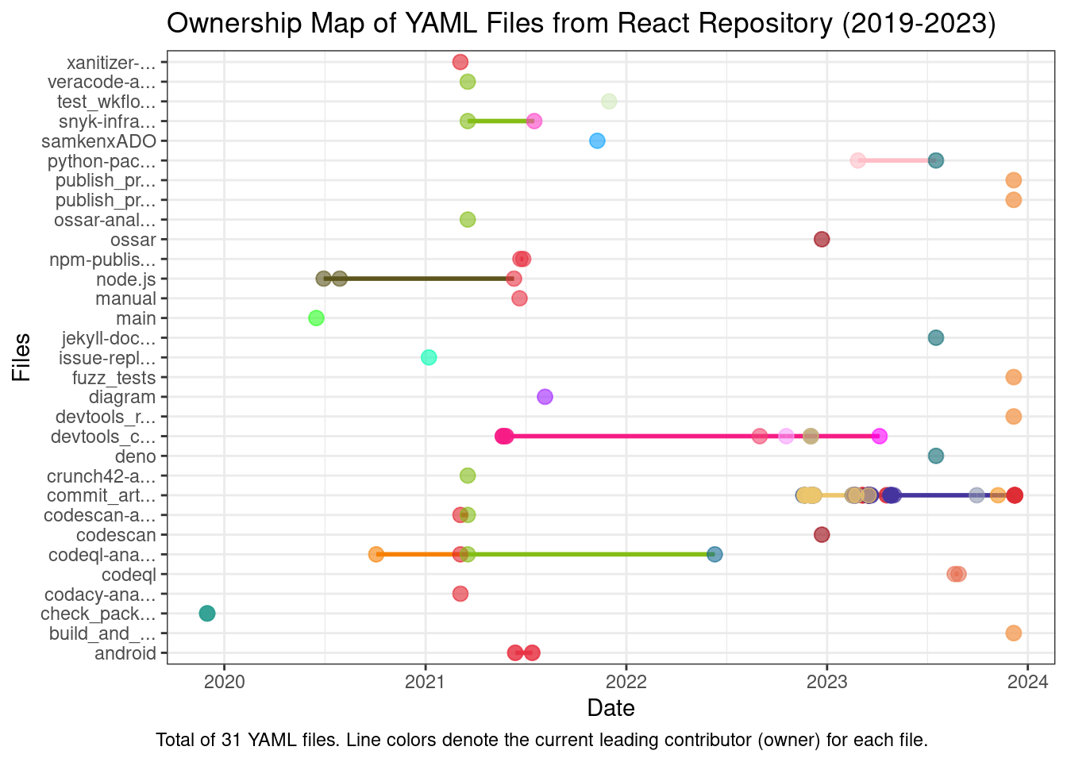
Results
GA Workflow Code Ownership
Monologue
Created tool to collect commits from 14 GitHub repositories
Dialogue
Parallel Contributions

Slide 15
Discussion
Code Ownership Patterns: The Evolution of GitHub Actions' YAML Configurations
No plot can show everything

Slide 16
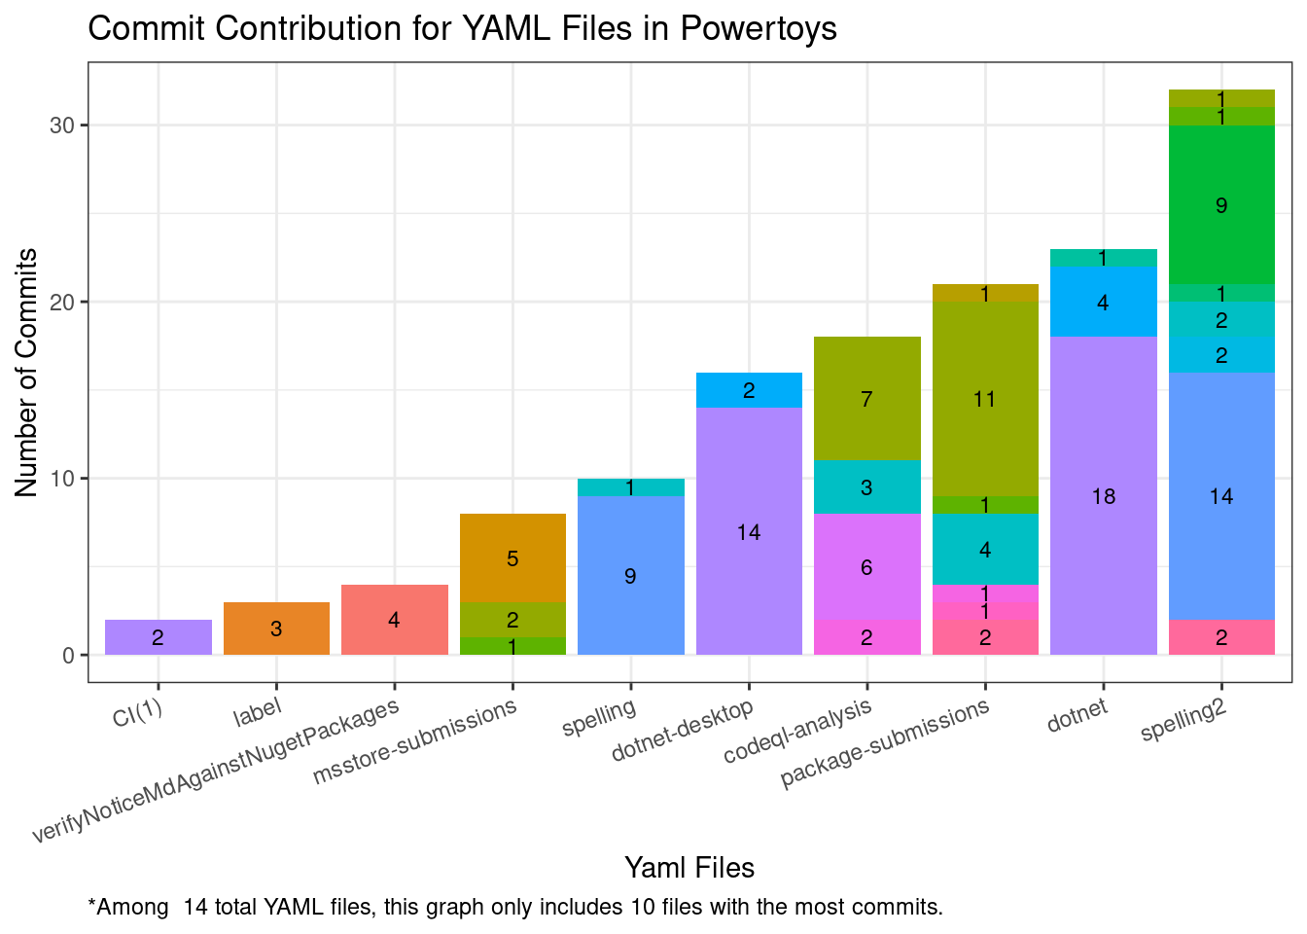
Results
GA Workflow Code Ownership
Created tool to collect commits from 14 GitHub repositories

Slide 17
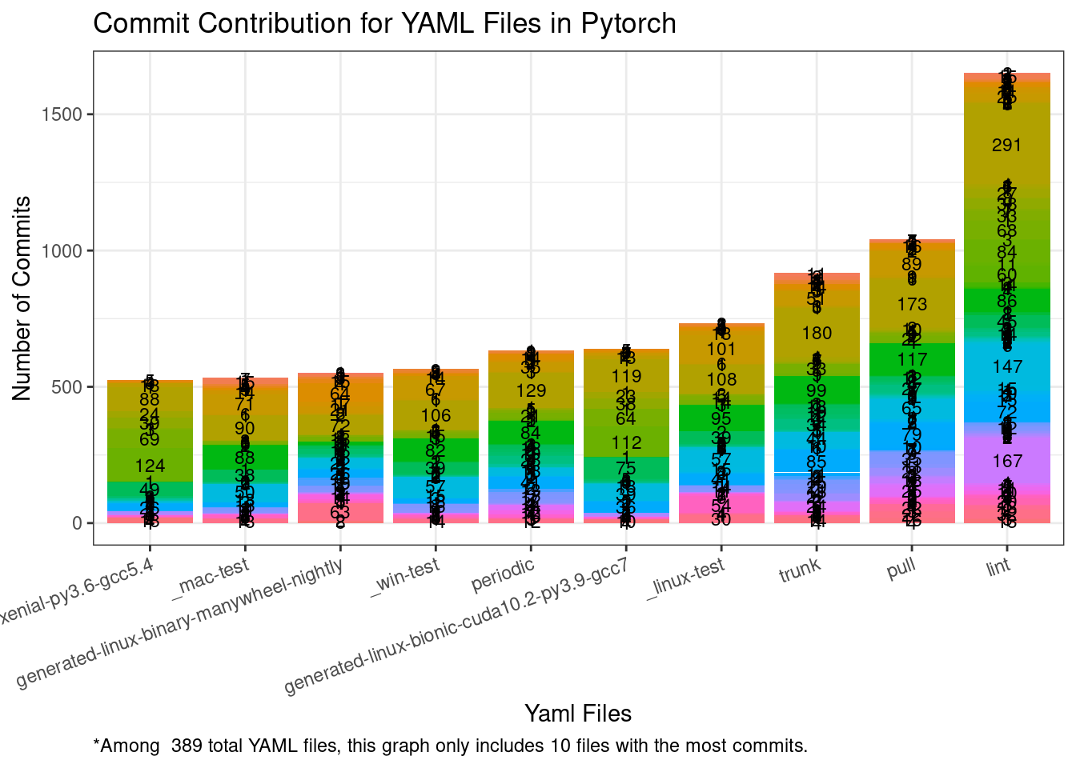
Results
GA Workflow Code Ownership
Created tool to collect commits from 14 GitHub repositories

Slide 18
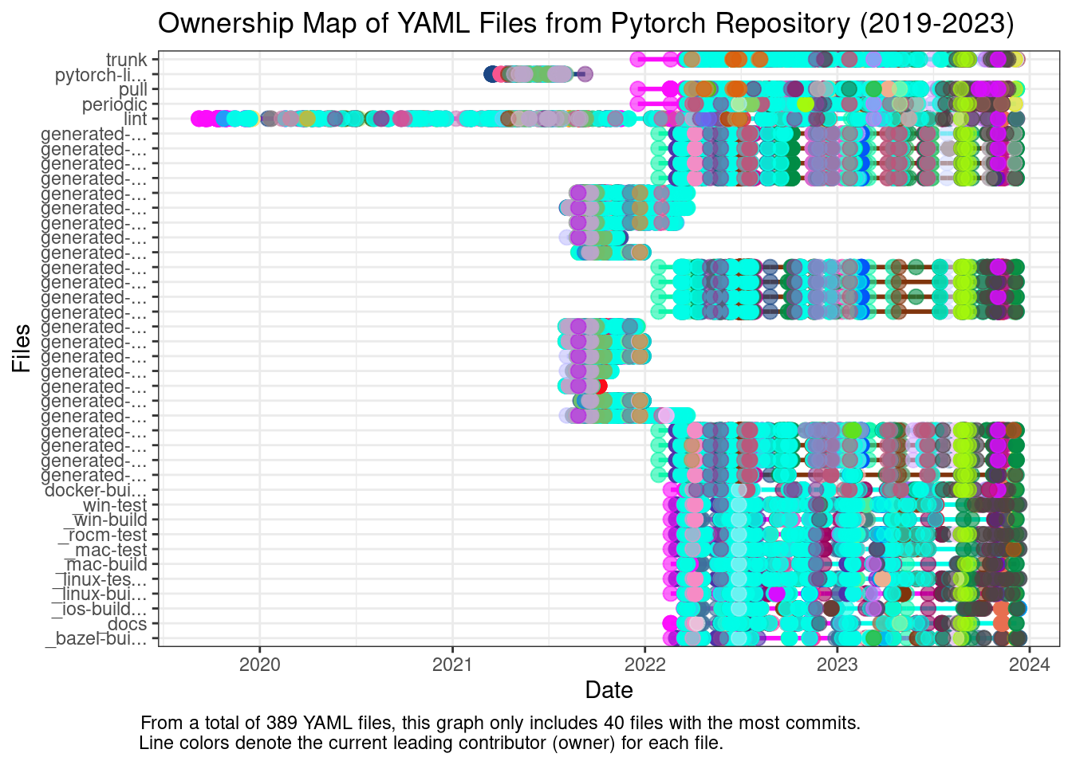
Results
GA Workflow Code Ownership
Created tool to collect commits from 14 GitHub repositories

Slide 19
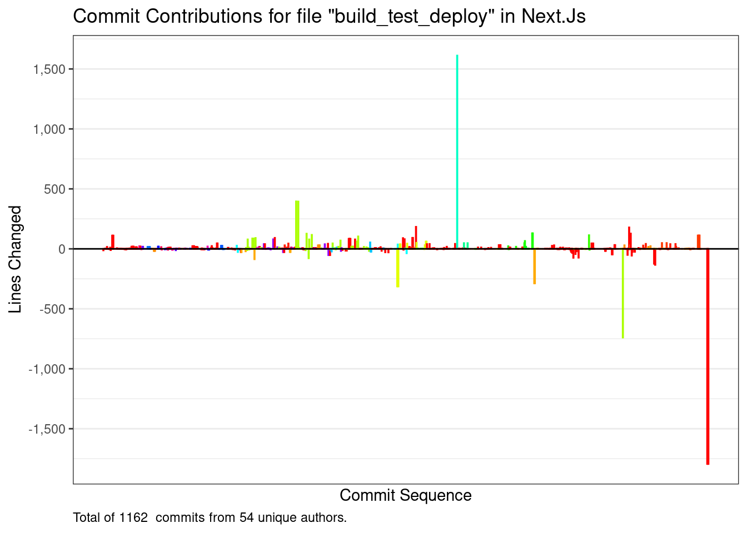
Results
GA Workflow Code Ownership
Created tool to collect commits from 14 GitHub repositories

Slide 20
Discussion
Code Ownership Patterns: The Evolution of GitHub Actions' YAML Configurations
No plot can show everything
"failures"

Slide 21
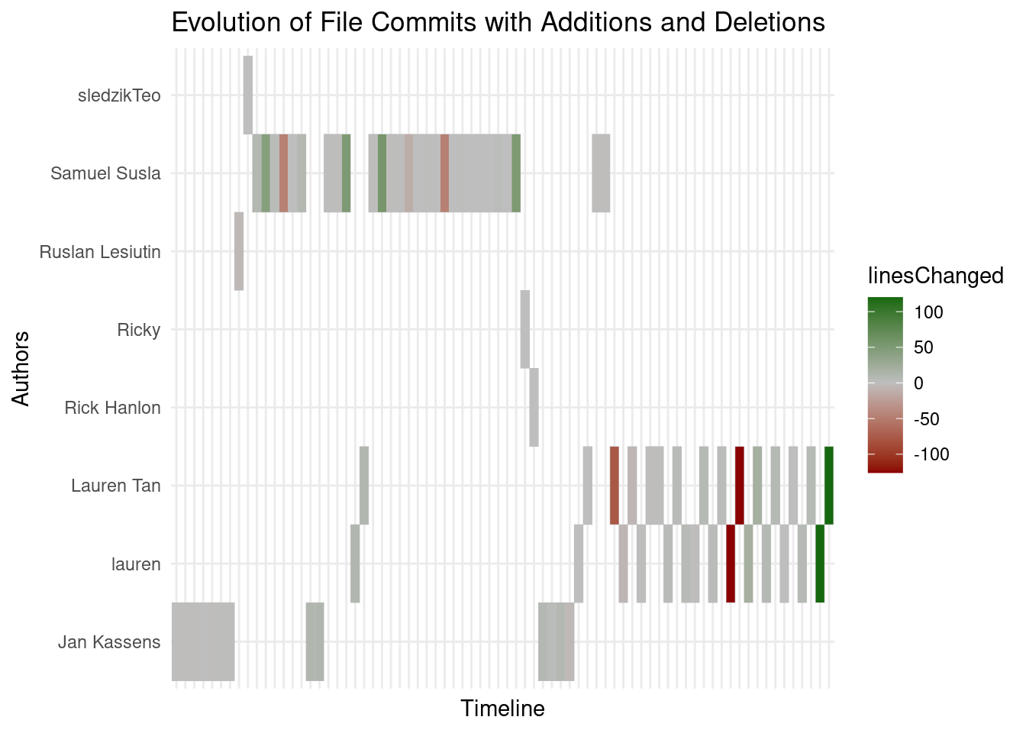
Results
GA Workflow Code Ownership
Created tool to collect commits from 14 GitHub repositories

Slide 22
Discussion
Code Ownership Patterns: The Evolution of GitHub Actions' YAML Configurations
No plot can show everything
"failures"
Further Work
Compare different organizations
Different/"better" definition for code ownership?

Slide 23
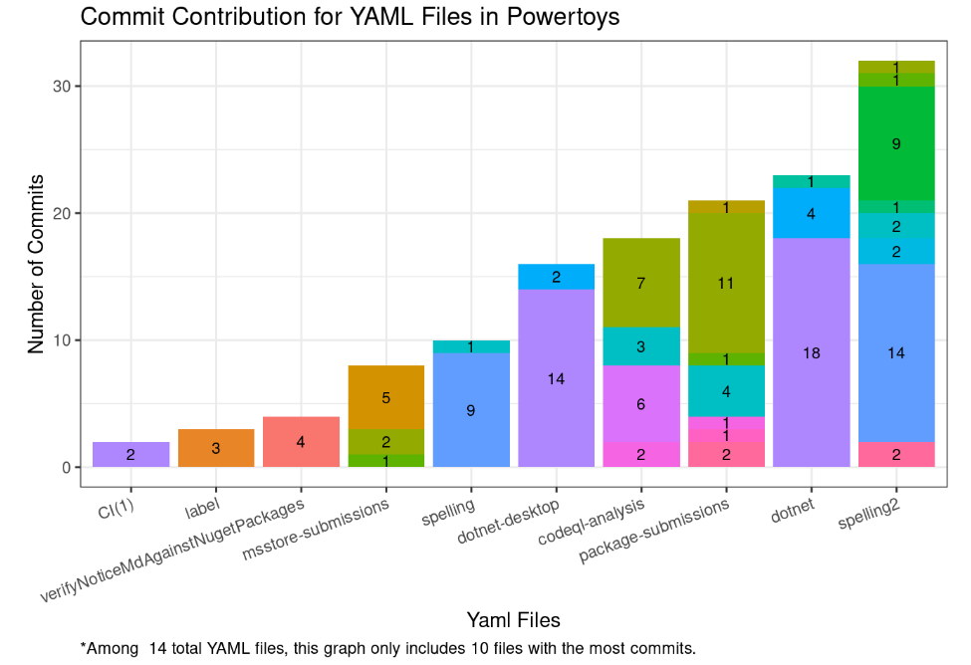
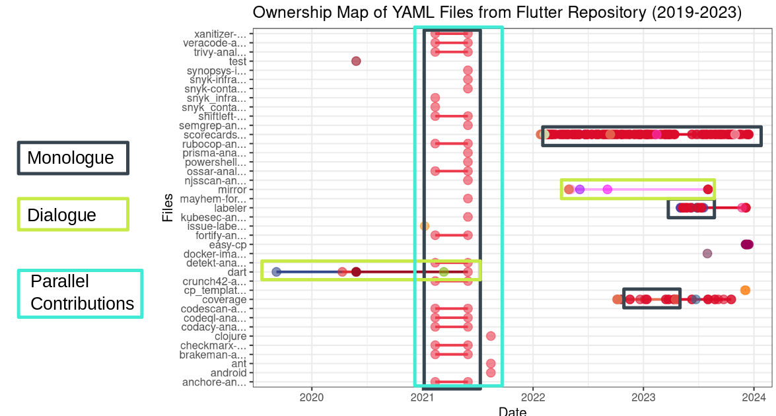
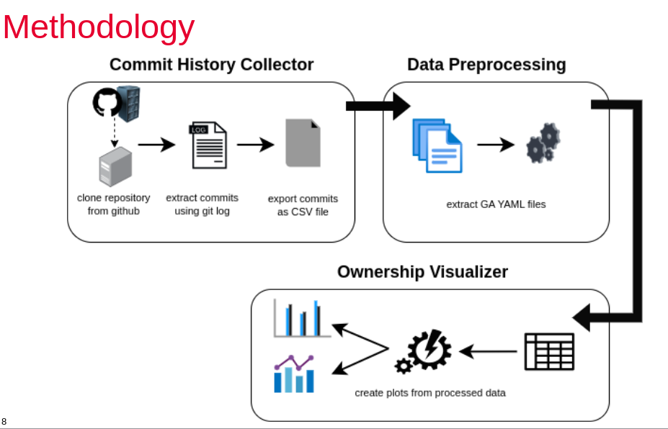
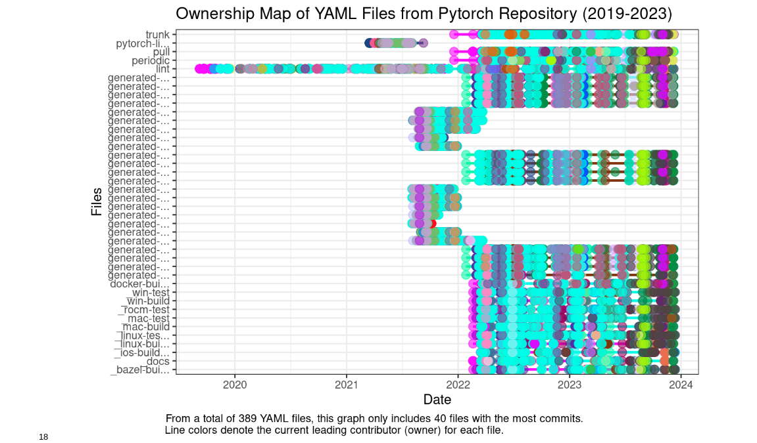
Summary
Code Ownership Patterns: The Evolution of GitHub Actions' YAML Configurations

Slide 24
Backup Slides
Code Ownership Patterns: The Evolution of GitHub Actions' YAML Configurations

Slide 25
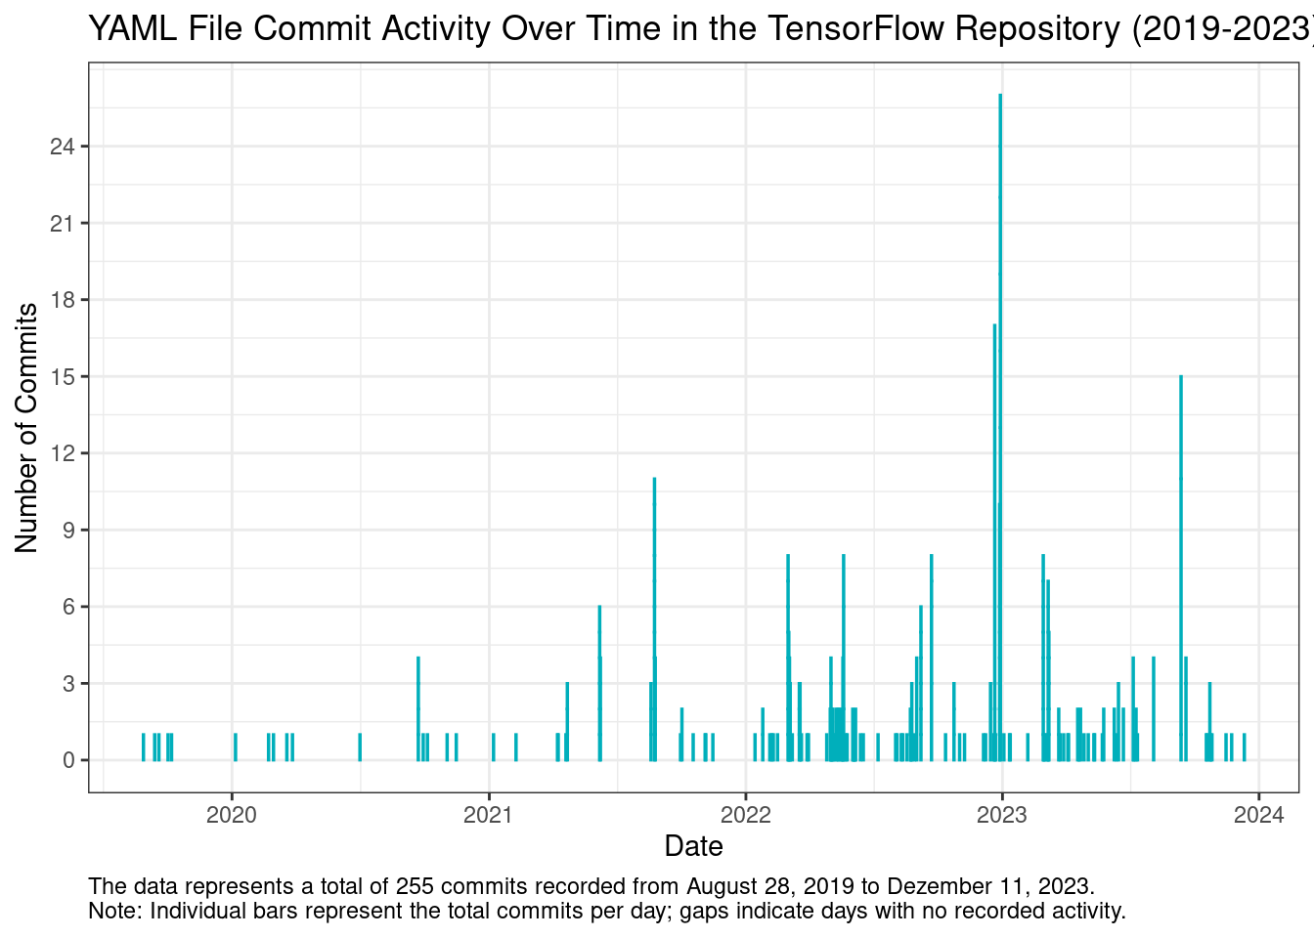
Results
GA Workflow Code Ownership
Created tool to collect commits from 14 GitHub repositories

Slide 26
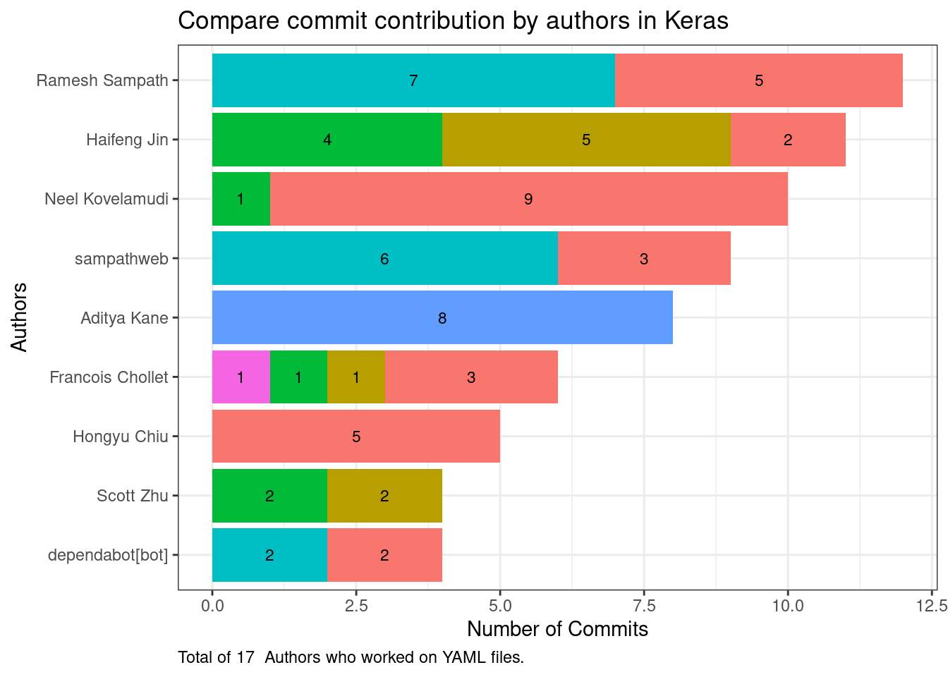
Results
GA Workflow Code Ownership
Created tool to collect commits from 14 GitHub repositories

Slide 27
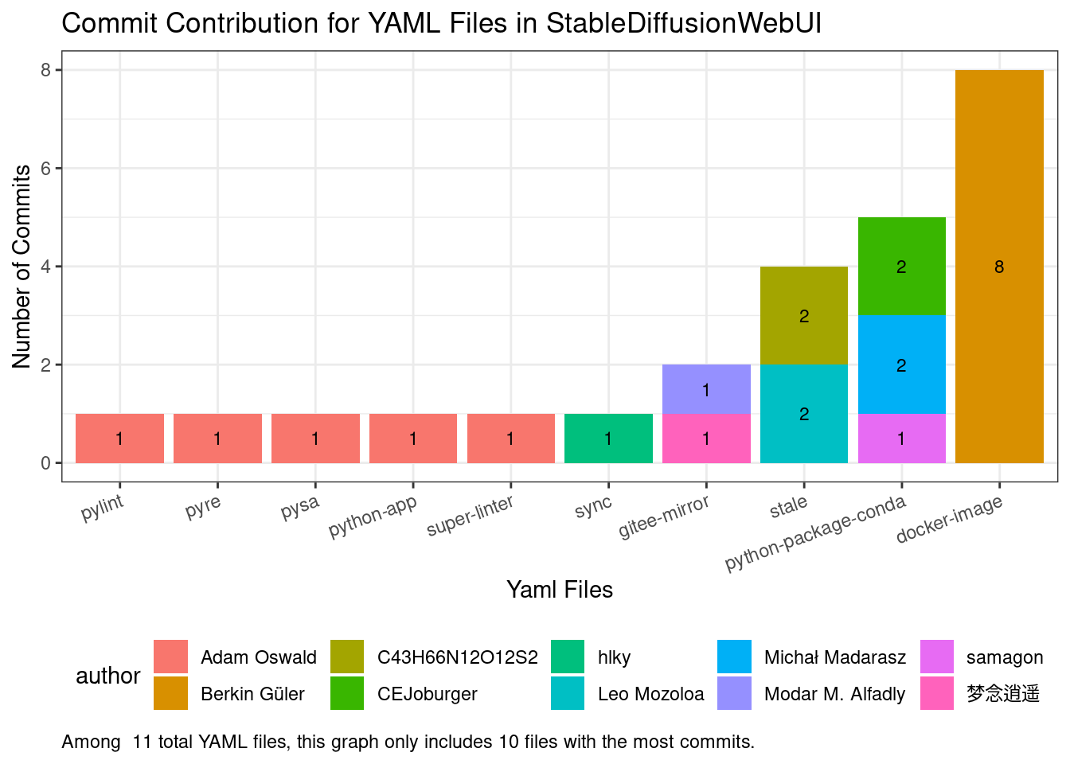
Results
GA Workflow Code Ownership
Created tool to collect commits from 14 GitHub repositories

