Slide 1
Annotations
Extracted from Oracle
The Java™ Tutorials

Slide 2
Annotations
Annotations, a form of metadata, provide data about a program that is not part of the program itself. Annotations have no direct effect on the operation of the code they annotate.
Annotations have a number of uses, among them:
Information for the compiler — Annotations can be used by the compiler to detect errors or suppress warnings.
Compile-time and deployment-time processing — Software tools can process annotation information to generate code, XML files, and so forth.
Runtime processing — Some annotations are available to be examined at runtime.

Slide 3
The Format of an Annotation
In its simplest form, an annotation looks like the following:
@Entity
The at sign character @ indicates to the compiler that what follows is an annotation.
In the following example, the annotation's name is ‘Override’
@Override
public void mySuperMethod() { ... }

Slide 4
Annotation elements
The annotation can include elements which can be named or unnamed, and there are values for those elements:
@Author(
name = "Benjamin Franklin",
date = "3/27/2003" )
public class MyClass() { ... }
Or
@SuppressWarnings(value = "unchecked")
Public void myMethod() { ... }

Slide 5
Contd:
If there is just one element named value then the name can be omitted, as in:
@SuppressWarnings("unchecked")
void myMethod() { ... }
If the annotation has no elements, then the parentheses can be omitted, as shown in the previous @Override example

Slide 6
Predefined Annotation Types
A set of annotation types are predefined in the Java SE API.
The predefined annotation types defined in java.lang are
@Deprecated
indicates that the marked element is deprecated and should no longer be used.
@Override
informs the compiler that the element is meant to override an element declared in a superclass
@SuppressWarnings
tells the compiler to suppress specific warnings that it would otherwise generate.

Slide 7
Examples
The compiler generates a warning whenever a program uses a method, class, or field with the @Deprecated annotation.
When an element is deprecated, it should also be documented using the Javadoc @deprecated tag.
// Javadoc comment follows /** * @deprecated * explanation of why it was deprecated */ @Deprecated public static void deprecatedMethod() {…… }

Slide 8
Examples
// mark method as a superclass method that has been overridden @Override public int overriddenMethod() { }
While it is not required to use this annotation when overriding a method, it helps to prevent errors
If a method marked with @Override fails to correctly override a method in one of its superclasses, the compiler generates an error

Slide 9
Example
In the following example, a deprecated method is used, and the compiler usually generates a warning. In this case, however, the annotation causes the warning to be suppressed
// use a deprecated method and tell compiler not to generate a warning @SuppressWarnings("deprecation") void useDeprecatedMethod() { // deprecation warning // - suppressed objectOne.deprecatedMethod(); }

Slide 10
Example contd
Every compiler warning belongs to a category. The Java Language Specification lists two categories deprecation and unchecked
The unchecked warning can occur when interfacing with legacy code written before the advent of generics.
To suppress multiple categories of warnings, use the following syntax:
@SuppressWarnings({"unchecked", "deprecation"})

Slide 11
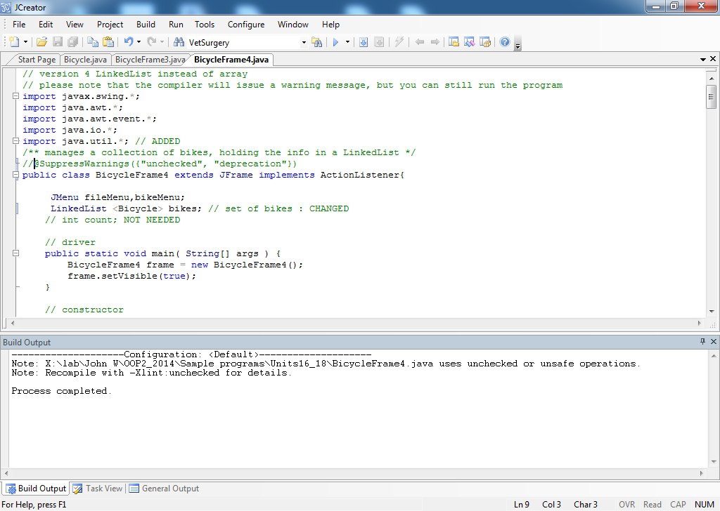

Slide 12
