Slide 1
Author: Horstmann Title: Big Java Late Objects
“This material is reproduced with permission of John Wiley & Sons, Inc.”).

Slide 2

3
CHAPTER
DECISIONS
Slides by Donald W. Smith
TechNeTrain.com
Final Draft
Oct 15, 2011

Slide 3
Chapter Goals
To implement decisions using the if statement
To compare integers, floating-point numbers, and Strings
To write statements using the Boolean data type
To develop strategies for testing your programs
To for validate user input
In this chapter, you will learn how to program simple and complex decisions. You will apply what you learn to the task of checking user input.

Slide 4

Contents
The if Statement
Comparing Numbers
and Strings
Multiple Alternatives
Nested Branches
Problem Solving: Flowcharts
Problem Solving: Test Cases
Boolean Variables and Operators
Application: Input Validation

Slide 5
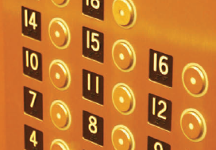
3.1 The if Statement
A computer program often needs to make decisions based on input, or circumstances
For example, buildings often ‘skip’ the 13th floor, and elevators should too
The 14th floor is really the 13th floor
So every floor above 12 is really ‘floor - 1’
If floor > 12, Actual floor = floor - 1
The two keywords of the if statement are:
if
else
The if statement allows a program to carry out different actions depending on the nature of the data to be processed.

Slide 6
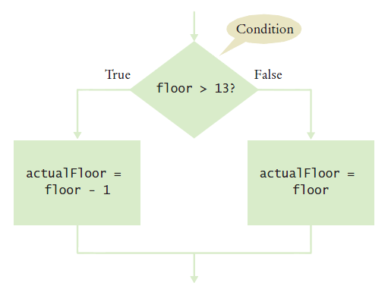
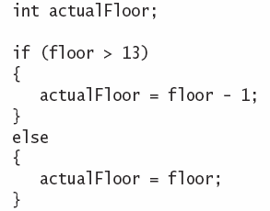
Flowchart of the if statement
One of the two branches is executed once
True (if) branch or False (else) branch

Slide 7
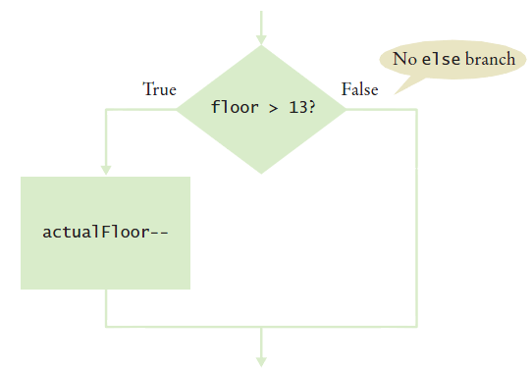
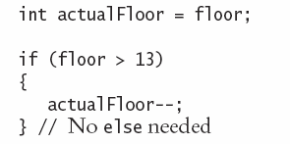
Flowchart with only true branch
An if statement may not need a ‘False’ (else) branch

Slide 8
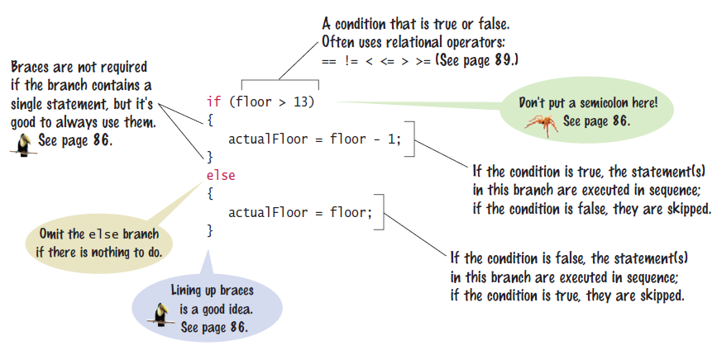
Syntax 3.1: The if statement

Slide 9
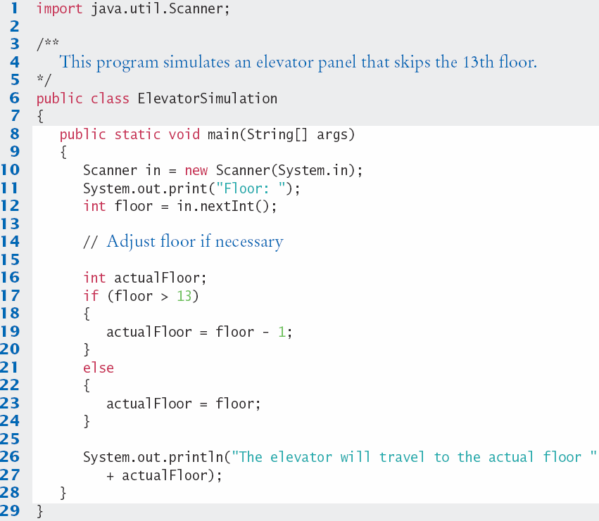
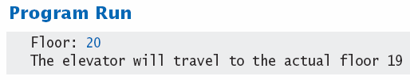
ElevatorSimulation.java

Slide 10




Tips On Using Braces
Line up all pairs of braces vertically
Lined up Not aligned (saves lines)
Always use braces
Although single statement clauses do not require them
Most programmer’s editors have a tool to align matching braces.

Slide 11
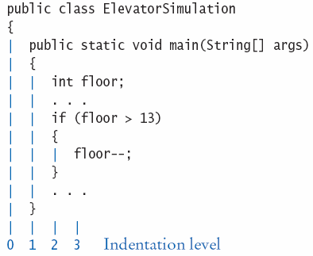
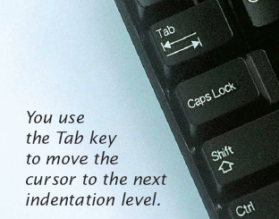
Tips on indenting blocks
Use Tab to indent a consistent number of spaces
This is referred to as ‘block- structured’ code. Indenting consistently makes code much easier for humans to follow.

Slide 12

Common Error 3.1
A semicolon after an if statement
It is easy to forget and add a semicolon after an if statement.
The true path is now the space just before the semicolon
The ‘body’ (between the curly braces) will always be executed in this case
if (floor > 13) ;
{
floor--;
}

Slide 13
The Conditional Operator
A ‘shortcut’ you may find in existing code
It is not used in this book
Includes all parts of an if-else clause, but uses:
? To begin the true branch
: To end the true branch and start the false branch
Condition
True branch
False branch
actualFloor = floor > 13 ? floor - 1 : floor;

Slide 14
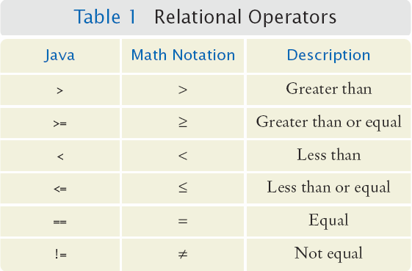
3.2 Comparing Numbers and Strings
Every if statement has a condition
Usually compares two values with an operator
if (floor > 13) ..
if (floor >= 13)
..
if (floor < 13) ..
if (floor <= 13)
..
if (floor == 13) ..
Beware!

Slide 15
Syntax 3.2: Comparisons

Slide 16
Operator Precedence
The comparison operators have lower precedence than arithmetic operators
Calculations are done before the comparison
Normally your calculations are on the ‘right side’ of the comparison or assignment operator
Calculations
actualFloor = floor + 1;
if (floor > height + 1)

Slide 17
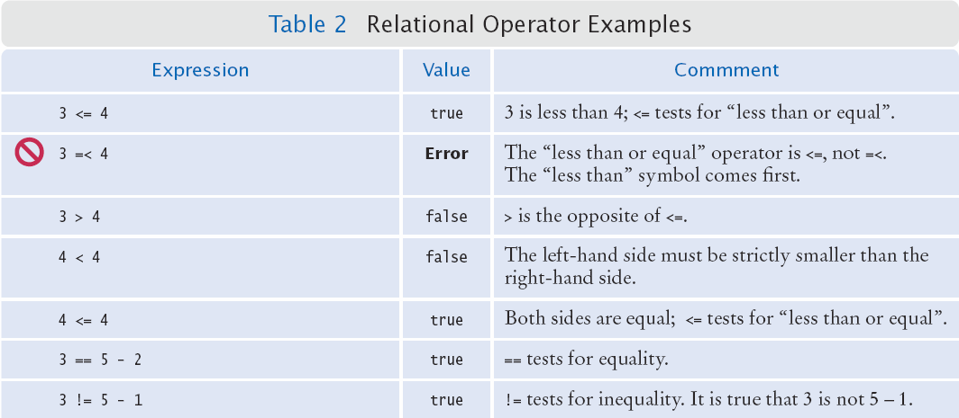
Relational Operator Use (1)

Slide 18
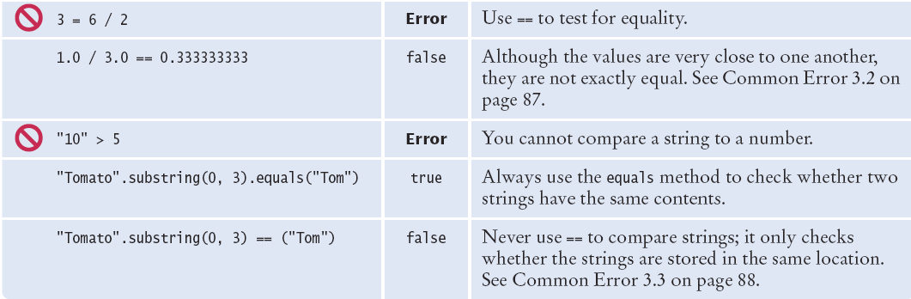
Relational Operator Use (2)

Slide 19
Comparing Strings
Strings are a bit ‘special’ in Java
Do not use the == operator with Strings
The following compares the locations of two strings, and not their contents
Instead use the String’s equals method:
if (string1 == string2) ...
if (string1.equals(string2)) ...

Slide 20
Common Error 3.2
Comparison of Floating-Point Numbers
Floating-point numbers have limited precision
Round-off errors can lead to unexpected results
double r = Math.sqrt(2.0);
if (r * r == 2.0)
{
System.out.println("Math.sqrt(2.0) squared is 2.0");
}
else
{
System.out.println("Math.sqrt(2.0) squared is not 2.0 but " + r * r);
}
Output:
Math.sqrt(2.0) squared is not 2.0 but 2.00000000000000044

Slide 21

The use of EPSILON
Use a very small value to compare the difference if floating-point values are ‘close enough’
The magnitude of their difference should be less than some threshold
Mathematically, we would write that x and y are close enough if:
final double EPSILON = 1E-14;
double r = Math.sqrt(2.0);
if (Math.abs(r * r - 2.0) < EPSILON)
{
System.out.println("Math.sqrt(2.0) squared is approx. 2.0");
}

Slide 22
Common Error 3.3
Using == to compare Strings
== compares the locations of the Strings
Java creates a new String every time a new word inside double-quotes is used
If there is one that matches it exactly, Java re-uses it
String nickname = "Rob";
. . .
if (nickname == "Rob") // Test is true
String name = "Robert";
String nickname = name.substring(0, 3);
. . .
if (nickname == "Rob") // Test is false

Slide 23
Lexicographical Order
To compare Strings in ‘dictionary’ order
When compared using compareTo, string1 comes:
Before string2 if
After string2 if
Equal to string2 if
Notes
All UPPERCASE letters come before lowercase
‘space’ comes before all other printable characters
Digits (0-9) come before all letters
See Appendix A for the Basic Latin Unicode (ASCII) table
string1.compareTo(string2) < 0
string1.compareTo(string2) > 0
string1.compareTo(string2) == 0

Slide 24


Implementing an if Statement
Decide on a branching condition
Write pseudocode for the true branch
Write pseudocode for the false branch
Double-check relational operators
Test values below, at, and above the comparison (127, 128, 129)

Slide 25


Implementing an if Statement (cont.)
Remove duplication
Test both branches
Write the code in Java

Slide 26
Implemented Example
The university bookstore has a Kilobyte Day sale every October 24, giving an 8 percent discount on all computer accessory purchases if the price is less than $128, and a 16 percent discount if the price is at least $128.
if (originalPrice < 128)
{
discountRate = 0.92;
}
else
{
discountRate = 0.84;
}
discountedPrice = discountRate * originalPrice;

Slide 27
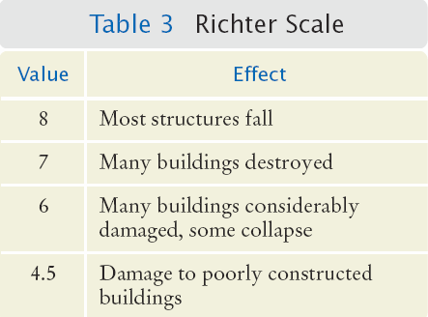
3.3 Multiple Alternatives
What if you have more than two branches?
Count the branches for the following earthquake effect example:
8 (or greater)
7 to 7.99
6 to 6.99
4.5 to 5.99
Less than 4.5
When using multiple if statements, test general conditions after more specific conditions.

Slide 28
Flowchart of Multiway branching
True
> 8.0?
Most Structures Fall
False
>= 7.0?
True
Many Buildings Destroyed
False
>= 6.0?
True
Many buildings considerably damaged, some collapse
False
>= 4.5?
True
Damage to poorly constructed buildings
False
No destruction of buildings

Slide 29
if, else if multiway branching
if (richter >= 8.0) // Handle the ‘special case’ first
{
System.out.println("Most structures fall");
}
else if (richter >= 7.0)
{
System.out.println("Many buildings destroyed");
}
else if (richter >= 6.0)
{
System.out.println("Many buildings damaged, some collapse");
}
else if (richter >= 4.5)
{
System.out.println("Damage to poorly constructed buildings");
}
else // so that the ‘general case’ can be handled last
{
System.out.println("No destruction of buildings");
}

Slide 30
What is wrong with this code?
if (richter >= 8.0)
{
System.out.println("Most structures fall");
}
if (richter >= 7.0)
{
System.out.println("Many buildings destroyed");
}
if (richter >= 6.0)
{
System.out.println("Many buildings damaged, some collapse");
}
if (richter >= 4.5)
{
System.out.println("Damage to poorly constructed buildings");
}

Slide 31
Another way to multiway branch
The switch statement chooses a case based on an integer value.
int digit = . . .;
switch (digit)
{
case 1: digitName = "one"; break;
case 2: digitName = "two"; break;
case 3: digitName = "three"; break;
case 4: digitName = "four"; break;
case 5: digitName = "five"; break;
case 6: digitName = "six"; break;
case 7: digitName = "seven"; break;
case 8: digitName = "eight"; break;
case 9: digitName = "nine"; break;
default: digitName = ""; break;
}
break ends each case
default catches all other values
If the break is missing, the case falls through to the next case’s statements.

Slide 32
3.4 Nested Branches
You can nest an if inside either branch of an if statement.
Simple example: Ordering drinks
Ask the customer for their drink order
if customer orders wine
Ask customer for ID
if customer’s age is 21 or over
Serve wine
Else
Politely explain the law to the customer
Else
Serve customers a non-alcoholic drink

Slide 33
Flowchart of a Nested if
Ask for order
Nested if-else inside true branch of an if statement.
Three paths
Wine?
True
Check ID
False
>= 21?
True
Serve wine
Serve non-alcoholic drink
False
Read law
Done

Slide 34
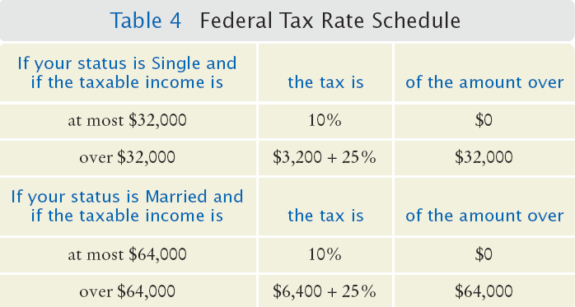
Tax Example: Nested ifs
Four outcomes (branches)
Single
<= 32000
> 32000
Married
<= 64000
> 64000

Slide 35
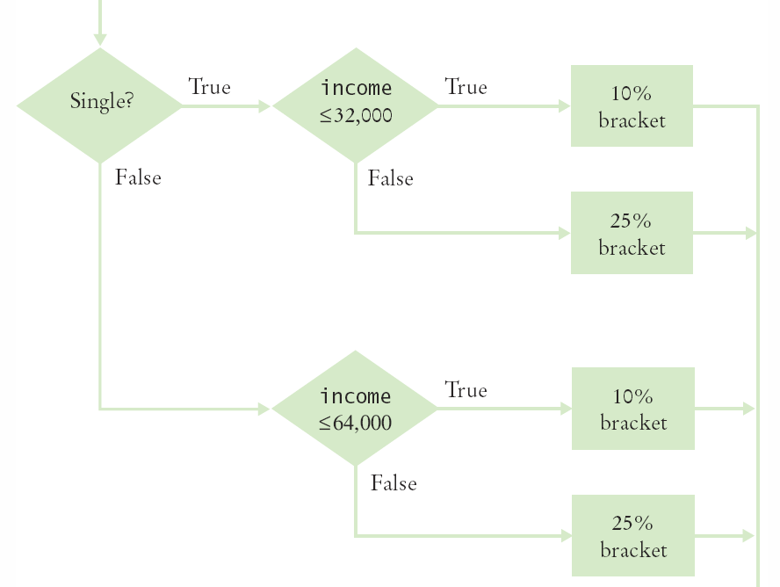
Flowchart for Tax Example
Four branches

Slide 36
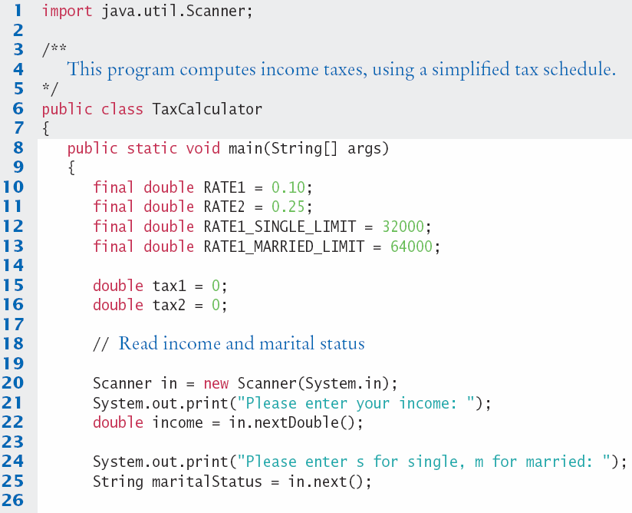
TaxCalculator.java (1)

Slide 37
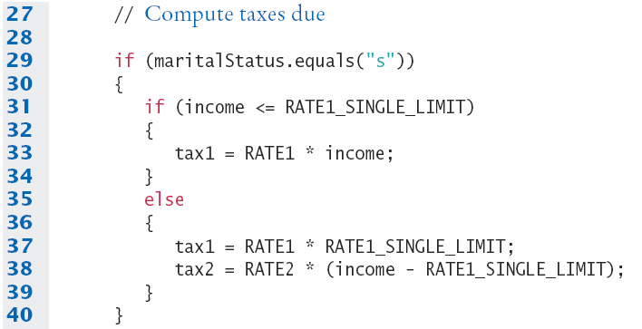
TaxCalculator.java (2)
The ‘True’ branch (Married)
Two branches within this branch

Slide 38
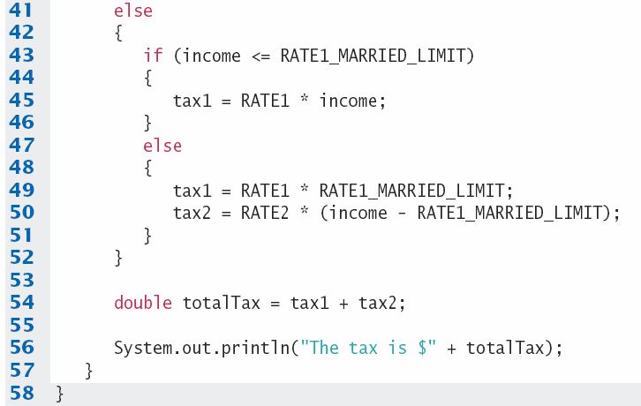
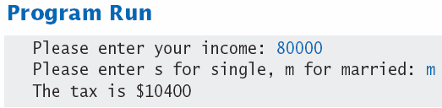
TaxCalculator.java (3)
The ‘False’ branch (not Married)

Slide 39


Hand-Tracing
Hand-tracing helps you understand whether a program works correctly
Create a table of key variables
Use pencil and paper to track their values
Works with pseudocode or code
Track location with a marker such as a
paper clip
Use example input values that:
You know what the correct outcome should be
Will test each branch of your code

Slide 40
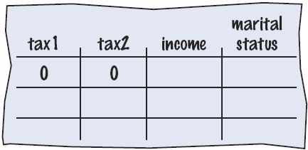
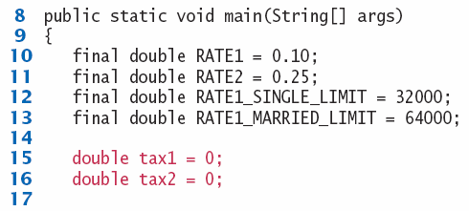
Hand-Tracing Tax Example (1)
Setup
Table of variables
Initial values

Slide 41
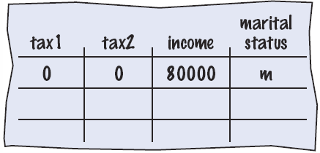
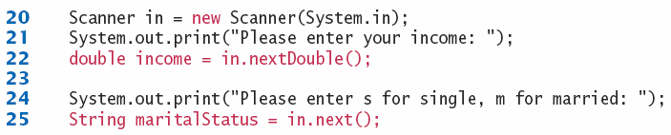


Hand-Tracing Tax Example (2)
Input variables
From user
Update table
Because marital status is not “s” we skip to the else on line 41

Slide 42
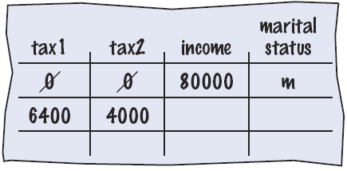
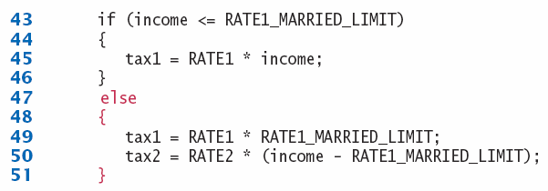
Hand-Tracing Tax Example (3)
Because income is not <= 64000, we move to the else clause on line 47
Update variables on lines 49 and 50
Use constants

Slide 43
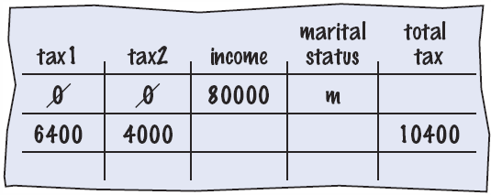

Hand-Tracing Tax Example (4)
Output
Calculate
As expected?

Slide 44
Common Error 3.4
The Dangling else Problem
When an if statement is nested inside another if statement, the following can occur:
The indentation level suggests that the else is related to the if country (“USA”)
Else clauses always associate to the closest if
double shippingCharge = 5.00; // $5 inside continental U.S.
if (country.equals("USA"))
if (state.equals("HI"))
shippingCharge = 10.00; // Hawaii is more expensive
else // Pitfall!
shippingCharge = 20.00; // As are foreign shipment

Slide 45
Enumerated Types
Java provides an easy way to name a finite list of values that a variable can hold
It is like declaring a new type, with a list of possible values
You can have any number of values, but you must include them all in the enum declaration
You can declare variables of the enumeration type:
And you can use the comparison operator with them:
public enum FilingStatus {
SINGLE, MARRIED,MARRIED_FILING_SEPARATELY }
FilingStatus status = FilingStatus.SINGLE;
if (status == FilingStatus.SINGLE) . . .

Slide 46
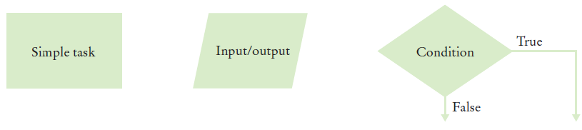
3.5 Problem Solving: Flowcharts
You have seen a few basic flowcharts
A flowchart shows the structure of decisions and tasks to solve a problem
Basic flowchart elements:
Connect them with arrows
But never point an arrow
inside another branch!
Each branch of a decision can contain tasks and further decisions.

Slide 47
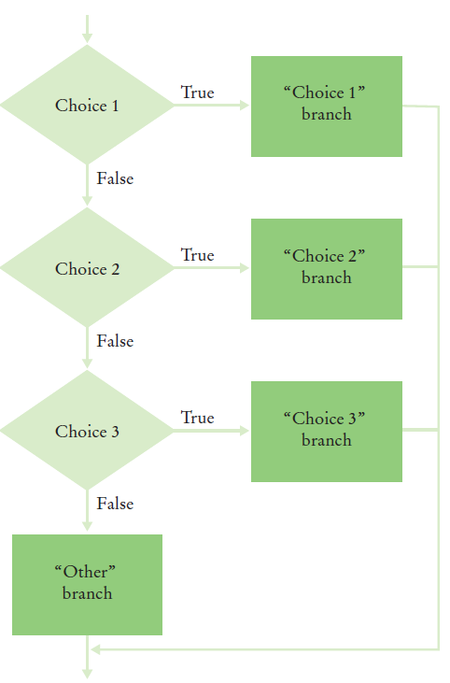
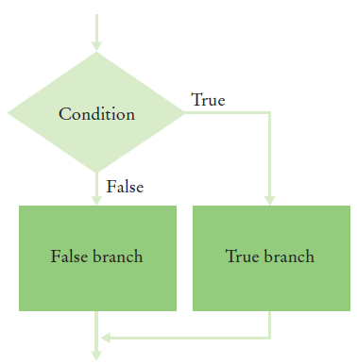
Conditional Flowcharts
Two Outcomes
Multiple Outcomes

Slide 48
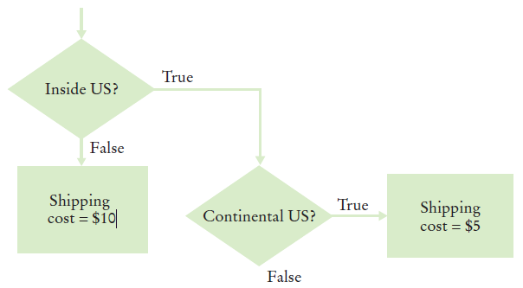
Shipping Cost Flowchart
Shipping costs are $5 inside the United States, except that to Hawaii and Alaska they are $10. International shipping costs are also $10.
Three Branches:
International
Branch
Hawaii/Alaska
Branch
Lower 48
Branch

Slide 49
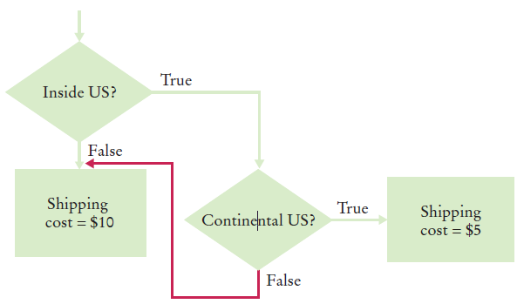
Don’t connect branches!
Shipping costs are $5 inside the United States, except that to Hawaii and Alaska they are $10. International shipping costs are also $10.
Don’t do this!
International
Branch
Hawaii/Alaska
Branch
Lower 48
Branch

Slide 50
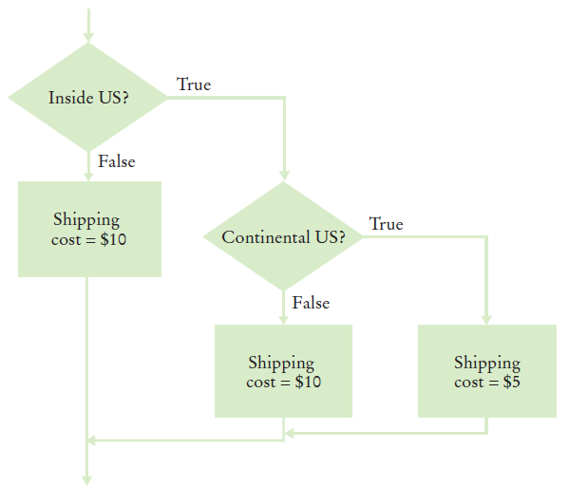
Shipping Cost Flowchart
Shipping costs are $5 inside the United States, except that to Hawaii and Alaska they are $10. International shipping costs are also $10.
Completed:

Slide 51
3.6 Problem Solving: Test Cases
Aim for complete coverage of all decision points:
There are two possibilities for the marital status and two tax brackets for each status, yielding four test cases
Test a handful of boundary conditions, such as an income that is at the boundary between two tax brackets, and a zero income
If you are responsible for error checking (which is discussed in Section 3.8), also test an invalid input, such as a negative income
Each branch of your code should be covered with a test case

Slide 52
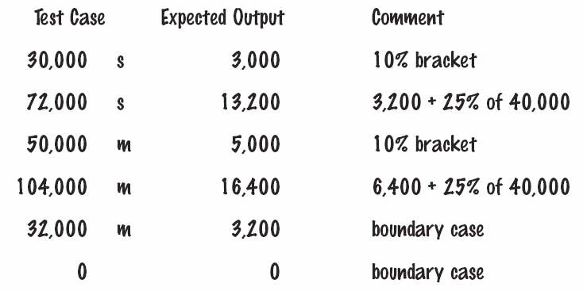
Choosing Test Cases
Choose input values that:
Test boundary cases and 0 values
Test each branch
A boundary case is a value that is tested in the code.

Slide 53

3.7 Boolean Variables
Boolean Variables
A Boolean variable is often called a flag because it can be either up (true) or down (false)
boolean is a Java data type
boolean failed = true;
Can be either true or false
Boolean Operators: && and ||
They combine multiple conditions
&& is the and operator
|| is the or operator

Slide 54
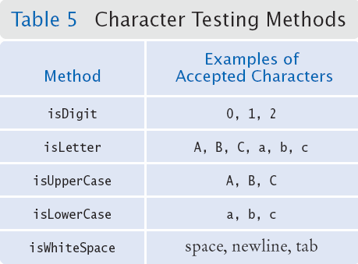
Character Testing Methods
The Character class has a number of handy methods that return a boolean value:
if (Character.isDigit(ch))
{
...
}

Slide 55
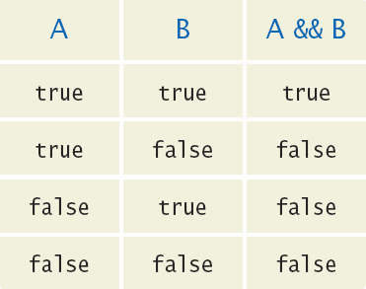
Combined Conditions: &&
Combining two conditions is often used in range checking
Is a value between two other values?
Both sides of the and must be true for the result to be true
if (temp > 0 && temp < 100)
{
System.out.println("Liquid");
}

Slide 56
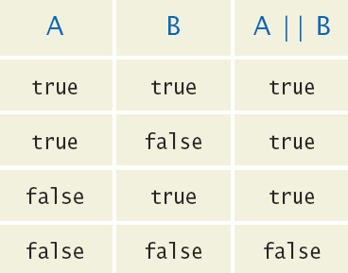
Combined Conditions: ||
If only one of two conditions need to be true
Use a compound conditional with an or:
If either is true
The result is true
if (balance > 100 || credit > 100)
{
System.out.println(“Accepted");
}

Slide 57
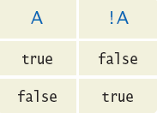
The not Operator: !
If you need to invert a boolean variable or comparison, precede it with !
If using !, try to use simpler logic:
if (!attending || grade < 60)
{
System.out.println(“Drop?");
}
if (attending && !(grade < 60))
{
System.out.println(“Stay");
}
if (attending && (grade >= 60))

Slide 58
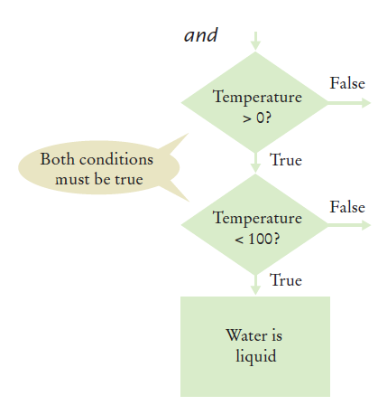
and Flowchart
if (temp > 0 && temp < 100)
{
System.out.println("Liquid");
}
This is often called ‘range checking’
Used to validate that input is between two values

Slide 59
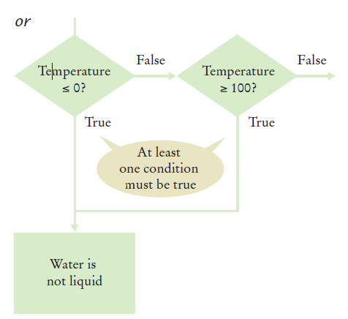
or Flowchart
Another form of ‘range checking’
Checks if value is outside a range
if (temp <= 0 || temp >= 100)
{
System.out.println(“Not Liquid");
}

Slide 60
Boolean Operator Examples

Slide 61
Boolean Operator Examples

Slide 62
Common Error 3.5
Combining Multiple Relational Operators
This format is used in math, but not in Java!
It requires two comparisons:
This is also not allowed in Java:
This also requires two comparisons:
if (0 <= temp <= 100) // Syntax error!
if (0 <= temp && temp <= 100)
if (input == 1 || 2) // Syntax error!
if (input == 1 || input == 2)

Slide 63
Common Error 3.6
Confusing && and ||Conditions
It is a surprisingly common error to confuse && and || conditions.
A value lies between 0 and 100 if it is at least 0 and at most 100.
It lies outside that range if it is less than 0 or greater than 100.
There is no golden rule; you just have to think carefully.

Slide 64
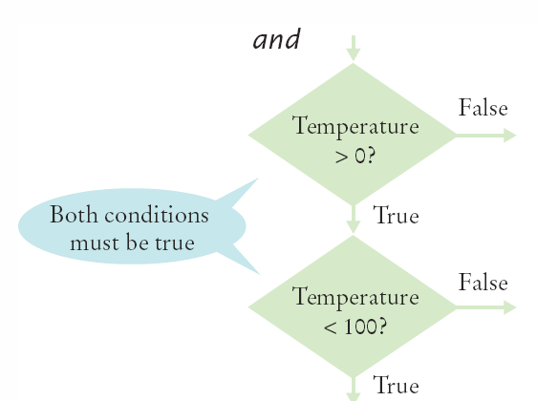
Short-Circuit Evaluation: &&
Combined conditions are evaluated from left to right
If the left half of an and condition is false, why look further?
A useful example:
if (temp > 0 && temp < 100)
{
System.out.println("Liquid");
}
Done!
if (quantity > 0 && price / quantity < 10)

Slide 65
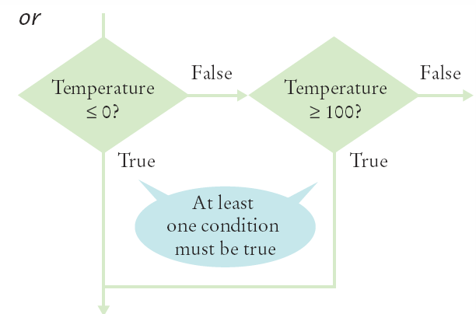
Short-Circuit Evaluation: ||
If the left half of the or is true, why look further?
Java doesn’t!
Don’t do these second:
Assignment
Output
if (temp <= 0 || temp >= 100)
{
System.out.println(“Not Liquid");
}
Done!

Slide 66
De Morgan’s Law
De Morgan’s law tells you how to negate && and || conditions:
!(A && B) is the same as !A || !B
!(A || B) is the same as !A && !B
Example: Shipping is higher to AK and HI
To simplify conditions with negations of and or or expressions, it is usually a good idea to apply De Morgan’s Law to move the negations to the innermost level.
if (!(country.equals("USA")
&& !state.equals("AK")
&& !state.equals("HI")))
shippingCharge = 20.00;
if !country.equals("USA")
|| state.equals("AK")
|| state.equals("HI") shippingCharge = 20.00;

Slide 67
3.8 Input Validation
Accepting user input is dangerous
Consider the Elevator program:
The user may input an invalid character or value
Must be an integer
Scanner can help!
hasNextInt
True if integer
False if not
Then range check value
We expect a floor number to be between 1 and 20
NOT 0, 13 or > 20
if (in.hasNextInt())
{
int floor = in.nextInt();
// Process the input value
}
else
{
System.out.println("Not integer.");
}

Slide 68
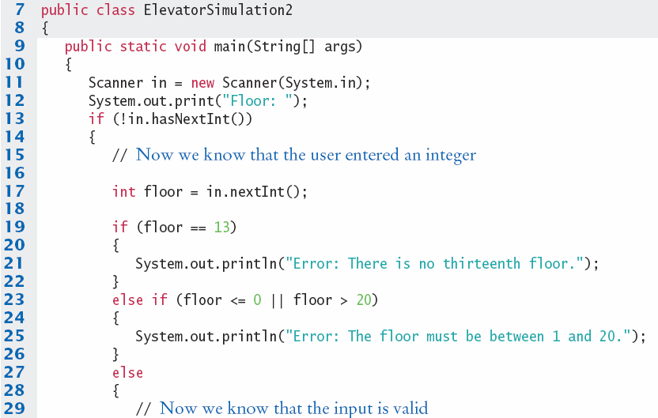
ElevatorSimulation2.java
Input value validity checking
Input value range checking

Slide 69
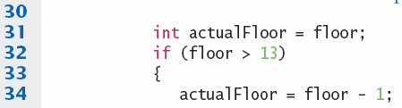
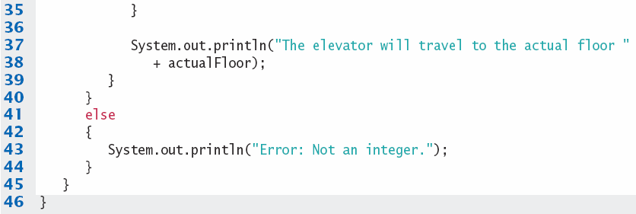

ElevatorSimulation2.java

Slide 70
Summary: if Statement
The if statement allows a program to carry out different actions depending on the nature of the data to be processed.
Relational operators ( < <= > >= == != ) are used to compare numbers and Strings.
Do not use the == operator to compare Strings.
Use the equals method instead.
The compareTo method compares Strings in lexicographic order.
Multiple if statements can be combined to evaluate complex decisions.
When using multiple if statements, test general conditions after more specific conditions.

Slide 71
Summary: Flowcharts and Testing
When a decision statement is contained inside the branch of another decision statement, the statements are nested.
Nested decisions are required for problems that have two levels of decision making.
Flow charts are made up of elements for tasks, input/ output, and decisions.
Each branch of a decision can contain tasks and further decisions.
Never point an arrow inside another branch.
Each branch of your program should be covered by a test case.
It is a good idea to design test cases before implementing a program.

Slide 72
Summary: Boolean
The Boolean type boolean has two values, true and false.
Java has two Boolean operators that combine conditions: && (and) and || (or).
To invert a condition, use the ! (not) operator.
The && and || operators are computed lazily: As soon as the truth value is determined, no further conditions are evaluated.
De Morgan’s law tells you how to negate && and || conditions.
You can use Scanner hasNext methods to ensure that the data is what you expect.

