Slide 1


numerals
On the winning card five of the objects are ___
Left: types: 5/4 Colors: 6/3
Right: types: 6/3, colors: 5/4

Slide 2

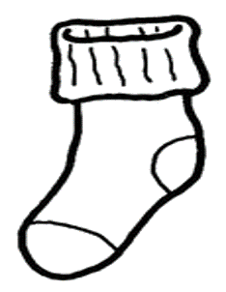
numerals
On the winning card five of the objects are ___
Left: types: 5/4 Colors: 6/3
Right: types: 6/3, colors: 5/4

Slide 3

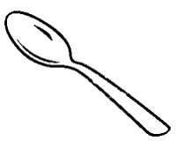
numerals
On the winning card five of the objects are ___

Slide 4
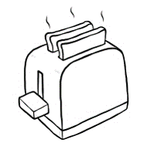

numerals
On the winning card six of the objects are ___

Slide 5
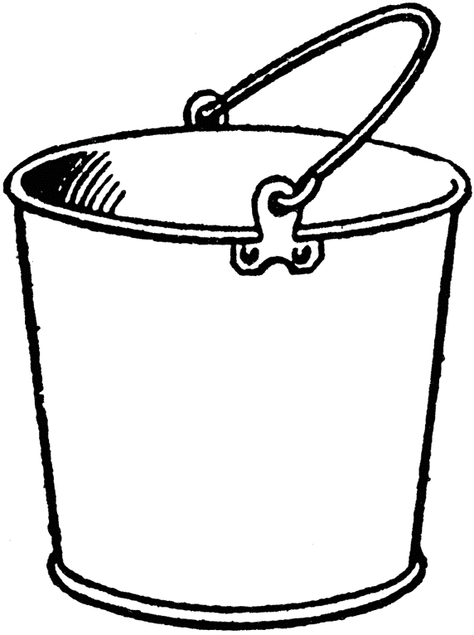

numerals
On the winning card six of the objects are ___

Slide 6
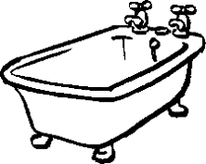

numerals
On the winning card six of the objects are ___

Slide 7
numerals
On the winning card two of the objects are ___

Slide 8
numerals
On the winning card two of the objects are ___

Slide 9
numerals
On the winning card two of the objects are ___

Slide 10
numerals
On the winning card three of the objects are ___

Slide 11
numerals
On the winning card three of the objects are ___

Slide 12
numerals
On the winning card three of the objects are ___

Slide 13


most
On the winning card most of the objects are ___

Slide 14


most
On the winning card most of the objects are ___

Slide 15


most
On the winning card most of the objects are ___

Slide 16
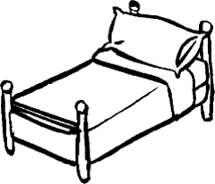
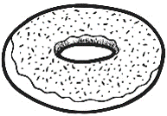
most
On the winning card most of the objects are ___

Slide 17

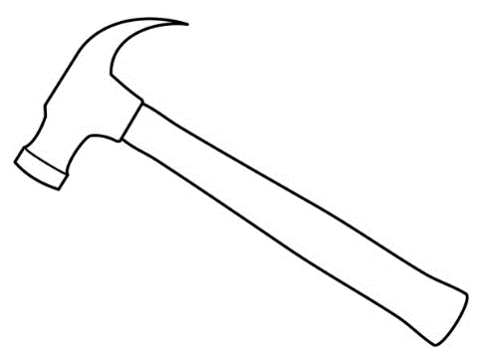
most
On the winning card most of the objects are ___

Slide 18


most
On the winning card most of the objects are ___

Slide 19

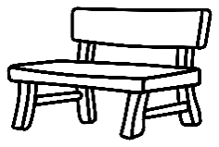
Ad hoc
On the winning card the objects in the top row are ___

Slide 20

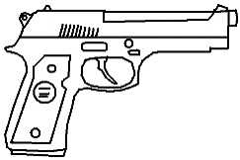
Ad hoc
On the winning card objects in the middle row are ___

Slide 21

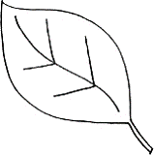
Ad hoc
On the winning card the objects in the bottom row are ___

Slide 22

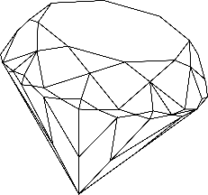
Ad hoc
On the winning card the objects in the top row are ___

Slide 23

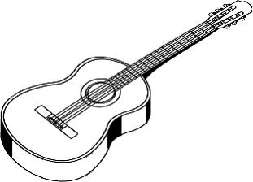
Ad hoc
On the winning card the objects in the middle row are ___

Slide 24

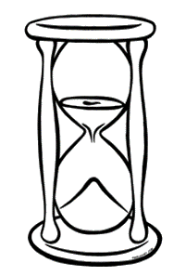
Ad hoc
On the winning card the objects in the bottom row are ___

Slide 26


Control: none
On the winning card none of the objects are ___

Slide 27
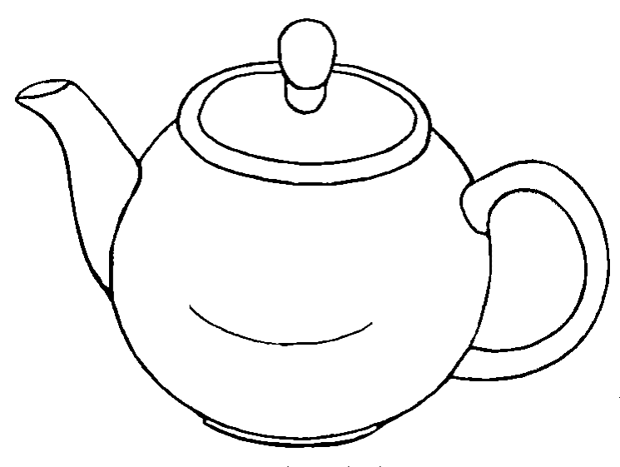

Control: none
On the winning card none of the objects are ___

Slide 28

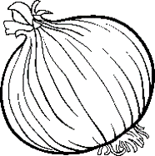
Control: none
On the winning card none of the objects are ___

Slide 29

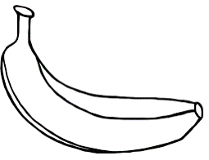
Control: none
On the winning card none of the objects are ___

Slide 30

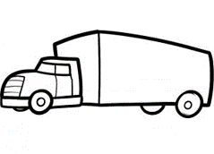
Control: none
On the winning card none of the objects are ___

Slide 31


Control: none
On the winning card none of the objects is ___

Slide 32


Control: none
On the winning card none of the objects are ___

Slide 33
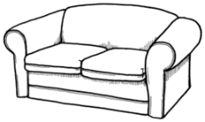
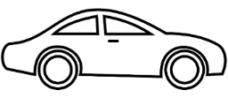
Control: none
On the winning card none of the objects are ___

Slide 34
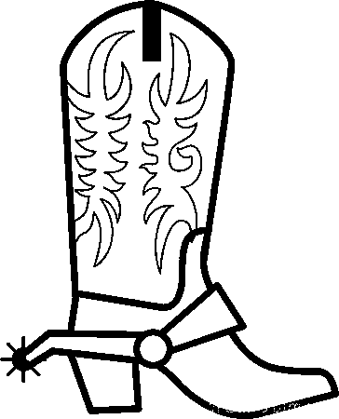

Control: none
On the winning card none of the objects are ___

Slide 35


Control: all
On the winning card all of the objects are ___

Slide 36

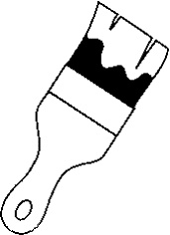
Control: all
On the winning card all of the objects are ___

Slide 37


Control: all
On the winning card all of the objects are ___

Slide 38


Control: all
On the winning card all of the objects are ___

Slide 39
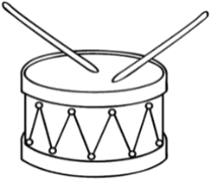
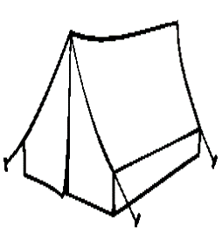
Control: all
On the winning card all of the objects are ___

Slide 40

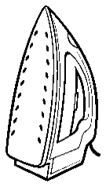
Control: all
On the winning card all of the objects are ___

Slide 41


Control: all
On the winning card all of the objects are ___

Slide 42


Control: all
On the winning card all of the objects are ___

Slide 43

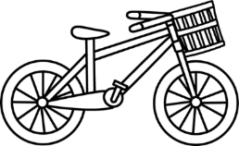
Control: all
On the winning card all of the objects are ___

Slide 44


EXAMPLE
EXAMPLE: On the winning card none of the objects are hats

Slide 45
EXAMPLE
EXAMPLE: On the winning card none of the objects are hats

Slide 46

On the winning card the top object is ___

Slide 47

On the winning card the objects in the top row are red or ___

Slide 48


On the winning card the top object is ___

Slide 49

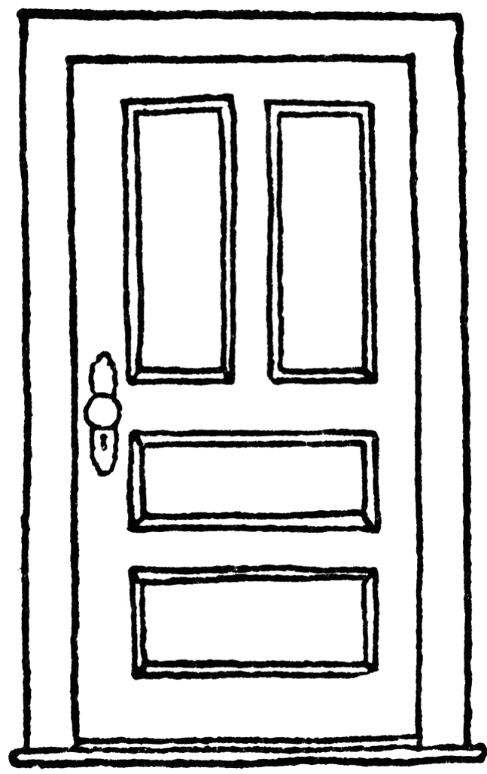

On the winning card the top object is ___

Slide 50

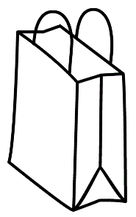
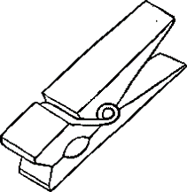


SCARTI

Slide 51


