Slide 1
Supplementary lab – intro to probability
Or: Combinatorics on steroids
The Language of Thought: computational cognitive science approaches to category learning
Who: Fausto Carcassi
When: Sommer semester 2022

Slide 2
Probability – finite discrete
Suppose we flip a coin three times.
What is the probability of getting tails exactly once?
Suppose we flip a coin 30 times.
What is the probability of getting tails exactly 5 times?
Suppose we roll a dice twice.
What is the probability of the sum of the two values being 4?
Note the ingredients of these questions:
We have some situation with a probabilistic component
The situation can turn out in various ways
We are interested in the probability of each of those ways

Slide 3
Probability – finite discrete
Often we need one of four distributions in this context:
Binary event {0,1} that happens once: Bernoulli distribution
Only has one parameter p, namely the probability of 1
Binary event {0,1} that happens n times: Binomial distribution
Answers the question: What is the p that 0 happens exactly n times?
Has parameters p and n.
Bounded above by n: [0, n] is called the support of the distribution
Event {0,1,…,m} that happens once: Categorical distribution
Has one parameter, which is not a number!, but a prob vector of length m
Question: why is m not a parameter?
Can you tell me what a probability vector is?
What question do you think it answers?
Event {0,1,…,m} that happens n times: Multinomial distribution
Two parameters, n and a probability vector of length m
What question do you think it answers?

Slide 4
Probability – families
We have been talking vaguely, so let’s introduce some terminology
The various ‘distributions’ we have talked about are not distributions. They become distributions when a value is given for the parameters.
Rather, they are called families of distribution.
For instance, ‘Bernoulli family’, ‘Binomial family’, etc.
You can think of a family of distributions as a parameterized set: a set of distributions, each of which can be specified by setting some parameters.
Infinite sets!
p=0.4, n=4
p=0.3, n=4
Binomial family
p=0.3, n=5

Slide 5
Probability – support
The support of a distribution is the set of values with probability > 0
In many cases, the support is a set of numbers
For instance, in Bernoulli distributions the support is {0, 1}
However, the support doesn’t have to be a set of numbers
Can you think of an example where it’s not a set of numbers?
For instance, the support of the multinomial distribution is the set of non-negative integer vectors summing to n: Vectors, not numbers!
Question: does the support have to be identical for all distributions in a given family?
Answer: No!
E.g. for binomial and multinomial, the support depends on n

Slide 6
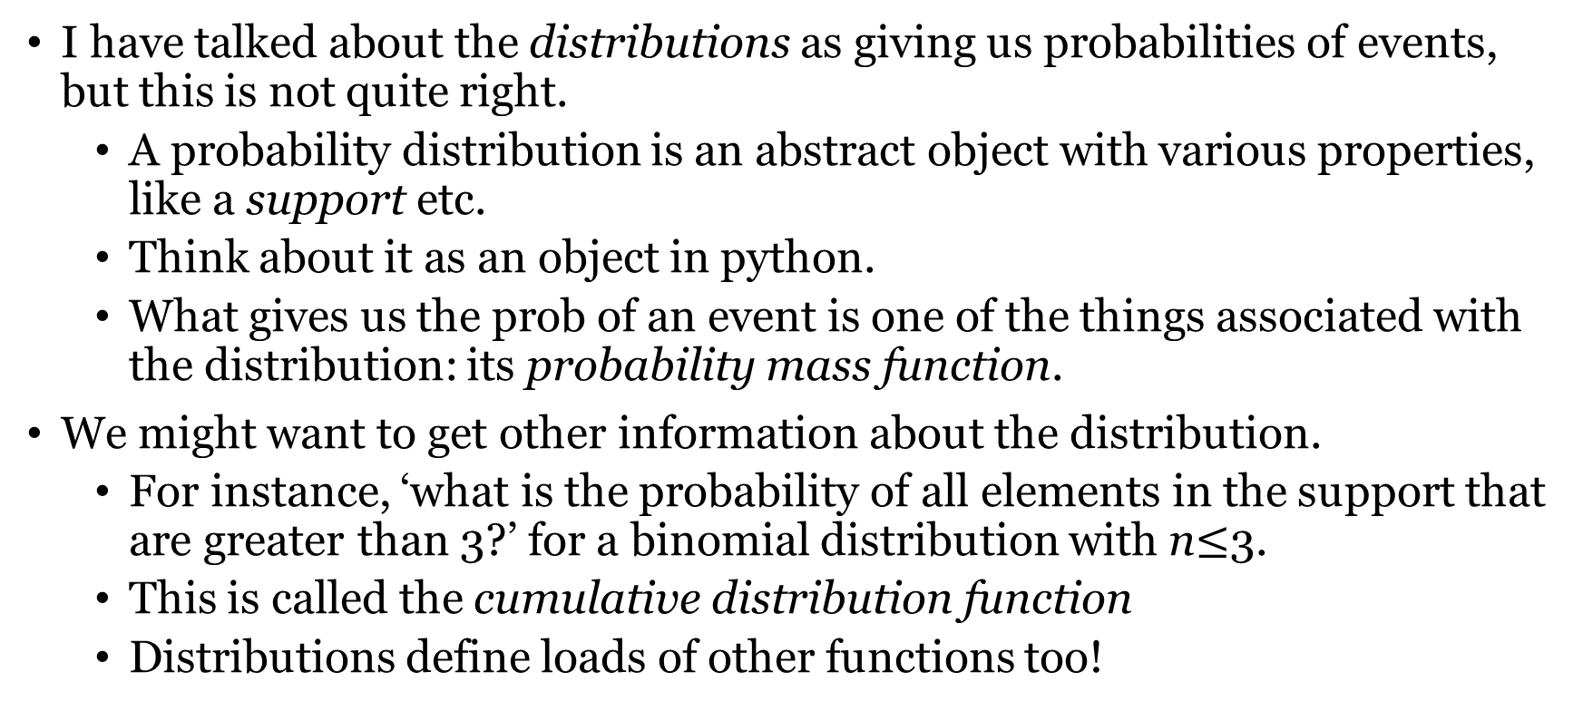
Probability mass function
I have talked about the distributions as giving us probabilities of events, but this is not quite right.
A probability distribution is an abstract object with various properties, like a support etc.
Think about it as an object in python.
What gives us the prob of an event is one of the things associated with the distribution: its probability mass function.
We might want to get other information about the distribution.
For instance, ‘what is the probability of all elements in the support that are greater than 3?’ for a binomial distribution with n$≤$3.
This is called the cumulative distribution function
Distributions define loads of other functions too!

Slide 7
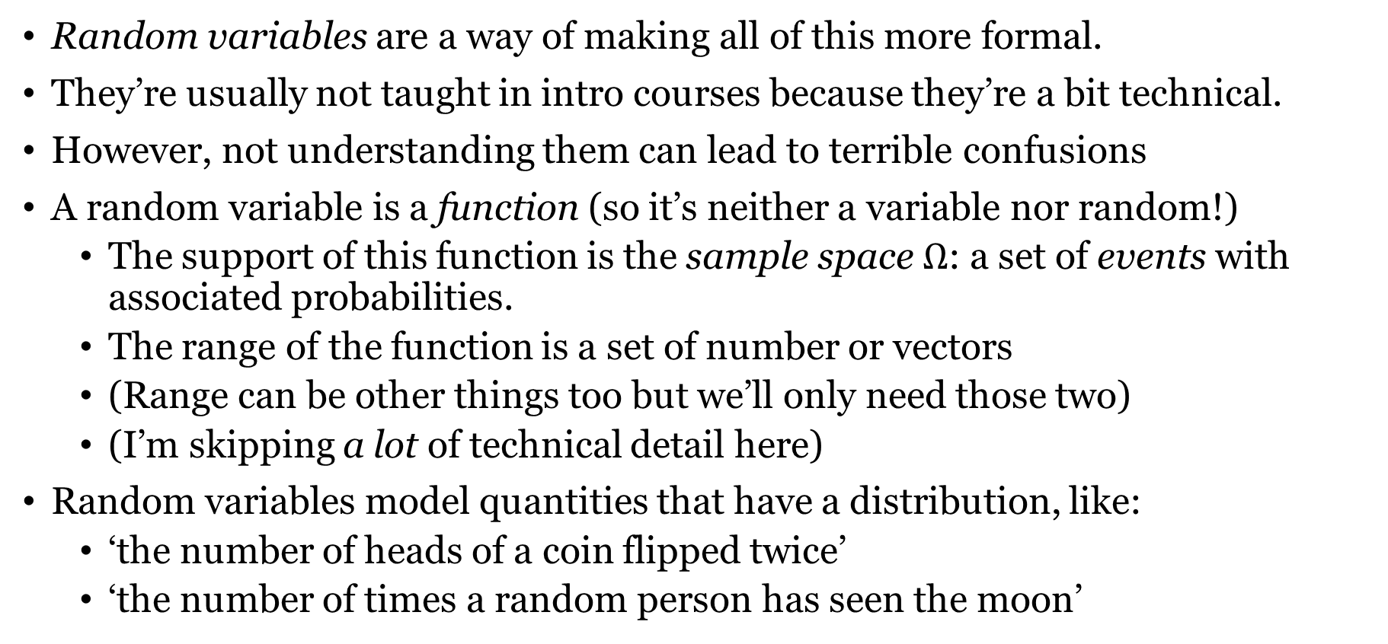
Random variables
Random variables are a way of making all of this more formal.
They’re usually not taught in intro courses because they’re a bit technical.
However, not understanding them can lead to terrible confusions
A random variable is a function (so it’s neither a variable nor random!)
The support of this function is the sample space $Ω$: a set of events with associated probabilities.
The range of the function is a set of number or vectors
(Range can be other things too but we’ll only need those two)
(I’m skipping a lot of technical detail here)
Random variables model quantities that have a distribution, like:
‘the number of heads of a coin flipped twice’
‘the number of times a random person has seen the moon’

Slide 8
Random variable - examples
‘whether a flipped coin shows heads’
‘whether a flipped coin shows heads of tails’
‘the number of heads of two flipped coins’
‘the number of leaves in a tree in bota’
‘whether the number of leaves in a tree in bota is odd’

Slide 9
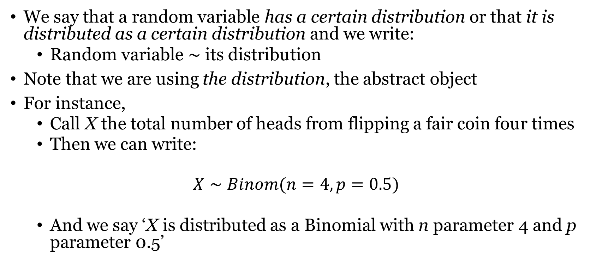
Random variables
We say that a random variable has a certain distribution or that it is distributed as a certain distribution and we write:
Random variable $∼$ its distribution
Note that we are using the distribution, the abstract object
For instance,
Call X the total number of heads from flipping a fair coin four times
Then we can write:
$$X∼Binom(n=4, p=0.5)$$
And we say ‘X is distributed as a Binomial with n parameter 4 and p parameter 0.5’

Slide 10
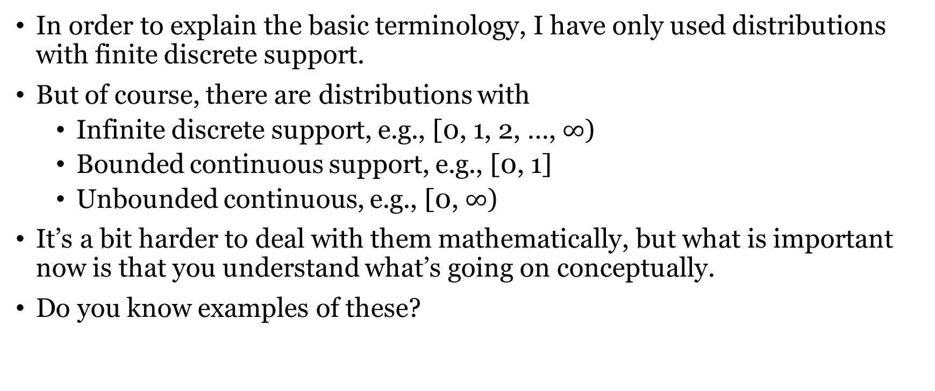
Probability – continuous support
In order to explain the basic terminology, I have only used distributions with finite discrete support.
But of course, there are distributions with
Infinite discrete support, e.g., [0, 1, 2, …, $∞$)
Bounded continuous support, e.g., [0, 1]
Unbounded continuous, e.g., [0, $∞$)
It’s a bit harder to deal with them mathematically, but what is important now is that you understand what’s going on conceptually.
Do you know examples of these?

Slide 11
If there is time left: some foundations
What is a set?
Abstract collection of disjoint (non-repeated) objects
How can we define a set?
Listing the elements of the set (but careful: sets are not ordered!)
List notation: {table, chair}
Stating a property which all and only the objects in the set have
Intentional notation: {x | x is an integer greater than 3}
Defining rules that generate the elements of the set
Recursive definition you have seen in the python lab!
Two sets are the same iff they contain the same members
Member, subset, superset, intersection, union, power set

Slide 12
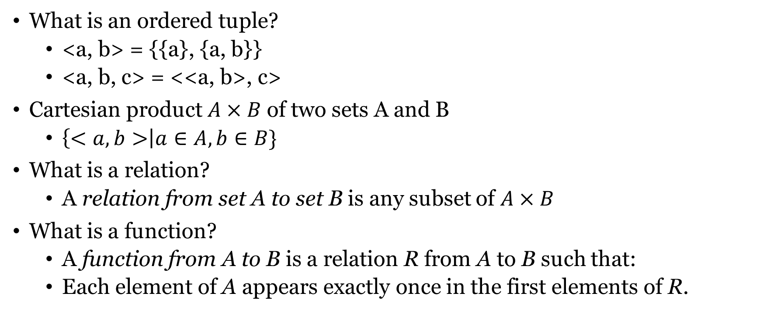
If there is time left: some foundations
What is an ordered tuple?
<a, b> = {{a}, {a, b}}
<a, b, c> = <<a, b>, c>
Cartesian product $A×B$ of two sets A and B
$\left\{<a, b>\right|a∈A, b∈B\}$
What is a relation?
A relation from set A to set B is any subset of $A×B$
What is a function?
A function from A to B is a relation R from A to B such that:
Each element of A appears exactly once in the first elements of R.

