Slide 1
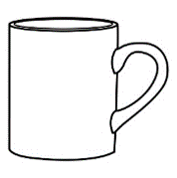

numerals
On the winning card five of the objects are ___
Left: types: 5/4 Colors: 6/3
Right: types: 6/3, colors: 5/4

Slide 2
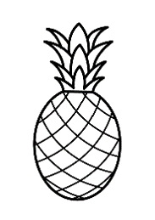
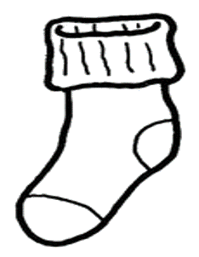
numerals
On the winning card five of the objects are ___
Left: types: 5/4 Colors: 6/3
Right: types: 6/3, colors: 5/4

Slide 3

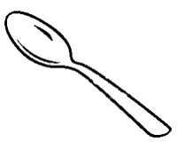
numerals
On the winning card five of the objects are ___

Slide 4
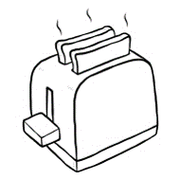
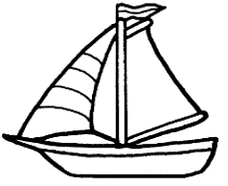
numerals
On the winning card six of the objects are ___

Slide 5
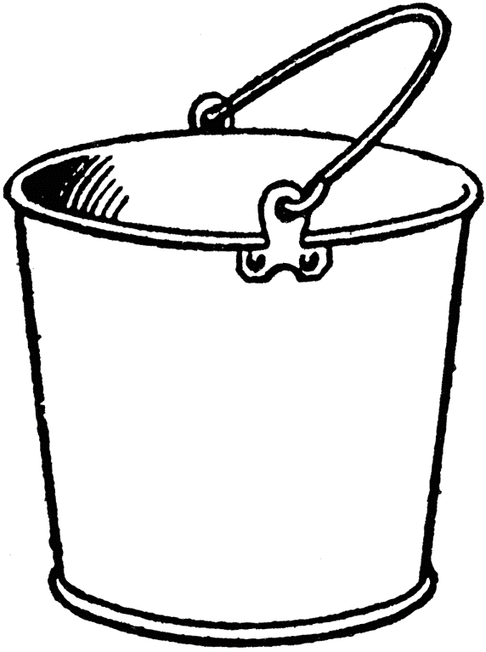
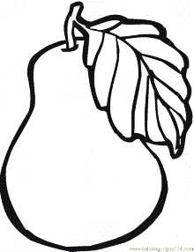
numerals
On the winning card six of the objects are ___

Slide 6
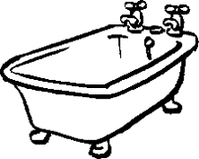
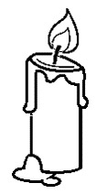
numerals
On the winning card six of the objects are ___

Slide 7


most
On the winning card most of the objects are ___

Slide 8


most
On the winning card most of the objects are ___

Slide 9


most
On the winning card most of the objects are ___

Slide 10
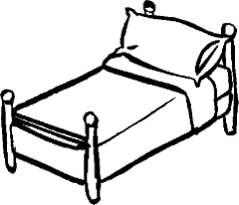
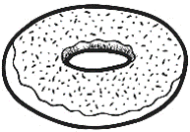
most
On the winning card most of the objects are ___

Slide 11

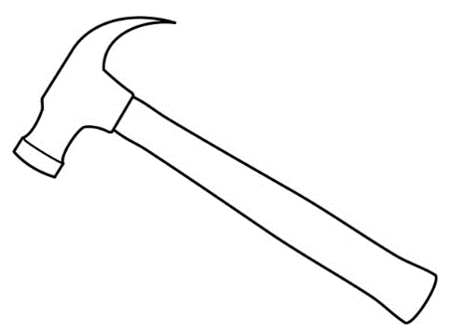
most
On the winning card most of the objects are ___

Slide 12
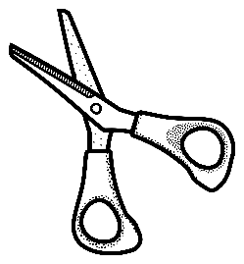

most
On the winning card most of the objects are ___

Slide 13
some

Slide 14
some

Slide 15
some

Slide 16
some

Slide 17
some

Slide 18
some

Slide 19
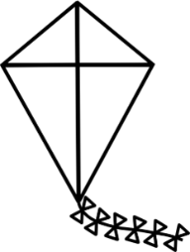
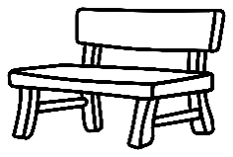
Ad hoc
On the winning card the objects in the top row are ___

Slide 20

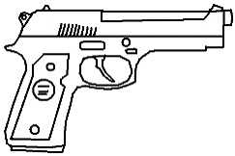
Ad hoc
On the winning card objects in the middle row are ___

Slide 21
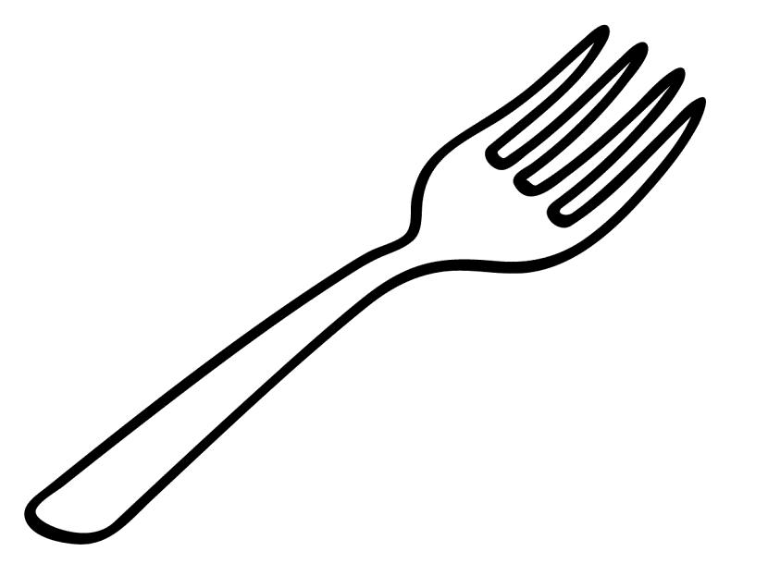
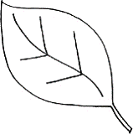
Ad hoc
On the winning card the objects in the bottom row are ___

Slide 22

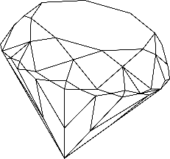
Ad hoc
On the winning card the objects in the top row are ___

Slide 23

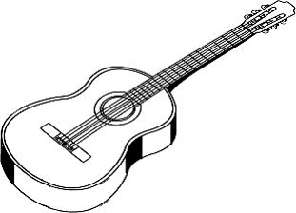
Ad hoc
On the winning card the objects in the middle row are ___

Slide 24

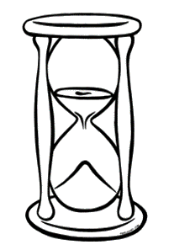
Ad hoc
On the winning card the objects in the bottom row are ___

Slide 26


Control: none
On the winning card none of the objects are ___

Slide 27
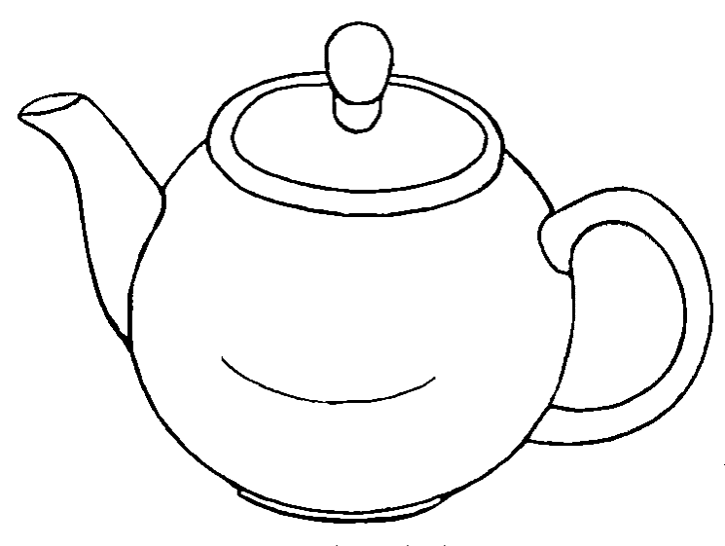

Control: none
On the winning card none of the objects are ___

Slide 28
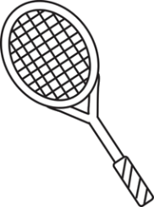
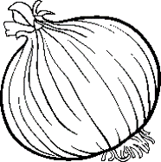
Control: none
On the winning card none of the objects are ___

Slide 29
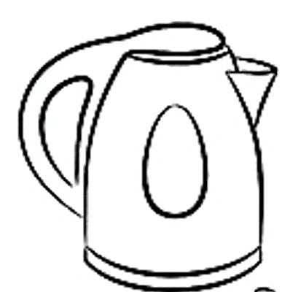
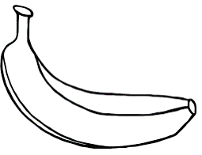
Control: none
On the winning card none of the objects are ___

Slide 30
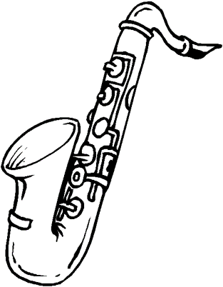
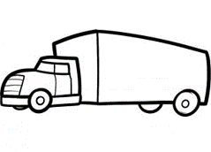
Control: none
On the winning card none of the objects are ___

Slide 31
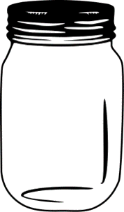
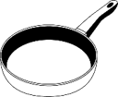
Control: none
On the winning card none of the objects is ___

Slide 32


Control: none
On the winning card none of the objects are ___

Slide 33
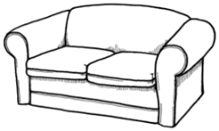
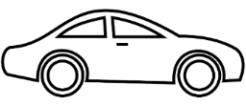
Control: none
On the winning card none of the objects are ___

Slide 34
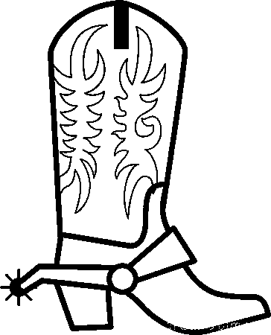
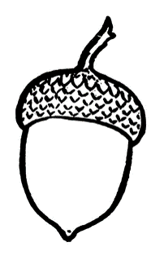
Control: none
On the winning card none of the objects are ___

Slide 35
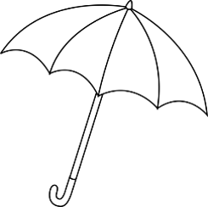

Control: all
On the winning card all of the objects are ___

Slide 36

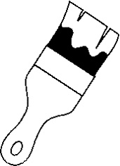
Control: all
On the winning card all of the objects are ___

Slide 37

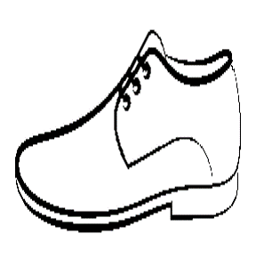
Control: all
On the winning card all of the objects are ___

Slide 38

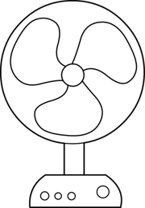
Control: all
On the winning card all of the objects are ___

Slide 39
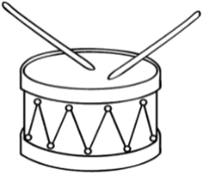
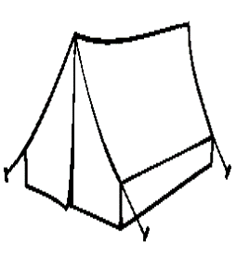
Control: all
On the winning card all of the objects are ___

Slide 40

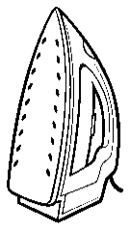
Control: all
On the winning card all of the objects are ___

Slide 41


Control: all
On the winning card all of the objects are ___

Slide 42


Control: all
On the winning card all of the objects are ___

Slide 43
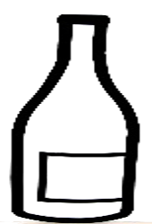
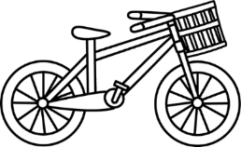
Control: all
On the winning card all of the objects are ___

Slide 44


EXAMPLE
EXAMPLE: On the winning card none of the objects are hats

Slide 45
EXAMPLE
EXAMPLE: On the winning card none of the objects are hats

Slide 46
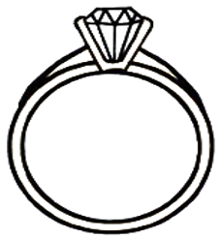
On the winning card the top object is ___

Slide 47

On the winning card the objects in the top row are red or ___

Slide 48
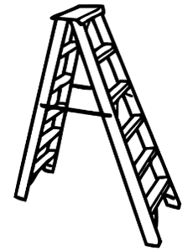

On the winning card the top object is ___

Slide 49
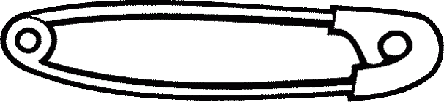
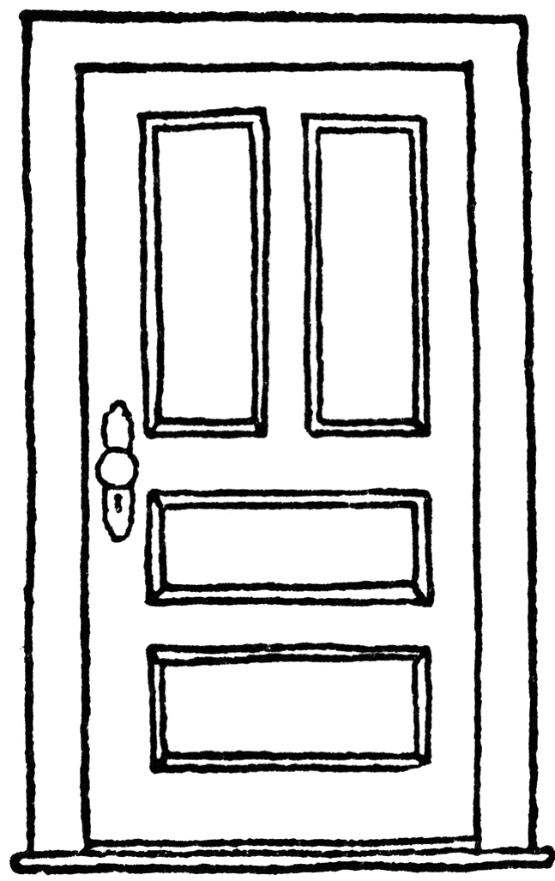

On the winning card the top object is ___

Slide 50

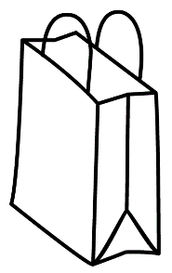
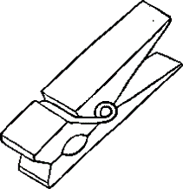


SCARTI

Slide 51


Slide 52
Guesser view: none
The describer said: The green card is the card where none of the objects are pink.
Click on the card you think is the green card!

Slide 53
Guesser Training 1 – all true
The green card is the card where all of the objects are hats.

Slide 54
Guesser Training 2 – all ambiguous
The green card is the card where all of the objects are colored.

Slide 55
Guesser Training 3 – none true
The green card is the card where none of the objects are yellow.

Slide 56
Guesser Training 4 – none ambiguous
The green card is the card where none of the objects are pink.

