Slide 1
AI and logical inferences
Dimitri Didmanidze, Michael High
Dr. McCartin-Lim

Slide 2
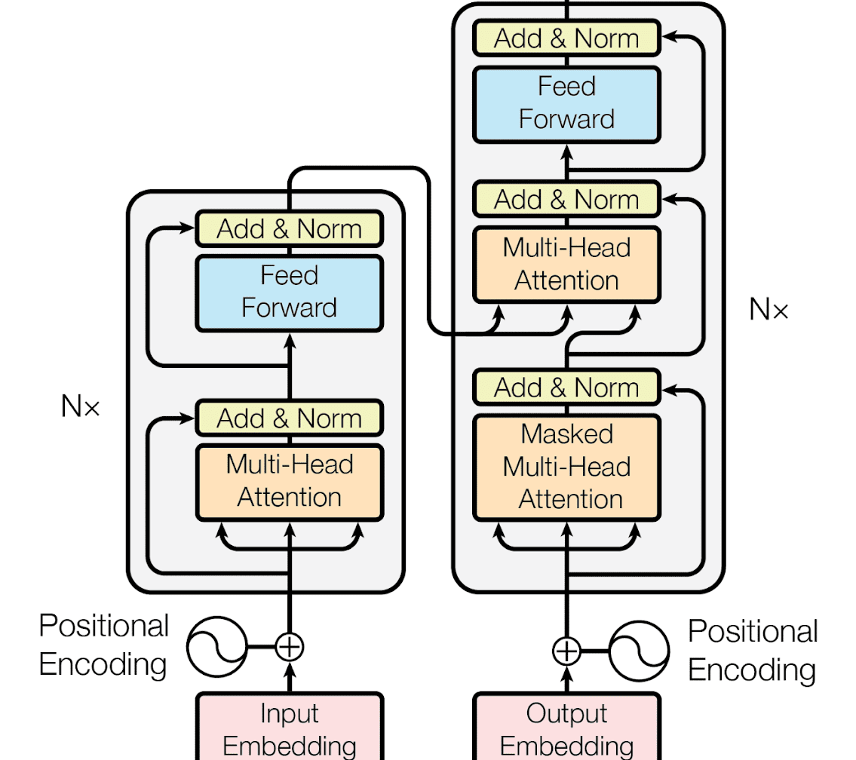
Like RNNs and LSTMs transformer uses encoder/decoders and attention
Though, Transformer is not recurrent
This means the training process is easily parallelizable.

Slide 3
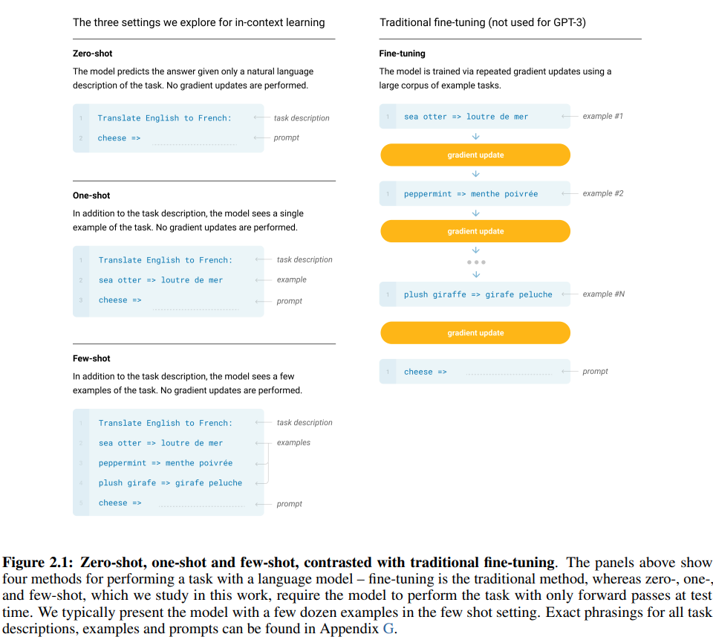
In-Context Learning
Made possible with transformer models

Slide 4
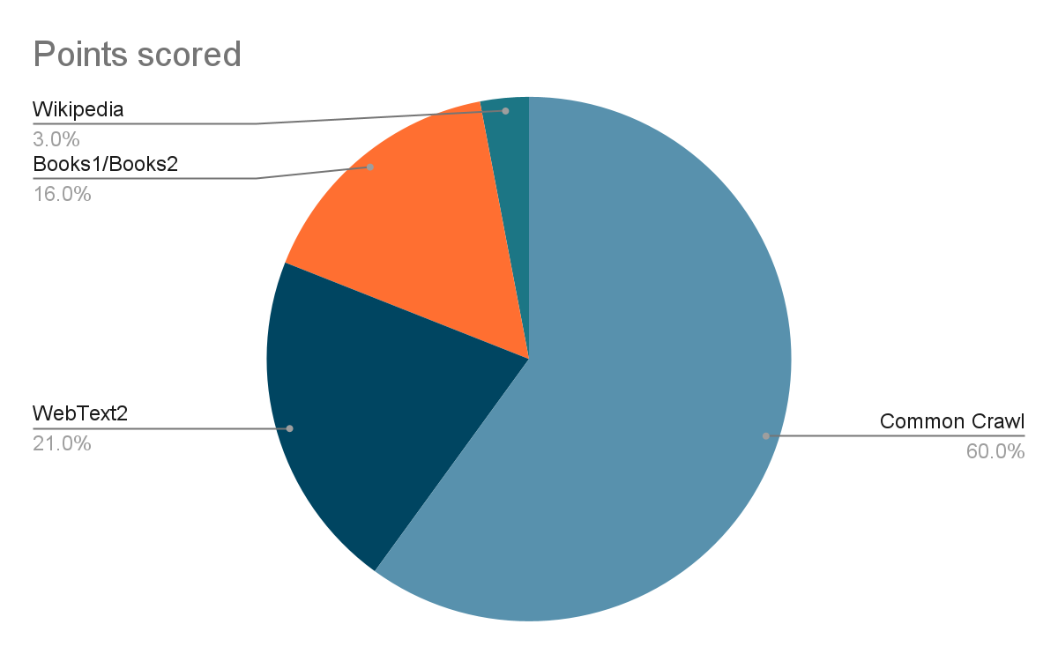
GPT-3 by OpenAI
Trained on hundreds of billions of words

Slide 5
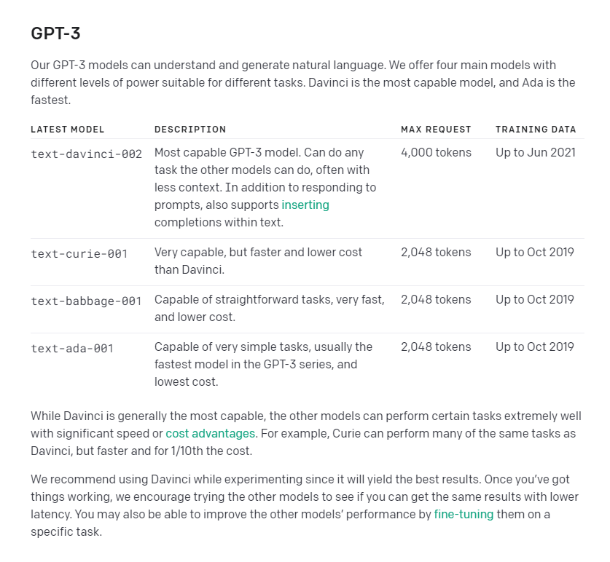
GPT-3 models
Davinci: 175B parameters
Curie: 6.7B parameters
Babbage: 1.3B parameters
Ada: 350M parameters

Slide 6
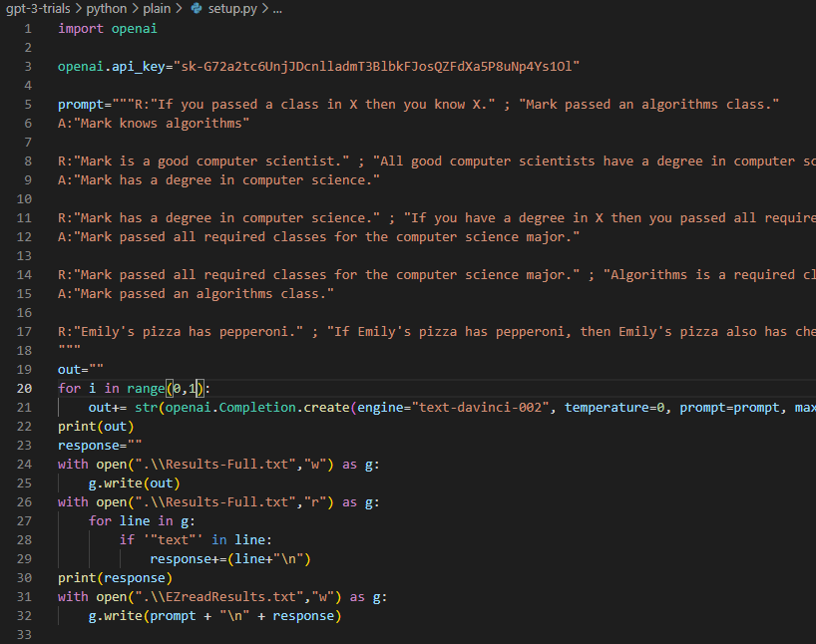
Open AI GPT-3 API
API doesn’t offer any extra features from the playground, but it can make running lots of tests more efficient

Slide 7
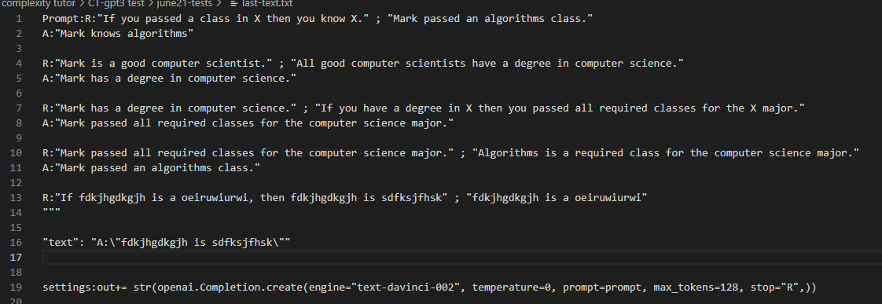
Initial Results
GPT-3 Davinci and AI21 j1-jumbo both appear to complete basic inferences

Slide 8
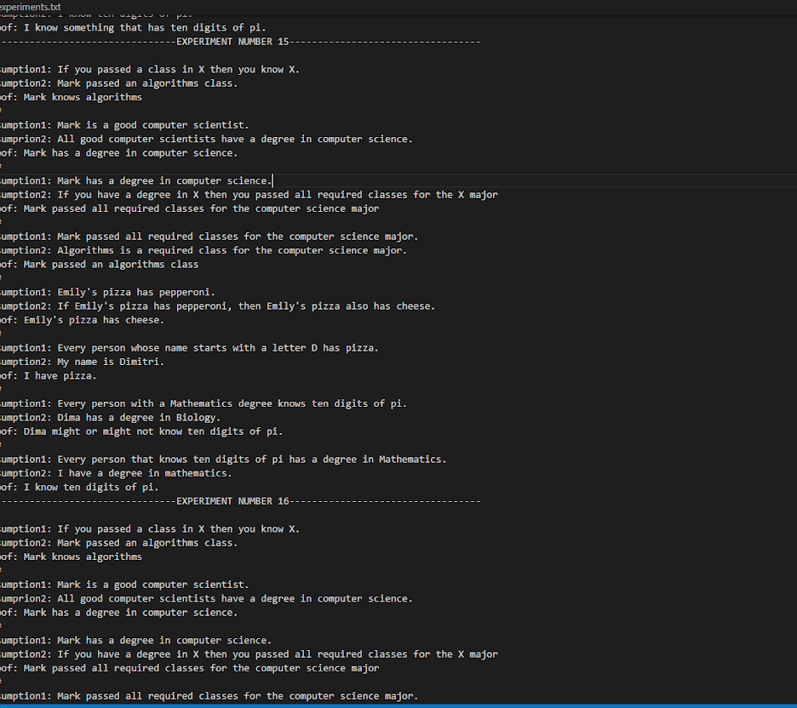
Experiments with Babbage
Testing the feasibility of smaller models
Possibility of moving to the OPT model

Slide 9
Alternatives to GPT-3
AI21 studio’s Jurassic models
Meta’s OPT models

