Slide 1


AllOps
Speed up your business
Project Proposal Presentation 2023/12/11
Michael Kleefisch, Aghiles Gasselin, Luoshan Rosan Zheng
CS459 Introduction to Service Computing
Notes:
AllOps = Platform towards startups to help with the growth of their business by handling bureaucratic task

Slide 2




Issues and Problems in Startups
Lack of Organisational Structure | Limited Resources | Scaling and Time to Market Requirements
Multiple roles for one entity Undefined processes and scattered tools for internal organisation Inefficiencies as a result | A handful of employees that are mainly responsible for revenue-related activities Limited financial resources to invest in expensive assistance tools | Pressure of revenue generation Organisational structure needs to scale with growth of the business
Notes:
competition
pressure for economical gains
organisation does not scale

Slide 3

Our Services
AllOps
Employee
Manager
Time Management
Leave Requests
Worked Hours
Financial Documentation
Spendings and Income
Daily Dashboard
Task Overview
Team Attendance
Daily Information (Inbox, Weather)
Access Management Service
Soft- and Hardware
IoT Devices
Finance Management
Company
HR Department

Slide 4

SOA Characteristics through Design Choices in AllOps
Adapting Web Service architectural style
Message orientation through REST utilization
Middle-Tier Architecture for connecting to external services
Architecture facilitates independent deployments
Platform independent services
Identification of necessary services via top-down analysis of daily business processes
Service granularity

Slide 5
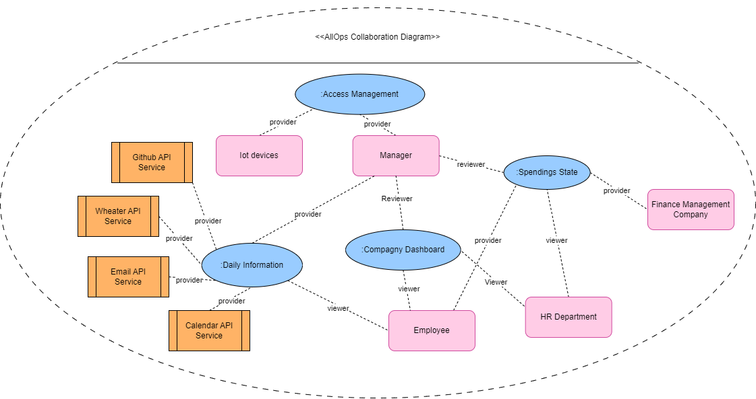
SOA Design in AllOps

Slide 6
SOA Goals in AllOps
Focus on business idea
Reduce bureaucracy
more efficient workflows
Reduce organizational tasks
more time for the business itself
Bundled information
Less tabs
Standardised flows

Slide 7
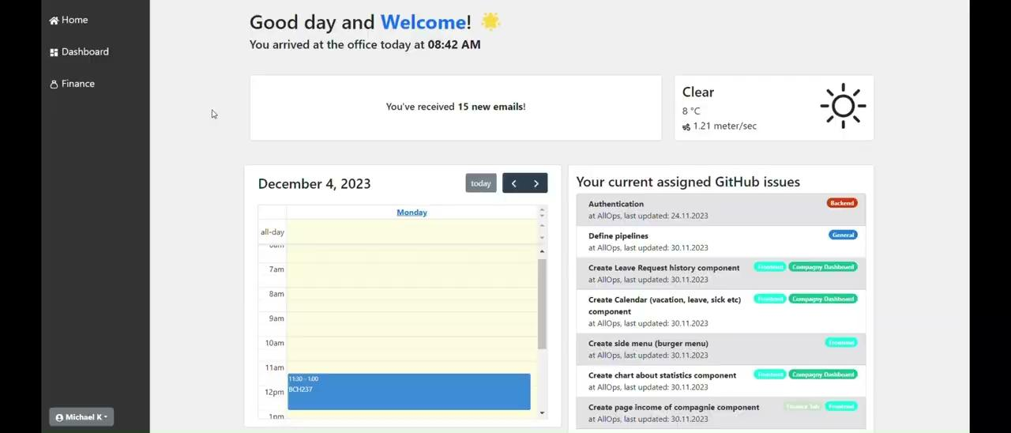

Slide 8


Slide 9
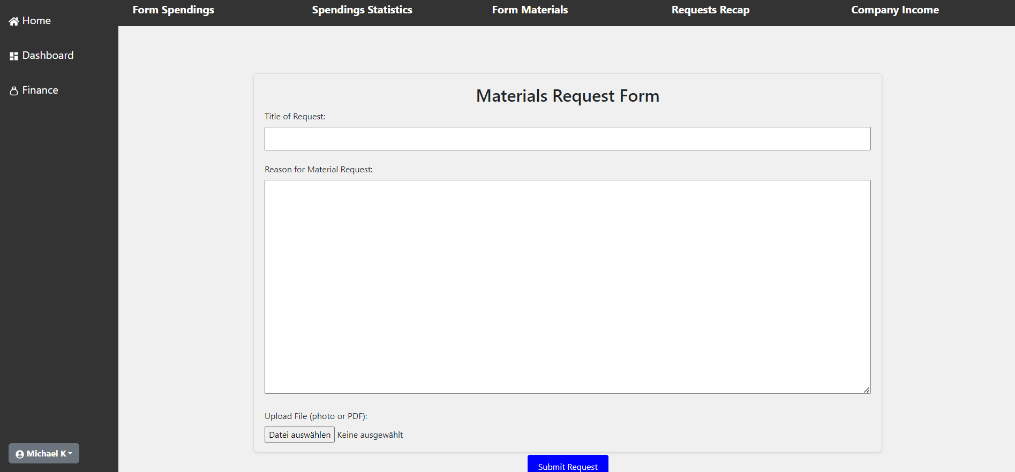

Slide 10
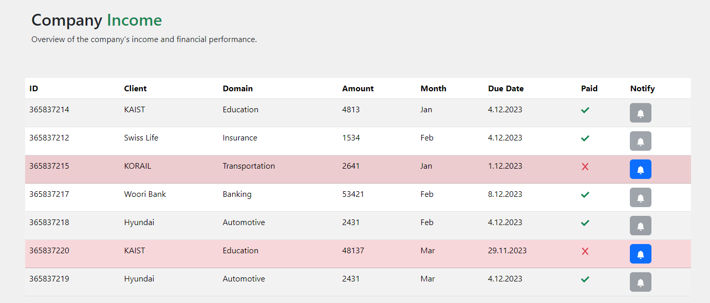
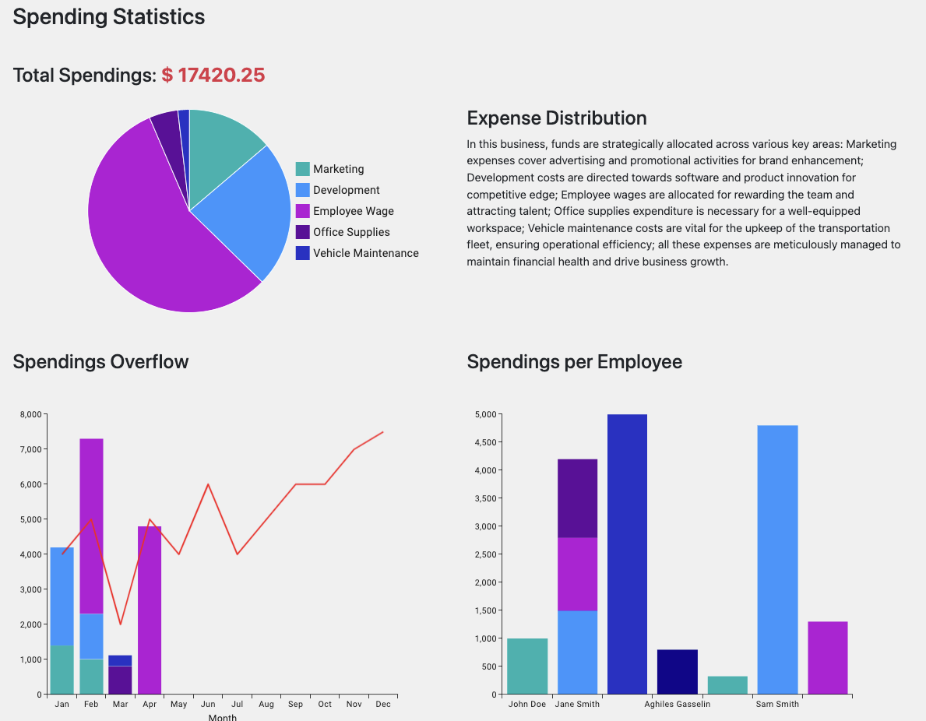

Slide 11
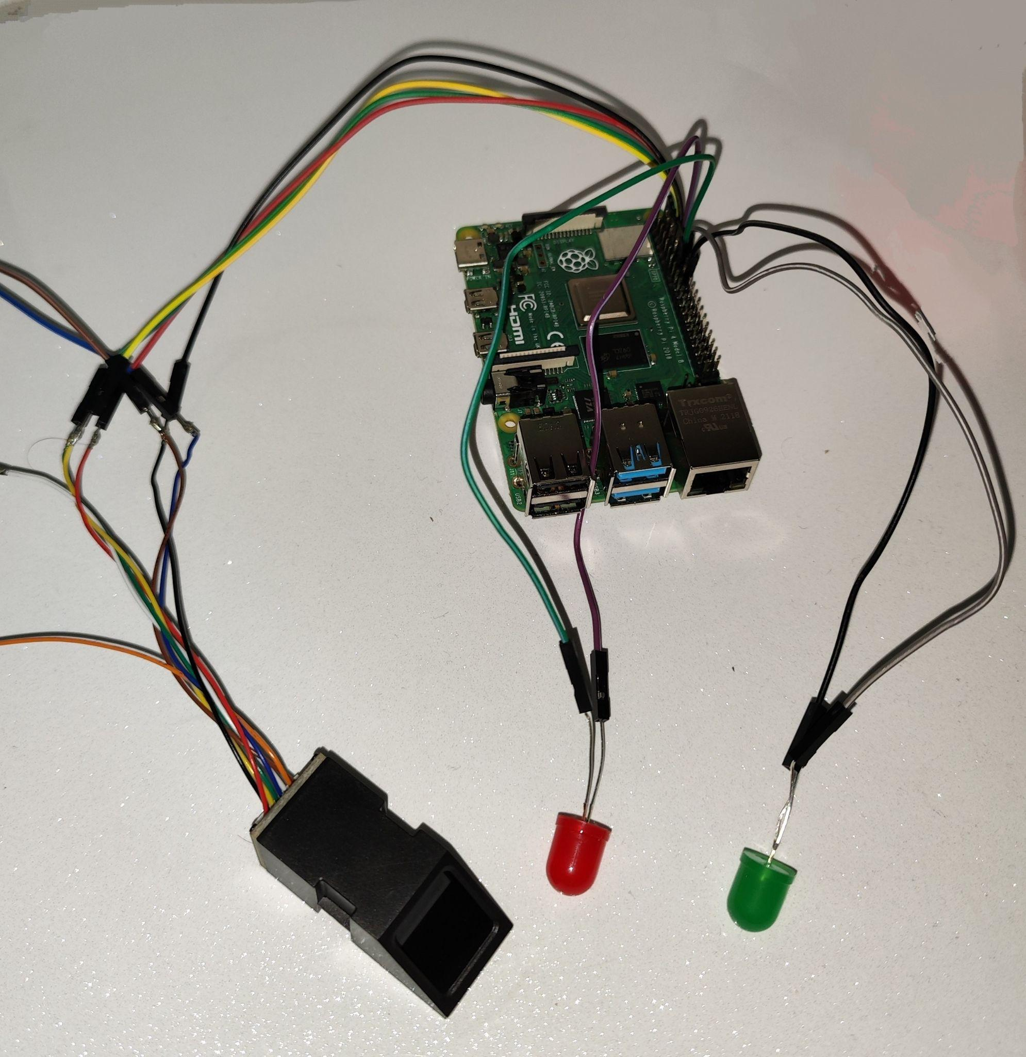
System Evaluation : The Pros
Unified Platform: various business functions into a single system.
Customizable & Scalable: specific needs and growth of startups and small enterprises
Enhanced Security: IoT technologies for secure access control and monitoring + login (data secured)
Operational Efficiency: Streamlines administrative processes, saving time and resources.
Data-Driven Insights: analytics for informed decision-making.
Cloud Deployment: high availability and scalability of services.
IoT devices controlling the entrance in the building

Slide 12

System Evaluation : The Cons
Complexity in Integration: merging various functionalities into one system == challenges.
Learning Curve: new dev may require more knowledge on each tech.
Hardware Reliability: IoT devices == performance and reliability have to be perfect.
Limited Real-World Testing: platform not tested and proven in real life scenarios
Adaptation to Rapid Changes: fast-evolving business world -> keeping the platform updated can be a challenge.
Inflexibility on Services: modularity cannot be infinite
https://www.google.com/url?sa=i&url=https%3A%2F%2Fpestleanalysis.com%2Fpros-and-cons-list-make-decisions%2F&psig=AOvVaw2DQYVpxcA_fHB_wad0U-r7&ust=1701394194589000&source=images&cd=vfe&opi=89978449&ved=0CBIQjRxqFwoTCNj88bbJ6oIDFQAAAAAdAAAAABAt

Slide 13

Conclusion - Lessons Learned
Use of web services
Integration not always easy
UML Diagrams for visualization and general understanding but time consuming
How to apply SOA (top down & bottom up)
Existing code / library -> make development faster and easier
Learn new technologies (React, Express, Adafruit library)
Fast project setup from template but less lessons
Work as a team in a relatively short time frame
Expectations between teammates (questions on technologie/design)
https://www.google.com/url?sa=i&url=https%3A%2F%2Fwww.pragmaticpmo.com%2Flessons-learned-specific-or-universal%2F&psig=AOvVaw2tD1ed69NxP_xjcRtz3Iwu&ust=1701394997604000&source=images&cd=vfe&opi=89978449&ved=0CBIQjRxqFwoTCMiW4bXM6oIDFQAAAAAdAAAAABAE

Slide 14
Thank you for your attention!
Any Questions?

