Slide 1

Building portable and scalable bioinformatics workflows using Common Workflow Language
Michael Kotliar
Andrey Kartashov
Artem Barski
Barski Lab
CCHMC
Thanks Erica Depasquale for the R scripts
Notes:
CWL is a way to describe command line tools and connect them together to create workflows.
Because CWL is a specification and not a specific piece of software, tools and workflows described using CWL are portable across a variety of platforms that support the CWL standard.

Slide 2
STEP 1:
software installation
>_ beginner level
Rabix Composer
Windows https://github.com/rabix/composer/releases/download/1.0.0/rabix-composer.Setup.1.0.0.exe
MacOS https://github.com/rabix/composer/releases/download/1.0.0/rabix-composer-1.0.0.dmg
Ubuntu https://github.com/rabix/composer/releases/download/1.0.0/rabix-composer-1.0.0-x86_64.AppImage
Java Development Kit 8+
Windows/MacOS/Ubuntu
http://www.oracle.com/technetwork/java/javase/downloads/jdk8-downloads-2133151.html
>_ advanced level
Docker
Windows 10 https://download.docker.com/win/stable/Docker%20for%20Windows%20Installer.exe
Windows < 10 https://download.docker.com/win/stable/DockerToolbox.exe
MacOS https://download.docker.com/mac/stable/Docker.dmg
Ubuntu https://docs.docker.com/install/linux/docker-ce/ubuntu/
>_ jedi level
cwltool
MacOS pip install cwltool
Java Development Kit 8+
MacOS brew cask install java
Docker
MacOS brew cask install docker
Notes:
===CLICK===
Rabix Composer is an open-source development kit for creating computational workflows in the Common Workflow Language (CWL).
It provides an intuitive, visual editor to view and edit CWL tools and workflows.
To install the latest stable version of Rabix Composer follow the provided links. Chose the link depending on the Operating System you use.
In latest version Rabix Composer also includes Rabix Executor that allows to run workflows on your local machine.
===CLICK===
Rabix Executor is written on Java. Therefore to execute CWL workflows Java Development Kit should be installed. Open the provided link and chose the version that corresponds to you Operating System Type.
===CLICK===
Additionally, Docker must be present in your system. Docker is a computer program that performs operating-system-level virtualization, also known as "containerization”.
Docker is used to run software packages called "containers” in isolated environments. To make it clearer, lets assume that it works like any other virtual machine that you might use in Virtual Box, for example.
We are not going to use it in our examples, but it’s a required dependency for Rabix Composer to work. To install Docker follow one of the links depending on your Operating System Type.
===CLICK===
And if you are one of those who “feels the force”, you can install all these programs using your console. However, we will not cover how to become a Jedi in this workshop.

Slide 3
Step 2:
wrap “ECHO” command in cwl
echo.yml
Type in the console
message: Hello World
echo.yml
>_ echo Hello World > echo.txt
echo.cwl
cwlVersion: v1.0
class: CommandLineTool
inputs:
message:
type: string
inputBinding:
position: 1
outputs: echo_file: type: File
outputBinding: glob: "*" stdout: "echo.txt”
baseCommand: echo
CommandLineTool
inputs
message
baseCommand
echo
outputs
echo_file
echo.txt
echo.txt
Hello World
Notes:
To undestand what it’s all about and how to use it, let’s look at the examples.
===CLICK===
Let’s say we want to wrap in CWL the simplest command – "echo".
If you type this in your console, the “Hello World” will be saved into the file “echo.txt”.
===CLICK===
First thing we need to do if we want to wrap our "echo" command in CWL is to decide what are our inputs and outputs.
Also, we need to chose the names for these inputs and outputs.
As you can see, we have only on input (let’s call it “message”) and only one output (let’s call it "echo_file").
We will use “message” to pass our “Hello World” to the baseCommand “echo”, and “echo_file” to return the results to the text file.
===CLICK===
Next step is to figure out how to pass the value to our input “message”.
===CLICK===
The simplest way is to read it from the so called job file. In our case this file has name “echo.yml”.
You don’t need any job files in the exercises you will do later, because Rabix Composer will do it for you.
However, it’s always good to know how it’s all organized on the lower level.
===CLICK===
The results will be always saved into the text file “echo.txt”. The output filename is hardcoded.
It was made intentionally to simplify the example.
Later we will have the separate workflow step to save the output with the custom name.
===CLICK===
Once we have an idea how the CWL version of ”echo” command should look like, we can start writing the code of our CWL file.
I’ll briefly explain every line of the code.
We always start our CWL file with the cwlVersion field.
It indicates the version of the CWL we are going to use.
The latest stable version is v1.0. Different versions might have slightly different syntax.
The class field indicates that this document describes a CommandLineTool.
It means that we are going to describe one single command, not the workflow.
Workflows may sequentially (or sometimes in parallel) run several commands.
We’ll see how to write the Workflow in the next example.
The baseCommand provides the name of the program that will actually run.
In our case it’s “echo”.
The inputs section describes the inputs of the tool.
Here we have list of inputs that includes only one input.
This input has and identifier “message” with the data type “string”.
You can also use other data types such as int, long, float, double, null, File, Directory.
inputBinding field describes how this input parameter should appear on the command line.
In this example, the position field indicates that the value passed to “message” input should appear on the first position after “echo" baseCommand.
Position field is optional. There are other alternatives that you can use instead of position field, but you cannot avoid using inputBinding field.
Otherwise, this input will not appear in your command line.
The outputs of a tool is a list of output parameters that should be returned after running the tool.
In out case we have only one output with the name “echo_file”.
Every output should also have a type describing what type of data should be returned from the tool.
In our case the data type is File
The field outputBinding describes how to to set the value of our “echo_file” output.
In this particular example we use the field “glob” with the wildcard pattern ”*”.
It will return any file generated by our “echo” basecCommand.
The stdout field is used to capture a tool’s standard output stream and redirect it to the file “echo.txt”
===CLICK===
Here we can see how our job file may look like.
It’s a simple YAML file where you set the value for our input "message".
Alternatively you can use JSON formatted job file.
===CLICK===
And this is how the output file may look like.

Slide 4
Step 3.1:
combine two steps in a wokrflow
echo-rename.cwl
echo.cwl
rename.cwl
cwlVersion: v1.0
class: CommandLineTool
inputs:
message:
type: string
inputBinding:
position: 1
outputs: echo_file: type: File
outputBinding: glob: "*" stdout: "echo.txt”
baseCommand: echo
inputs
cwlVersion: v1.0 class: CommandLineTool inputs: src_file: type: File inputBinding: position: 1 trgt_filename: type: string inputBinding: position: 2 outputs: renamed_file: type: File outputBinding: glob: "*" baseCommand: cp
message
trgt_filename
STEPS
echo: echo.cwl
in
out
rename: rename.cwl
in
out
outputs
renamed_file
Notes:
The next example illustrates you how to combine two command line tools in a workflow.
We already have our echo command line tool that exports results into the echo.txt file.
What if we want to save results with the different name?
Moreover, what if we want to chose the output filename every time we execute our workflow.
Of course, the easiest way is to add another input into our echo command line tool, but that is too easy.
Instead, we will create another command line tool, that will rename the results of the echo step.
Later, both command line tools will be combined in a workflow.
===CLICK===
Let's look at the structure of this workflow
We have two inputs. The first one (”message”) will be used to set the text we want to save into the output file.
This is the input we use to pass our “Hello World” string.
Another input “trgt_filename” should be used to set the name of the output file (instead of our “echo.txt”)
Workflow should have two steps. Let’s call then “echo” and “rename”.
“rename” step should get the output of the “echo” step and also the “trgt_filename” from the workflow inputs.
The workflow results will be returned using the output with the name “renamed_file”
===CLICK===
We already have “echo” command line tool that we created on the previous slide.
However, we need another tool tool that will rename the file we get from “echo” step.
===CLICK===
This is how the "rename" command line tool should look like.
The major difference between "echo" and "rename" tools is that the later has two inputs instead of one.
Input “src_file” defines the file we want to rename. It has a type set to "File".
Another input “trgt_filename” has a string type. It’s used to set new name for “echo.txt” file.
The "baseCommand" here is a simple “cp”.
Renamed file is returned as "renamed_file" output, that has data type "File" and "outputBinding" field with the "glob" set to “*”

Slide 5
Step 3.2:
combine two steps in a wokrflow
echo-rename.yml
echo-rename.cwl
echo-rename.yml
cwlVersion: v1.0 class: Workflow inputs: message: type: string trgt_filename: type: string outputs: renamed_file: type: File outputSource: rename/renamed_file steps: echo: run: ../tools/echo.cwl in: message: message out: [echo_file] rename: run: ../tools/rename.cwl in: src_file: echo/echo_file trgt_filename: trgt_filename out: [renamed_file]
message: Hello World trgt_filename: renamed.txt
echo-rename.cwl
inputs
message
trgt_filename
STEPS
echo: echo.cwl
message
message
in
echo_file
out
rename: rename.cwl
echo_file
src_file
in
trgt_filename
trgt_filename
renamed_file
out
outputs
renamed_file
renamed.txt
Hello World
renamed.txt
Notes:
Let’s take a closer look at this workflow
===CLICK===
Here we can see our workflow that consists of two steps: "echo" and "rename".
It has two inputs: "message" and "trgt_filename", and only one output – "renamed_file".
There isn’t any "baseCommand" fileds, because each step has its own command to run.
Every step has also a special field ”run” that points to the location of correposndent CWL command line tool file.
Another difference that you might notice is that the "class" is now set to "Workflow."
We also have slightly different structure of our inputs and outputs.
For inputs we don’t need to specify "inputBinding" anymore, because we don’t have any "baseCommand"s to run.
Outputs don’t have any "outputBinding" fileds. Instead we use "outputSource" that points the the name of the step and name of the output from that step to return value from.
When we run our workflow the value from the input “message” is passed as an input ”message” of the echo step.
When echo step is finished, it’s output "echo_file" is passed to the "rename" step as “src_file” input.
Additionally wokflow input “trgt_filename” is also passed to the "rename" step as “trgt_filename” input.
When "rename" step is finished, it’s results "renamed_file" is returned from the workflow as “rename_file” (using "outputSouce" field)
===CLICK===
This is an example of how the input job file may look like
===CLICK===
And this is how the workflow output file may look like if we had used our job file.

Slide 6
Step 4:
Wrap your own R script in cwl
>_ clean_up_data.R
>_ run_t_test.R
>_ make_heatmap.R
>>> hint 1
./tools/clean_up_data.cwl
./tools/run_t_test.cwl
./tools/make_heatmap.cwl
>>> hint 2
inputs: gct_file
outputs: cleaned_gct_file
baseCommand:
- Rscript
- /path/to/clean_up_data.R
inputs: cleaned_gct_file
outputs: p_value_file
baseCommand:
- Rscript
- /path/to/run_t_test.R
inputs: cleaned_gct_file
p_value_file outputs: heatmap_file baseCommand:
- Rscript
- /path/to/make_heatmap.R
>>> hint 3
outputBinding: glob: "*"
>>> hint 4
Script produces only one output file and saves it to the current folder

Slide 7
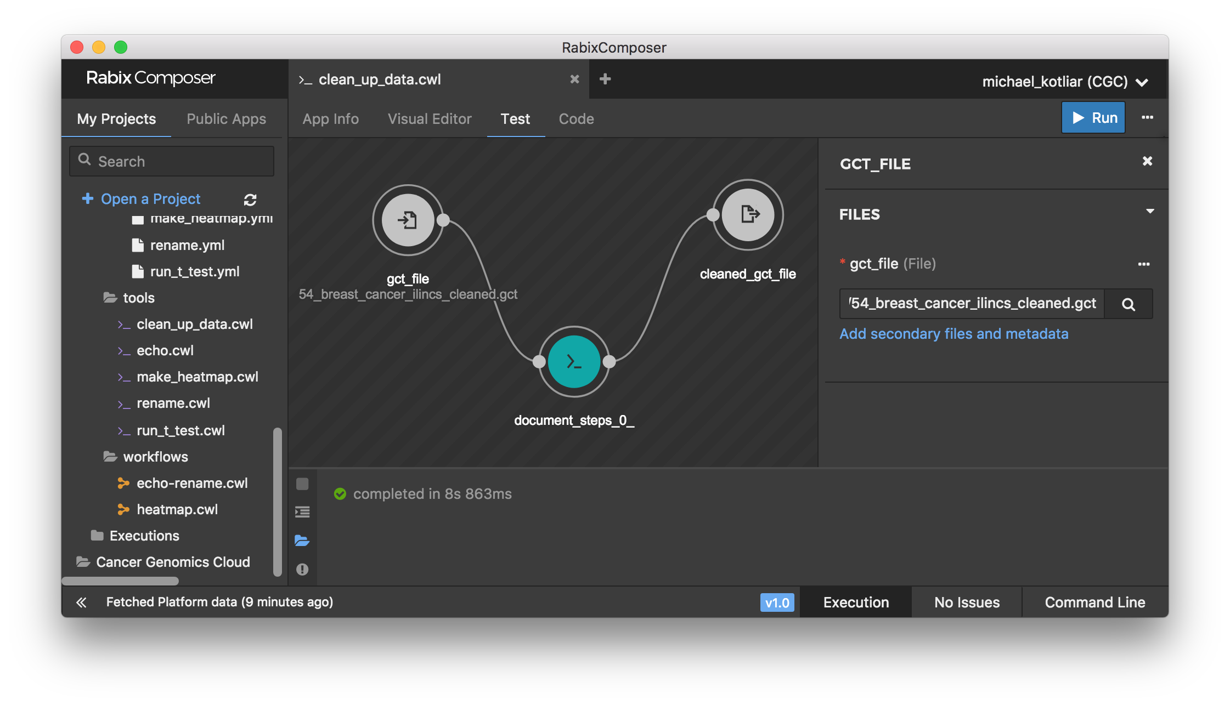
Step 5:
test what you have just created
1
2
3
4
5
6
7

Slide 8
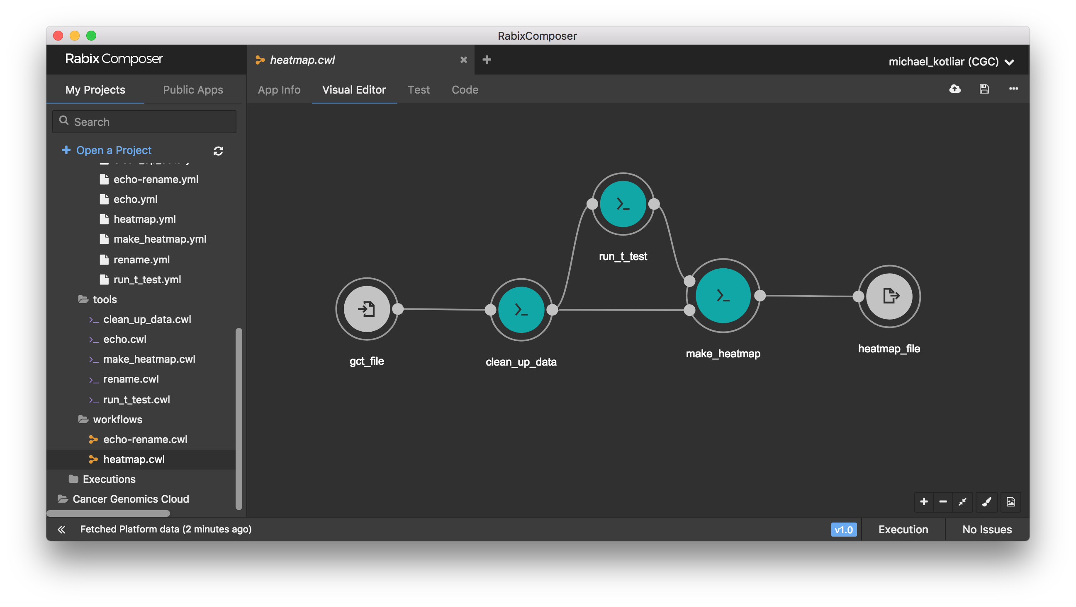
Step 6:
combine three steps in a wokrflow

Slide 9
Step 7.1:
update your wokrflow. fix make_heatmap script
Find the line where you filter your data by p-value
>_ make_heatmap.R
<some lines of code>
#reduce to top n significant genes n=min(500, length(which(statistics_data[,4]<=0.05)))
>_ make_heatmap_updated.R
<some lines of code>
max_p_value = as.character(args[3])
<some lines of code>
#reduce to top n significant genes n=min(500, length(which(statistics_data[,4]<=max_p_value)))
Remove hardcoded 0.05 for p-value filtering. Read p-value as a command line argument.

Slide 10
Step 7.2:
update your wokrflow. fix make_heatmap tool
>_ make_heatmap.cwl
>_ make_heatmap_updated.cwl
<some lines of code>
inputs: cleaned_gct_file: type: File inputBinding: position: 5 p_value_file: type: File inputBinding: position: 6
<some lines of code>
baseCommand: - Rscript - /path/to/make_heatmap.R
<some lines of code>
inputs: cleaned_gct_file: type: File inputBinding: position: 5 p_value_file: type: File inputBinding: position: 6
max_p_value: type: float inputBinding: position: 7
<some lines of code>
baseCommand: - Rscript - /path/to/make_heatmap_updated.R
Add input to set desired p-value
Update baseCommand

Slide 11
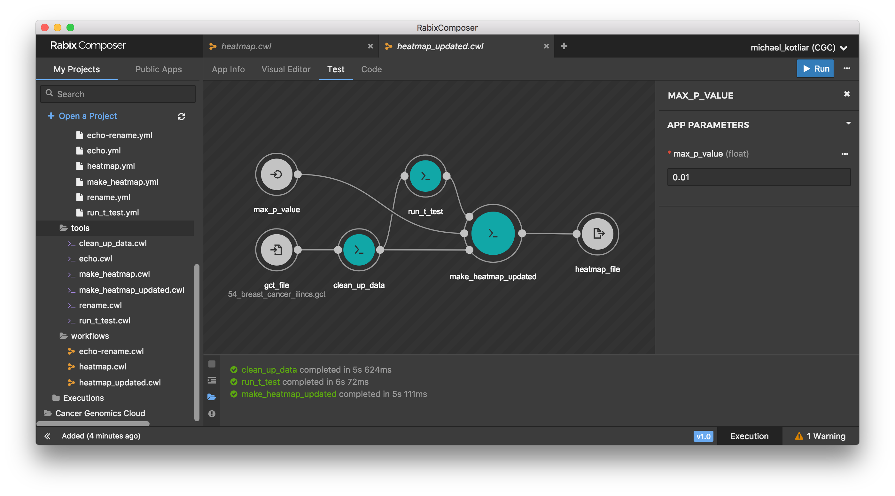
Step 7.3:
update your wokrflow. fix heatmap workflow

Slide 12
Step 8:
for those who wants to know more
>_ CWL executors
>_ CWL standards *
cwltool https://github.com/common-workflow-language/cwltool
CWL-Airflow https://github.com/Barski-lab/cwl-airflow
rabix http://rabix.io
toil https://github.com/DataBiosphere/toil
https://www.commonwl.org/
>_ Have a question?
Gitter
https://gitter.im/common-workflow-language/common-workflow-language
Biostars
https://www.biostars.org/t/cwl
Google Groups
https://groups.google.com/forum/#!forum/common-workflow-language
>_ CWL workflows
Barski Lab https://github.com/Barski-lab/workflows
Cancer Genomics Cloud https://cgc.sbgenomics.com/public/apps
Dockstore https://dockstore.org
>_ Containerized tools
Docker Hub https://hub.docker.com
Biocontainers https://biocontainers.pro
QUAY https://quay.io
>_ Useful links
CWL Viewer https://view.commonwl.org/workflows
Atom Plugin https://github.com/manabuishii/language-cwl
VS Code Plugin https://github.com/manabuishii/vscode-cwl
IntelliJ Plugin https://gitlab.com/AleksandrSl/cwl-plugin

