Slide 1

Building portable and scalable bioinformatics workflows using Common Workflow Language
Michael Kotliar
Andrey Kartashov
Artem Barski
Barski Lab
CCHMC
Thanks Erica Depasquale for the R scripts

Slide 2
STEP 1:
software installation
>_ beginner level
Rabix Composer
Windows https://github.com/rabix/composer/releases/download/1.0.0/rabix-composer.Setup.1.0.0.exe
MacOS https://github.com/rabix/composer/releases/download/1.0.0/rabix-composer-1.0.0.dmg
Ubuntu https://github.com/rabix/composer/releases/download/1.0.0/rabix-composer-1.0.0-x86_64.AppImage
Java Development Kit 8+
Windows/MacOS/Ubuntu
http://www.oracle.com/technetwork/java/javase/downloads/jdk8-downloads-2133151.html
>_ advanced level
Docker
Windows 10 https://download.docker.com/win/stable/Docker%20for%20Windows%20Installer.exe
Windows < 10 https://download.docker.com/win/stable/DockerToolbox.exe
MacOS https://download.docker.com/mac/stable/Docker.dmg
Ubuntu https://docs.docker.com/install/linux/docker-ce/ubuntu/
>_ jedi level
cwltool
MacOS pip install cwltool
Java Development Kit 8+
MacOS brew cask install java
Docker
MacOS brew cask install docker

Slide 3
Step 2:
wrap “ECHO” command in cwl
echo.yml
Type in the console
message: Hello World
echo.yml
>_ echo Hello World > echo.txt
echo.cwl
cwlVersion: v1.0
class: CommandLineTool
inputs:
message:
type: string
inputBinding:
position: 1
outputs: echo_file: type: File
outputBinding: glob: "*" stdout: "echo.txt”
baseCommand: echo
CommandLineTool
inputs
message
baseCommand
echo
outputs
echo_file
echo.txt
echo.txt
Hello World

Slide 4
Step 3.1:
combine two steps in a wokrflow
echo-rename.yml
echo-rename.cwl
echo.cwl
rename.cwl
cwlVersion: v1.0
class: CommandLineTool
inputs:
message:
type: string
inputBinding:
position: 1
outputs: echo_file: type: File
outputBinding: glob: "*" stdout: "echo.txt”
baseCommand: echo
inputs
cwlVersion: v1.0 class: CommandLineTool inputs: src_file: type: File inputBinding: position: 1 trgt_filename: type: string inputBinding: position: 2 outputs: renamed_file: type: File outputBinding: glob: "*" baseCommand: cp
message
trgt_filename
STEPS
echo: echo.cwl
in
out
rename: rename.cwl
in
out
outputs
renamed_file
renamed.txt
Notes:
CWL specification defines the structure of the three basic components. First of them is Command Line tool

Slide 5
Step 3.2:
combine two steps in a wokrflow
echo-rename.yml
echo-rename.yml
echo-rename.cwl
cwlVersion: v1.0 class: Workflow inputs: message: type: string trgt_filename: type: string outputs: renamed_file: type: File outputSource: rename/renamed_file steps: echo: run: ../tools/echo.cwl in: message: message out: [echo_file] rename: run: ../tools/rename.cwl in: src_file: echo/echo_file trgt_filename: trgt_filename out: [renamed_file]
message: Hello World trgt_filename: renamed.txt
echo-rename.cwl
inputs
message
trgt_filename
STEPS
echo: echo.cwl
message
message
in
echo_file
out
rename: rename.cwl
echo_file
src_file
in
trgt_filename
trgt_filename
renamed_file
out
outputs
renamed_file
renamed.txt
Hello World
renamed.txt
Notes:
CWL specification defines the structure of the three basic components. First of them is Command Line tool

Slide 6
Step 4:
Wrap your own R script in cwl
>_ clean_up_data.R
>_ run_t_test.R
>_ make_heatmap.R
>>> hint 1
./tools/clean_up_data.cwl
./tools/run_t_test.cwl
./tools/make_heatmap.cwl
>>> hint 2
inputs: gct_file
outputs: cleaned_gct_file
baseCommand:
- Rscript
- /path/to/clean_up_data.R
inputs: cleaned_gct_file
outputs: p_value_file
baseCommand:
- Rscript
- /path/to/run_t_test.R
inputs: cleaned_gct_file
p_value_file outputs: heatmap_file baseCommand:
- Rscript
- /path/to/make_heatmap.R
>>> hint 3
outputBinding: glob: "*"
>>> hint 4
Script produces only one output file and saves it to the current folder

Slide 7
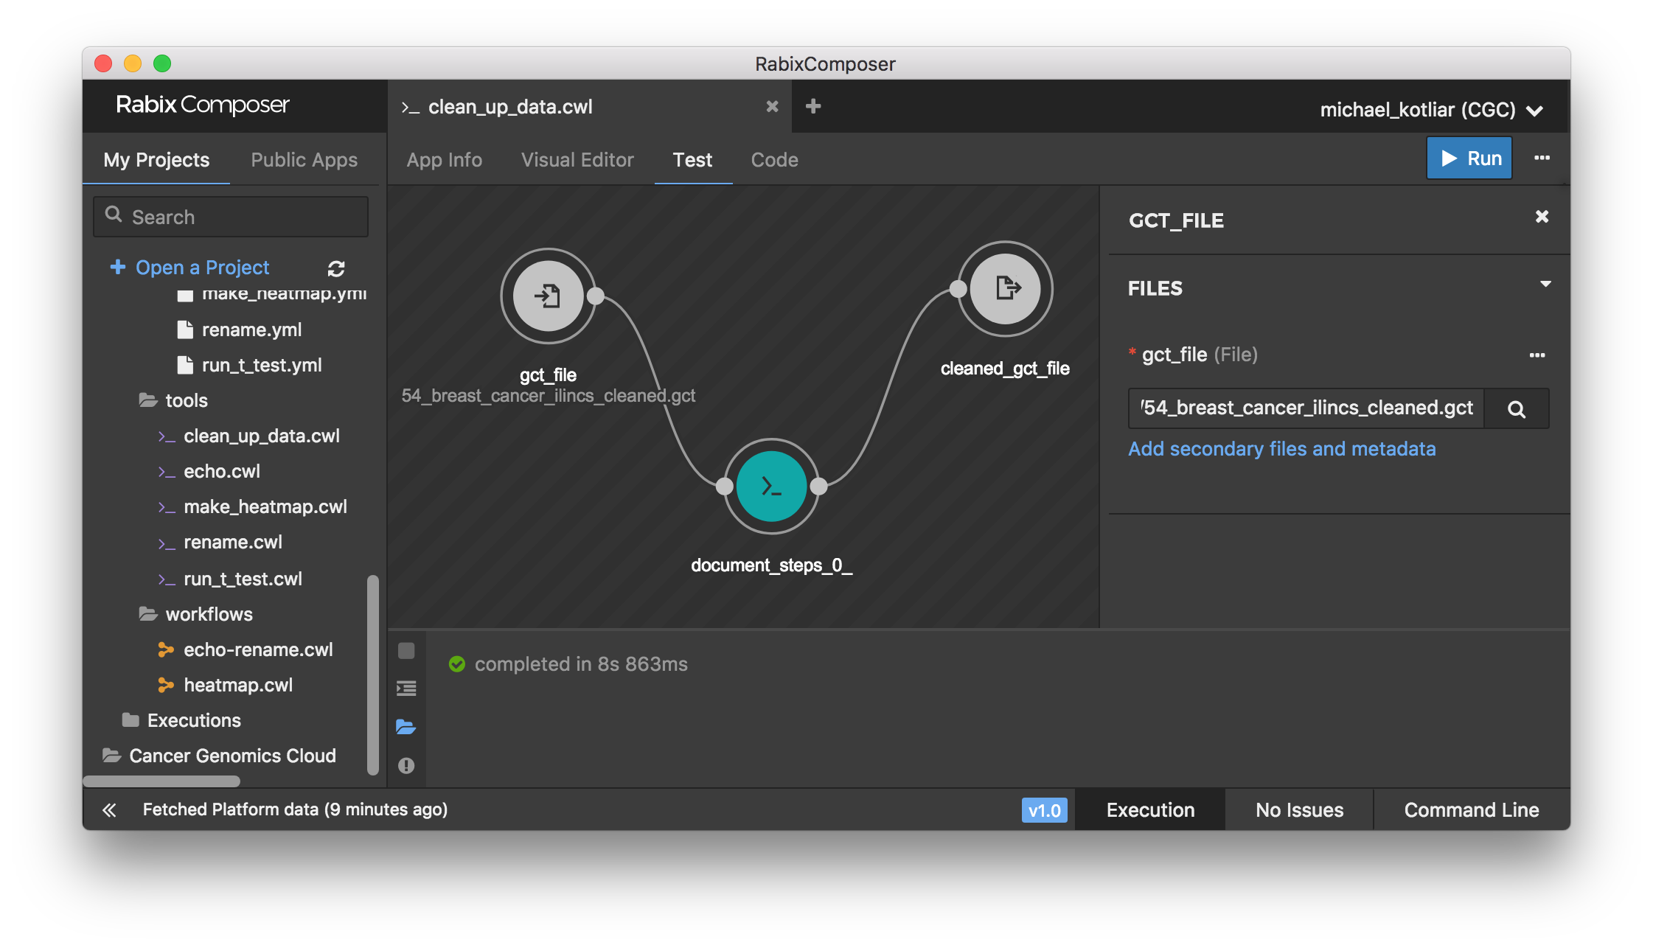
Step 5:
test what you have just created
1
2
3
4
5
6
7

Slide 8
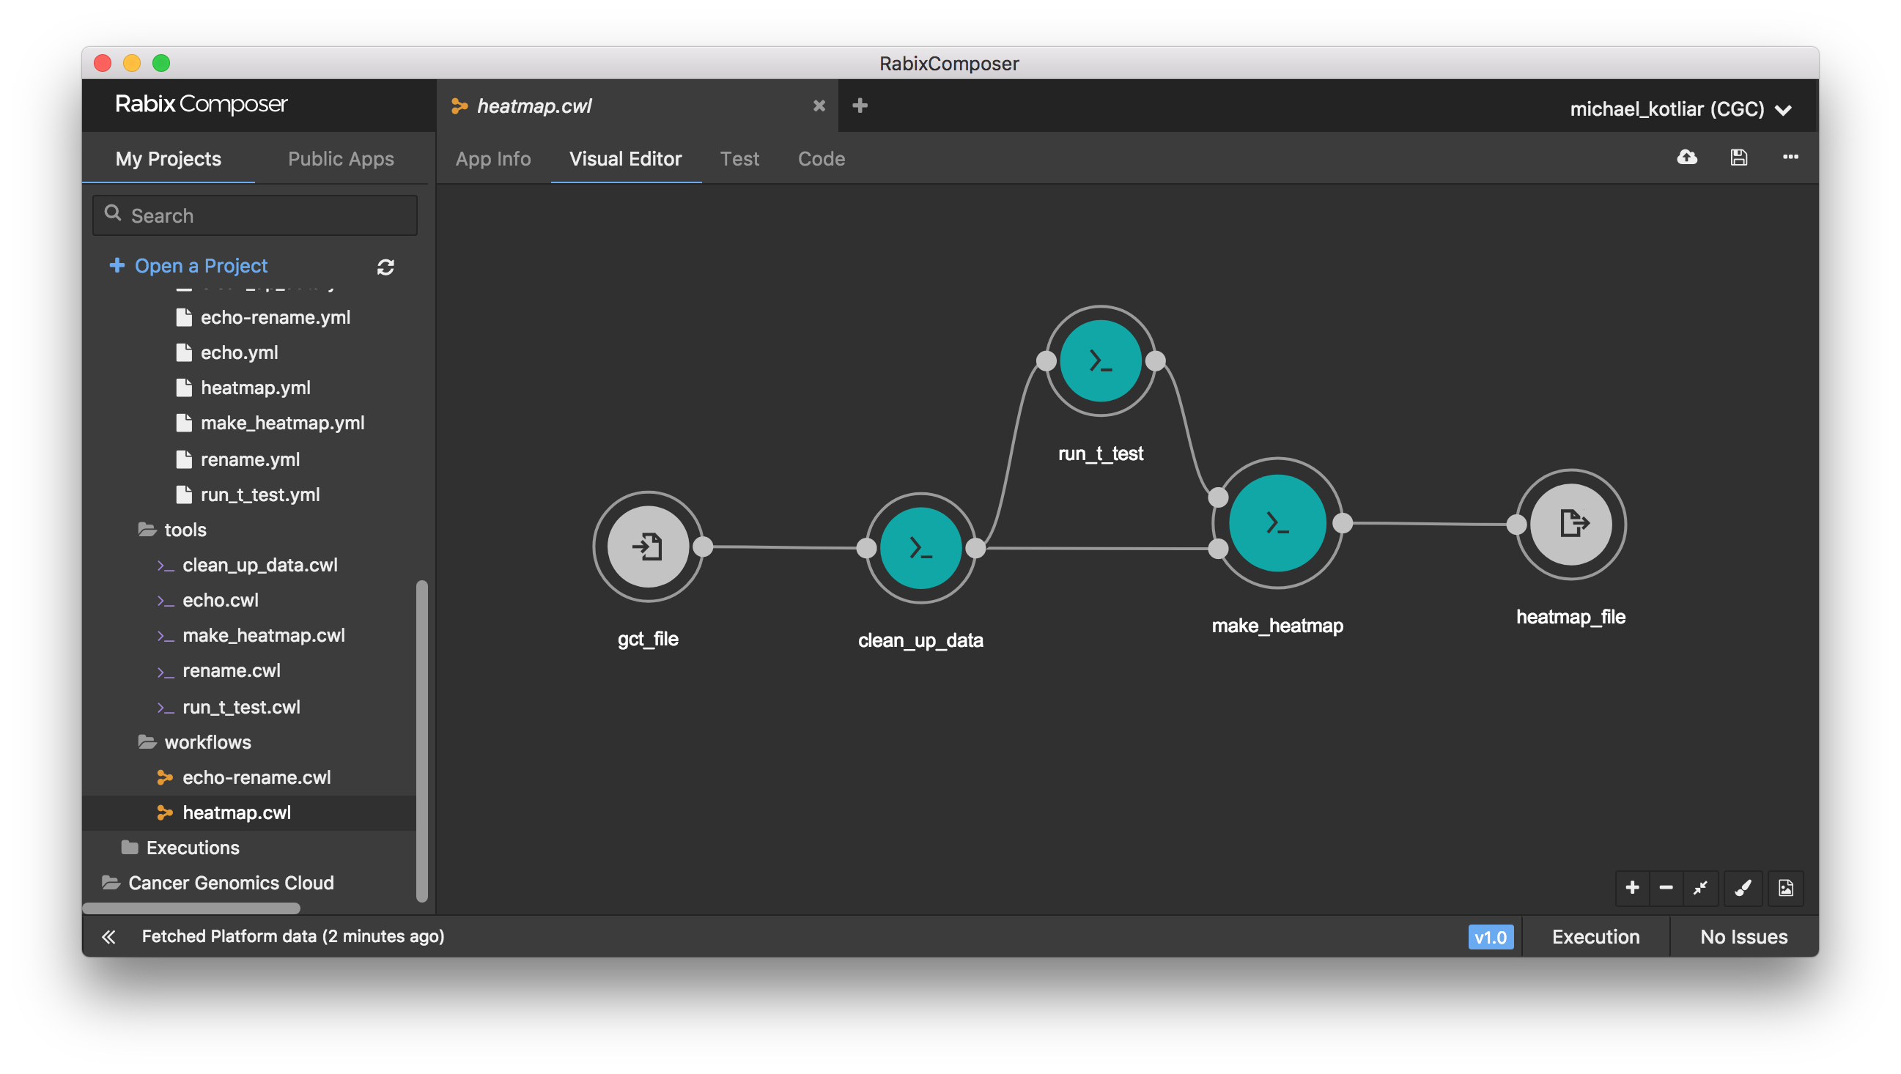
Step 6:
combine three steps in a wokrflow

Slide 9
Step 7.1:
update your wokrflow. fix make_heatmap script
Find the line where you filter your data by p-value
>_ make_heatmap.R
<some lines of code>
#reduce to top n significant genes n=min(500, length(which(statistics_data[,4]<=0.05)))
>_ make_heatmap_updated.R
<some lines of code>
max_p_value = as.character(args[3])
<some lines of code>
#reduce to top n significant genes n=min(500, length(which(statistics_data[,4]<=max_p_value)))
Remove hardcoded 0.05 for p-value filtering. Read p-value as a command line argument.

Slide 10
Step 7.2:
update your wokrflow. fix make_heatmap tool
>_ make_heatmap.cwl
>_ make_heatmap_updated.cwl
<some lines of code>
inputs: cleaned_gct_file: type: File inputBinding: position: 5 p_value_file: type: File inputBinding: position: 6
<some lines of code>
baseCommand: - Rscript - /path/to/make_heatmap.R
<some lines of code>
inputs: cleaned_gct_file: type: File inputBinding: position: 5 p_value_file: type: File inputBinding: position: 6
max_p_value: type: float inputBinding: position: 7
<some lines of code>
baseCommand: - Rscript - /path/to/make_heatmap_updated.R
Add input to set desired p-value
Update baseCommand

Slide 11
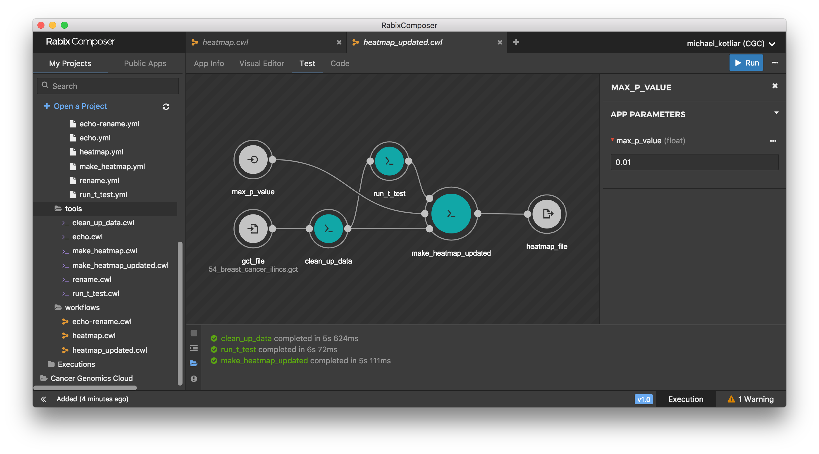
Step 7.3:
update your wokrflow. fix heatmap workflow

Slide 12
Step 8:
for those who wants to know more
>_ CWL executors
>_ CWL standards *
cwltool https://github.com/common-workflow-language/cwltool
CWL-Airflow https://github.com/Barski-lab/cwl-airflow
rabix http://rabix.io
toil https://github.com/DataBiosphere/toil
https://www.commonwl.org/
>_ Have a question?
Gitter
https://gitter.im/common-workflow-language/common-workflow-language
Biostars
https://www.biostars.org/t/cwl
Google Groups
https://groups.google.com/forum/#!forum/common-workflow-language
>_ CWL workflows
Barski Lab https://github.com/Barski-lab/workflows
Cancer Genomics Cloud https://cgc.sbgenomics.com/public/apps
Dockstore https://dockstore.org
>_ Containerized tools
Docker Hub https://hub.docker.com
Biocontainers https://biocontainers.pro
QUAY https://quay.io
>_ Useful links
CWL Viewer https://view.commonwl.org/workflows
Atom Plugin https://github.com/manabuishii/language-cwl
VS Code Plugin https://github.com/manabuishii/vscode-cwl
IntelliJ Plugin https://gitlab.com/AleksandrSl/cwl-plugin

