Slide 1





Consumer Assessment of
Wrigley’s Alpine Gum
Group Members:
Adam Benner
Michael Casserly
Christine Chen
Michelle Halabaso
Anide Jean
April 22, 2004

Slide 2
Agenda
Background
Objective
Research Goals
Executive Summary
Methodology
Analytical Findings
Implications

Slide 3
Background
  Wrigley is considering an introduction of Alpine gum into the U.S. market.
  Alpine, an existing Wrigley’s gum only available in Canada and a part of the cough drop/gum category, eases sore throat pain.
  Alpine reached 7% market share in Canada in the cough drop/gum category after only 2 years of its entrance into the market.

Slide 4
Objective
  Should Alpine sore throat gum attempt to enter the U.S. market and take on the top three competitors—Halls, Ricola, and Cold Eeze?

Slide 5
Research Goals
  Primary Goal:
    Determine whether Alpine gum should enter the U.S. market.
  Secondary Goal:
    Determine whether a consumer would choose Alpine gum over a non-gum cough drop competitor.

Slide 6
Executive Summary
Customer acquisition as opposed to customer retention
Findings indicate there are two target groups who have a high propensity to purchase gum and/or hard candy.
    Primary Target: 47.5% heavy users with propensity
    Secondary Target: 31.25% light users with propensity
The most important product attributes in a gum and cough relief product:
  Primary Target: Heavy Users w/ Propensity
    Gum: right shape
    Cough relief: different flavors
  Secondary Target: Light Users w/ Propensity
    Gum: freshens breath
    Gum and cough relief: tastes good

Slide 7
Methodology
Population of Interest
  Population of gum and/or hard candy users
Sample Size
  n = 90
Sample Problems
  Sample is a non-probability sample, but this was the best alternative given the research parameters.
Sampling Method
  Quantitative survey
    Entire sample was either a category user or related category user.
Analytical Procedure
  Conducted a light user run and profiles to identify heavy users
    Heavy users are defined as those who purchased gum and/or hard candy at least 6 times over the past two months.
  Assessed volumetric behavior and propensity to purchase

Slide 8
Data Collection
Contact Rate
  The percentage of people who are reached (before screening)
    100%: All 90 people were reached successfully.
Cooperation Rate
  The percentage of people who were contacted who actually agreed to participate in the study
    100%: All 90 people who were contacted actually agreed to participate in the study.
Completion Rate
  The percentage of people who cooperated and completed the study through the end.
    89%: Of the 90 people who cooperated, 80 completed the study.
100%
100%
89%

Slide 9
Findings

Slide 10
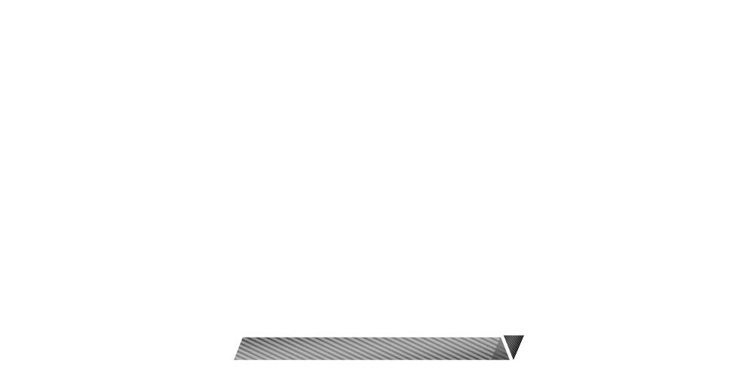
Non-Users
Non-Users
  Not likely to chew gum or
  eat hard candy in the next 2 weeks
  6.25% of respondents
  0% Category Volume
  All Caucasian
Green – Category Volume %
Blue – User %
Non Users 6.25% | 0% | 0 Index

Slide 11
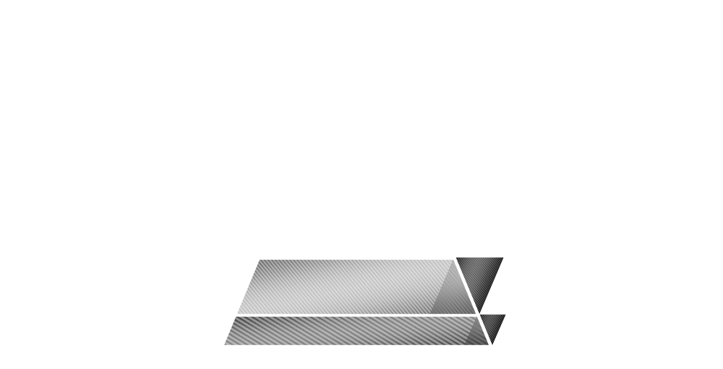
Light Users
w/ No Propensity
Light Users w/ No Propensity
  Light Users: Purchased 1-5x in the
  last 2 months
  11.25% of respondents
  3.87% of category volume
  No propensity to chew gum in
  the next 2 weeks
  No likelihood to purchase Alpine
  Ages 19+
Light Users w/ No Propensity
11.25% | 3.87% | 34 Index
Non Users 6.25% | 0% | 0 Index

Slide 12
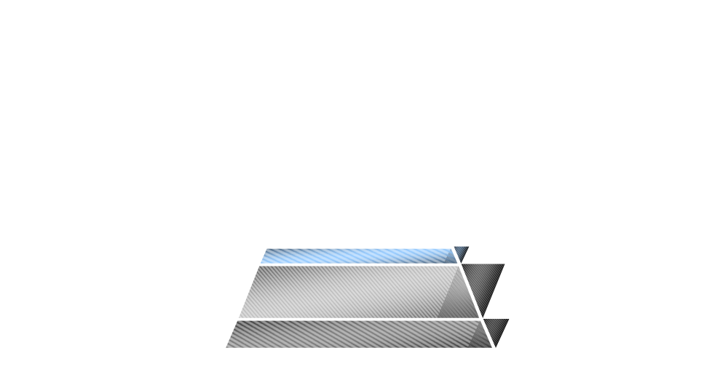
Heavy Users
w/ No Propensity
Heavy Users w/ No Propensity
  Heavy Users: Purchased
  6+ last 2 months
  3.75% of respondents
  4.26% of category volume
  No propensity to purchase gum in
  the next two weeks
  Expected price: $0.75 - $1.24
  Ages 19-30
Heavy Users w/ No Propensity
3.75% | 4.26% | 114 Index
Light Users w/ No Propensity
11.25% | 3.87% | 34 Index
Non Users 6.25% | 0% | 0 Index

Slide 13
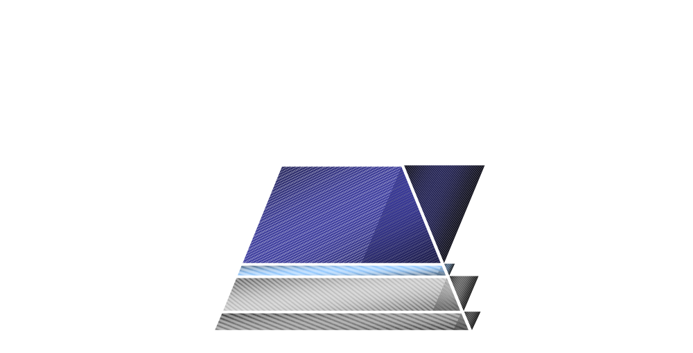
Light Users
w/ Propensity
Heavy Users / No Propensity
  Heavy Users (6+ last two months)
  3.75% of respondents
  4.26% of category volume
  No propensity to purchase gum in
  the next two weeks
  Felt the price .75 and1.24
  Aged 19-30
Light Users w/ Propensity
  Light Users: Purchased 1-5x in the
  last 2 months
  31.25% of respondents
  15.47% of category volume
  Very likely to chew gum in the next
  2 weeks
  Propensity to purchase Alpine
  Ages 19-50
Light Users w/ Propensity
31.25% | 15.47% | 50 Index
Heavy Users w/ No Propensity
3.75% | 4.26% | 114 Index
Light Users w/ No Propensity
11.25% | 3.87% | 34 Index
Non Users 6.25% | 0% | 0 Index

Slide 14

Heavy Users
w/ Propensity
Heavy Users
w/ Propensity
47.5% | 76.4% |
161 Index
Heavy Users w/ Propensity
  Heavy Users: Purchased
  6+ last two months
  47.5% of respondents
  76.4% of category volume
  Propensity to purchase Alpine
  Very likely to chew gum in the next
  2 weeks
  Ages 50 and under
  BEST targets
Light Users w/ Propensity
31.25% | 15.47% | 50 Index
Heavy Users w/ No Propensity
3.75% | 4.26% | 114 Index
Light Users w/ No Propensity
11.25% | 3.87% | 34 Index
Non Users 6.25% | 0% | 0 Index

Slide 15
Propensity to Buy with Primary and Secondary Targets
 | Segment | Group | Index
Primary Target: Heavy Users w/ Propensity | 15.79 | 13.75 | 115
Secondary Target: Light Users w/ Propensity | 20 | 13.75 | 145
Heavy Users No Propensity | 0 | 13.75 | 0
Light Users No Propensity | 0 | 13.75 | 0

Slide 16
Total Packs Purchased:
Volumetric Indices by Segment
 | % of Total Packs Purchased | % of Respondents | Index
Heavy Users w/ Propensity | 76.4 | 47.5 | 161
Heavy Users No Propensity | 4.26 | 3.75 | 113
Light Users w/ Propensity | 15.47 | 31.25 | 50
Light Users No Propensity | 3.87 | 11.25 | 34

Slide 17
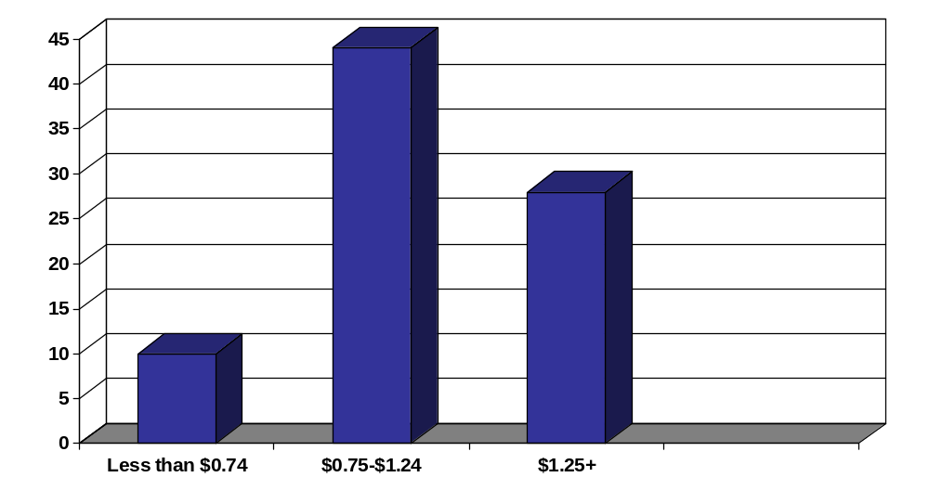
Expected Price Range of Alpine
Number of Respondents

Slide 18
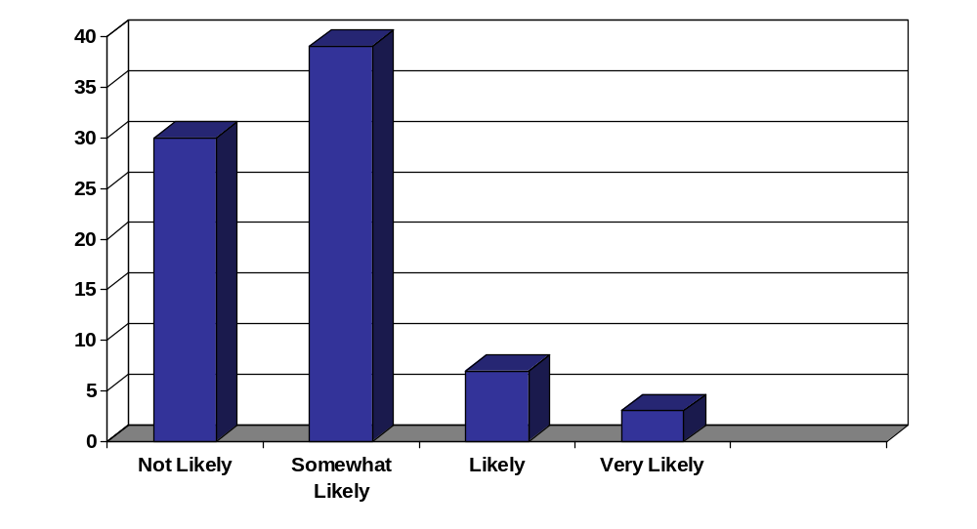
Likelihood of Purchasing Alpine after Trying It
Number of Respondents

Slide 19
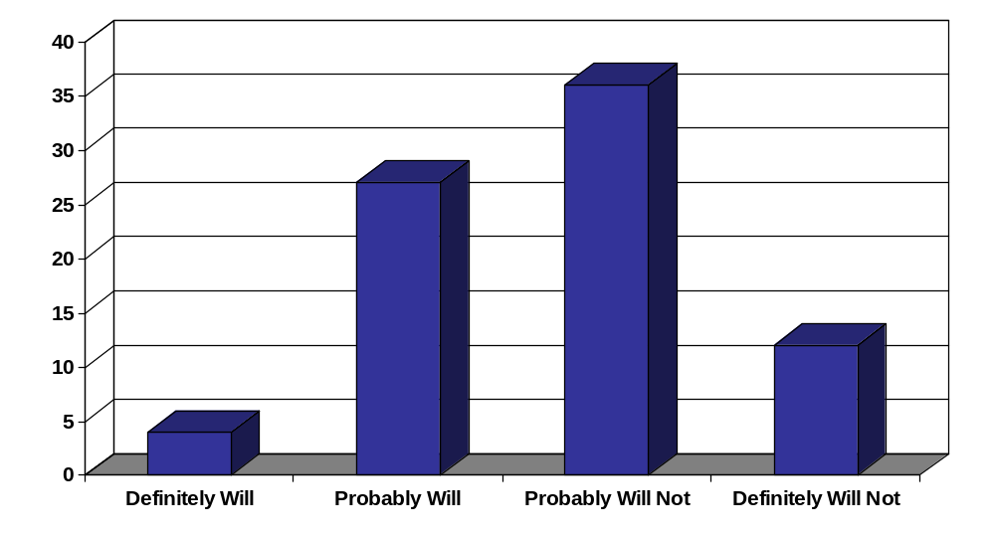
Likelihood to Recommend Alpine
Number of Respondents

Slide 20
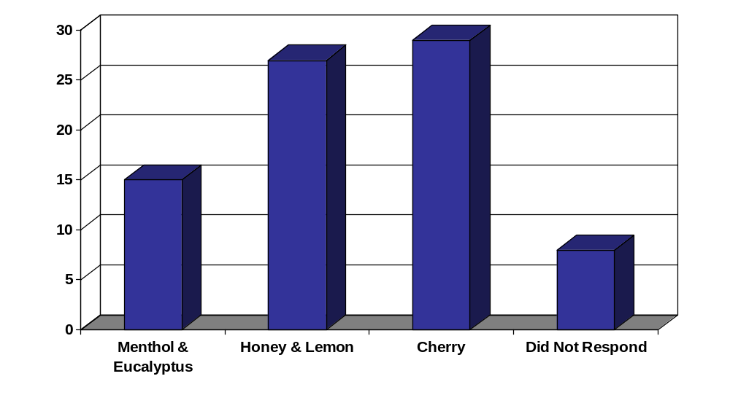
Favorite Alpine Flavor
Number of Respondents

Slide 21

Heavy Users with No Propensity value fresh breath and variety…
Heavy Users
w/ No Propensity
 | Total | Group | Index
Use hard candy as a breath freshener | 27.5 | 66.67 | 242
Prefer a cough relief product that is available everywhere | 49.35 | 66.67 | 135
Prefer cough relief that offers different flavors | 39.74 | 66.67 | 168

Slide 22
…and place no value on brand name, fast relief, or price.
Heavy Users
w/ No Propensity
 | Total | Group | Index
Prefer brand name gum | 48.1 | 0 | 0
Prefer gum with easy, fast relief | 49.35 | 0 | 0
Prefer cough relief that’s priced right | 52.56 | 0 | 0

Slide 23

Light Users with Propensity value price, taste, and a variety of flavors…
Light Users w/ Propensity
 | Total | Group | Index
Prefer gum that offers different flavors | 49.37 | 58.33 | 118
Prefer gum that’s priced right | 65.82 | 79.17 | 120
Prefer cough relief that tastes good | 57.69 | 70.83 | 123
Prefer cough relief that’s priced right | 52.56 | 62.5 | 119

Slide 24
… but may require heavy advertising to effectively reach this segment.
Light Users w/ Propensity
 | Total | Group | Index
Are influenced primarily through word of mouth | 42.5 | 32 | 75
Are influenced by friends and family gum usage | 17.95 | 12.5 | 70

Slide 25

Heavy Users with Propensity value gum shape, fast relief, and packaging…
Heavy Users
w/ Propensity
 | Total | Group | Index
Are influenced by the right shape of gum | 14.10 | 21.62 | 153
Are influenced by gum that provides easy fast relief | 49.35 | 56.76 | 115
Are influenced by gum that is packaged right | 32.05 | 37.84 | 118

Slide 26
…should be easy to reach…
Heavy Users
w/ Propensity
 | Total | Group | Index
Are influenced primarily through word of mouth | 42.5 | 47.37 | 111
Are influenced by friends and family gum usage | 17.95 | 21.62 | 120

Slide 27
…could be receptive to Alpine…
Heavy Users
w/ Propensity
 | Total | Group | Index
Are likely to chew gum | 50 | 100 | 200
Prefer to treat a cough with cough syrup | 39.74 | 27.03 | 68

Slide 28
…but heavily dislike Menthol
& Eucalyptus.
Heavy Users
w/ Propensity
 | Total | Group | Index
Chose cherry as favorite Alpine flavor | 41.67 | 45.71 | 110
Chose honey & lemon as favorite Alpine flavor | 36.11 | 42.86 | 119
Chose menthol and eucalyptus as favorite Alpine flavor | 22.22 | 11.43 | 51

Slide 29
Demographics
Heavy Users
w/ Propensity
 | Total | Heavy Users w/ Propensity | Index
Ages 19-30 | 70 | 84 | 120
Ages 31-40 | 23 | 11 | 48
African-American | 15 | 24 | 160
Men | 58 | 55 | 95
Women | 42 | 45 | 107
Live in the City | 55 | 58 | 105

Slide 30
Media Behavior
Heavy Users
w/ Propensity
 | Total | Heavy Users w/ Propensity | Index
Are influenced through word of mouth | 42.5 | 47.37 | 111
Are influenced through advertising | 11.25 | 13.16 | 117
Are influenced through web | 6.25 | 5.26 | 84
Are influenced through doctor | 42.5 | 36.84 | 87

Slide 31
Closer Look At These Groups By Various Breaks
  High Propensity Category Users
  Likelihood to Use Alpine

Slide 32

Heavy Users, Ages 19-30
84.21% | 70% | 120 Index
All
Other
Ages
Ages
19-30
All
Other
Ages
Ages
31-50
Light Users, Ages 31-50
40% | 26.25% | 152 Index
No Propensity
Non-Users

Slide 33
Validity of Data
Things to Consider:
    Respondent Bias
      age groups
      respondents did not need cough relief
      administered in city limits

Slide 34
Implications:
Heavy Users with Propensity
  The Marketing Mix
    PRODUCT
      Important attributes: rectangular gum shape, taste, fast relief, and packaging
      Favorite Existing Alpine flavors: 1st: Honey Lemon, 2nd: Cherry
      Potential New Flavors: Winterfresh, Peppermint, and Cinnamon
    PROMOTION
      Influential factors: Word of mouth, friends and family
      Advertising: Free sample with limited offer
    PLACEMENT
      Geographic Location: City Limits Store Location: Cough drop section
    PRICE
      $.75-$1.24

Slide 35
Implications:
Light Users with Propensity
  The Marketing Mix
    PRODUCT
      Important attributes: taste, price, and variety of flavors
      Favorite Existing Alpine flavors: 1st: Menthol & Eucalyptus
      2nd: Honey Lemon
      Potential New Flavors: Winterfresh, Peppermint, and Cinnamon
    PROMOTION
      Influential factors: Internet/Web, coupon, limited offer, and
      endorsement by a popular cough medicine
      Advertising: Internet/Web: eOpinions, Web MD, Drugstore.com,
      coupons, limited offer, and/or partnership advertising with popular
      cough medicine
    PLACEMENT
      Geographic Location: City Limits Store Location: Cough drop section
    PRICE
      $.75-$1.24

Slide 36
Final Observation
Recommend focusing on Primary Target: Heavy Users w/ propensity and Secondary Target: Light Users w/propensity.

Slide 37
Thank You

