Slide 1
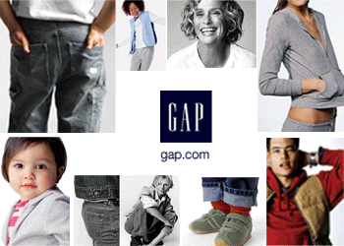
Brand Audit for
The Gap Clothing
Group Members:
Kebrina Carter
Michael Casserly
Jason Kim
December 16, 2004

Slide 2
Agenda
Objective
Identify Sources of Brand Equity
Desired Brand Knowledge
Communication Objectives
Marketing Tools
Action Objectives
Next Growth Opportunity—Gap Home
Build and Maintain Brand Equity
* Focus of presentation, analysis and recommendations are based primarily on the adult Gap clothing line.

Slide 3
Main Objective
  To strengthen nodes in The Gap’s associative network with the words fun and colorful, in addition create a node for fashionable personalization. These nodes will be enhanced through strategically focusing on communication, marketing, and action objectives that will emphasize The Gap’s accessory offering.

Slide 4

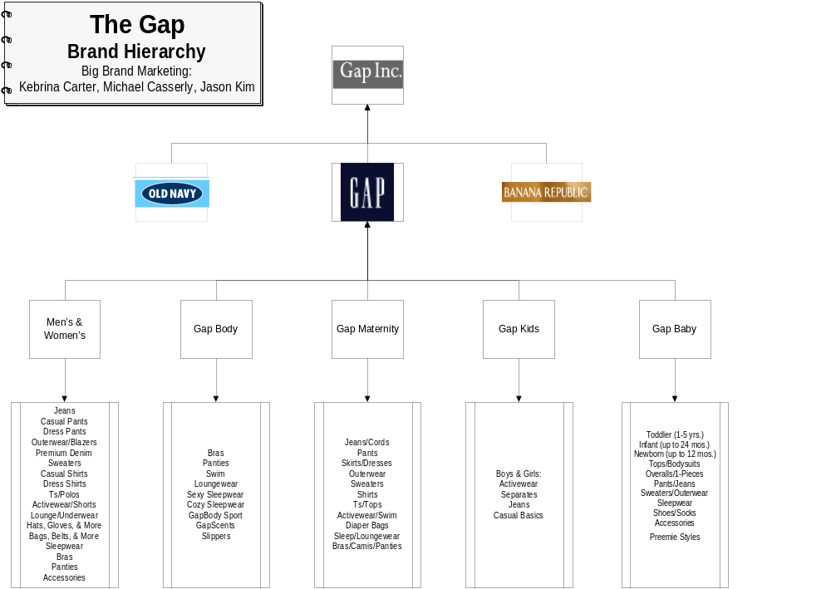

-<number>-
Big Brand Marketing—Dr. Dawn Lerman
-<number>-
Big Brand Marketing—Dr. Dawn Lerman

Slide 5
Identifying Sources of Brand Equity
Brand
Equity
  Conducted both qualitative and quantitative consumer research:
      Word Association
        49 responses
      Sentence Completion
        34 responses

Slide 6
Identify Sources of Brand Equity
Brand
Equity
Product-related attributes: | Durable/long-lasting quality fabric, blue bag, tag-less shirts, big embroidered, 3-letter sweatshirts, light-blue oxford button-down shirts
User imagery: | Preppy, trendy, northern California, yuppie, young, mainstream
Usage imagery: | Everyday wear, casual, corporate dress-down (business casual)
Brand Personality: | Fun, classic, all-American, “Sarah Jessica Parker”
Functional benefits: | Convenient, nice accessories, easy returns, durable, dependable
Experiential benefits: | Comfortable fitting, relaxing to wear
Symbolic benefits: | Feelings of classic style and fashion

Slide 7
Survey Findings:
Where does The Gap stand?
Brand
Equity
  Respondents favorite place to shop for clothes:
    Banana Republic (21%)
    The Gap (12%)
    Macys (6%)
    Bloomingdales (6%)
    N/A (5%)
    Theory, Armani, Rainbow, LL Bean, Bebe, Barney’s, Arden B, Nordstrom, Forever 21, Army/Navy thrift stores, Dr. Jays, Ann Taylor, Brooks Brothers, Target, New York and Company, Filene’s Basement (50%)

Slide 8
Survey Findings (continued)
Brand
Equity
  Respondents’ favorite place to shop for clothes:
  * One person could provide more than one answer
In general | Online | For my kids | For myself | For other kids | For others
Banana (7) The Gap (4) Macy’s (2) Bloomies (2) N/A (2) Other (17 different answers) | N/A (17) The Gap (5) Macy’s (2) Other (10 different answers) | N/A (23) GapKids/ babyGap (7) Old Navy (2) Other (2 different answers) | Banana (12) The Gap (6) Macy’s (3) NY & Co. (3) Old Navy (2) N/A (2) Other (6 different answers) | GapKids/ babyGap (17) N/A (5) The Children’s Place (3) Old Navy (2) Other (7 different answers) | Banana (10) N/A (7) The Gap (5) JCrew (4) Macy’s (2) Other (6 different answers)

Slide 9
Validity of Data
Things to Consider:
    Survey offered ethnically-diverse opinions
    Survey Bias
      age groups
      administered in city limits
      peer influence
      Survey was administered as “The Gap” survey, which automatically placed “The Gap” in the respondent’s mindset.

Slide 10
Observations on Survey Findings
Brand
Equity
  Some thought on the respondents’ favorite places to shop for clothes…
    It would not be wise for The Gap Corporation to pit The Gap Clothing store against its own Banana Republic brand
    The Banana Republic brand was popular among respondents either shopping for themselves or other adults

Slide 11
Key Sources of Brand Equity
  Basics
  Quality
  Jeans
  Comfort
  Classic

Slide 12
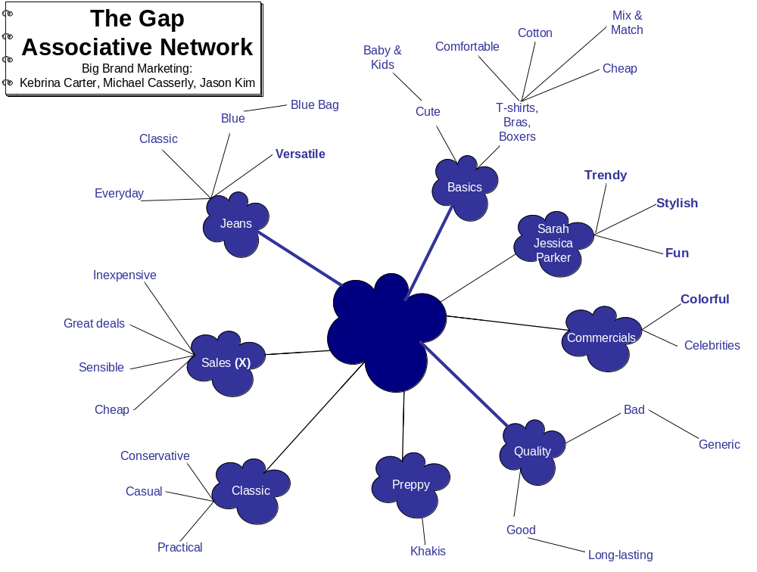
Current
Brand
Knowledge
Notes:
Key Highlights:
Associative network shows there is a great deal of distance between the Gap and mix & match, trendy, stylish, fun, colorful and versatile.
These are things we want to bring closer to the Gap, as our objective is to strengthen the connection between the Gap and fun/colorful.
There is a concern that Sarah Jessica Parker (SJP) is closely associated with the Gap which in turn triggers some connection with fun, stylish, trendy. When she is removed as the spokes person will the nods that she generates go with her? We want to make a stronger connection with those nods without the presence of SJP.
In addition, we want to weaken the association with sales/deals/bargain hunting.

Slide 13
Current Brand Knowledge
Sentence Completion Projective Technique
High response for shopping at The Gap for kids clothing whether for their own or someone else
24% (1/4) of respondents stated they were bored or had no emotional feelings toward The Gap
When asked to complete the following statement
  “The Gap is…”
  53% of respondents had positive comments to make about the Gap ranging from quality to fun to reliable
52% of the respondents who answered the question, “when I wear Gap I feel…” said they felt comfortable
The number one reason respondents did not like The Gap - IT IS NOT UNIQUE

Slide 14
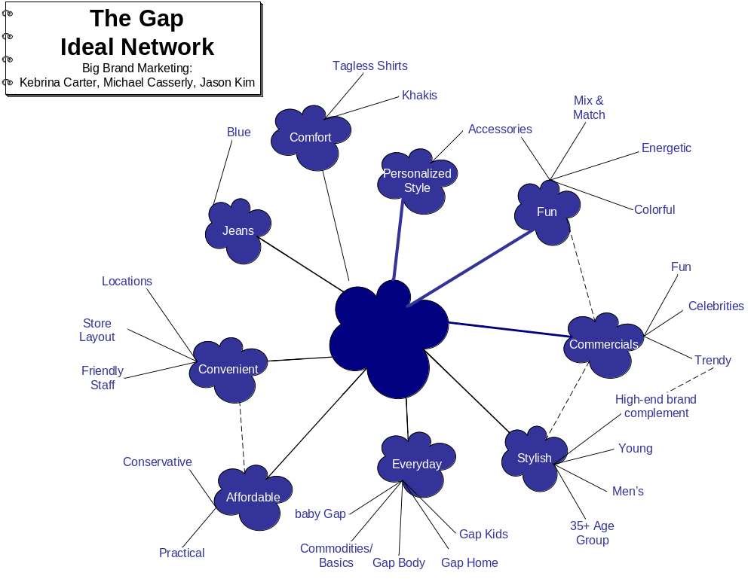
Brand Audit for
The GAP Clothing
Big Brand Marketing—Dr. Dawn Lerman
-<number>-

Slide 15
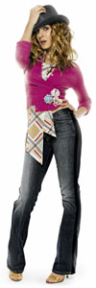
Desired Brand Knowledge
The Gap should have a higher correlation with the following words/phrases:
  Fun
  Personalized style
  Trendy
  The source for all of your clothing basics & more…
  The perfect fit for everybody/ every body
  Quality
  Jeans
  Comfort
  Classic
Brand Personality (photo)
  Fashion conscious, down-to-earth, stylish
Notes:
Important strategic point
In determining what the desired brand knowledge should look like we were careful not to delete the positive qualities that consumers associate with the GAP. These were things that were pointed out in the brand equity slides as being critical to the Gap’s success.
These qualities are highlighted in red on the above slide.

Slide 16
Current Communication Objectives
Annual Reports
  (2000) Classic clothing that are must have fashions
    More energy and styles to basics offering broader assortment with new fits and washes
  (2001) Simple classic styles for everybody
    Gap is about khakis, jeans, ribbed sweaters
  (2002) Classic casual American style
    Get the right fit and the right product
    Enhance store operations
Note: The next few slides on marketing tools will show you how these objectives played out in The Gap’s advertising and detail the most recent communication objectives.

Slide 17
Desired Communication Objective
Gap is fun
  Enhance fashion conscious ads
  Make the personalization statement “How Do You Wear It” more prominent
  Create solo ads highlighting accessories
Observation
  Appears that current ad messages, particularly “how you wear it” are not reaching consumers successfully as responses from surveys don’t reiterate their ad messages

Slide 18

Marketing Tools
Print Ads
TV Commercials
Promotions
  eToys gift certificate with Gap purchase
  Online and store promotional contests and giveaways
Internet – online advertising
Affiliate programs
Other
  “Share The Warmth” clothing donation program -> “Brannan the Bear” teddy bear

Slide 19
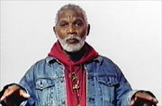
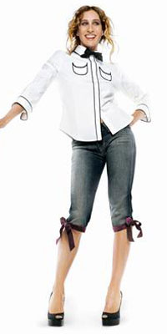
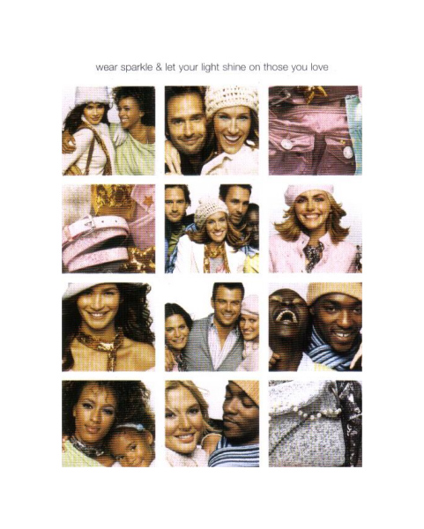



Print Advertising
Consistency
Fashion magazines, periodicals
Use of celebrities that personify the brand
Use of colors
Focus on the holidays
Tagline: “Give Your Gift”

Slide 20
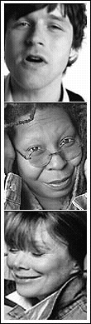
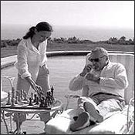
“Individuals of Style” – 1988+
Basics and individual components
Whoopi Goldberg, Spike Lee, Lorraine Bracco, Christina Ricci, Dennis Hopper
Directed by celebrities also: Cameron Crowe and the Coen brothers
These individuals personify the Gap brand
Lisa Prisco - Gap "Two White Shirts"

Slide 21
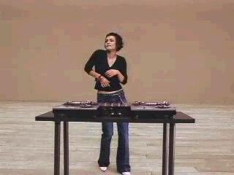
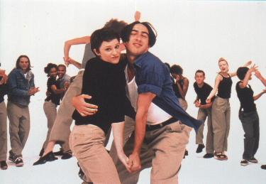
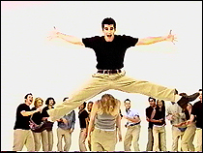
“Khakis Swing” – 1997/1998
Fun and trendy
Back to Gap’s khaki staple
Likeability and integration of music to match the mood
Lisa Prisco – Gap "Khakis Soul"
Lisa Prisco – Gap "Khakis Street"

Slide 22

“Give A Little Bit” – 2001
Supertramp
Spotlighted a music celebrity’s take on “Give a Little Bit”
Introduction of personal style
Sheryl Crow, India Arie, Lisa Lopez, Dwight Yokam, Alanis Morissette

Slide 23
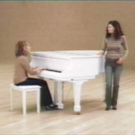

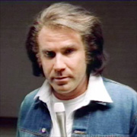
“Jeans For Every Generation” – 2002
Established, Current, and Break-out celebrities
"Whether you are six, sixteen or sixty, nothing is more universal than a pair of Gap jeans," opines Millard Drexler. But then he would say that, he was President and CEO of Gap
Willie Nelson, Ryan Adams, Whoopi Goldberg, Sissy Spacek
“Forever in blue jeans, babe” – Will Ferrell as Neil Diamond

Slide 24
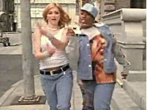
Madonna – “updated classic”, 2003
Cross-over commercials with Missy Elliot
“I can do that”
Brings sense of style and trendiness
Continues with music mix theme
Targets women, especially trendy moms
Do consumers think Madonna buys her jeans from The Gap?

Slide 25
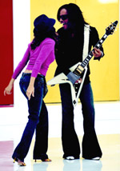
Sarah Jessica Parker – “style conscious”, 2004
Mega trendy and stylish
Montages of clothing – outfits, not single pieces
Accessorize with your own style
Fresh and affordable
“You fit in, but you stand out” – Pina Ferlisi, Gap Head Designer
"I think the Gap is terrifically creative, fun, inspired, and the clothes are for everyone, of every age," said Parker, known as a fashionista both on-screen and off, in a statement e-mailed to The Associated Press. "They are timeless, easy, colorful, classic and affordable.“
The Gap "How Do You Wear It?"

Slide 26
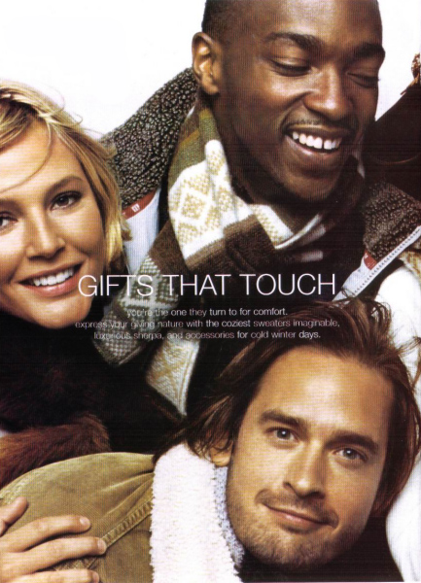
“How Do You Wear it?” - 2004
"Asking the world 'How Do You Wear It?' is an invitation for personal expression and a conscious effort to connect the brand more closely with consumers," Gary Muto, President of Gap
"That's the Way (I like it)"
Additional promotion of regular people trying-out for ads with non-celebrities showing how they wear Gap clothes
Migration to ‘How Do You Share It?’ and ‘Share The Warmth’ campaign

Slide 27
Marketing Tool Focus
Extend current brand objectives
Focus on brand segments, especially women and teens
Accessories for personalization
Pilot 35+ Women’s line
Extend into a horizontal product line: Home Goods

Slide 28
Action Objectives
Reinforce:
  Emotional ties to The Gap – fun, comfort
Extend:
  Uniqueness for personalization
  Stylish comfort
  Women audience

Slide 29

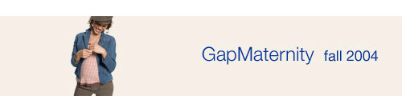
Next Growth Opportunity (current)
35+ line of clothing
  The Gap’s marketing research points to this area
  Continuation from Sarah Jessica Parker
  Focus on trendy classics
  Gap products as a required staple
  Targeted for late 2005

Slide 30
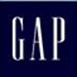
Next Growth Opportunity (recommendation)
Gap Home!
  53% of respondents said they may buy or definitely would buy Gap’s home line
  Offers Gap lovers a continuation of the Gap experience
  In line with most prominent brand equity of comfort
  * Note: When designing and marketing the home line be conscious of differentiating it from Pottery Barn. Also, respondents seem price sensitive in this area, therefore focusing on competitive pricing is key. Lastly, respondents appeared excited about the possible color combinations and patterns the Gap would create.

Slide 31
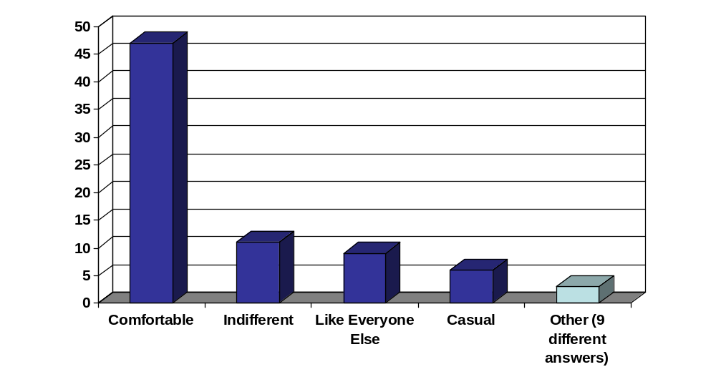
Next Growth Opportunity (recommendation)
When I wear Gap I feel…

Slide 32
Build and Maintain Brand Equity
It is extremely important for The Gap to recognize the sources of perceived value in its brand, and not stray away from those sources in any of its marketing campaigns.
As mentioned earlier, the primary sources of The Gap’s brand equity include:
    Basics
    Quality
    Jeans
    Comfort
    Classic
It is important for The Gap to promote the personalization aspect of its products. This will help to combat the common feeling among current consumers that The Gap is “not unique”

Slide 33
Questions

Slide 34
Thank You

Slide 35
Findings
(APPENDIX)

Slide 36
Female Factor
  Studies show that women's influence on 65% to 85% of all purchasing decisions
  U.S. Census data shows that between 1970 and 2002, even as the population of American women outpaced that of men, the employment gender gap closed by more than half
  The number of unmarried American females is at an all-time high and the percentage of children living in households headed by a single mother has more than doubled since 1970
Source: Adweek, 12/06/04

Slide 37
Key Highlights
Associative Network
Associative network shows there is a great deal of distance between the Gap and mix & match, trendy, stylish, fun, colorful and versatile.
These are things we want to bring closer to the Gap, as our objective is to strengthen the connection between the Gap and fun/colorful.
There is a concern that Sarah Jessica Parker (SJP) is closely associated with the Gap which in turn triggers some connection with fun, stylish, trendy. When she is removed as the spokes person will the nods that she generates go with her? We want to make a stronger connection with those nods without the presence of SJP.
In addition, we want to weaken the association with sales/deals/bargain hunting.

Slide 38
Important Strategic Point
Desired Brand Knowledge
In determining what the desired brand knowledge should look like we were careful not to delete the positive qualities that consumers associate with the GAP. These were things that were pointed out in the brand equity slides as being critical to the Gap’s success.
These qualities are highlighted in red on the “Desired Brand Knowledge” slide.

Slide 39
Data Collection (Phase 1)
Associative Network Survey
Contact Rate
  The percentage of people who are reached
    90%: Out of 83 surveys sent, 75 people were reached successfully.
Cooperation Rate
  The percentage of people who were contacted who actually agreed to participate in the study
    63%: 49 out of the 75 people who were contacted actually agreed to participate in the study.
Completion Rate
  The percentage of people who cooperated and completed the study through the end.
    100%: Of the 47 people who cooperated, 47 completed the study.
90%
63%
100%

Slide 40
Demographics (Phase 1)
Associative Network Survey
 | Total |  | % of Respondents
Ages 29 and under | 30 |  | 61
Ages 30-35 | 10 |  | 20
Ages 36+ | 9 |  | 19
Married | 20 |  | 41
Men | 23 |  | 47
Women | 26 |  | 53
Have Children | 11 |  | 22

Slide 41
Associative Network Survey
Questions
Asked
List the first 7 things that come to mind when you think of the GAP (No more then one or two words per line)
1.
2.
3.
4.
5.
6.
7.
If you have more words to add, please list them below.
1.
2.
3.
4.
5.
6.
7.
8.
If you have exhausted your word list on the GAP look over your list of 7 to help you come up with more words. List them below.
1.
2.
3.
4.
5.

Slide 42
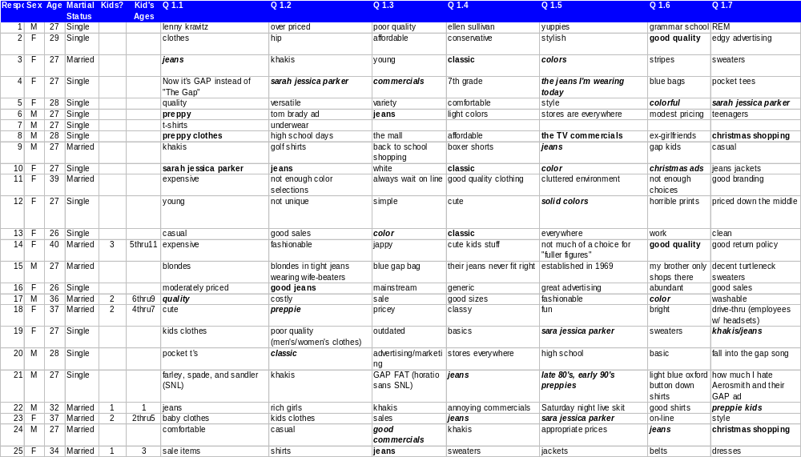
Associative Network Survey
Tier 1, Respondents 1-25

Slide 43
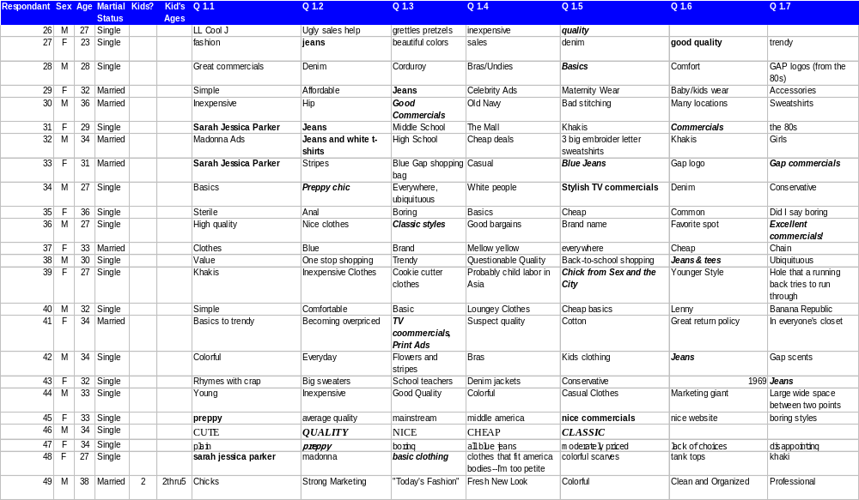
Associative Network Survey
Tier 1, Respondents 26-49

Slide 44
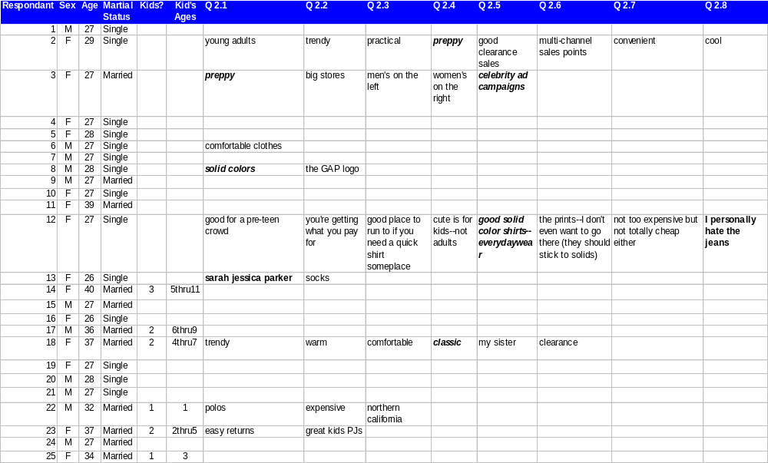
Associative Network Survey
Tier 2, Respondents 1-25

Slide 45
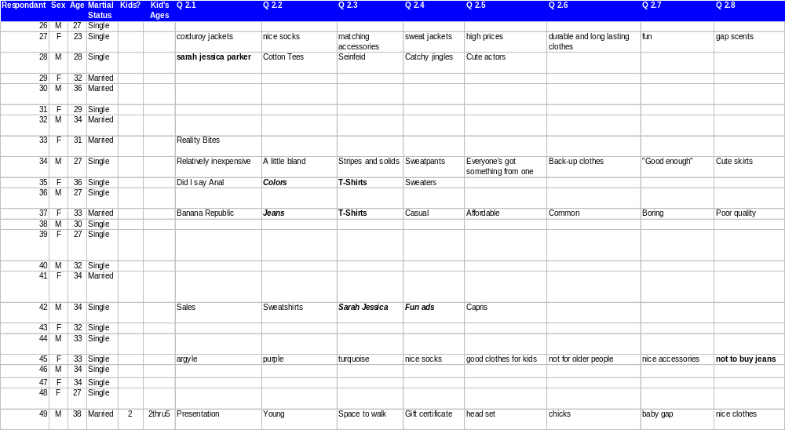
Associative Network Survey
Tier 2, Respondents 26-49

Slide 46
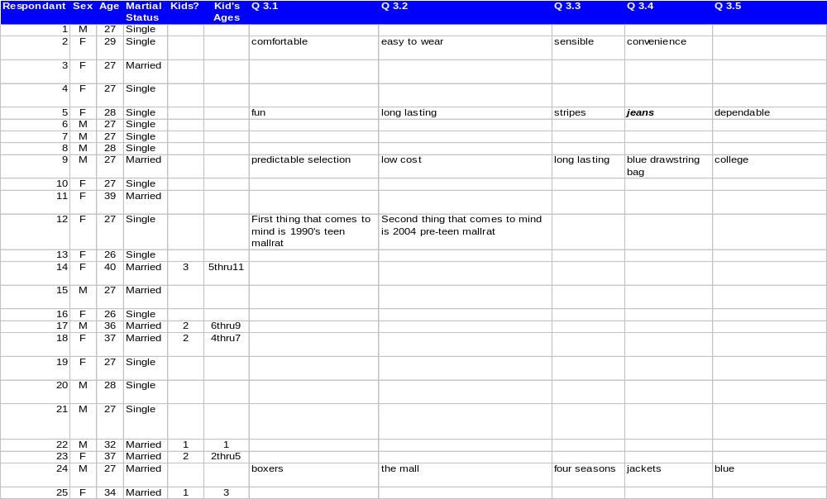
Associative Network Survey
Tier 3, Respondents 1-25

Slide 47
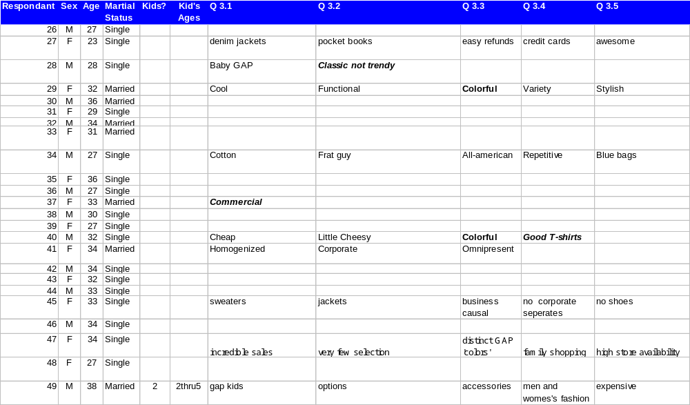
Associative Network Survey
Tier 3, Respondents 26-49

Slide 48
Data Collection (Phase 2)
Sentence Completion Exercise
Contact Rate
  The percentage of people who are reached
    100%: All 47 people were reached successfully.
Cooperation Rate
  The percentage of people who were contacted who actually agreed to participate in the study
    72%: 34 out of 47 people who were contacted actually agreed to participate in the study.
Completion Rate
  The percentage of people who cooperated and completed the study through the end.
    100%: Of the 34 people who cooperated, 34 completed the study.
100%
72%
100%

Slide 49
Demographics (Phase 2)
Sentence
Completion
Exercise
 | Total |  | % of Respondents
Ages 29 and under | 22 |  | 65
Ages 30-35 | 8 |  | 24
Ages 36+ | 4 |  | 11
Married | 20 |  | 59
Men | 13 |  | 38
Women | 21 |  | 62
Have Children | 10 |  | 30

Slide 50
Sentence Completion Exercise
Questions
Asked
My favorite place to shop for clothes is_______
My favorite place to shop for clothes online is_________
When I shop for clothes for my kids (if applicable) I go to_______
When I shop for clothes for myself, I go to_______
When I shop for clothes for other people's children I go to_________
When I shop for clothes for others I go to________
When I go to the GAP, I feel________
The GAP is__________
I associate GAP with_______
I like GAP products because________
I don't like the GAP because_______
Tell me 3 things you know about the GAP: ______________ ______________ ______________
The number one trait I think of when I hear GAP is______________
If GAP came out with a home line (bed linen, curtains, etc.), would you buy it? ____....What do you think it look like?________
When I wear GAP I feel___________

Slide 51
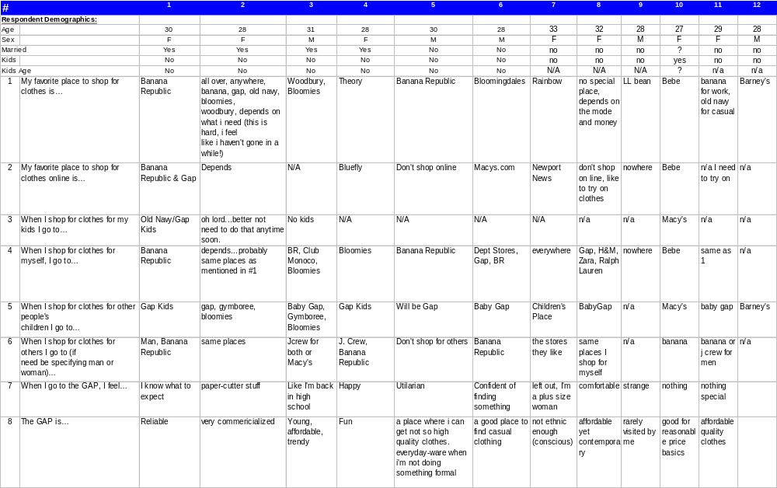
Sentence Completion Exercise
Quest. 1-8 Respondents 1-12

Slide 52
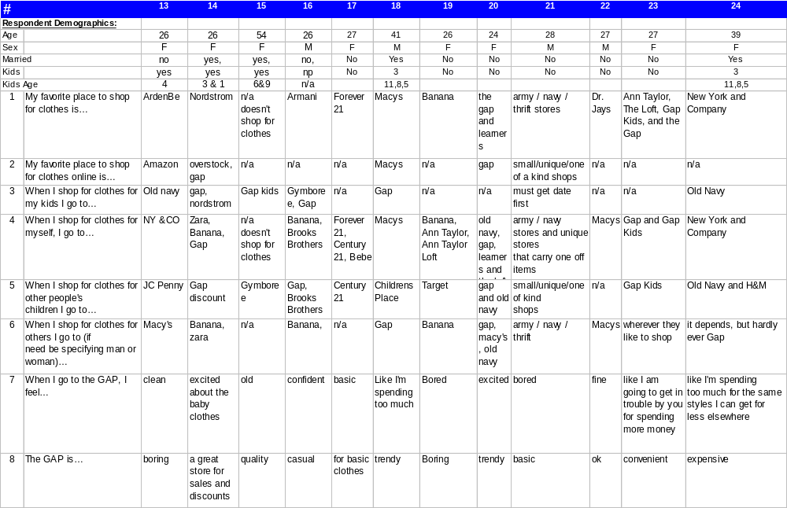
Sentence Completion Exercise
Quest. 1-8 Respondents 13-24

Slide 53
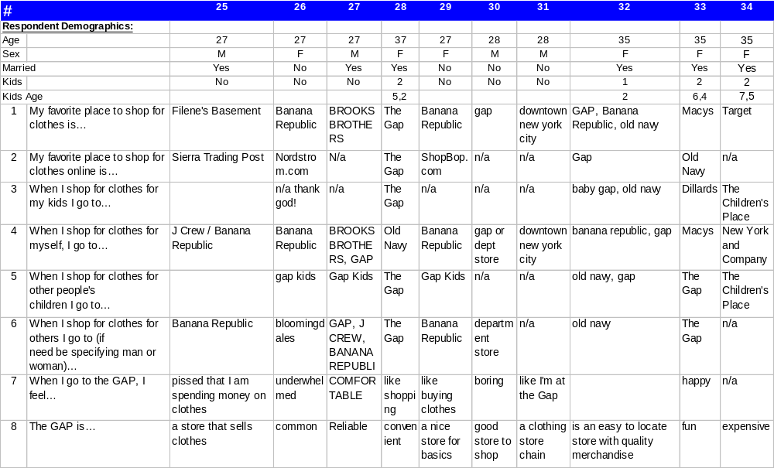
Sentence Completion Exercise
Quest. 1-8 Respondents 25-34

Slide 54
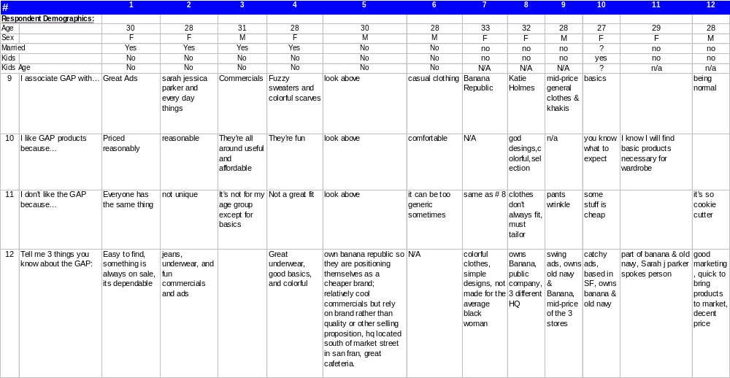
Sentence Completion Exercise
Quest. 9-12 Respondents 1-12

Slide 55
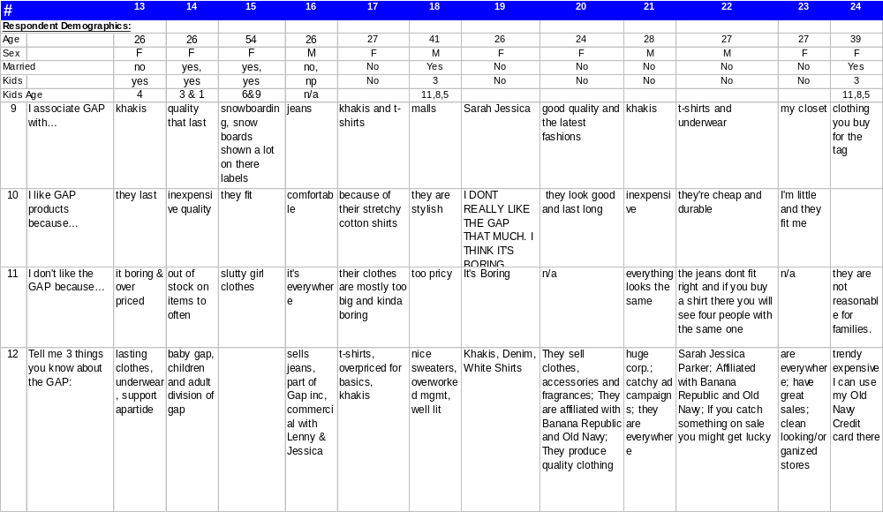
Sentence Completion Exercise
Quest. 9-12 Respondents 13-24

Slide 56
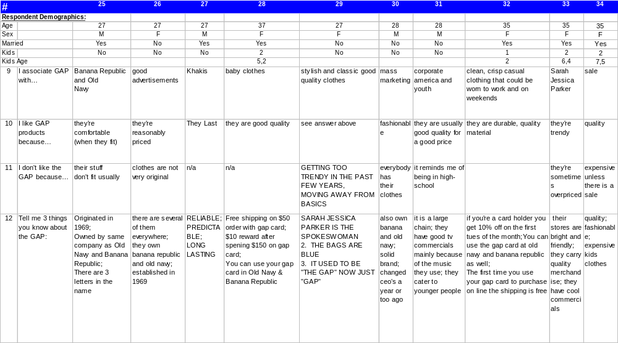
Sentence Completion Exercise
Quest. 9-12 Respondents 25-34

Slide 57
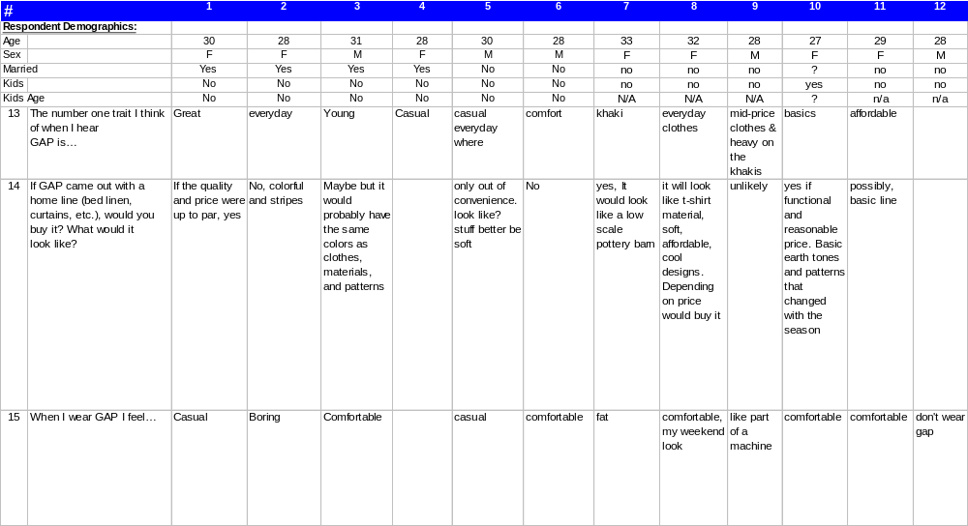
Sentence Completion Exercise
Quest. 13-15 Respondents 1-12

Slide 58
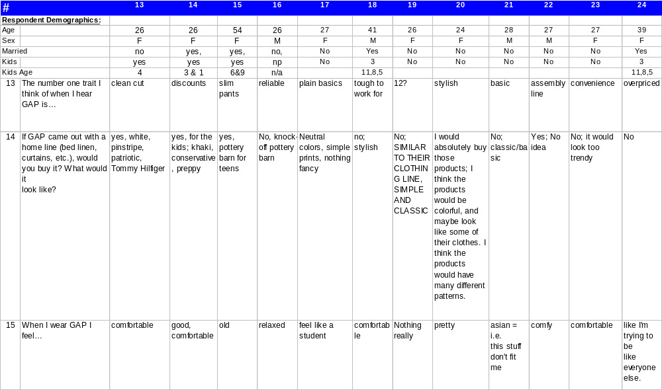
Sentence Completion Exercise
Quest. 13-15 Respondents 13-24

Slide 59
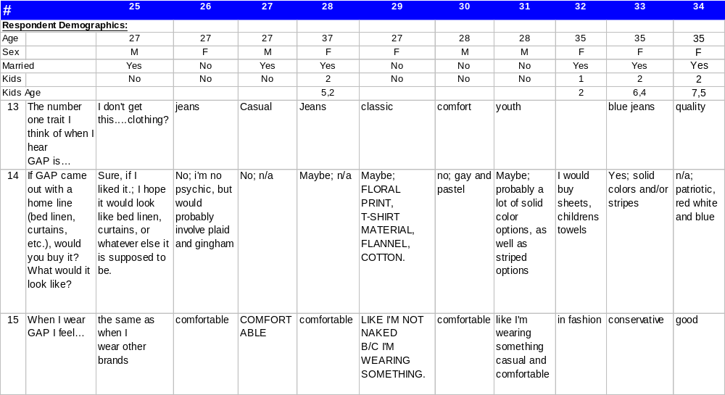
Sentence Completion Exercise
Quest. 13-15 Respondents 25-34

