Slide 1
Marketing Applications of Data Mining
Analysis Team Project
The Blue Notes
Michael Casserly
Francesca DeLisi
Ryosuke Okumura
Hyok-Hee Ho
Andrew Weisselberg

Slide 2
Executive Summary
Project
  Use customer databases of hospital cancer patients to identify relevant demographic information for use in target marketing
    Utilize demographic variables in regional data set – NY, NJ, CT
Product
  A chemotherapy treatment that reduces the side effects of cancer, specifically nausea and vomiting
Market Potential
  1.4 million new cancer patients every year in the United States

Slide 3
Identifying Market Segments
Data mining task
  Classification
Determine relationships between cancer and independent variables (age, income, marital status, race, sex)
Data Transformation

Slide 4
Findings
Age Demographics
  Largest % of male patients falls into 60 - 80 (66%)
    Distribution is similar for most of the cancers, prostate cancer exception
  Largest % of female patients falls into the 50-80 (71%)
    Majority of Breast Cancer patients are between 50 and 70

Slide 5
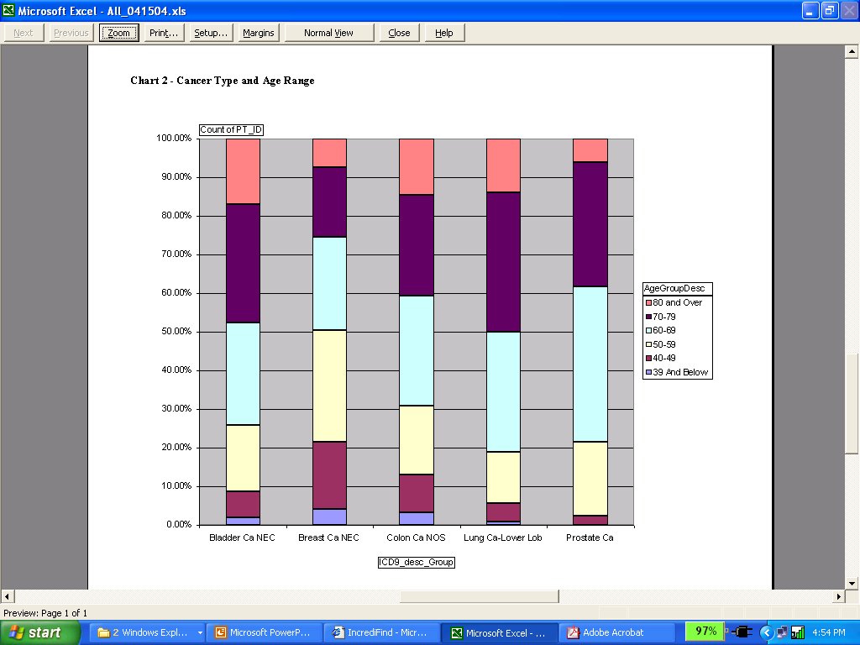
Age Demographic Chart

Slide 6
Findings
Income Demographics
  Largest % of male and female patients fall into the middle income bracket, $31,000 – $75,000 (59%)
  Income distribution consistent among all cancers

Slide 7
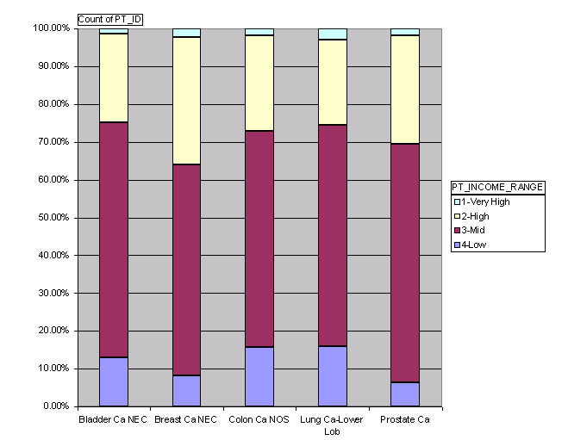
Income Demographic Chart

Slide 8
Findings
Race Demographics
  Largest % of patients are Caucasian (85%)
  Second largest % are Black Non Hispanic (6.58%)

Slide 9
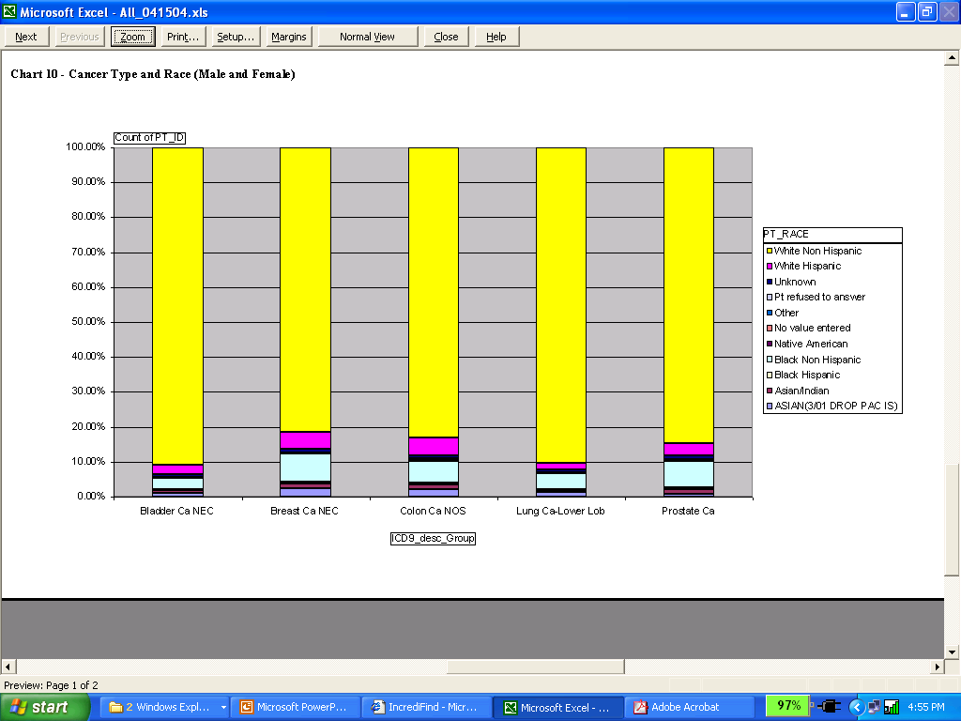
Race Demographic Chart

Slide 10
Conclusions
Based on the extrapolated demographic information we have a clear and static target market that represents a significant economic opportunity
We therefore request $500,000 in incremental funding to secure additional patient databases in order to validate our findings on a national basis

