Slide 1
VUE3
Charlie

Slide 2
Environment Setup

Slide 3
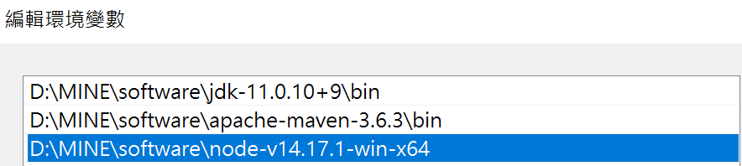

Install Node.js
Download Node.js (https://nodejs.org/en/download/)
Edit Environment Variables
Check

Slide 4
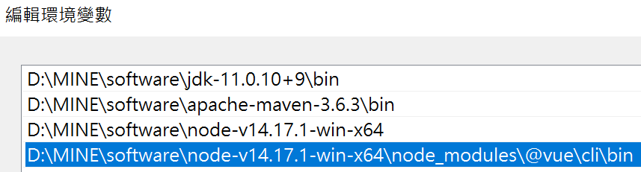

Install Vue
Install vue using npm
Edit Environment Variables
Check

Slide 5
Proxy Setting
npm config set strict-ssl=false
npm config set registry https://nexus.testesunbank.com.tw:8443/repository/npm/

Slide 6
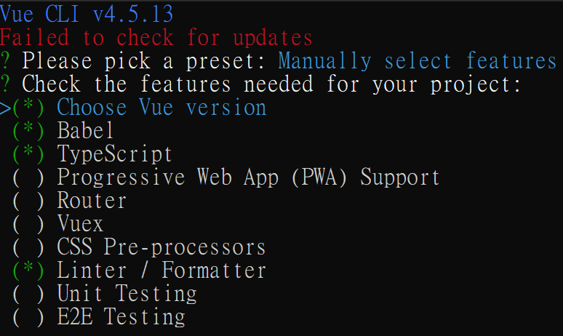

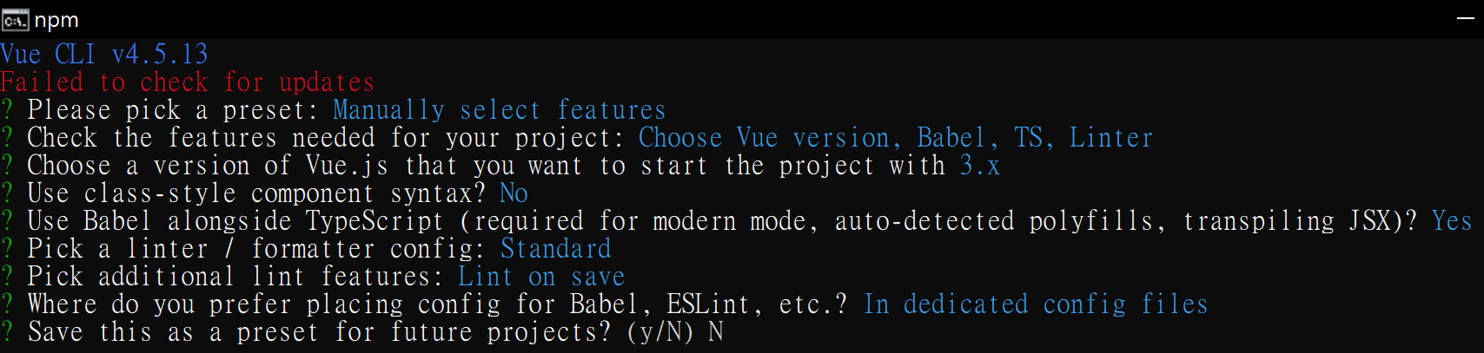
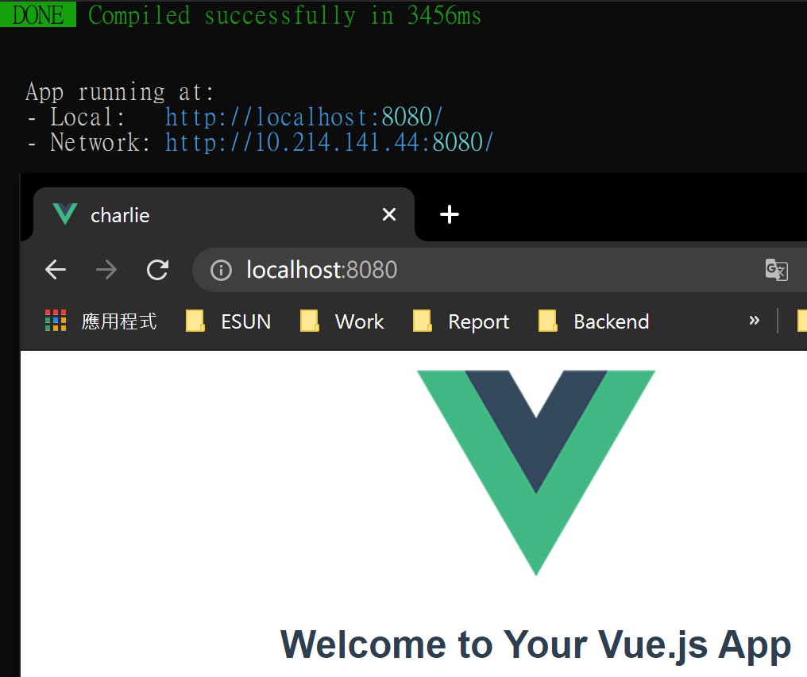
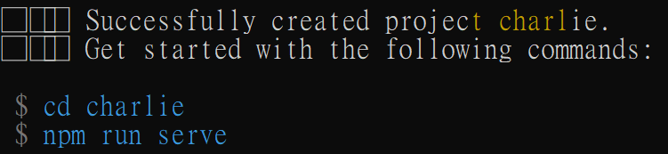
Create Project

Slide 7
VUE Basic
Vue is a JavaScript framework that allows us to quickly develop single-page applications (SPAs)

Slide 8
How it Works?

Slide 9
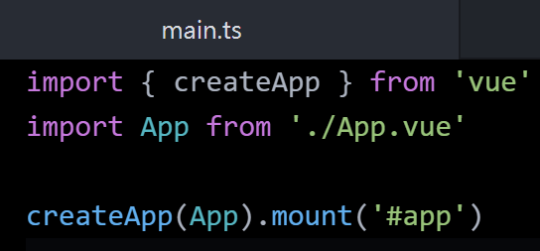
How it Works?
Every Vue application starts by creating a new application instance with the createApp function. The options passed to createApp are used to configure the root component. That component is used as the starting point for rendering when we mount the application. (from vue3 official document)

Slide 10
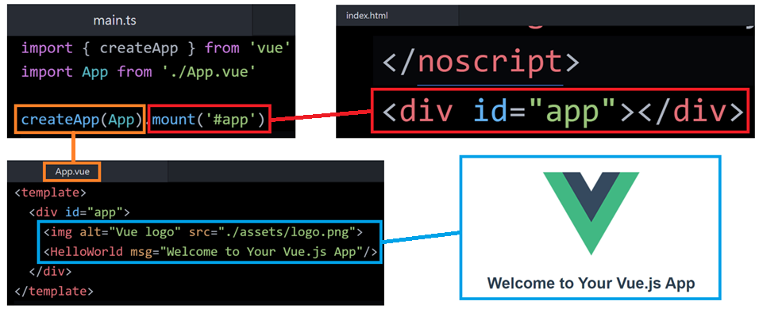
How it Works?
An application needs to be mounted into a DOM element. For example, if we want to mount a Vue application into <div id="app"></div>, we should pass #app.

Slide 11
Declarative Rendering

Slide 12
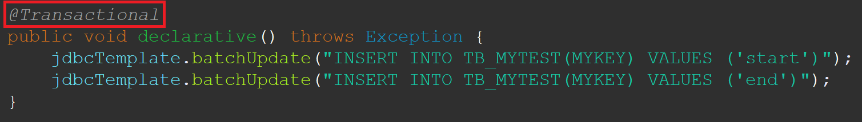
What is Declarative?
Denoting high-level programming languages which can be used to solve problems without requiring the programmer to specify an exact procedure to be followed. (from google dictionary)
Take java for example:

Slide 13
Declarative Rendering
At the core of Vue.js is a system that enables us to declaratively render data to the DOM using straightforward template syntax. (from vue3 official document)
So, we don’t have to manipulate DOM manually!

Slide 14
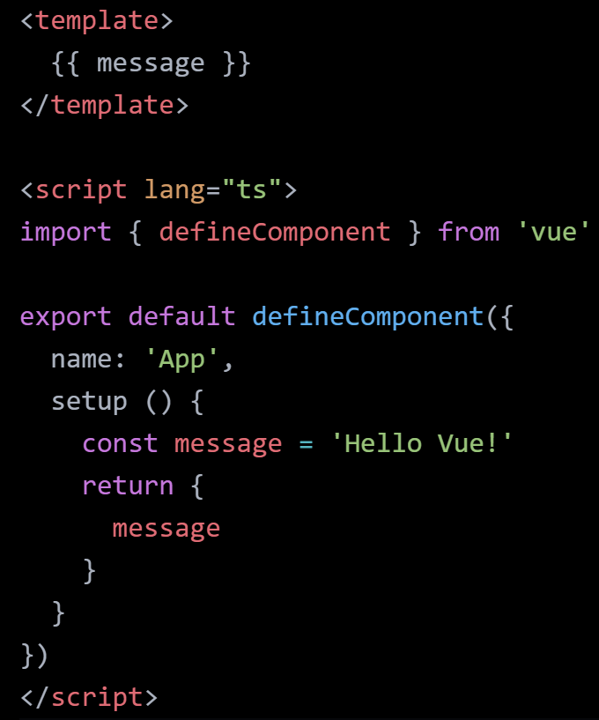
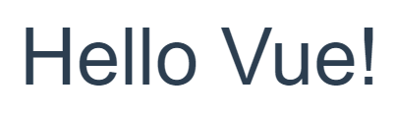
Declarative Rendering

Slide 15
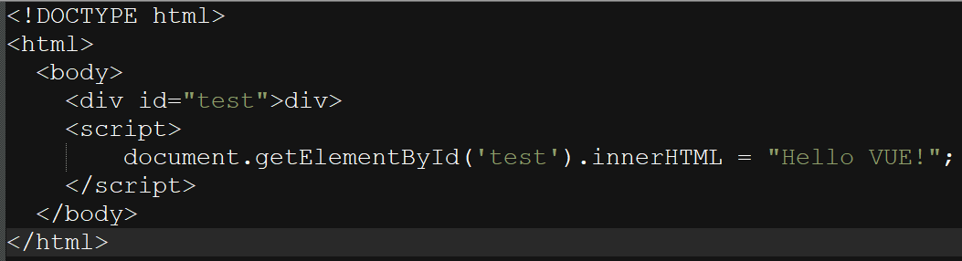
Non-Declarative Rendering (Imperative)
Imperative programming is a paradigm of computer programming where the program describes steps that change the state of the computer. (from computerhope.com)

Slide 16
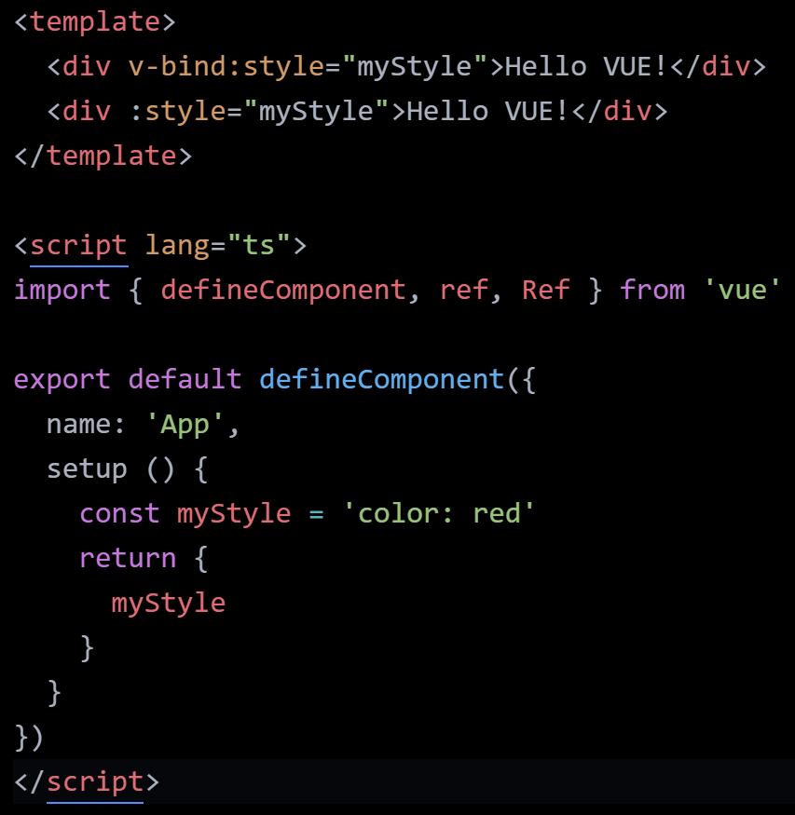
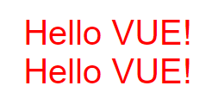
Declarative Rendering (attributes)
The shorthand for v-bind is simply a colon (:)

Slide 17
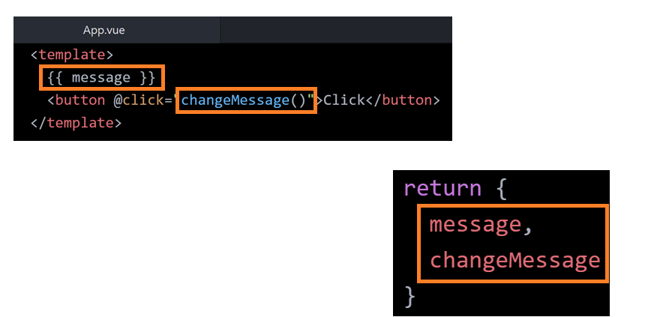
Declarative Rendering
要在 <template> 裡面使用的變數或方法，必須要寫在 setup() 的 return block.

Slide 18
Event Handling

Slide 19
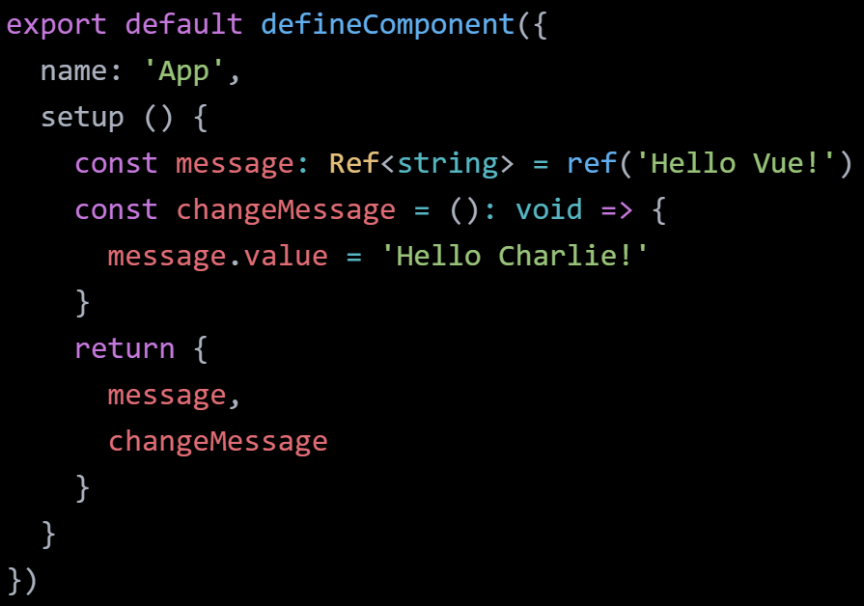
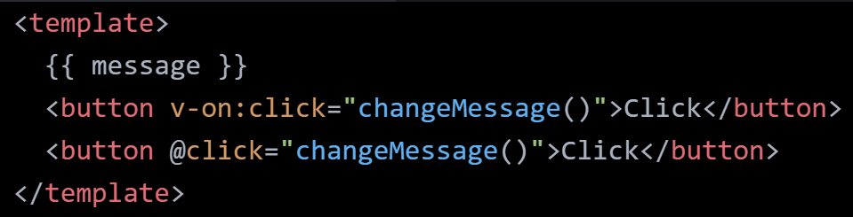


Event Handling (click)
目前先不用管 ref，等等會提到
After Clicking the button
The shorthand for v-on is simply a (@)

Slide 20
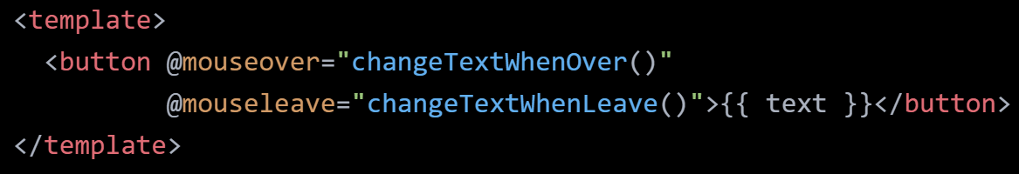

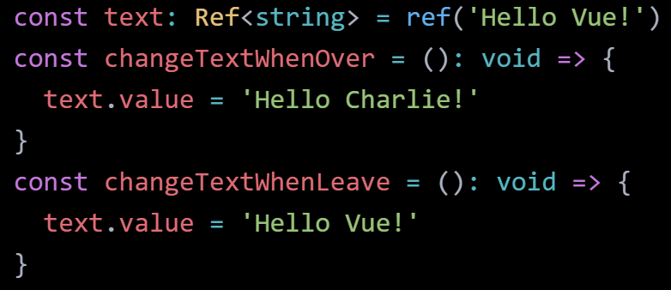

Event Handling (mouse)
Mouse Over
Mouse Leave

Slide 21
Event Handling (two-way binding)
Two-way data binding refers to sharing data between a component class and its template. If you change data in one place, it will automatically reflate at the other end. For example, if you change the value of the input box, then it will also update the value of the attached property in a component class. (from tutorialsteacher.com)

Slide 22
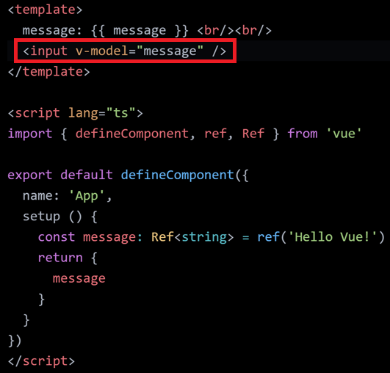
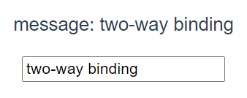
Event Handling (two-way binding)
打在 Input Block 的字串會即時顯示在上方

Slide 23
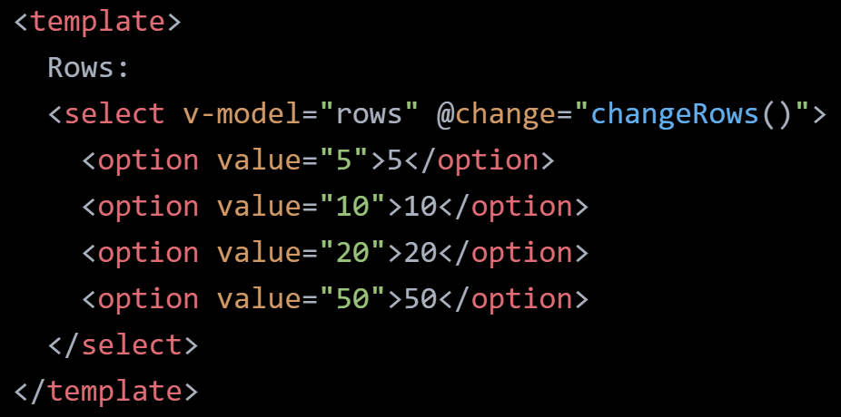
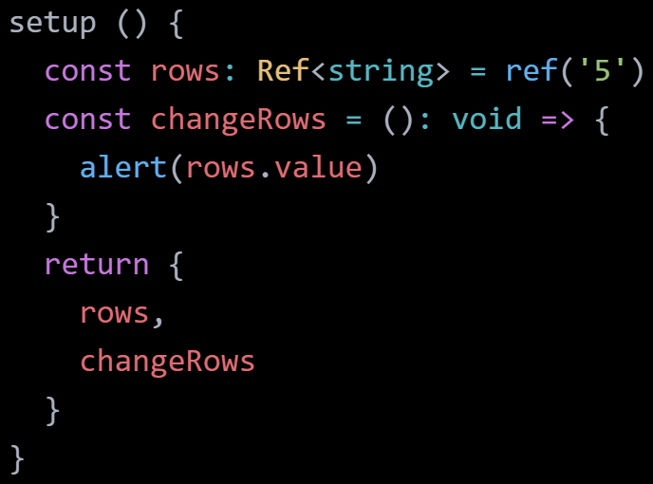

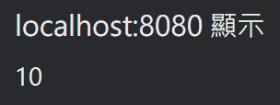

Event Handling (change)
change

Slide 24
Event Handling
Note that in previous examples we update the state of our app without touching the DOM - all DOM manipulations are handled by Vue, and the code you write is focused on the underlying logic. (from vue3 official document)

Slide 25
Reactivity vs. Non-Reactivity

Slide 26
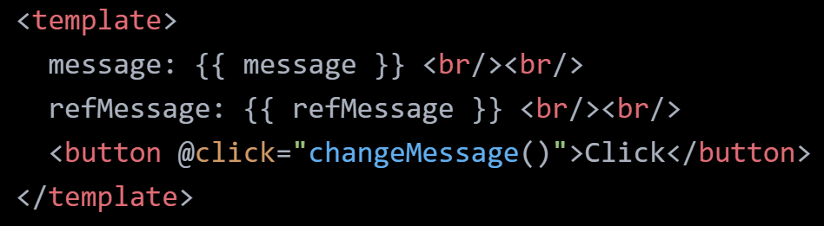
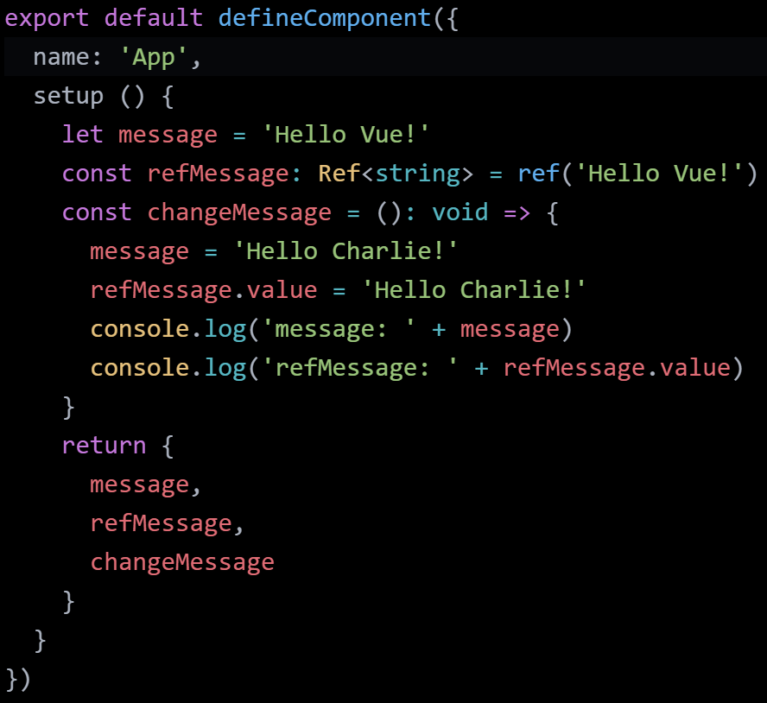
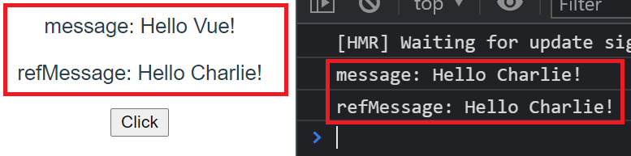
Reactivity vs. Non-Reactivity
Result:
message 沒有更新，因為它不是 reactive object

Slide 27
What is reactive object?
reactive object

Slide 28
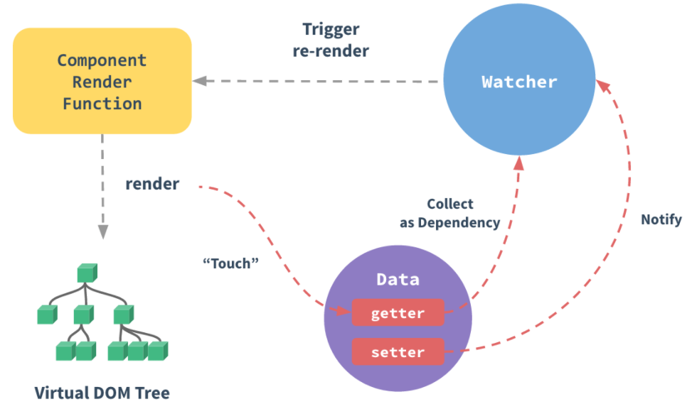
How Changes Are Tracked

Slide 29
Goodbye
Charlie

