Slide 1
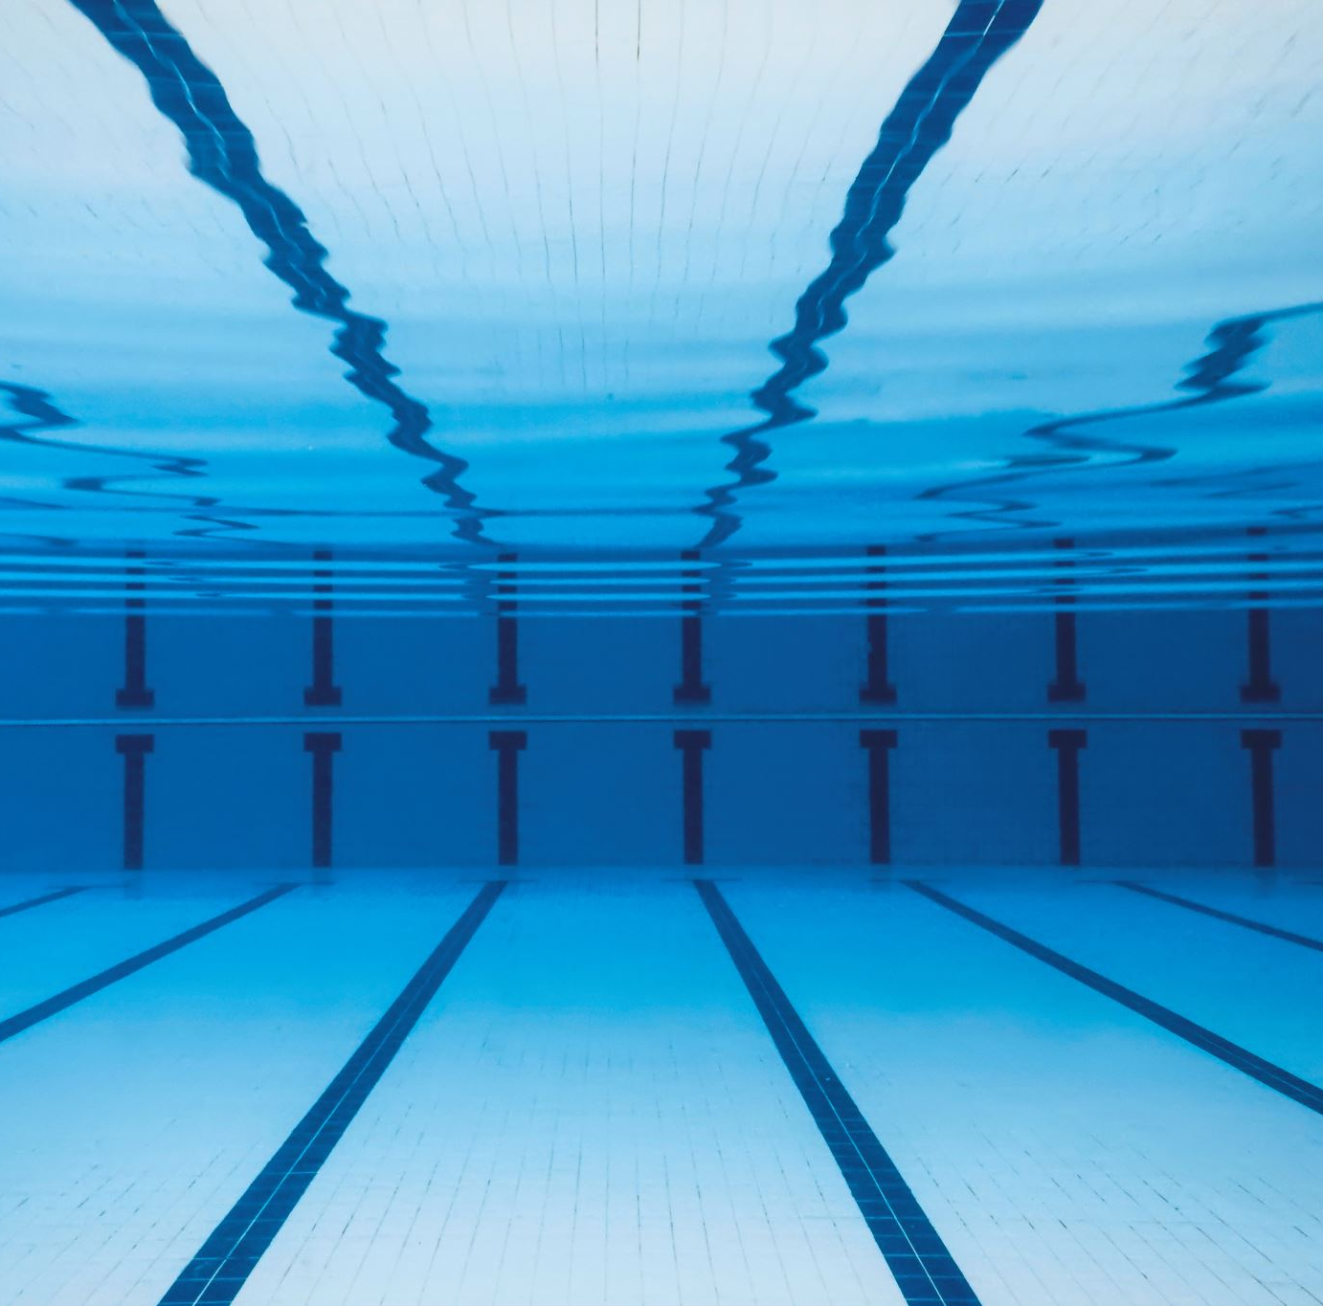
Progress Pitch #2
Michael Pruett

Slide 2
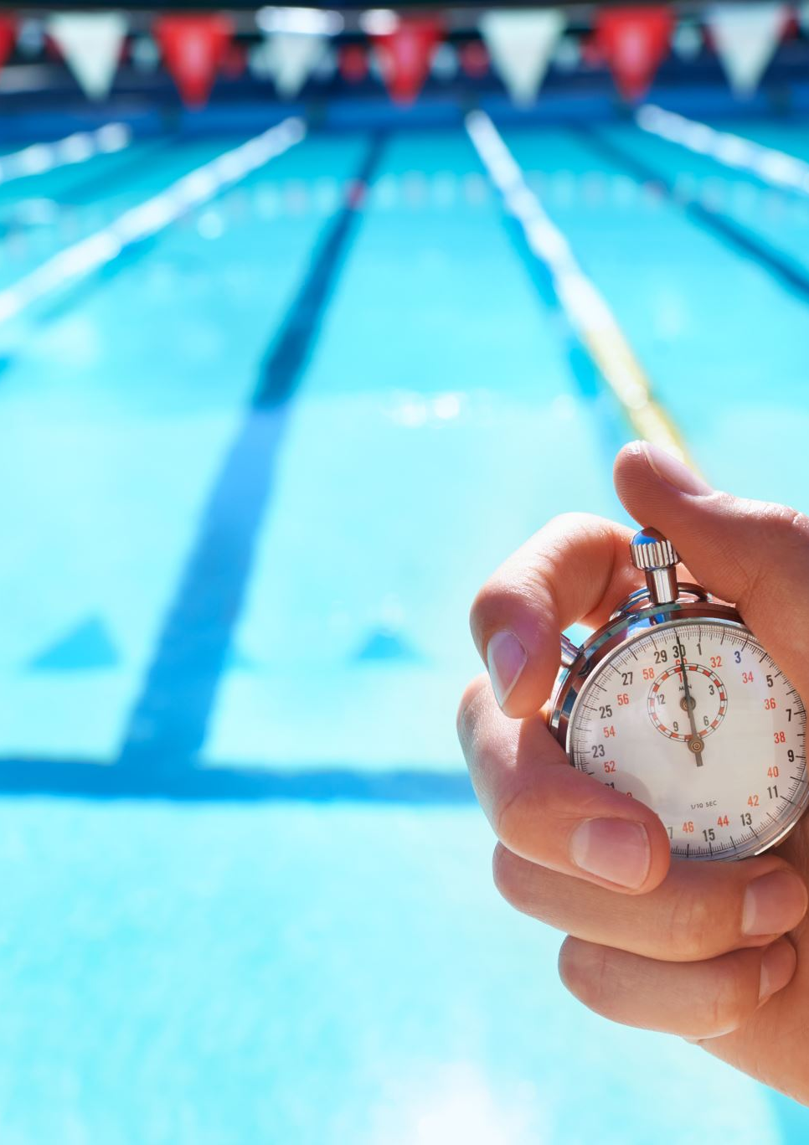
Since the Prototype #1
Added automatic practice-window generation instead of only checking predefined practice times.
Coaches can now choose:
earliest possible start time
latest possible end time
practice duration
required transition time
The system generates practice options in 15-minute increments, checks conflicts for all swimmers, and ranks the best practice times automatically.
Improved the scheduling UI so the recommendations are easier to read and compare.

Slide 3
Next Steps
Add a performance progression graph instead of only the current progression list.
Begin implementing a relational database for schedules, swimmers, performance data, and other persistent information.
Continue improving the practice recommendation system and overall UI based on coach/user feedback.
Later: authentication/real role permissions, goals/practice tracking, and possible approved external-data imports.

