Slide 1
FSW-113 JavaScript II – Intermediate Programming
Week 1 – Course Overview, JavaScript Review and Iterations

Slide 2
“You should imagine variables as tentacles, rather than boxes. They do not contain values, they grasp them - two variables can refer to the same value.” – Marjin Haverbeke

Slide 3
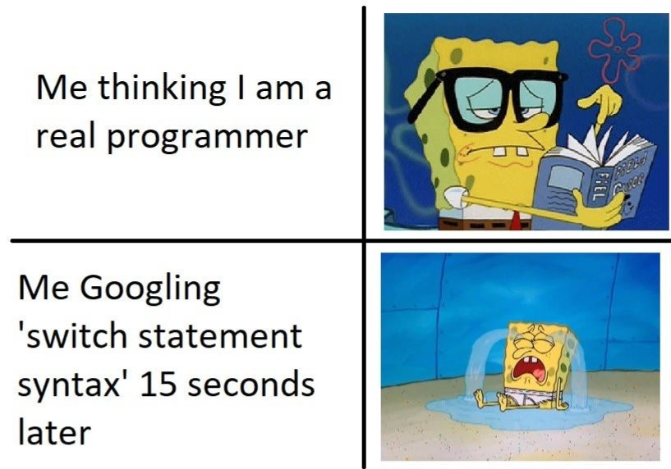
When to use Google and When NOT to use Google.

Slide 4
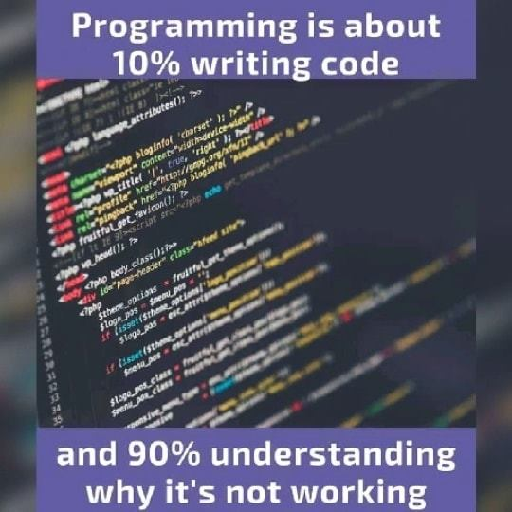
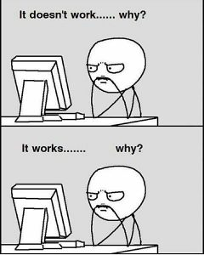

Slide 5
Week 5 - Topics
Review Syllabus
Course Expectations
Arrays
JavaScript Review – Live Demo of code
Accessing array elements
Workings with objects
Event Handling
Interacting with the DOM
Loops
For
While
Do While
others
Q & A

Slide 6
Arrays – Definition and Creation
What is an Array? – An Array is a JavaScript object used to store multiple values in a single variable. Arrays can contain mixed data types.
Arrays are created using square brackets [] or the new keyword
var icecreamFlavors = [“Chocolate”, “Vanilla”, “Strawberry”, “RockyRoad”]
var icecreamFlavors = new Array(“Chocolate”, “Vanilla”, “Strawberry”, “RockyRoad”)
Items in an Array are accessed and referenced by an index number that starts at 0.
var myFavoriteFlavor = icecreamFlavors[2] // myFavoriteFlavor = “Strawberry”
push(e) - Adds an element(e) to the end of an Array
pop() – Removes an element(e) from the end of an Array
shift() – Removes an element from the beginning of an Array
indexOf(e) – Finds the index of an element(e) in an Array
slice(start,end) – Returns selected elements in an Array, starting at start and ends at end, but does not include end, as a new Array. If start is omitted, the default is 0. If end is omitted, then the default value is the end of the array.
splice(start, howmany) – Removes item(s) starting at the start position and removes howmany elements. Default value of howmany is 1.

Slide 7
Arrays – Methods of
forEach(callbackFn) - Calls a function (callbackFn) for each element in the array.
filter(callbackFn) – Returns a new array containing all the elements of the calling array for which the provided filtering function (callbackFn) returns true.
map(callbackFn) - Returns a new array containing the results of calling a function (callbackFn) on every element in this array.
find(callbackFn) - Returns the value of the first element in the provided array that satisfies the provided testing function. If no values satisfy the testing function (callbackFn), undefined is returned.
some (callbackFn) - Returns true if at least one element in this array satisfies the provided testing function (callbackFn).
every(callbackFn) - Returns true if every element in this array satisfies the testing function (callbackFn).
reduce (callbackFn) - Apply a user-supplied “reducer” function on each element of the array (from left-to-right) passing the calculation value to the next element. The final result is a single value.
sort(compareFn)- Sorts the elements of an array in place and returns the array. compareFn is optional and if omitted, the elements are converted to strings and then sorted.

Slide 8
Bonus Tip – Emoji and JavaScript
https://emojipedia.org/
🤔 ➡️ 💡
https://www.w3schools.com/jsref/dom_obj_event.asp

Slide 9
Loops
A loop usually has one or more of the following features:
A counter, which is initialized with a certain value — this is the starting point of the loop
A condition, which is a true/false test to determine whether the loop continues to run or stops — usually when the counter reaches a certain value.
An iterator, which generally increments the counter by a small amount on each successive loop until the condition is no longer true.
Use the “break” statement to immediately exit the loop

Slide 10
Loops – for
The for statement loops through a block of code a specified number of times.
for (counter; condition; iterator) {
// code to run
}
const cats = ["Zelda", "Holly", "Adzuki", "Cocoa"]
let textStr = "My cat's names are: "
for(let i=0; i < cats.length; i++) {
if (i != cats.length-1)
textStr += cats[i] + ", "
else
textStr += "and " + cats[i]
}
console.log(textStr) // My cat's names are: Zelda, Holly, Adzuki, and Cocoa

Slide 11
Loops – for…of
The for…of statement loops through values of an iterable object.
for (variable of iterable) {
// code to run
}
const cats = ["Zelda", "Holly", "Adzuki", "Cocoa"]
let textStr = "My cat's names are: "
for(let cat of cats) {
textStr += cat + ", "
}
console.log(textStr)
// My cat's names are: Zelda, Holly, Adzuki, Cocoa,

Slide 12
Loops – for…in
The for…in statement loops through the properties of an object.
for (variable in object) {
// code to run
}
const car = {color: “Black", make: "Nissan", model: "Rogue"}
var textStr = ""
for(let val in car) {
textStr += car[val] + " "
}
console.log(textStr) // output: Black Nissan Rogue

Slide 13
Loops – while
The while loops through a block of code while a condition is true.
counter
while (condition) {
// code to run
iterator
}
const cats = ["Zelda", "Holly", "Adzuki", "Cocoa"]
let textStr = "My cat's names are: "
let i = 0
while (i < cats.length) {
if (i != cats.length-1)
textStr += cats[i] + ", "
else
textStr += "and " + cats[i]
i++
}

Slide 14
Loops – while
counter
while (condition) {
// code to run
iterator
}
const cats = ["Zelda", "Holly", "Adzuki", "Cocoa"]
let textStr = "My cat's names are: "
let i = 0
while (i < cats.length) {
if (i != cats.length-1)
textStr += cats[i] + ", "
else
textStr += "and " + cats[i]
}
Infinite Loops are BAD!

Slide 15
Loops – do … while
The do…while loops through a block of code once, then repeats while a specified condition is true.
counter
do {
// code to run
iterator
} while (condition)
const cats = ["Zelda", "Holly", "Adzuki", "Cocoa"]
let textStr = "My cat's names are: "
let i = 0
do {
if (i != cats.length-1)
textStr += cats[i] + ", "
else
textStr += "and " + cats[i]
i++
} while (i < cats.length)

Slide 16
Loops – Do … While
In the do…while loop, the code block (code inside the curly braces) is always run once before the first check is made to determine if the loop should run again.
The for and while loops, check the condition first, so the code block may never run.

Slide 17
Demo
Show me the code!

