Slide 1
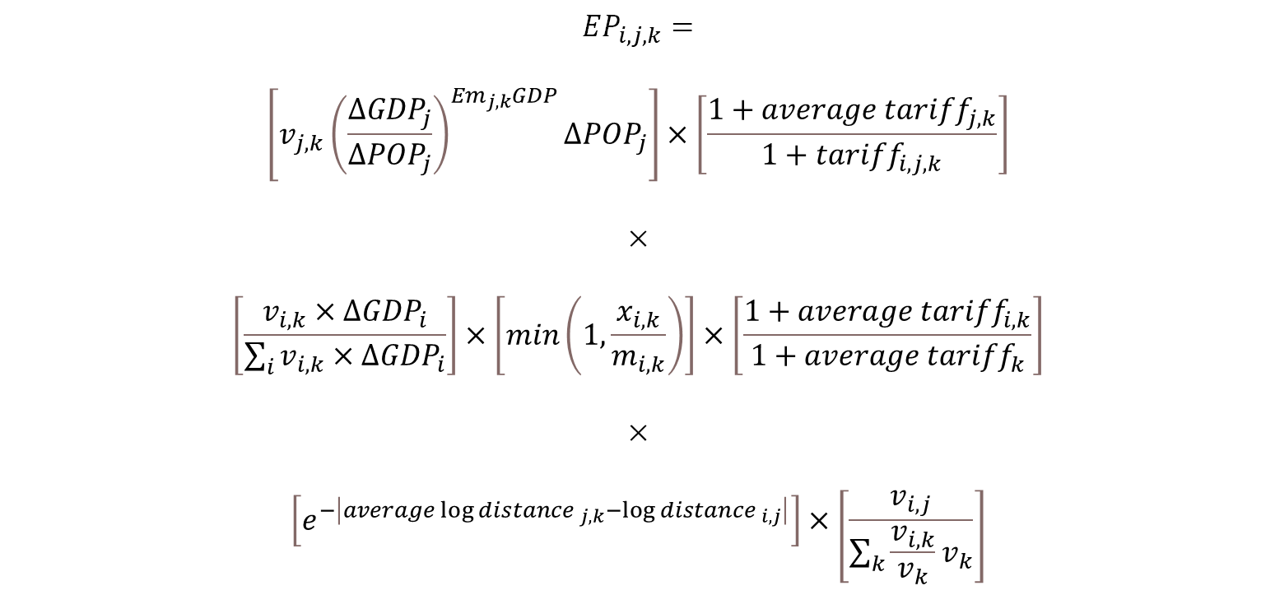
$${EP}_{i,j,k}=$$
$$\left[v_{j,k}{\left(\frac{{∆GDP}_{j}}{{∆POP}_{j}}\right)}^{{Em}_{j,k}GDP}{∆POP}_{j}\right]×\left[\frac{1+{average tariff}_{j,k}}{1+{tariff}_{i,j,k}}\right]$$
$$×$$
$$\left[\frac{v_{i,k}×∆{GDP}_{i}}{\sum_{i}{v_{i,k}×∆{GDP}_{i}}}\right]×\left[min\left(1,\frac{x_{i,k}}{m_{i,k}}\right)\right]×\left[\frac{1+{average tariff}_{i,k}}{1+average {tariff}_{k}}\right]$$
$$×$$
$$\left[e^{−\left|{average\log{distance }}_{j,k}−{\log{distance }}_{i,j}\right|}\right]×\left[\frac{v_{i,j}}{\sum_{k}{\frac{v_{i,k}}{v_{k}}v_{k}}}\right]$$
Where $i$ is the exporting country (i.e. the UK); $j$ is the destination market; $k$ is the commodity of interest.

Slide 2

Demand
$${EP}_{i,j,k}=$$
$$\left[v_{j,k}{\left(\frac{{∆GDP}_{j}}{{∆POP}_{j}}\right)}^{{Em}_{j,k}GDP}{∆POP}_{j}\right]×\left[\frac{1+{average tariff}_{j,k}}{1+{tariff}_{i,j,k}}\right]$$
$$×$$
$$\left[\frac{v_{i,k}×∆{GDP}_{i}}{\sum_{i}{v_{i,k}×∆{GDP}_{i}}}\right]×\left[min\left(1,\frac{x_{i,k}}{m_{i,k}}\right)\right]×\left[\frac{1+{average tariff}_{i,k}}{1+average {tariff}_{k}}\right]$$
$$×$$
$$\left[e^{−\left|{average\log{distance }}_{j,k}−{\log{distance }}_{i,j}\right|}\right]×\left[\frac{v_{i,j}}{\sum_{k}{\frac{v_{i,k}}{v_{k}}v_{jk}}}\right]$$
Supply
Ease of trade
Where $i$ is the exporting country (i.e. the UK); $j$ is the destination market; $k$ is the commodity of interest.

Slide 3
Demand First Term: Expected future imports in the destination country
The only substantial value in the entire set of Export Potential Indicator calculations is $v_{j,k}$ i.e. the total imports in destination market j of commodity k in $.
In the first demand term, this is modified to give an estimate of the total expected future imports in destination market j of commodity k, according to the following equation:
$$\left[v_{j,k}{\left(\frac{{∆GDP}_{j}}{{∆POP}_{j}}\right)}^{{Em}_{j,k}GDP}{∆POP}_{j}\right]$$
In this term, $\left(\frac{{∆GDP}_{j}}{{∆POP}_{j}}\right)$ is an estimate of the growth in GDP per capita. To do this accurately, both ${∆GDP}_{j}$ and ${∆POP}_{j}$ should be measured in the form [1+%$∆]$, where ‘%$∆$’ is the expected growth rate in percentage terms.
As an illustrative example, if GDP were expected to grow by 10% over the period, ${∆GDP}_{j}$ would be equal to 1.1, and if population were expected to shrink by 5%, ${∆POP}_{j}$ would be equal to 0.95.
$\frac{{∆GDP}_{j}}{{∆POP}_{j}}$ then calculates the expected change in GDP per capita in the same units – in this illustrative example 1.158, so an increase of 15.8%. If GDP per capita is expected to increase (decrease) this component will take a value greater than (less than) 1.

Slide 4
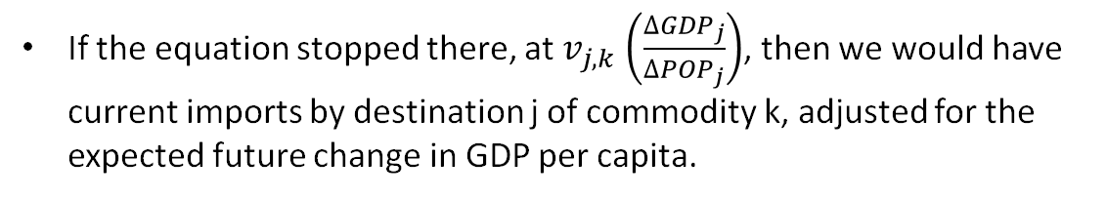
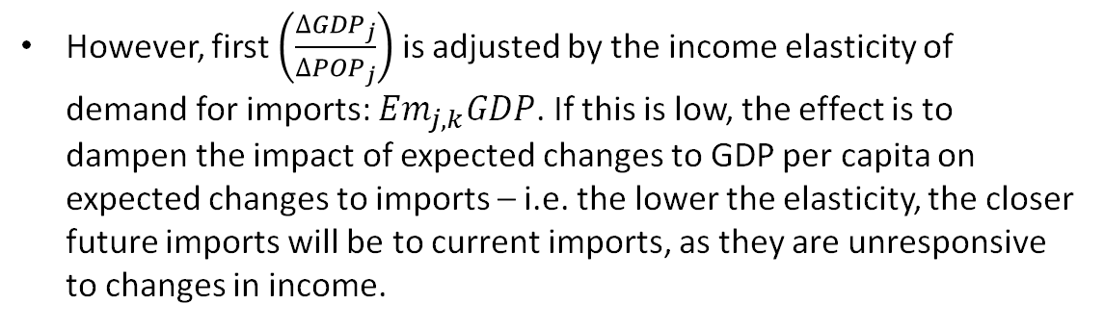
Demand First Term: Expected future imports in the destination country (cont.)
If the equation stopped there, at $v_{j,k}$ $\left(\frac{{∆GDP}_{j}}{{∆POP}_{j}}\right)$, then we would have current imports by destination j of commodity k, adjusted for the expected future change in GDP per capita.
However, first $\left(\frac{{∆GDP}_{j}}{{∆POP}_{j}}\right)$ is adjusted by the income elasticity of demand for imports: ${Em}_{j,k}GDP$. If this is low, the effect is to dampen the impact of expected changes to GDP per capita on expected changes to imports – i.e. the lower the elasticity, the closer future imports will be to current imports, as they are unresponsive to changes in income.
By contrast, the higher the elasticity, the more responsive imports are to changes in income, so a given reduction or increase in GDP per capita will cause future imports to diverge more (in either direction) from current imports.
This is illustrated in the chart above, which shows the multiplicative impact (y axis) of a range of changes in GDP per capita (x axis) on expected future imports relative to current, for 3 different income elasticities (line colour).

Slide 5

Demand First Term: Expected future imports in the destination country (cont.)
Returning to the first term of the demand component of the EPI, $v_{j,k}{\left(\frac{{∆GDP}_{j}}{{∆POP}_{j}}\right)}^{{Em}_{j,k}GDP}$ gives us current total imports in destination j of commodity k, adjust for expected future income growth per person.
All this is lacking then is an adjustment for the expected change in the number of people – i.e. the change in population. This is added in the last part of this term, where the expression above is multiplied by ${∆POP}_{j}$ - once again measured in the form [1+%$∆]$.
The effect of this is obviously to increase expected future imports (relative to current imports) if the population is expected to increase, and reduce them if the population is expected to decrease.
This leaves us with the first term of the demand component: expected total future imports in destination country j of commodity k, in $:
$$\left[v_{j,k}{\left(\frac{{∆GDP}_{j}}{{∆POP}_{j}}\right)}^{{Em}_{j,k}GDP}{∆POP}_{j}\right]$$

Slide 6
Demand
$${EP}_{i,j,k}=$$
$$\left[v_{j,k}{\left(\frac{{∆GDP}_{j}}{{∆POP}_{j}}\right)}^{{Em}_{j,k}GDP}{∆POP}_{j}\right]×\left[\frac{1+{average tariff}_{j,k}}{1+{tariff}_{i,j,k}}\right]$$
$$×$$
$$\left[\frac{v_{i,k}×∆{GDP}_{i}}{\sum_{i}{v_{i,k}×∆{GDP}_{i}}}\right]×\left[min\left(1,\frac{x_{i,k}}{m_{i,k}}\right)\right]×\left[\frac{1+{average tariff}_{i,k}}{1+average {tariff}_{k}}\right]$$
$$×$$
$$\left[e^{−\left|{average\log{distance }}_{j,k}−{\log{distance }}_{i,j}\right|}\right]×\left[\frac{v_{i,j}}{\sum_{k}{\frac{v_{i,k}}{v_{k}}v_{jk}}}\right]$$
Supply
Ease of trade
Where $i$ is the exporting country (i.e. the UK); $j$ is the destination market; $k$ is the commodity of interest.

Slide 7
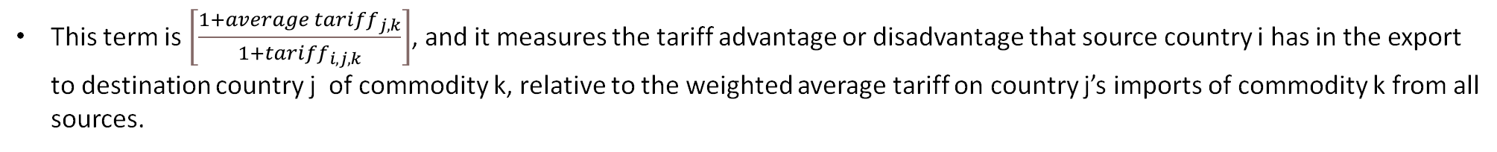
Demand Second Term: Adjustment for tariff (dis)advantage
The second term of the demand section of the EPI is the first term in which any information appears which is specific to the source country i. This, and all other terms in the EPI, perform adjustments to the expected future total imports in destination country j of commodity k, in $. These adjustments make the ultimate estimated export potential (EPI – also in $) ever more specific to the characteristics of source country i.
This term is $\left[\frac{1+{average tariff}_{j,k}}{1+{tariff}_{i,j,k}}\right]$, and it measures the tariff advantage or disadvantage that source country i has in the export to destination country j of commodity k, relative to the weighted average tariff on country j’s imports of commodity k from all sources.
If the tariff on commodity k coming from source country i is lower (higher) than that average, then this term is greater (less) than 1, and its effect is to increase (reduce) potential exports.
This adjustment is applied to the first term, to give the whole demand section of the EPI:
$$\left[v_{j,k}{\left(\frac{{∆GDP}_{j}}{{∆POP}_{j}}\right)}^{{Em}_{j,k}GDP}{∆POP}_{j}\right]×\left[\frac{1+{average tariff}_{j,k}}{1+{tariff}_{i,j,k}}\right]$$

Slide 8
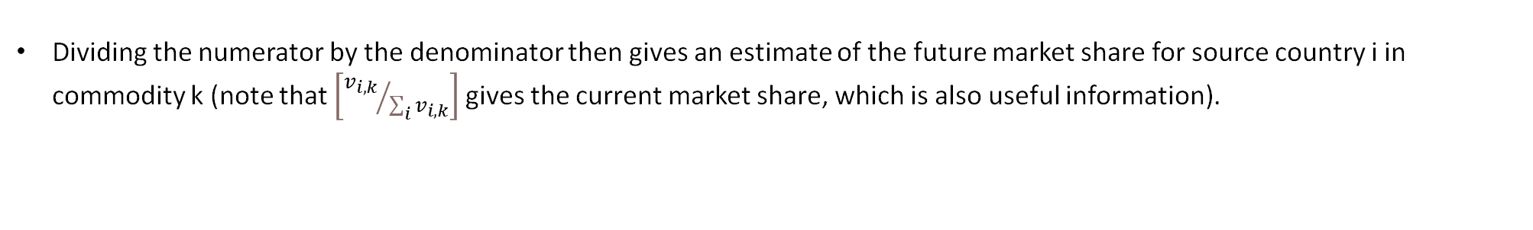
Supply First Term: Expected future market share
The first term in the supply section of the EPI applies a major adjustment to the value generated above, by estimating source country i’s projected market share of global exports in commodity k, and then applying this to the project imports in destination country j, which was estimated in the demand section. This is done in the term:
$$\left[\frac{v_{i,k}×∆{GDP}_{i}}{\sum_{i}{v_{i,k}×∆{GDP}_{i}}}\right]$$
The numerator in the above term takes current exports from source country i of commodity k, and multiplies them by the projected expansion of the economy in that country, to estimate the future value of exports.
As above, the appropriate units for $∆{GDP}_{i}$ is [1+% $∆$], so the numerator will be larger than current exports if the source country economy is expected to grow, and smaller if the economy is expected to shrink.
The denominator then does this same for all countries – i.e. multiplies current exports by future GDP growth – and sums them to get an estimate of the future global value of all exports of commodity k.
Dividing the numerator by the denominator then gives an estimate of the future market share for source country i in commodity k (note that $\left[{v_{i,k}}/{\sum_{i}{v_{i,k}}}\right]$ gives the current market share, which is also useful information).

Slide 9
Supply Second Term: Net importer adjustment
The second term in the supply section applies a downward adjustment if source country i is a net importer of commodity k. This is done in the term:
$$\left[min\left(1,\frac{x_{i,k}}{m_{i,k}}\right)\right]$$
Here, $x_{i,k}$ represents the value of exports from source country i of commodity k, while $m_{i,k}$ represents imports of the same.
If exports are greater than imports – i.e. the country is a net exporter – then the expression $\frac{x_{i,k}}{m_{i,k}}$ will yield a value greater than 1, so the minimum of this value and 1 will be 1, and there will be no adjustment to the export potential value.
On the other hand if imports are greater than exports – i.e. the country is a net importer – then the expression will yield a value less than 1, so the minimum of this value and 1 will be the value, and the export potential value will be adjusted downwards.
The size of the downward adjustment will depend on the extent to which i is a net importer. For example, if the value of imports were twice the value of exports, this would yield a value of 0.5, and thus halve the export potential estimate.

Slide 10
Supply Third Term: Global tariff (dis)advantage adjustment
The final term in the supply section applies an adjustment based on the extent to which country i currently has a tariff advantage or disadvantage, on the basis that this could be ‘artificially’ inflating or deflating their global market share, such that the market share in destination country j needs to be adjusted downwards or upwards. This is done in the term:
$$\left[\frac{1+{average tariff}_{i,k}}{1+average {tariff}_{k}}\right]$$
If for commodity k, the average tariff faced by exports from i is greater than the average global tariff on k, then country i currently has a tariff disadvantage, and its market share needs to be adjusted upwards – so the value of this term is greater than 1.
On the other hand, if the average tariff faced by exports from i is less than the average global tariff on k, then country i currently has a tariff advantage, and its market share needs to be adjusted downwards – so the value of this term is less than 1.

Slide 11
Demand
Supply
Ease of trade
Where $i$ is the exporting country (i.e. the UK); $j$ is the destination market; $k$ is the commodity of interest.

Slide 12
Ease of trade First Term: Distance
The first term in the ease of trade section makes a downward adjustment based on distance. The term takes a value of between 0 and 1.
However, this is adjustment is not simply that the trade potential increases if countries are closer together and decreases if they are further away. Instead, the relevant factor is the distance between the countries relative to the average distance travelled by country j’s imports of k. This is done in the term:
$$\left[e^{−\left|{average\log{distance }}_{j,k}−{\log{distance }}_{i,j}\right|}\right]$$
The || signs around the expression make this an absolute value, which ensures that the minus sign in front of the expression makes the exponent negative. Any base to the power of a negative number is the same as 1 / (base to the power of the absolute number). In this case, we will have 1/(e ^ a positive number).
Euler's number (e) to the power of x will always have the gradient (rate of change with respect to x) of x.
The smallest value the exponent can take is 0; hence the smallest number the denominator can take is 1. This would give the entire expression a value of (1/1) = 1.
Therefore, as the distance between I and j tends towards the average distance on all j’s imports of k, then this number tends towards 1, and the downward adjustment gets smaller and smaller. There can be no upward adjustment from this expression.
The greater the difference between I and j's distance and the average distance of all of j's imports of k, the more this term shrinks the whole EPI down.

Slide 13
Ease of trade Second Term: relative propensity to trade do the countries trade goods more or less than we’d expect?
The second term in the ease of trade section accounts for whether observed exports of all commodities from origin i to destination j are higher or lower than what we’d expect to see based on the average i -> RoW flows.
$$\left[\frac{v_{i,j}}{\sum_{k}{\frac{v_{i,k}}{v_{k}}v_{jk}}}\right]$$
Denominator: ratio: the value of commodity k exported by origin country i as a proportion of total global commodity k exports. Ie., how much of total global exports of k come from origin country i? Maximum value of 1, minimum of 0.
Denominator: multiplying this by v_jk: the value of commodity k imported by country j (an absolute amount in $). The ratio is modifying down this import figure according to what proportion of total global trade origin country i’s exports of k represent. The assumption is that destination country j is typical of all countries w/r/t the proportion of its imports of k that come from country i. A value in $ absolute terms.
Denominator: summing the result over all commodities: this gives a total value in $ absolute terms by adding up across all commodities. It gives the total value of what we’d assume would be imported to j from origin i if i -> j trade were typical of i -> world trade. The result is a large absolute number in $. It’s an estimate.
Numerator: the total value of all exports from origin I to destination j (of all commodities). A large absolute number in $. Empirically observed.
Numerator / denominator: the result of the expression is a $/$ ratio. It could be anything from 0 to an arbitrarily large number, but if the observed relationship reflected the estimate based on global average, it would equal 1. This ratio is saying: ‘the total i -> j flows (of all commodities) we observe, relative to the flows we would expect to observe if j was typical’. So it’s ‘empirical / expected’. If what we observe is more than what would be expected based on the average, the number will be >1 and this will multiply the EPI expression upwards. If observed commodity flows from origin I to destination j are lower than we’d expect (based on the average), this will be 0 <= x < 1, and this fraction will modify down the value of the EPI expression.
This term is not specific to the choice of commodity k. It varies w/r/t i-j country pairs and is an i-j pair-specific value. It doesn’t vary w/r/t k.

Slide 14
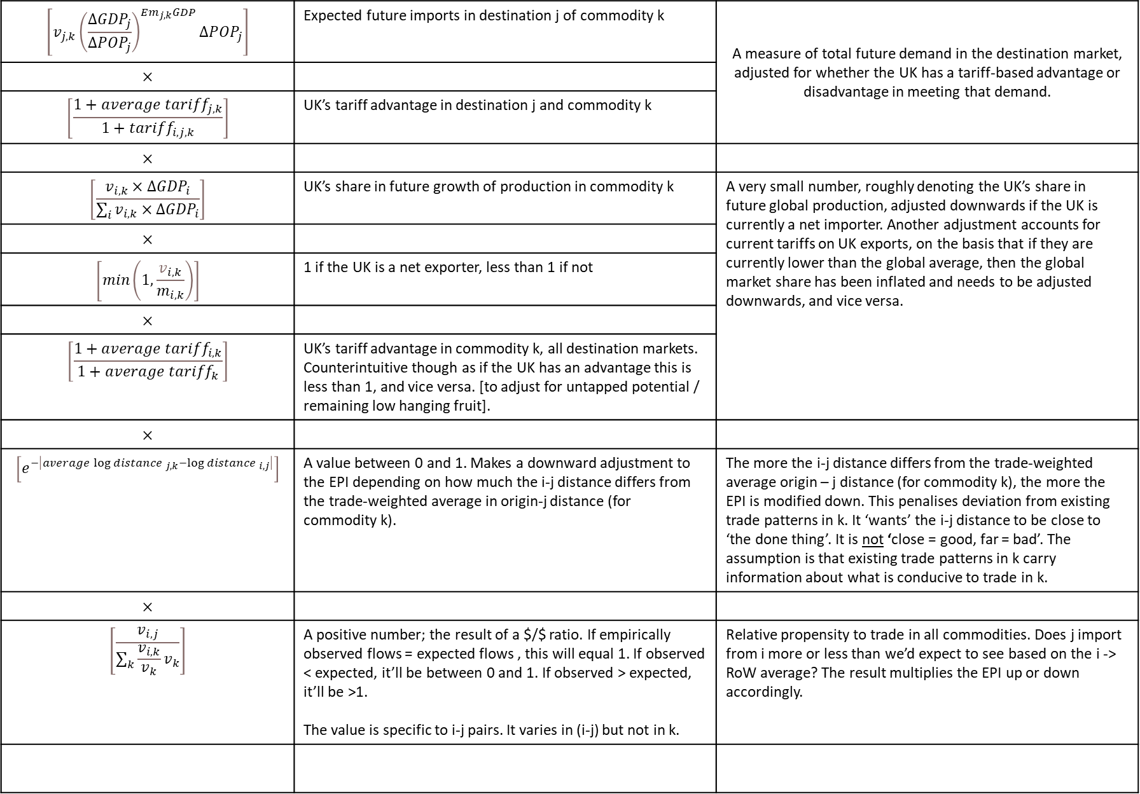
$$\left[v_{j,k}{\left(\frac{{∆GDP}_{j}}{{∆POP}_{j}}\right)}^{{Em}_{j,k}GDP}{∆POP}_{j}\right]$$ | Expected future imports in destination j of commodity k | A measure of total future demand in the destination market, adjusted for whether the UK has a tariff-based advantage or disadvantage in meeting that demand.
$$×$$
$$\left[\frac{1+{average tariff}_{j,k}}{1+{tariff}_{i,j,k}}\right]$$ | UK’s tariff advantage in destination j and commodity k
$$×$$
$$\left[\frac{v_{i,k}×∆{GDP}_{i}}{\sum_{i}{v_{i,k}×∆{GDP}_{i}}}\right]$$ | UK’s share in future growth of production in commodity k | A very small number, roughly denoting the UK’s share in future global production, adjusted downwards if the UK is currently a net importer. Another adjustment accounts for current tariffs on UK exports, on the basis that if they are currently lower than the global average, then the global market share has been inflated and needs to be adjusted downwards, and vice versa.
$$×$$
$$\left[min\left(1,\frac{v_{i,k}}{m_{i,k}}\right)\right]$$ | 1 if the UK is a net exporter, less than 1 if not
$$×$$
$$\left[\frac{1+{average tariff}_{i,k}}{1+average {tariff}_{k}}\right]$$ | UK’s tariff advantage in commodity k, all destination markets. Counterintuitive though as if the UK has an advantage this is less than 1, and vice versa. [to adjust for untapped potential / remaining low hanging fruit].
$$×$$
$$\left[e^{−\left|{average\log{distance }}_{j,k}−{\log{distance }}_{i,j}\right|}\right]$$ | A value between 0 and 1. Makes a downward adjustment to the EPI depending on how much the i-j distance differs from the trade-weighted average in origin-j distance (for commodity k). | The more the i-j distance differs from the trade-weighted average origin – j distance (for commodity k), the more the EPI is modified down. This penalises deviation from existing trade patterns in k. It ‘wants’ the i-j distance to be close to ‘the done thing’. It is not ‘close = good, far = bad’. The assumption is that existing trade patterns in k carry information about what is conducive to trade in k.
$$×$$
$$\left[\frac{v_{i,j}}{\sum_{k}{\frac{v_{i,k}}{v_{k}}v_{k}}}\right]$$ | A positive number; the result of a $/$ ratio. If empirically observed flows = expected flows , this will equal 1. If observed < expected, it’ll be between 0 and 1. If observed > expected, it’ll be >1. The value is specific to i-j pairs. It varies in (i-j) but not in k. | Relative propensity to trade in all commodities. Does j import from i more or less than we’d expect to see based on the i -> RoW average? The result multiplies the EPI up or down accordingly.

Slide 15
Variables 1: Trade flows (current)
$m_{i,k}$=> total UK (i) imports of commodity k
$v_{i,j}$=> total UK (i) exports to destination market j
$v_{i,k}$ => total UK (i) exports of commodity k
$v_{j,k}$ => total imports in destination market j of commodity k
$v_{k}$ => total global trade in commodity k

Slide 16
Variables 2: Tariffs
${average.tariff}_{i,k}$=> average tariff faced by exports of commodity k from UK (i)
${average.tariff}_{k}$=> average tariff faced by all trade flows of commodity k
${average.tariff}_{j,k}$ => average tariff faced by all imports of commodity k by market j
${tariff}_{i,j,k}$ => tariff faced by exports of commodity k from the UK (i) to destination market j

Slide 17
Variables 3: Distances
${average\log{distance}}_{j,k}$=> average distance of imports of commodity k by destination market j, logged
${\log{distance}}_{i,j}$=> distance between UK (i) and destination market j

Slide 18
Variables 4: Projections
${∆GDP}_{i}$=> projected change in GDP in UK (i)
${∆GDP}_{j}$=> projected change in GDP destination market j
${∆POP}_{j}$=> projected change in population in destination market j

Slide 19
Variables 5: Elasticities
${Em,GDP}_{j,k}$=> Elasticity of imports per capita with respect to GDP per capita of commodity k in destination country j
$σ_{k}$=> Armington elasticity of substitution

