Slide 1
Introduction to quantitative text analysis
Michael Marshall
GEOGRAPHY and Planning, University of Sheffield

Slide 2
Download R
https://cran.rstudio.com/
Download RStudio
https://posit.co/download/rstudio-desktop/
Download session materials from github and save it in your U:drive
https://github.com/michael-s-marshall/foss_text_analysis.git
Run the script below
00_installing_packages.R
Download Glove embeddings – glove.6B.zip
https://nlp.stanford.edu/projects/glove/

Slide 3
Welcome
Michael Marshall
Research Associate in Geography and Planning
Research the political economy of housing and decarbonisation of the built environment
Quantitative text analysis projects:
Changing style of political leaders in the UK Labour Party
How UK Members of Parliament talk about housing policy in parliamentary speeches
Understanding regulatory reform in the English affordable housing sector

Slide 4
Content
What is quantitative text analysis?
Common tasks and applications
Challenges in text analysis
Preparing data
Representing text as numbers
Dictionary analysis
Practical

Slide 5
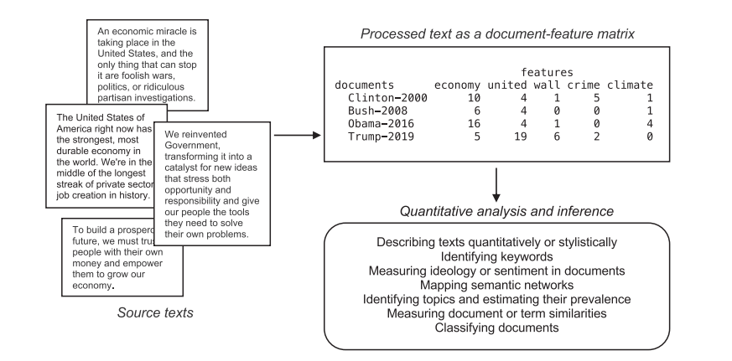
What is quantitative text analysis?
Treatment of text as data
Conversion of text to a quantitative form to allow for statistical analysis
“Quantitative text analysis thus moves textual data into the same domain as other types of quantitative data analysis, making it possible to bring to bear well-tested statistical and machine learning tools of analysis and prediction” (Benoit, 2020: 464)

Slide 6
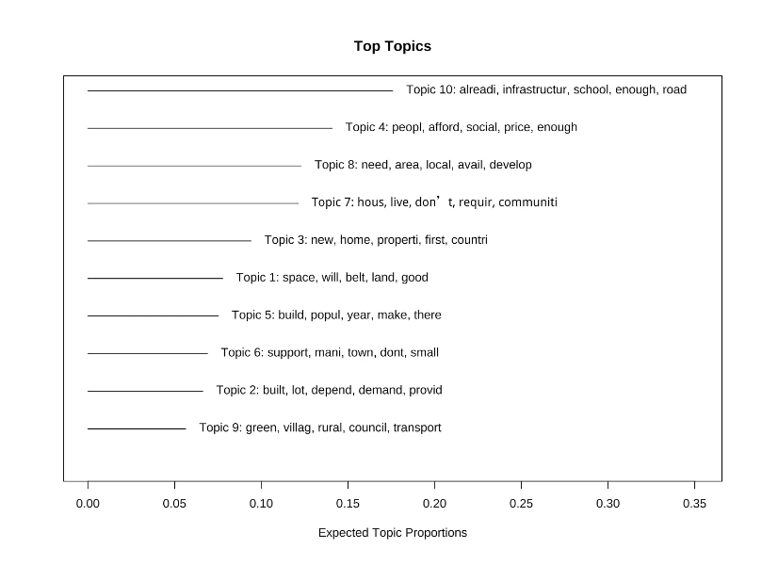
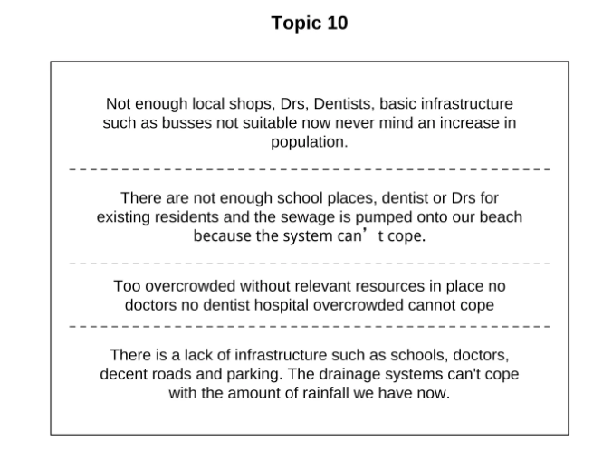
Common tasks and applications
1. Topic modelling
Identify the themes (i.e. topics) within a set of documents
Estimate whether the discussion of a topic varies according to an independent variable
Ansell (2023) The UK’s Political Housing Crisis

Slide 7
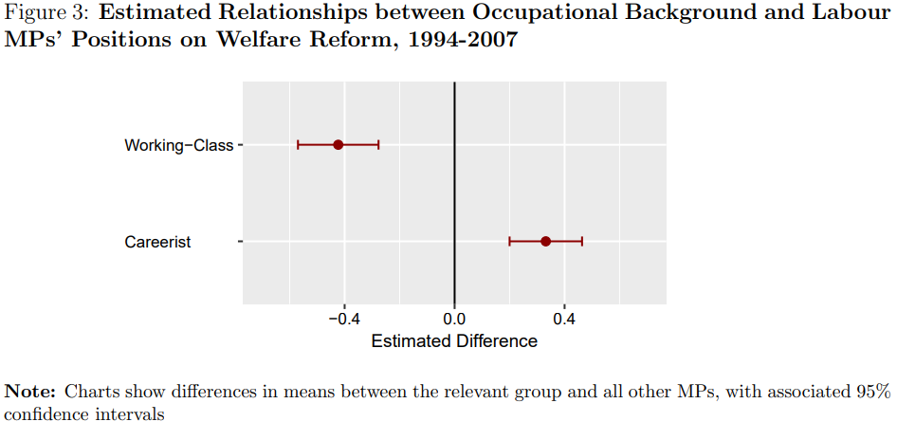
Common tasks and applications
2. Scaling
Place documents along a latent continuous scale according to their word usage
Comparing the stance of working class and careerist MPs on welfare reform (O’Grady, 2018)

Slide 8
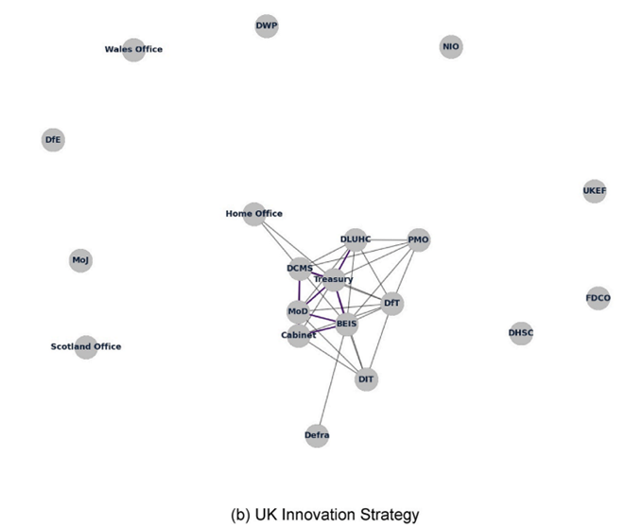
Common tasks and applications
3. Document similarity
Identifying similar documents based upon word or phrase usage
Analysing policy coordination across government using networks of document similarity between government departments (Coyle and Muhtar, 2023)

Slide 9
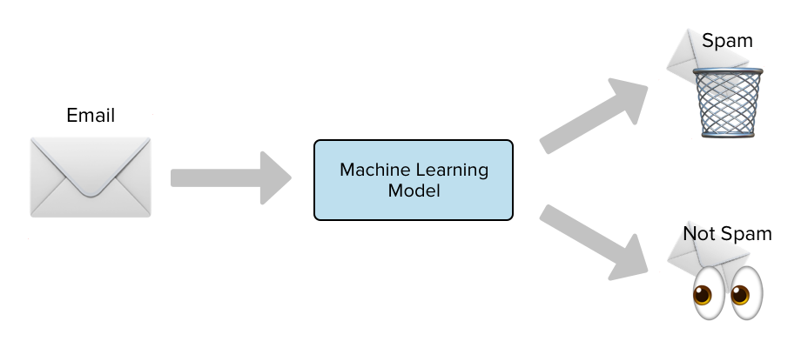
Common tasks and applications
4. Text classification
Classifying documents according by a categorical outcome variable e.g. author, political position, spam filter

Slide 10
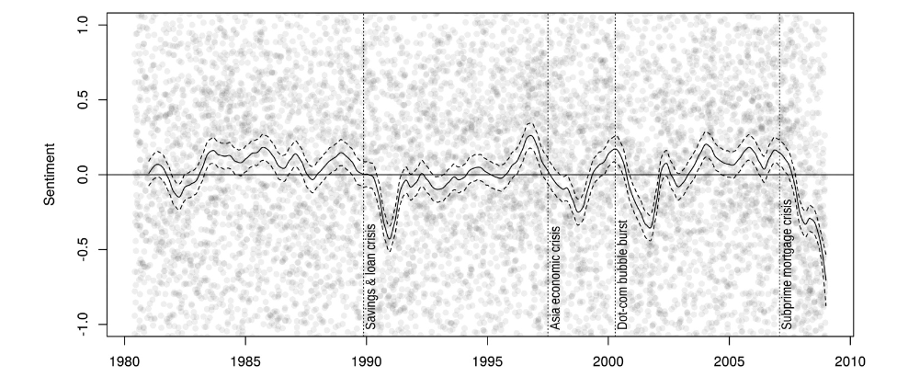
Common tasks and applications
5. Sentiment analysis
Classify or scale documents according to their positive or negative sentiment
Sentiment of New York Times articles on the economy over time (Watanabe, 2021)

Slide 11

Challenges in text analysis
Defining the corpus and avoiding sample bias
Conversion to a common electronic format
Large amounts of unstructured data
Encoding issues
Ethical considerations

Slide 12
Preparing data
Cleaning
Converting to lower case
Removing punctuation and symbols
Correcting spelling mistakes
Removing stop words
a, the, is, at, of…

Slide 13
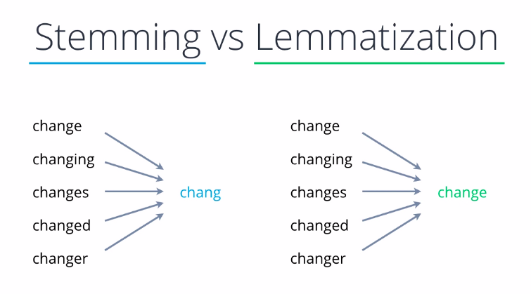
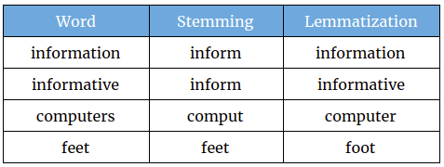
Preparing data

Slide 14
Preparing data
Tokenisation
Reducing documents down to ‘tokens’
Tokens = smallest units of analysis that are used for analysis
Often words
But could be smaller e.g. letters
Or larger multi-word expressions e.g. ‘European Union’
Tokenisation occurs before the numerical representation of words

Slide 15
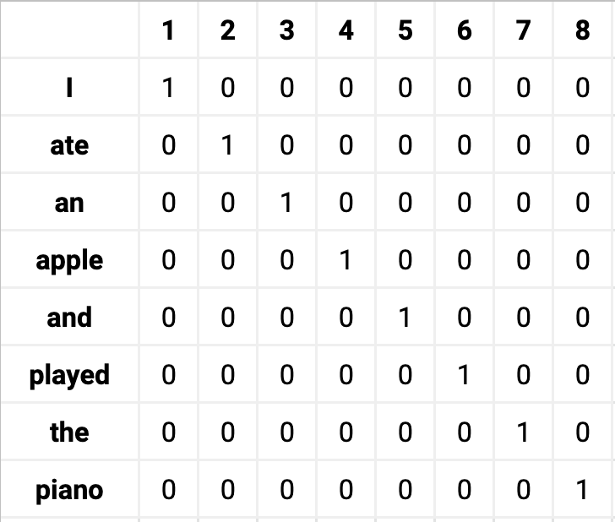
Representing text as numbers
One-hot encoding

Slide 16
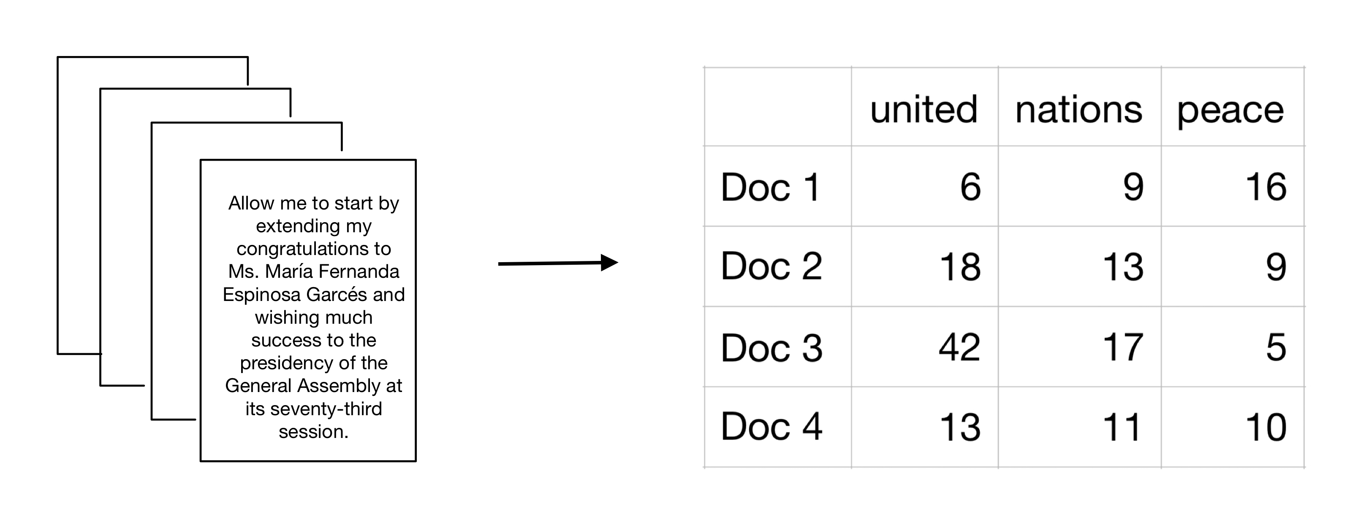
Representing text as numbers
DOCUMENT FEATURE MATRIX (DFM)
Also known as document term matrix (DTM)
Each row is a document
Each column is a feature i.e. a token
Cells are the count of each feature per document

Slide 17
Dictionary analysis
Dictionary defines words associated with a given concept
Positive sentiment: happy, amazing, brilliant, joyful
Aggression: anger, attack, hostile
Calculate the frequency or proportion of words in a document occurring in the dictionary
Pros:
Simple
Large number of dictionaries have been created – no need to reinvent the wheel
Cons:
Too simplistic for some tasks
False positive and negative words in dictionary construction
Dictionaries often context-specific
Dictionary construction slow and time consuming
Can easily increase the prevalence of a concept by increasing size of the dictionary

Slide 18


Practical
Political party manifestos
Green Party vs. Reform UK
Analysis steps
Importing data
Cleaning and pre-processing
Counts of high frequency words
Conversion to dfm
Dictionary analysis: environment dictionary, immigration dictionary

Slide 19
References
Ansell, B. (2023). The UK’s Political Housing Crisis. Substack. https://benansell.substack.com/p/the-uks-political-housing-crisis
Benoit, K. (2020). Text as data: An overview. In SAGE Handbook of Research Methods in Political Science and International Relations. London: SAGE.
Coyle, D. and Muhtar, A. (2023). Assessing policy co-ordination in government: Text and network analysis of the UK's economic strategies. European Journal of Political Economy, 79(23). https://doi.org/10.1016/j.ejpoleco.2023.102402
O’Grady, T. (2019). Careerists Versus Coal-Miners: Welfare Reforms and the Substantive Representation of Social Groups in the British Labour Party. Comparative Political Studies, 52(4), 544-578. https://doi.org/10.1177/0010414018784065
Watanabe, K. (2021) Latent Semantic Scaling: A Semisupervised Text Analysis Technique for New Domains and Languages. Communication Methods and Measures, 15:2, 81-102, DOI: 10.1080/19312458.2020.1832976

