Slide 1
Introduction to quantitative text classification
Michael Marshall
GEOGRAPHY and Planning, University of Sheffield

Slide 2
Content
TF-IDF
Text classification and logit regression
Word embeddings
Text classification with word embeddings
Transformers / LLMs

Slide 3
TF-IDF
Term frequency-inverse document frequency
Measure of importance of a word to a document
Alternative to word counts
Useful for exploratory analysis or as a weighting factor for words in a model

Slide 4
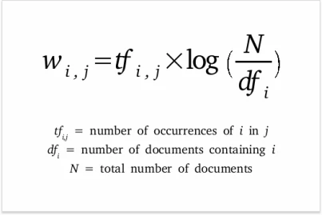
TF-IDF
Frequency of a word in a document multiplied by its inverse frequency
In effect, it applies a weight that penalises words that occur frequently across all documents
Identifies words that are important to the specific document in question, rather than words common across all documents

Slide 5
TF-IDF practical
Green Party and Reform UK manifestos
Top 50 most important words in each manifesto according to tf-idf

Slide 6
Text classification
Classifying documents according to a categorical outcome variable
Examples:
classifying tweets by whether they discuss climate change or not (Shyrokykh et al., 2023)
classifying acts of state violence by whether they were targeted or indiscriminate (Gohdes, 2020)
Classifying news headlines according to their geographical focus (Watanabe, 2017)
Often an instrumental step in a larger analysis e.g. constructing a predictor variable

Slide 7
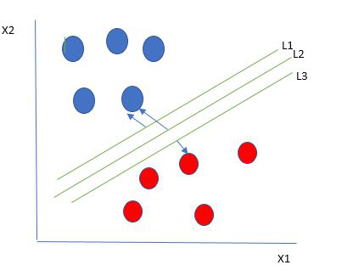
Text classification
Can be achieved through many different modelling approaches, including:
Support vector machines
Random forests
XGBoost
Neural networks

Slide 8
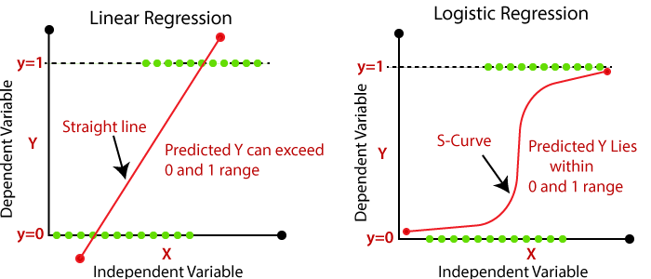
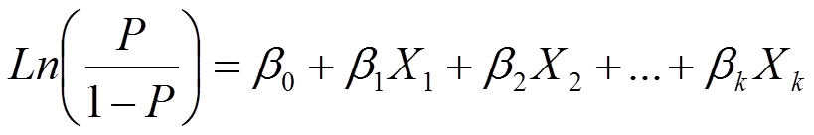
Text classification
But we will use a simple approach that is still often effective - logit regression
Binary outcome variable
Model the log odds of the outcome using a linear regression model
Log odds transformed back into a predicted probability to classify documents

Slide 9
Text classification practical
Classifying sentences by whether they were authored by the Green Party or Reform UK
Logit regression as classifier
Predictors are the frequencies of high tf-idf words identified in the previous step

Slide 10
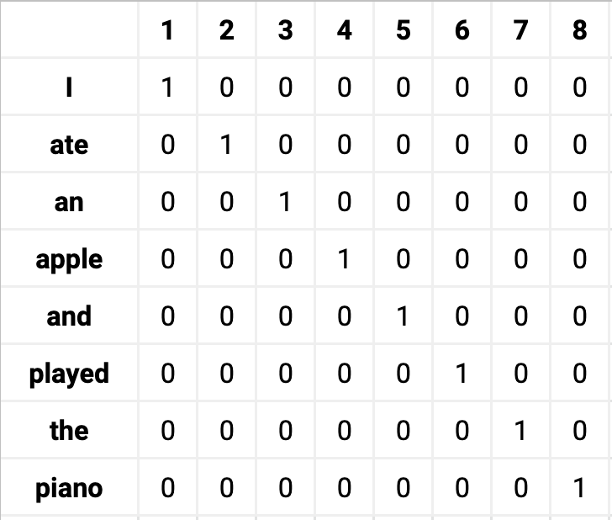
Word embeddings
One-hot-encoding and word counts have drawbacks as quantitative representations of words
Matrix sparsity – high number of dimensions, inefficient and computationally expensive
Blind to context – bag of words assumption doesn’t encode information about word contexts or similar word usages

Slide 11
Word embeddings
Word embeddings address these limitations
Word embeddings are dense vectors that represent individual words, where the values in the vector encode information about the word's meaning and its relation to other words
Embeddings are sometimes thought of as conceptually similar to principal components analysis or factor analysis, as latent factors that represent word usage and meaning. But unlike factor analysis, in practice the latent factors in word embeddings are often not interpretable or substantively meaningful

Slide 12
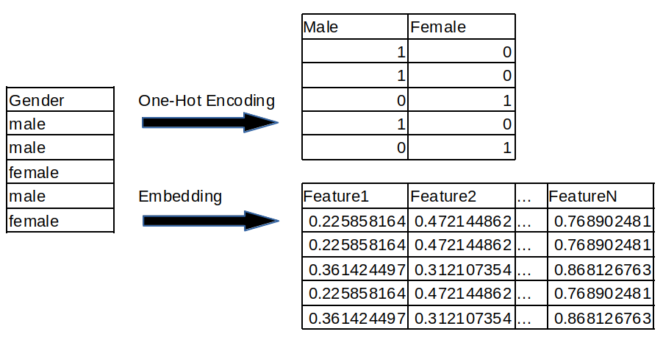
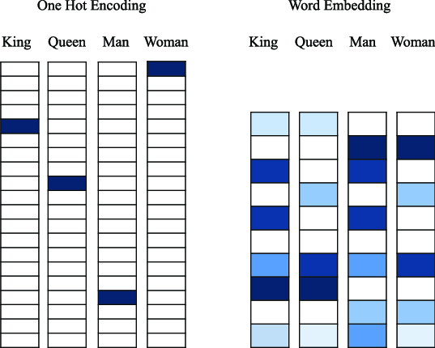
Word embeddings
Density of word embeddings makes them efficient vs. sparsity of other matrices (e.g. one-hot-encoding)

Slide 13
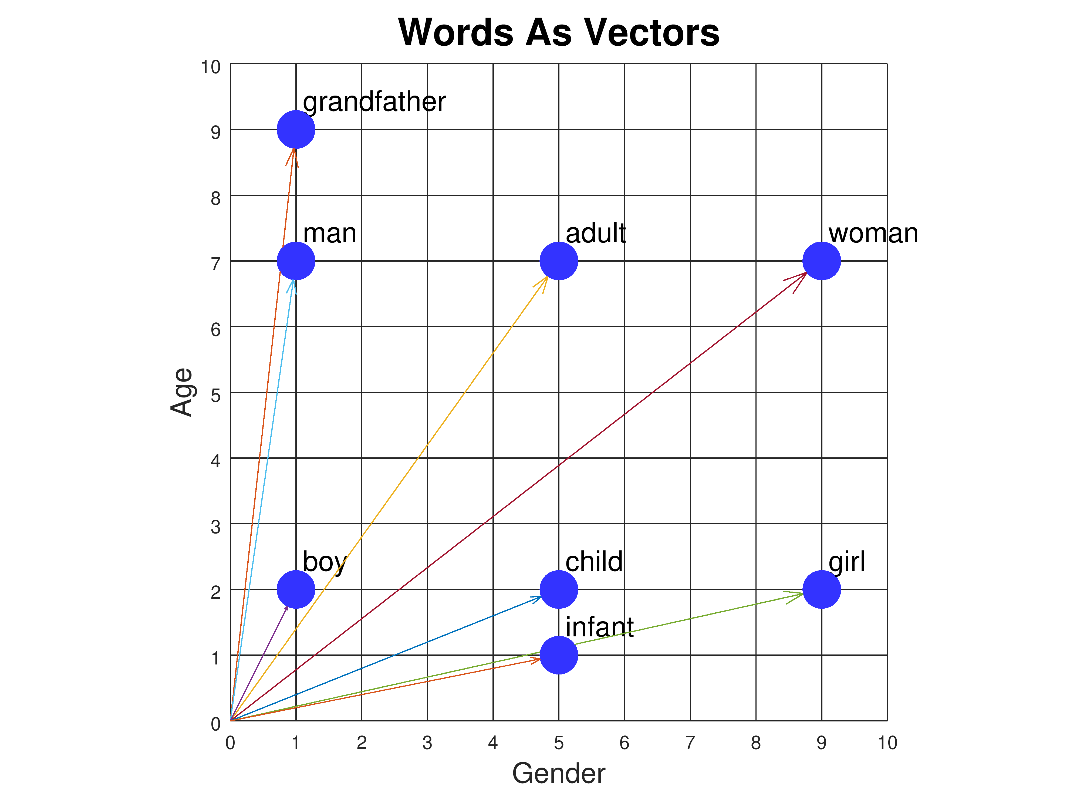
Word embeddings
Unlike one-hot-encoding, we can capture word context and similarity in word embeddings
Embedding vectors can be thought of as coordinates representing words
Words with similar meanings are often located close to each other in the embedding space
Size of the angle between vectors often used as a measure of word similarity – calculated as cosine similarity

Slide 14
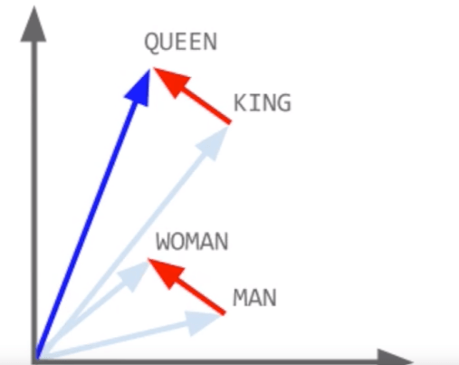
Word embeddings
Embeddings useful for identifying analogous words
Can perform vector arithmetic
king – man + woman = queen

Slide 15
Training word embeddings
Can be trained locally using your own dataset
Or you can use pre-trained embeddings
word2vec – pre-trained word vectors. Vector is the weights of a neural network, where the neural network is predicting a word based upon its immediately neighbouring words

Slide 16
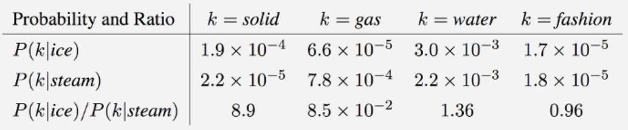
Word embeddings: GloVe
Pennington et al. (2014) Global Vectors (GloVe) for Word Representation
“You will know a word by the company that it keeps”
Word co-occurrence probabilities capture some latent meaning

Slide 17
Word embeddings: GloVe
Co-occurrence matrix of words – co-occurrence of word j in context of word i
Context is a fixed window around word i
GloVe algorithm identifies word vectors that predict the co-occurrence probabilities of the word with other words
Resulting vectors represent the meaning of words based upon how they are used in context
Words appearing in similar contexts will be closer together in vector space

Slide 18
Text classification with word embeddings
Pre-trained GloVe embeddings with 200 dimensions
Calculate the mean embedding for each document
Mean embedding = sum of word embeddings / number of words
This gives us data frame where:
each row is a document
each column represents an element in a GloVe embedding (k=200)
each cell is the mean value for that element per document
Used to classify sentences by political party i.e. Green Party or Reform UK

Slide 19
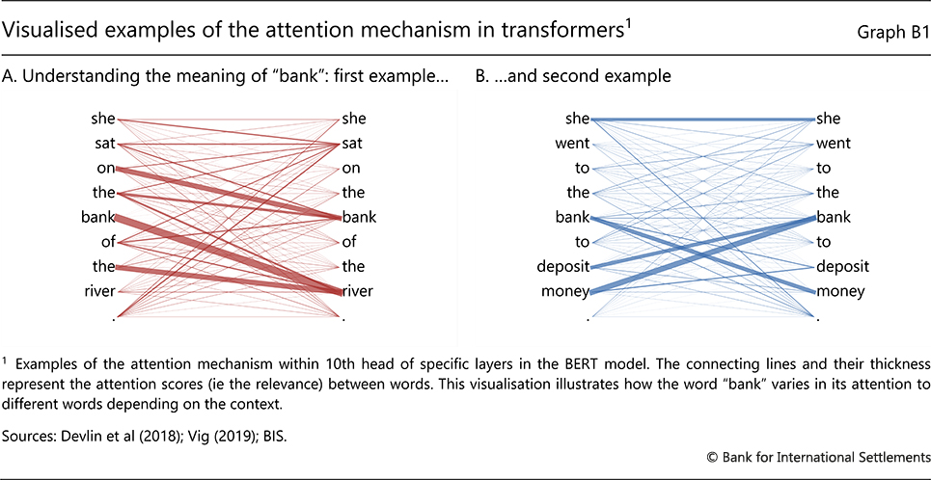
Transformers / LLMs
Transformers extend natural language processing by adding an attention mechanism
Improves classification by adding further context
Querying paradigm has emerged around pre-trained models e.g. GPT-4

Slide 20
References
Gohdes, A. R. (2020). Repression Technology: Internet Accessibility and State Violence. American Journal of Political Science. 64(3).
Pennington, J., Socher, R., Manning, C. D. (2014). GloVe: Global Vectors for Word Representation. https://nlp.stanford.edu/pubs/glove.pdf
Shyrokykh, K., Girnyk, M., Dellmuth, L. (2023). Short text classification with machine learning in the social sciences: The case of climate change on Twitter. PLOS ONE. 18(9): e0290762. https://doi.org/10.1371/journal.pone.0290762
Watanabe, K. (2017). Newsmap: semi-supervised approach to geographical news classification. Digital Journalism. ISSN 2167-0811 DOI: 10.1080/21670811.2017.1293487

