Slide 1

Grant Advisor
Community Economic Resilience & Micro-Grants
Agents for Impact 2026 | Track: Main Street Relief | Corridor: Central Market, SF
Team 3

Slide 2

The Problem: Relief That Ignores the Network
A city has $50,000 and more applicants than money. Ranking them one by one misses the supply chains between them: one closure can push businesses 1–2 hops away into trouble.
Who benefits: grant officers get a defensible, network-aware recommendation; residents of high-poverty corridors like SF's Central Market keep the storefronts they rely on.

Slide 3
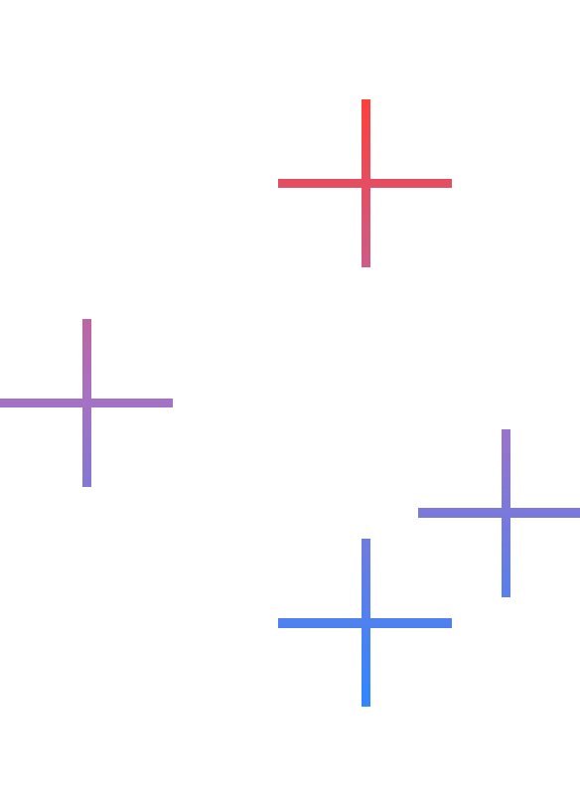
A Network-Aware Grant Advisor
The Agent
Google ADK + Gemini walk a BigQuery property graph (multi-hop GQL) to find every business a closure would expose.
User Interaction
The officer sets a budget in the Grant Desk; the agent ranks the queue, traces the cascade and answers follow-up questions.
Concrete Outcome
A Grant Memo: who to fund, how much, which businesses it protects, why not the runner-up, plus an equity audit.

Slide 4

Live Demo on Real Data
App: grant-desk (private Cloud Run service)
Data: BigQuery, 232 real Central Market businesses
Repo: github.com/michael-shl/google-hackathon-trt3
$50,000 across 11 applicants (simulated applications, real businesses):
• Funds Cumaica Coffee $20k and Sour Flour $25k: each protects 148 businesses within 2 hops.
• Uses the whole budget: a partial $5k grant to G.Rabbit (18 businesses exposed).
• Every path comes from a live BigQuery GQL traversal, written up as a 7-section Grant Memo.

Slide 5
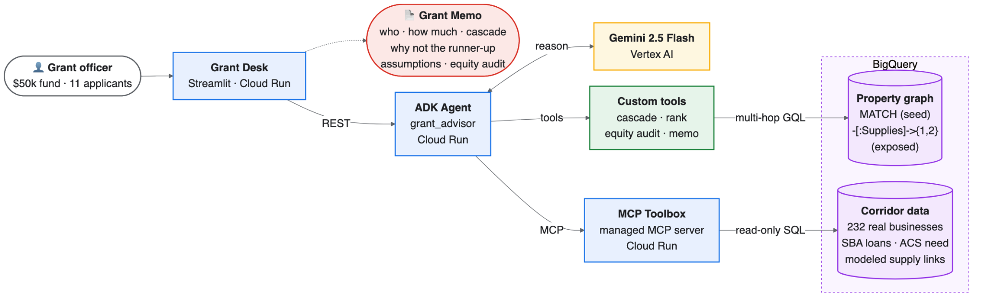
Architecture & Rigor
Built on: Cloud Run (private) · ADK + Gemini 2.5 Flash · MCP Toolbox · BigQuery property graph
Rigor: real vs modeled data labelled on every answer · grant effect stated with low / base / high settings · equity audit · 31 tests

