Slide 1
Distributed Ledger Technology
Hands On Lecture
Michael Spengler

Slide 2
My Way to Understanding the DLT
In 2012 I had been asked what I think about Bitcoin…
I gave a pretty stupid answer…
Reason: I wasn’t even aware of the problems which the Bitcoin whitepaper provides solutions for

Slide 3
Aspects of the Problem Space
Fiat Money
Manipulation
Corruption enabled by centralized entities
Inflation as a Vector
…

Slide 4
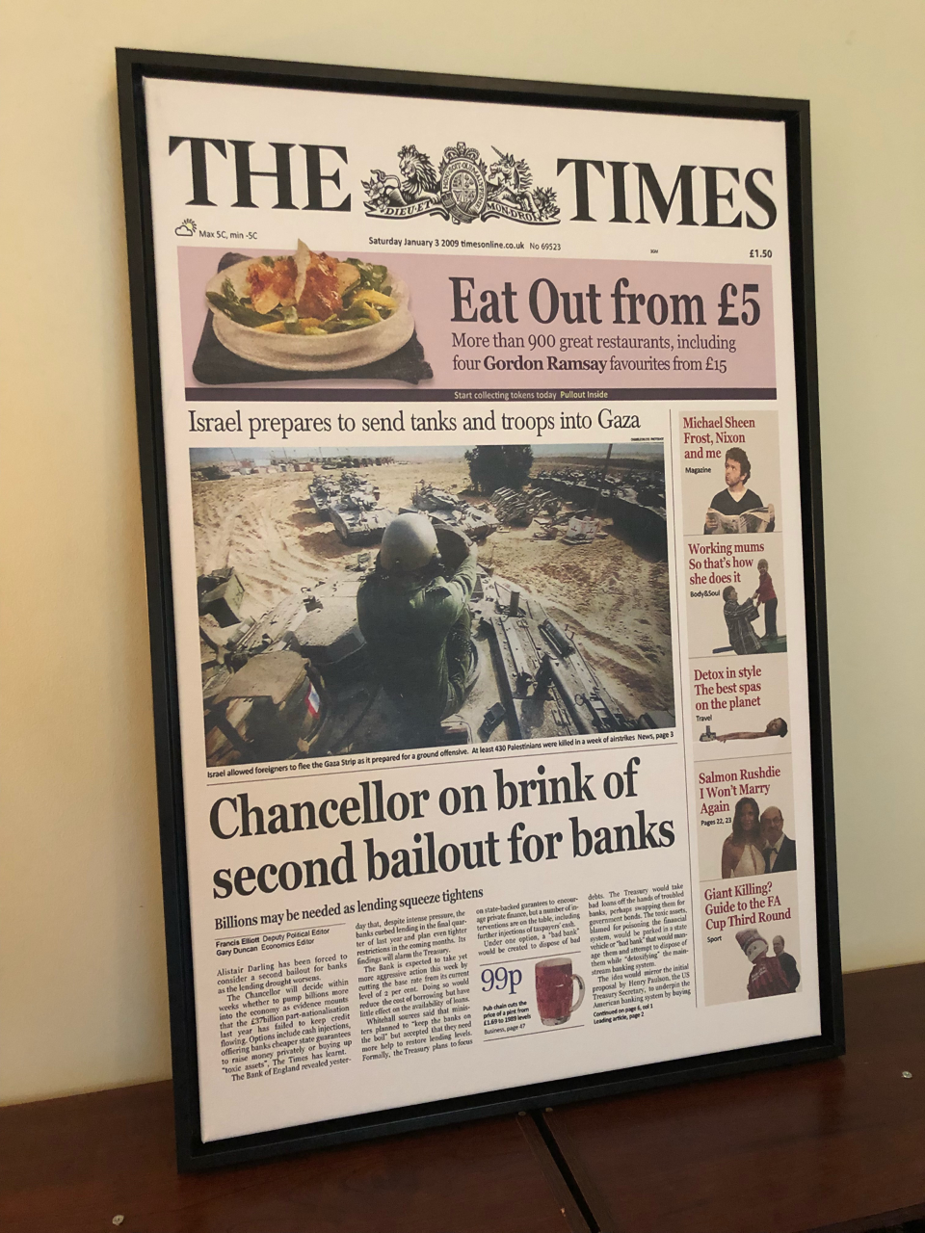
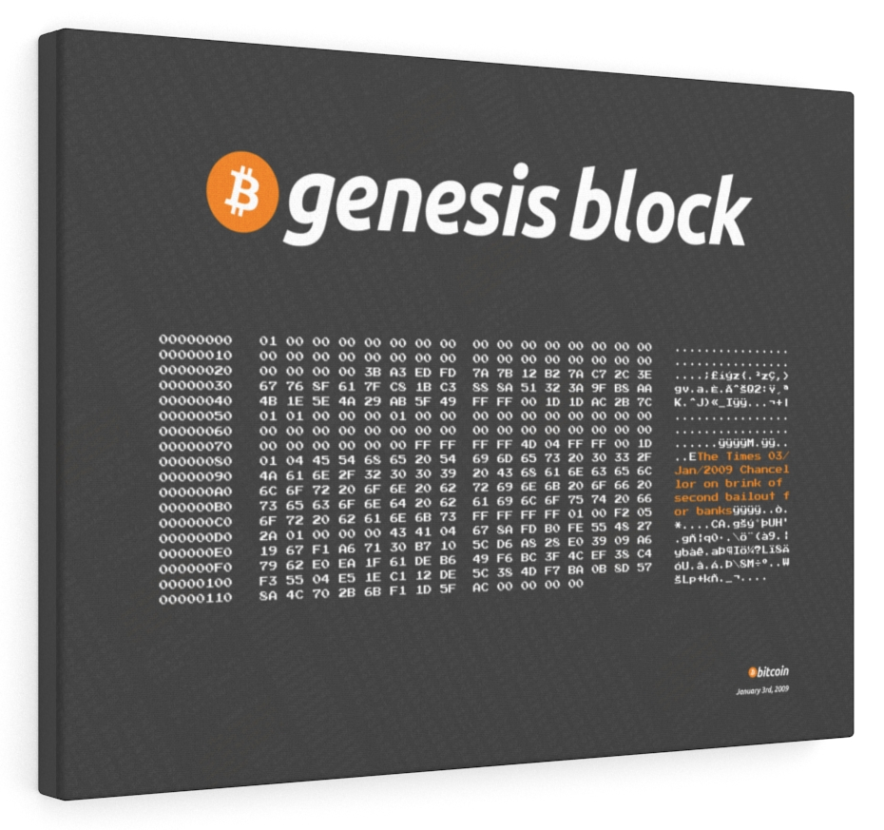
Fun Facts Around Bitcoin

Slide 5
Perspectives into the Crypto Space
Crypto Currencies
Crypto Smart Contract Platforms (https://ethereum.org)
Crypto Financial Services (https://defipulse.com)
Crypto Art
Crypto Governance (https://daostack.io)
…

Slide 6
Creating a Currency in Detail
Implement a Smart Contract which defines the attributes of the currency – e.g. fixed supply etc.
Deploy this Smart Contract on the Ethereum Blockchain using https://remix.ethereum.org
Create a Liquidity Pool (trading pairs… - e.g. via https://uniswap.org)

Slide 7
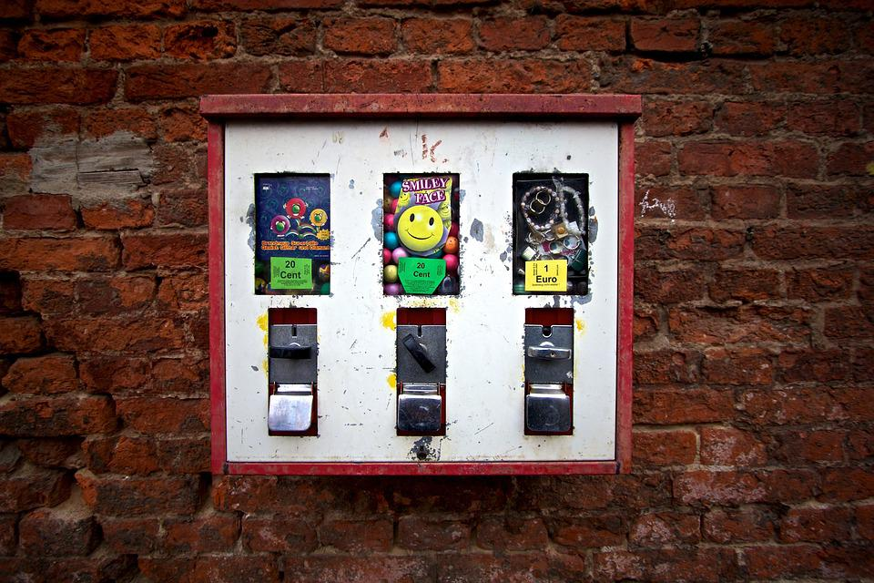
Smart Contracts

Slide 8
Incentive Engineering & Tokenomics
How can we design systems in a way that they support the emergence & prosperity of fairness?
Decentralized Autonomous Organizations (DAOs)
Value Propositions (e.g. Universal Basic Income)

Slide 9
Fungible- / Non-Fungible- & Semi-Fungible
Fungible Tokens
Frequently used as currency and governance tokens
Frequently created using the ERC20 Template
Non-Fungible Tokens (NFTs)
Frequently used as unique collectibles
Frequently created using the ERC721 Template
Semi-Fungible Tokens
Frequently used as gaming items & non-unique collectibles
Frequently created using the ERC1155 Template

Slide 10
Creating an NFT in Detail
Implement a Smart Contract which defines / represents the Non-Fungible Token
Deploy this Smart Contract on the Ethereum Blockchain using https://remix.ethereum.org

Slide 11
Milestones in Web Programming
Web 1 – the static web (static HTML pages with links)
Web 2 – the dynamic web (mainly due to javascript)
Web 3 – the distributed web (mainly due to Ethereum)

Slide 12
Distributed / Decentralized Apps (DApps)
Decentralized Backend (e.g. via Smart Contracts on the Ethereum Blockchain)
Decentralized Frontend Provisioning (e.g. via ipfs.io + ens.domains)
Decentralized / Non-Proprietary Tools & Frameworks for Creating those DApps

Slide 13
Custodial vs. Non-Custodial Wallets
Not your Keys --> Not your Crypto
Paper Wallets
Browser Wallets
…

Slide 14
Educational Example Projects
GitCoin.com
Democracy.earth
Ens.domains
Ipfs.io
arweave.org
Volatility Farming
Zapper.fi
Uniswap.org
1inch.io (aggregator…)
mastodon.social
proofofhumanity.id

Slide 15
Enterprise Use Cases Diskussions
For NFTs
For Decentralized Autonomous Organizations
For Decentralized Finance
…

Slide 16
Debating Club Role Play
Form two groups with seemingly opposing opinions
Switch Sides
Give Time to Collect Ideas
Start the Debate
Have a Break
Recap

Slide 17
Further Info & Concrete Hands On Tasks
https://github.com/michael-spengler/distributed-ledger-technology-hands-on-lecture/blob/main/README.md
Valuable Current Summary by Charles Hoskinson
Whenever you face any challenges around those topics, feel free to contact me via https://t.me/danceplanner

