Slide 1
LASSO / Ridge Regression Analysis
Penalized Regression Approaches

Slide 2
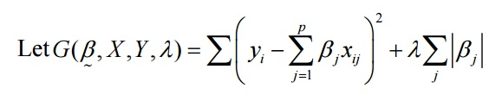


Lasso Regression: Least Absolute Shrinkage and Selection Operator
Minimization of G is the best estimate regre for the Betas (Coefficients).
G can be put in matrix form.
Rewritten as….

Slide 3
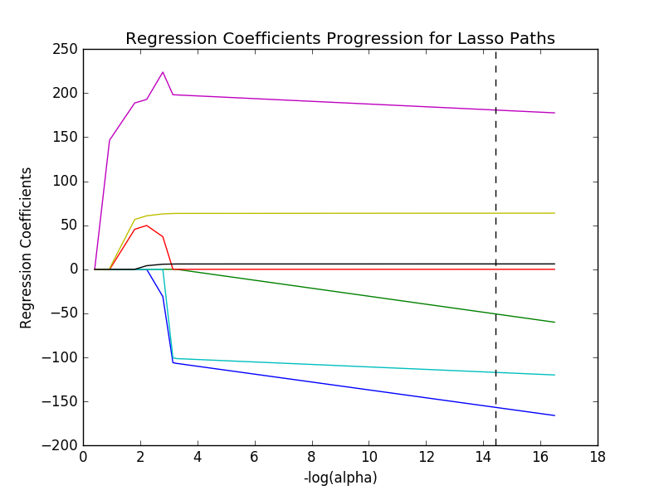



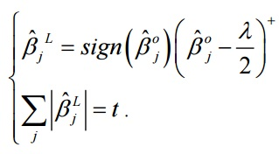
Differential in
relation to Beta.
OLS
Getting the sign
for Beta.
Threshold,
alpha solution.

Slide 4
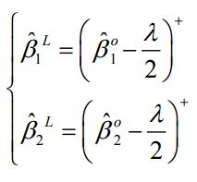


Knowing this, each alpha corresponds to a unique t value.
We take the summation of Beta and add them up for p steps.
Beta1….p
Solve for alpha

Slide 5
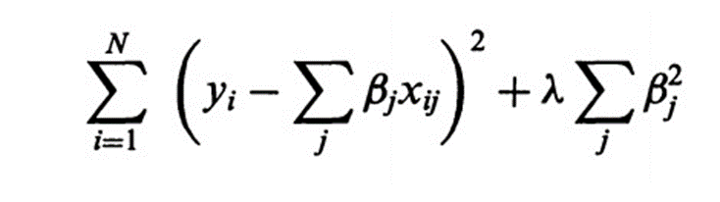
Ridge Regression
How does this differ from LASSO?
The penalization is a sum of squares of the Betas (coefficients). L2
This keeps all predictors in the model as coefficients can never become zero.

Slide 6
Energy efficiency Data Set - uci machine learning repository
CMPT | SA | WA | RA | OH | O | GA | GAD | Y1
0.98 | 514.5 | 294 | 110.25 | 7 | 2 | 0 | 0 | 15.55
0.98 | 514.5 | 294 | 110.25 | 7 | 3 | 0 | 0 | 15.55
0.98 | 514.5 | 294 | 110.25 | 7 | 4 | 0 | 0 | 15.55
0.98 | 514.5 | 294 | 110.25 | 7 | 5 | 0 | 0 | 15.55
0.9 | 563.5 | 318.5 | 122.5 | 7 | 2 | 0 | 0 | 20.84
0.9 | 563.5 | 318.5 | 122.5 | 7 | 3 | 0 | 0 | 21.46
0.9 | 563.5 | 318.5 | 122.5 | 7 | 4 | 0 | 0 | 20.71
0.9 | 563.5 | 318.5 | 122.5 | 7 | 5 | 0 | 0 | 19.68
0.86 | 588 | 294 | 147 | 7 | 2 | 0 | 0 | 19.5
CMPT: Relative Compactness
SA: Surface Area
WA: Wall Area
RA: Roof Area
OH: Overall Height
O: Orientation
GA: Glazing Area
GAD: Glazing Area Distribution
Y1: Heating Load

Slide 7
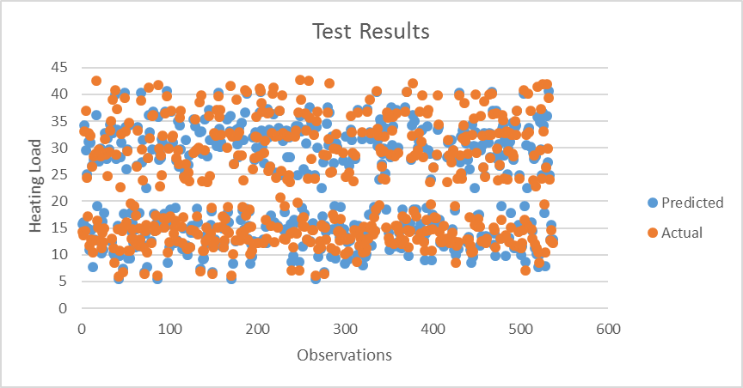
Lasso Test Set
After running the data through the algorithm it came back with the predicted set. A quick comparison with the actual responses.

Slide 8
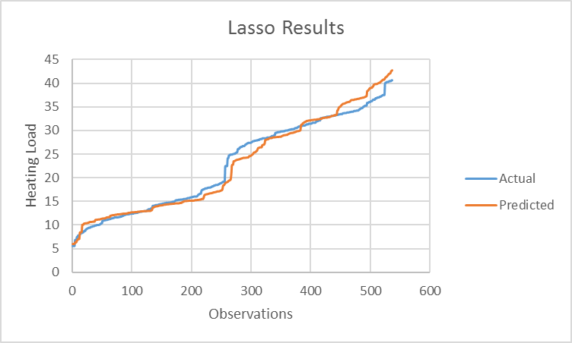
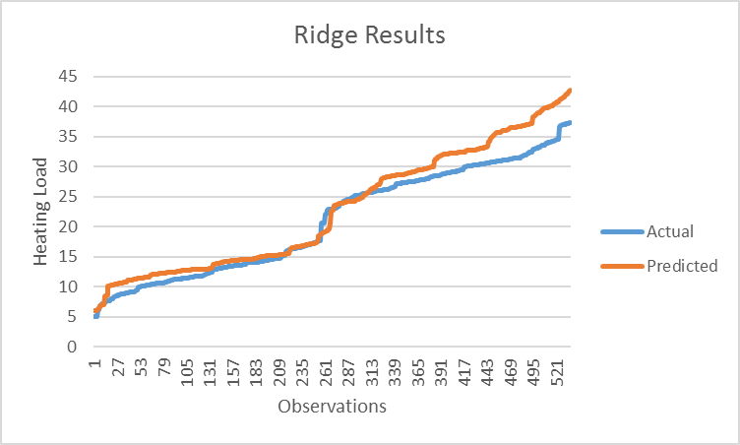
Comparison with Organized Responses
LASSO
RIDGE

Slide 9
Beta (Coefficient) Analysis
Lasso
CMPT | SA | WA | RA | OH | O | GA | GAD
-7.03872398 | -2.5460344 | 0 | -5.16365245 | 7.67453068 | 2.7744924 | .2618938 | 0
Ridge
CMPT | SA | WA | RA | OH | O | GA | GAD
-6.8330432 | -2.9948271 | .0000392 | -5.22487568 | 7.59874521 | 3.4425478 | .45215885 | .00072632

Slide 10
MSE: Mean Squared Error
Lasso
Ridge
MSE | R-Squared
7.95864461365 | .916490392891
MSE | R-Squared
8.568421528 | .89225187456
Lasso accounts for 91.6% of the variation
Ridge accounts for 89.2% of the variation

Slide 11
Resources
http://statweb.stanford.edu/~tibs/sta305files/Rudyregularization.pdf
http://statweb.stanford.edu/~tibs/lasso/lasso.pdf
https://archive.ics.uci.edu/ml/datasets/Energy+efficiency
http://www.d.umn.edu/math/Technical%20Reports/Technical%20Reports%202007-/TR%202007-2008/TR_2008_9XZhao.pdf

Slide 12
Questions
When would you choose LASSO over Ridge?
A. When your dataset has a large set of predictors and a low number of observations.
Why would LASSO be useful for large predictor sets?
A. Because it allows for dropping of uncorrelated predictors to lower model complexity.
Why penalize coefficients?
To keep them from growing uncontrolled and making data analysis painful.

Slide 13
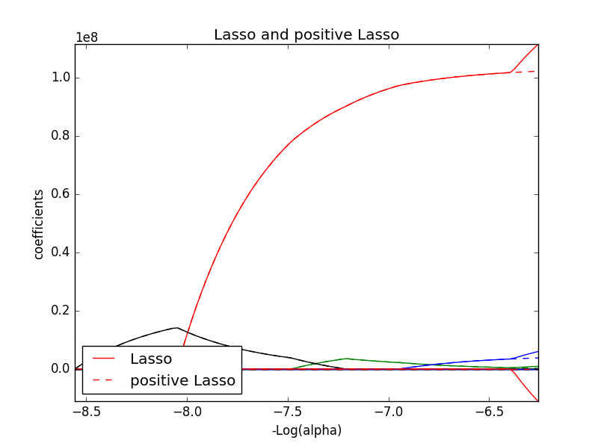
Mistakes
Implementation Errors
Algebraic Errors
Data Analysis Errors

