Slide 1
CS301
Vendor Management
Paul Nguyen, Yuchen Tian & Michael Tran
Sponsored by Bravium Consulting Inc.

Slide 2
Vendor Management
What it is
  Acquisition
  Selection
  Review
Stakeholders
  Business
  Vendor manager
  Vendor
Solution
  Freeware
  Proprietary
  ServiceNow

Slide 3
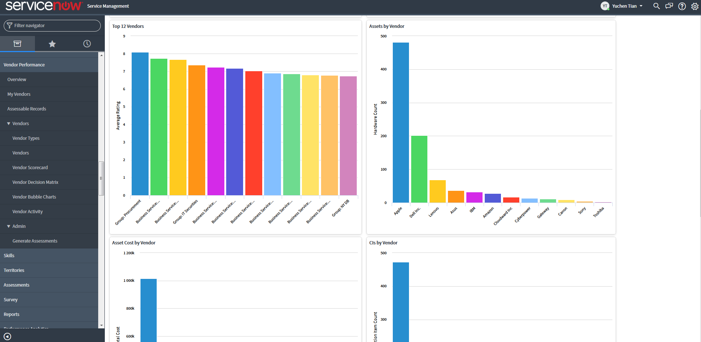

ServiceNow
Business management suite
System agnostic
Active development
Plugin support

Slide 4
Workflow – vendor profile approval
Creation
Submission
Review
Amendment
Approval/Denial

Slide 5
Workflow – job application
Job posting
Request information
Application review
Down select
Award contract

Slide 6
Data Dictionary
Vendor information
Skills
Notifications
Etc.

