Slide 1

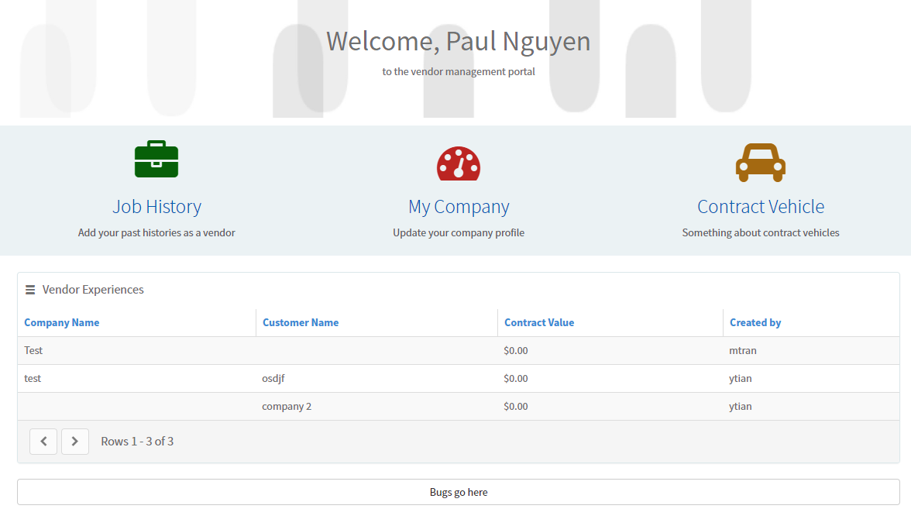


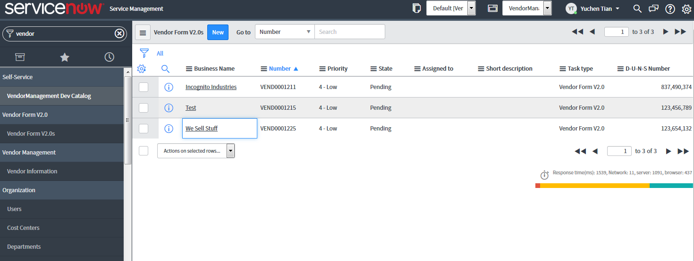

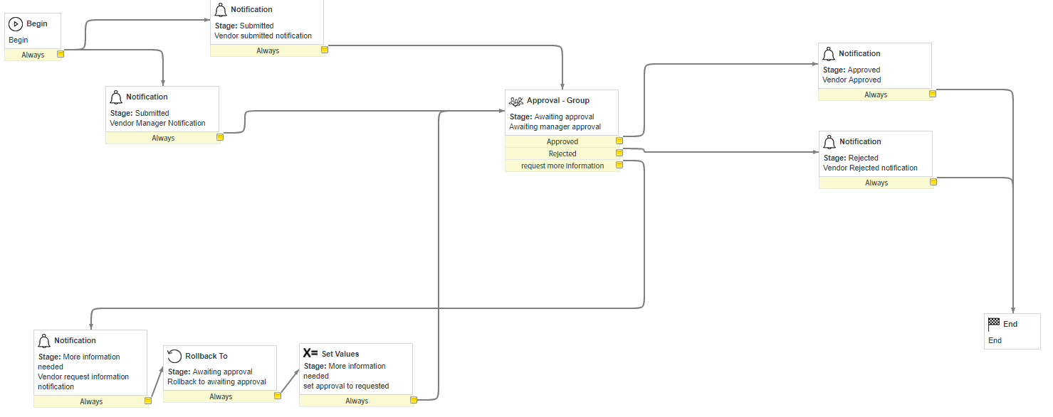

301
Vendor Management Portal
Team members: Paul Nguyen, Michael Tran, Yuchen Tian | Faculty adviser: Robert Dahlberg | Sponsor: Bravium Consulting Inc. | Mentor: Robert Dahlberg
Problem
Organizations lack a streamlined process for managing external vendors, which leads to duplicative work performed on the vendor side but also within the organizations themselves. Organizations oftentimes manage vendors using disparate systems that lack workflow automation and reporting or analytics to facilitate a more efficient and accurate vendor management process.
Requirements
Build a self service portal that allows a vendor to interact with businesses and automate
the job acquisition process.
A vendor manager will be able to approve or reject newly registered vendors in order to prevent fake companies from being added to the database.
Constraints
Must be built within the ServiceNow platform
Technologies
ServiceNow is a tool that provides service management software as a service. It specializes in IT services management (ITSM), IT operations management (ITOM) and IT business management (ITBM).
Service Portal
Service Management
Vendor Management Workflow

