Slide 1
Final Group Project
By Veronica Dean, Michael Winay, Derek Ruggirello, and Hassan Almusawai
05/06/2022

Slide 2
What to Expect
-An application free of bugs that provide full functionality
-Update as needed
-Create strong foundation
-Hands on approach
-Teamwork

Slide 3
Getting to the details..
-”BarMaster” simulates a Bartender/Server’s user interface
-This app will store, forward, and search user inserted drinks and cocktails
- A graphical UI will at least track servers, drinks, times and recipe quantities
-A terms and conditions acceptance page will be provided

Slide 4
New updates
When something gets added or deleted the info window closes.
When a drink gets added or deleted it is done so dynamically. (Meaning it no longer needs to be refreshed!)
User filtering for improper entries in the “add drink” section show a more detailed “Error” pop up using regex.
When the user clicks on an entry, the info window allows the user to edit the entry.

Slide 5
Programs used
Javascript
HTML
CSS
Python
Collaborated on Github

Slide 6
Timeline
Planning/Research 2 weeks
Design/Consultation 2 weeks
Development Up to 4 weeks
Testing/Launch 3 weeks

Slide 7
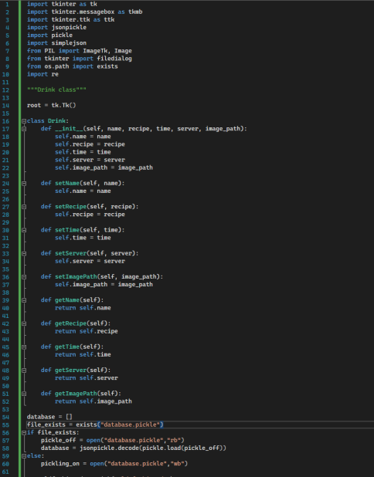
Organization and code

Slide 8
Cloud Computation
On-Demand Self-Service – A user can continuously monitor the allotted network storage, server uptime, and computing...

Slide 9
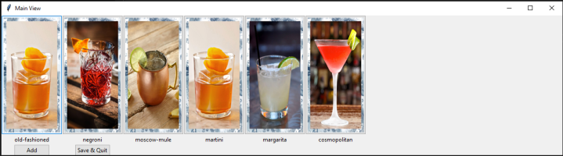
Sample Webpage Idea

Slide 10
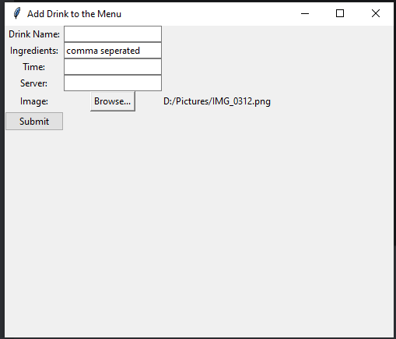
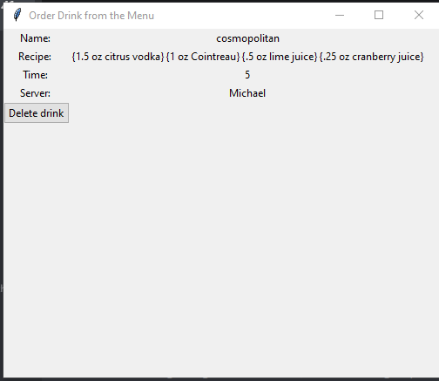
Adding and viewing the data

Slide 11
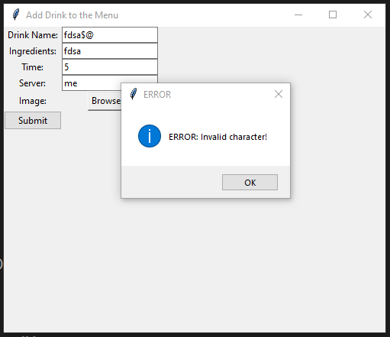
Attempts to add “forbidden” characters will result in the following error:

Slide 12
Thank you for your time!
From all of Forestview Group 5 thank you for your time, and keep us in mind for your future application needs!

