Slide 1

Final Project Smart Meter Analysis
Lee, Michael
CSCI E-63 Big Data Analytics, Spring 2021
Harvard University Extension School
Prof. Zoran B. Djordjević

Slide 2
Introduction
Smart Meters are a useful tool to measure energy consumption in households.
Goal of this project is to take energy consumption data provided by Smart Meters and analyze what factors can impact household energy consumption.
Socioeconomic Factors
Weather
Holidays
Time (Month, Day of Week, Hour of Day)
Series of regression models built to predict energy consumption of a given household.

Slide 3
Description of Software/Tools
Spark
Python
PySpark
Loading data from csv files in Spark DataFrames
Joining Spark DataFrames to form a consolidated DataFrame
Visualization
Matplotlib
Scatter Plots
Line Plots
Bar Charts
Regression
Spark ML
Linear Regression
Decision Tree Regression
Random Forest Regression
Gradient Boosted Tree Regression

Slide 4
Description of Data
Smart Meters in London Dataset from Kaggle
https://www.kaggle.com/jeanmidev/smart-meters-in-london
5,561 Smart Meters in database
Date Range: November 2011 to February 2014
Includes:
Daily energy consumption and hourly energy consumption readings
Socioeconomic grouping
UK’s ACORN geo-demographic classification system
Weather data
Temperature
Windspeed
UV Index
Billing Method
Standard Billing
Time-of-Use Billing
Over 10GB of data total
Most visualizations based on daily energy consumption dataset
Hourly energy consumption for a single household used for final regression models.

Slide 5
Installation / Configuration
Installing pandas, numpy, matplotlib
pip install pandas numpy matplotlib
Installing Spark
Check if Java 8 or 11 is installed:
If Java is not installed, install Java from https://www.java.com/en/download/help/download_options.html based on your operating system
Set JAVA_HOME environmental variable to Java directory
Install Spark:
If using Windows, you need to install Hadoop binaries for Windows using https://github.com/steveloughran/winutils
Set HADOOP_HOME environmental variable to Java directory
Download latest version of Spark from https://spark.apache.org/downloads.html
Set SPARK_HOME environmental variable to Java directory
Installing PySpark
pip install pyspark

Slide 6
Code Highlights
Code for joining and cleaning data for daily energy consumption dataset
# Join the meter and the household DataFrames into meter_household_daily_df joinType = "inner" joinExpression = ["LCLid"] meter_household_daily_df = meter_daily_df.join(household_df, joinExpression, joinType) # Join meter_household_daily_df and the daily weather DataFrame into met_hou_wea_daily_df joinType = "inner" joinExpression = ["time"] met_hou_wea_daily_df = meter_household_daily_df.join(weather_daily_df, joinExpression, joinType) # Add a binary variable to indicate if the date is a holiday combined_daily_df = met_hou_wea_daily_df.withColumn("holiday", col("time")) \ .join(holiday_df.withColumn("holiday", col("holiday")), on="holiday", how="left") \ .select("*", when(col("Type").isNotNull(), "1").otherwise("0").alias("holiday_binary")) \ .drop("Type") # check to see if there are any null values daily_timestamp_cols_filtered = [c for c, t in combined_daily_df.dtypes if t != 'date' and t != 'timestamp'] daily_data_nullcheck = combined_daily_df.select(*daily_timestamp_cols_filtered) daily_data_nullcheck.select([count(when(isnan(c) | col(c).isNull() | (col(c) == "NA") | (col(c) == "NULL"),c)) \ .alias(c) for c in daily_data_nullcheck.columns]).show() # remove all rows which have null values combined_daily_df = combined_daily_df.na.drop()

Slide 7
Code Highlights
Code for plotting a scatterplot using matplotlib
# convert Spark DataFrame to Pandas dataframe for plotting energy_daily = combined_daily_df.select("time","energy_mean","min","max", "energy_sum").toPandas() energy_daily.set_index("time") # save holiday dates as a list for plotting holiday_daily_list = holiday_df.select("holiday").filter(col("holiday") < "2014-04-01").collect() holiday_daily_list # create a scatter plot using matplotlib plt.figure(figsize=(12,6)) plt.scatter(energy_daily["time"], energy_daily["energy_sum"], label="Energy Consumption (kWh)") plt.xlabel("Date") plt.ylabel("Daily Energy Consumption (kWh)") plt.title("Daily Energy Consumption") for h in holiday_daily_list: plt.axvline(x=h, color='red') # red vertical lines indicate holiday plt.show()

Slide 8
Code Highlights
Code for creating linear regression model
# create linear regression model lr_daily = LinearRegression(featuresCol="features", labelCol="label", maxIter=20, regParam=0.1, elasticNetParam=0.1) lr_daily_model = lr_daily.fit(prepared_daily_train_df) # view model coefficients and intercept print("Coefficients: " + str(np.round(lr_daily_model.coefficients,2))) print("Intercept: " + str(np.round(lr_daily_model.intercept,2))) # view index-to-feature mapping to identify which index position corresponds with which feature coef_daily = lr_daily_model.coefficients print("Maximum model coefficient:", np.round(max(np.abs(coef_daily)),2)) print("Index position of maximum model coefficient:", np.argmax(coef_daily)) numeric_coeff_daily = prepared_daily_train_df .select("features").schema[0].metadata.get('ml_attr').get('attrs').get('numeric') categorical_coeff_daily = prepared_daily_train_df. select("features").schema[0].metadata.get('ml_attr').get('attrs').get('binary')
model_coeff_daily = numeric_coeff_daily + categorical_coeff_daily model_coeff_daily # view training R2 and RMSE trainingSummary_daily = lr_daily_model.summary print("RMSE: %.2f" % trainingSummary_daily.rootMeanSquaredError) print("r2: %.3f" % trainingSummary_daily.r2) # view test predictions lr_daily_predictions = lr_daily_model.transform(prepared_daily_test_df) lr_daily_predictions_df = lr_daily_predictions.select("prediction","energy_sum").toPandas() lr_daily_predictions_df['prediction'].describe() # view test R2 and RMSE lr_daily_evaluator = RegressionEvaluator(predictionCol="prediction", labelCol="energy_sum", metricName="r2") lr_daily_test_r2 = lr_daily_evaluator.evaluate(lr_daily_predictions) print("R Squared (R2) on test data = %.2g" % lr_daily_test_r2)

Slide 9
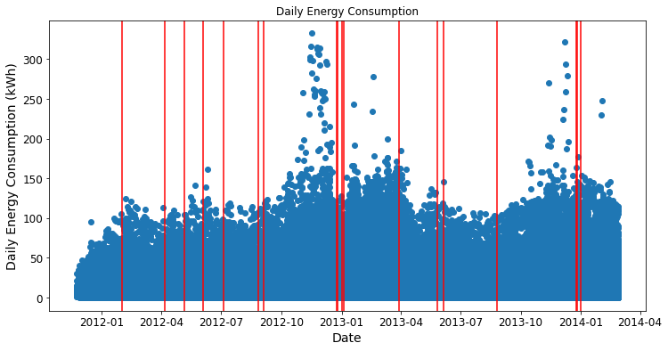
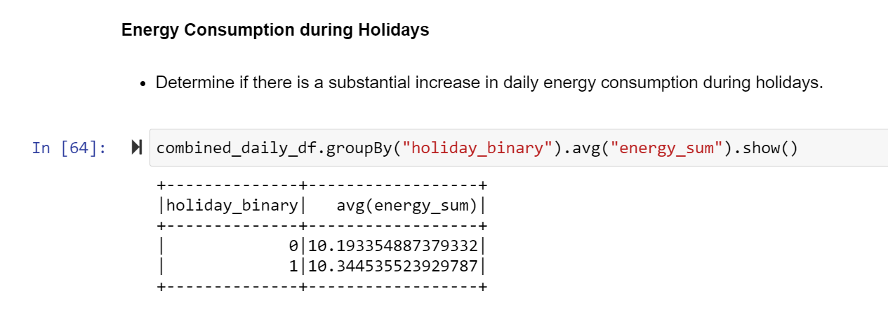
Results
Plot of Daily Energy Usage over time
Red lines indicate holiday
Slight Increase in energy consumption over holidays

Slide 10
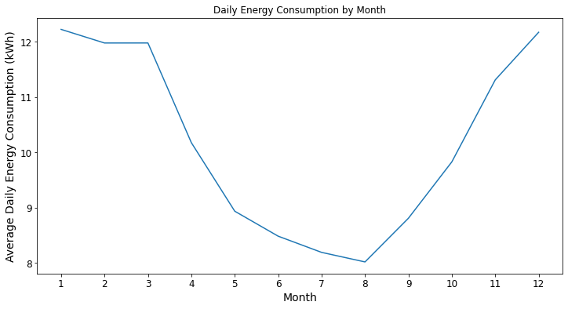
Results
Plot of Daily Energy Usage by Month
Energy usage is highest during winter months and lowest during summer months

Slide 11
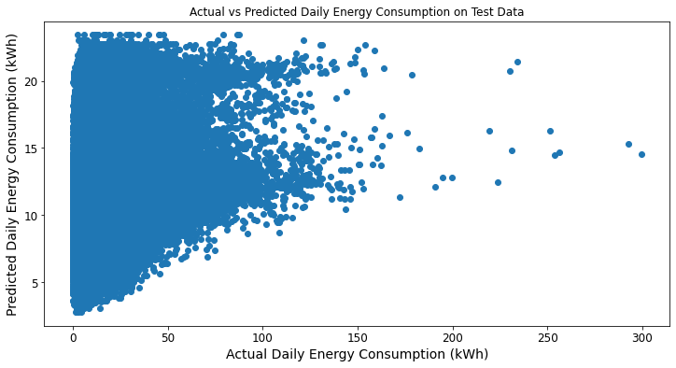
Results
Plot of Predicted vs. Actual Energy Consumption for overall dataset using linear regression model.
Test R² is 0.089 and RMSE is 8.71
None of the regression models perform well predicting energy consumption for all households in dataset.
Predicted values are not in same range as the actual energy consumption values
May need additional information about house building size and number of people living in residence to improve predictive model

Slide 12
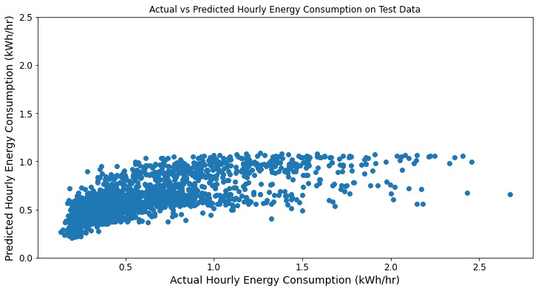
Results
Plot of Predicted vs. Actual Energy Consumption for single meter hourly dataset using linear regression model
Test R² is 0.45 and RMSE is 0.29
Regression models have lower RMSE, less than half of the mean hourly energy consumption dataset
Models are Not perfect, but an improvement over the models using the overall Smart Meter dataset

Slide 13
Summary
Spark can be used to load, join, and clean Smart Meter data.
Even though Spark is designed for big data applications, computations on full 10GB dataset are slow so be selective in loading data.
Visualizations in matplotlib show how energy consumption is related to factors such as weather, socioeconomic factors, and time.
Plotting aggregated data is much quicker than plotting raw data points.
Spark ML can be used to build regression models for predicting a single household’s energy consumption.
Unsuccessful in building overall model to predict energy consumption across all households in dataset.
Large variance in energy consumption within same socioeconomic group.
Don’t know about house size, number of people living in residence

Slide 14
Next Steps
Try to improve predictive models using time series regression.
Use statistical tests to determine whether difference between two binary classes (i.e. holiday vs. non holiday) are statistically significant or not.
Java version of Spark MLlib has t-test function but PySpark’s version does not.
Try repartitioning the Spark DataFrames
Suggested partition size is 100-200MB
Repartition before performing multiple join operations

Slide 15
YouTube URLs, Last Page
2 minute (short): http://bit.ly/CSCIE-63SmartMeterShortVideo
15 minutes (long): http://bit.ly/CSCIE-63SmartMeterLongVideo

