Slide 1
Interrupt Handling
- Sparrow OS Design Document
赵凤阳/Michael Z
michael2012zhao@gmail.com

Slide 2
Content
Interrupt Handling Process
Interrupt Table
Source Code Snippet
  struct irq_handler
  generic_handle_irq()

Slide 3
Interrupt Handling Process
Multi-level IRQ handling architecture, support sub-interrupt
Support interrupt embedding

Slide 4
Sparrow
Hardware
Level 1
Level 2
Level …
mask
mask
Interrupting Devices
Vectored Interrupt Controller
ack
ack
handle
handle
unmask
unmask

Slide 5
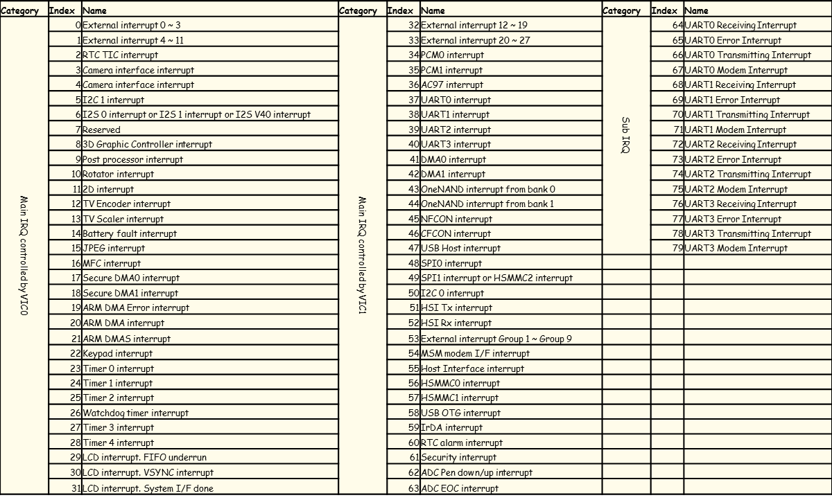
Interrupt Table

Slide 6
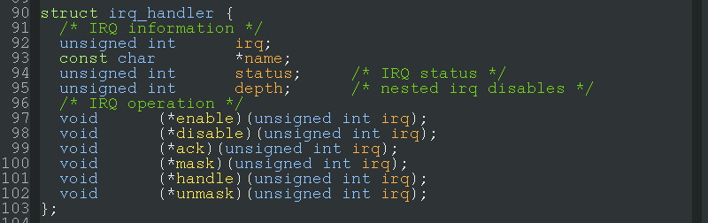
struct irq_handler
struct irq_handler defines an interrupt, including number, name, and every operating call back functions.

Slide 7
generic_handle_irq()
Function generic_handle_irq() is the entry of Sparrow IRQ handling. It invokes every IRQ operations.
If parent IRQ need to involve a child IRQ, generic_handle_irq() is called.

Slide 8
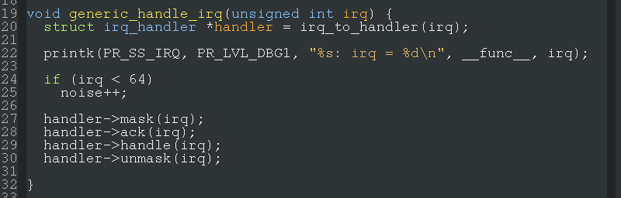
generic_handle_irq()
Definition of generic_handle_irq().

