Slide 1
Tracing
- Sparrow OS Design Document
赵凤阳/Michael Z
michael2012zhao@gmail.com

Slide 2
Content
printk
printu
Ring Buffer

Slide 3
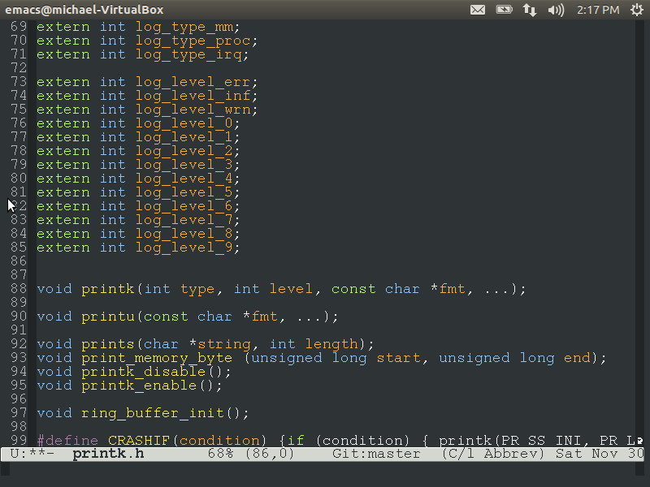
printk
Printk is the function for kernel debugging.
It’s controlled by tracing matrix.
Tracing Matrix is a method to configure what information is printed from kernel.

Slide 4
Tracing Matrix
Tracing Matrix is a mechanism to control what trace to output.
Trace is managed by 2 dimensions: TYPE and LEVEL.

Slide 5
Tracing Matrix
Level Type | ERR (error) | INF (information) | WRN (warning) | 0 | 1 | 2 | 3 | 4 | 5 | 6 | 7 | 8 | 9
INI (Initialization)
FS (File System)
MM (Memory)
PROC (Process)
IRQ (Exception)
Example:
When type MM and level 4 is enabled, all trace printed by
printk(PR_SS_MM, PR_LVL_4, …)
will show.

Slide 6
Tracing Matrix Definition
Level Type | 0 | 1 | 2 | 3 | 4 | 5 | 6 | 7 | 8 | 9
INI (Initialization) | General |  |  |  |  | Shell
FS (File System) | Mount | Un-mount | ListFS parsing | File Reading
MM (Memory) | Boot Allocator Allocation | Boot Allocator De-allocation | Page Allocator Allocation | Page Allocator De-allocation | Slab Allocator Allocation | Slab Allocator De-allocation | Paging | Memory Mapping |  | Memory Dumping
PROC (Process) | Process initialization | Program load | Program exit | Program actions |  | Schedule actions | Schedule algorithm | Schedule queue handling
IRQ (Exception) | IRQ setup | IRQ handling: general | IRQ handling: detailed |  |  | Prefetch/ Data abort handling | System Call

Slide 7
printu
Printu is the function to print information to user.
There isn’t any limit/control, all messages printed by printu() are output to screen.

Slide 8
Ring Buffer
Ring Buffer is a “container” to buffer the trace before it’s printed to screen.
Ring Buffer limit the amount of trace text, old trace will be replaced by new trace.
Ring Buffer control the occasion to release the trace to screen.

Slide 9


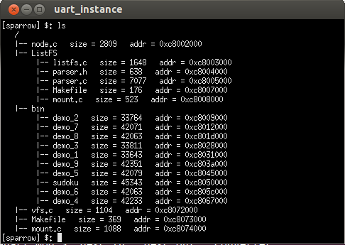
Ring Buffer
trace
trace
kernel
ring buffer
screen

Slide 10
Ring Buffer Illustrate
head
tail
tail
tail
head
head
Buffer is empty.
Input some trace.
Output some trace.
head
free space
trace content
input/output
tail
tail
tail
head
head
More input trace,
old trace was over-wrote.
Output some trace,
release space.
Buffer is full.

