Slide 1
Process
- Sparrow OS Design Document
赵凤阳/Michael Z
michael2012zhao@gmail.com

Slide 2
Content
Life Cycle
Priority
Schedule
CFS
Context Switch

Slide 3
Process Life Cycle
There are 4 states in a process’s life cycle
  Ready
  Running
  Waiting
  Dead

Slide 4
Process Life Cycle
A process may fall in waiting state due to:
  Waiting for input
  Sleeping for specified time interval
  Waiting for another process to exit

Slide 5
Process Life Cycle
Ready
Waiting Type:
- INPUT
- SLEEPING
- DEPENDENCE
Running
Waiting
Dead

Slide 6
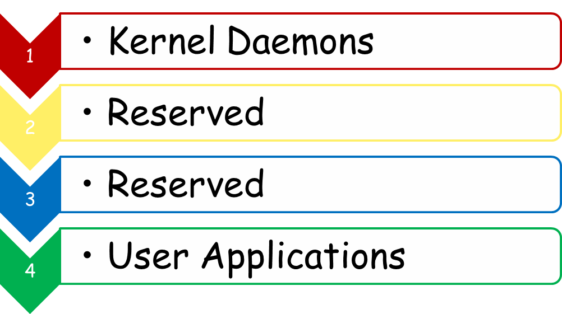
Priority
4 priority levels are defined, they are useful in scheduling.

Slide 7


Scheduling
active process
scheduler
scheduling engine
process queue

Slide 8
Scheduling Basic
Terms:
  Clock tick
    Clock interrupt occasion, same as heartbeat
  Scheduling Occasion
    The clock ticks that scheduling is determined to be done. Usually, Sparrow check the scheduling necessity every 4 ticks.
  Continuous Ticks
    Clock ticks a process continuously occupy the CPU

Slide 9
Scheduling Framework
The whole scheduling framework is consist of three parts:
  Scheduling Engine
  Scheduler Instance
  Scheduled Processes

Slide 10
Scheduling Engine
Scheduling Engine
  SE is a stationary part of the kernel
  SE doesn’t schedule processes directly
  SE invokes a specific Scheduler to perform the scheduling

Slide 11
Scheduler
Scheduler
  Scheduler implements the functionality of scheduling
  Scheduling algorithm is defined by scheduler

Slide 12
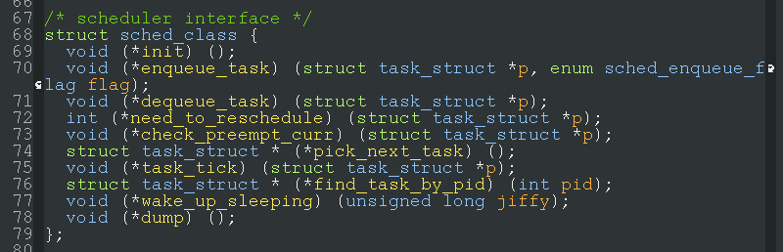
Scheduler Interface
An interface is defined between Scheduling Engine and Scheduler

Slide 13
CFS (Scheduler)
CFS (Completely Fair Scheduler) works in following rules:
  Assume all processes are launched at system start-up. The elapsed time till now is called virtual-runtime (v-runtime).
  In each clock-tick, the v-runtime of current process increment a little.
  In scheduling occasion, the process with LEAST v-runtime is chosen to run.

Slide 14
v-runtime
v-runtime delta (Δ) at clock tick:
Δ v-runtime
= continuous ticks + priority
Δ v-runtime of
kernel daemons
5 =
+
continuous ticks = 4
priority = 1
Δ v-runtime of
user programs
8 =
+
continuous ticks = 4
priority = 4

Slide 15
CFS Illustration
Initially, 3 processes is running in the system, A has lowest v-runtime.
Waiting Queue
v-runtime sorting
process A
process B
process C

Slide 16
CFS Illustration
So process A is peeked, loaded into CPU and run.
process A
CPU
Waiting Queue
v-runtime sorting
process B
process C

Slide 17
CFS Illustration
In next scheduling occasion, v-runtime of process A increases and return to queue.
Waiting Queue
v-runtime sorting
process B
process C
process A

Slide 18
CFS Illustration
Then process B is chosen to run, as it has least v-runtime.
process B
CPU
Waiting Queue
v-runtime sorting
process C
process A

Slide 19
Process Switching
Process context is switched if a process is determined to pause and another to resume.
Process A
Process B
Process C
CPU

