Slide 1
User Space
- Sparrow OS Design Document
赵凤阳/Michael Z
michael2012zhao@gmail.com

Slide 2
Content
User Space Layout
VMA
Stack Expanding
Heap Expanding/Breaking

Slide 3
User Space Layout
32K
empty area
64M
guard area
text
bss
heap
stack
0
0x8000
heap
border
stack
limit
stack
border
0xC0000000
3G bytes

Slide 4
User Space Layout
Guard Area
  32K empty area, used to identify null-pointer memory access from user program.
Text
  Executable binary code

Slide 5
User Space Layout
BSS
  The space to store uninitialized global variables.
Heap
  The memory allocated by program in run-time, dynamically.
  Expand from low memory to high.

Slide 6
User Space Layout
Stack
  The space to store stack-frames.
  While invoking a function, a frame is pushed into stack, and stack border decreases.
  Stack expand from high memory to low.

Slide 7
VMA
VMA = Virtual Memory Area
......
VMA 1
VMA 2
VMA 3
User Space
Physical Memory
(mapped)
Physical Memory
(not mapped)
Physical Memory
(mapped)

Slide 8
VMA
VMA is used to manage user space memory:
  Each VMA covers a memory area
  The physical memory of a VMA is mapped only when the memory is accessed.

Slide 9
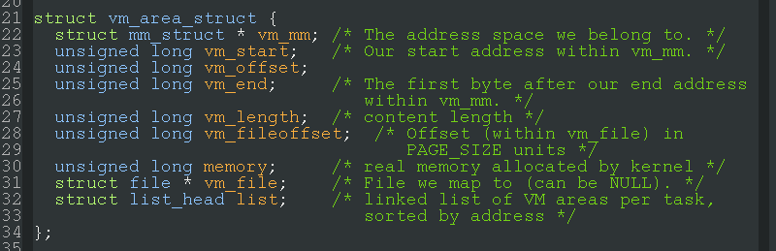
VMA
What’s in VMA?
  VMA hold necessary administrative information to manage user memory.

Slide 10
Stack Expanding
Scenario:
  Function calling back-trace:
    func4()
    func3()
    func2()
    func1()
func4() is called now

Slide 11
Stack Expanding
Before calling func4(), 3 frames are in stack.
......
VMA n
User Space
frame 3
frame 2
frame 1
stack
border
0xC0000000

Slide 12
Stack Expanding
Call func4(), new frame covers un-mapped memory, leads page fault.
......
VMA n
not mapped
User Space
frame 4
frame 3
frame 2
frame 1
stack
border
0xC0000000

Slide 13
Stack Expanding
Kernel create a new VMA at first, but physical memory not mapped.
......
VMA n-1
VMA n
User Space
physical memory
not mapped
frame 4
frame 3
frame 2
frame 1
target stack
border
current stack
border
0xC0000000

Slide 14
Stack Expanding
Kernel assign physical memory and populate page table.
......
VMA n-1
VMA n
User Space
frame 4
frame 3
frame 2
frame 1
stack
border
0xC0000000

Slide 15
Heap Expanding
Heap expanding/breaking works in same way as stack expanding.
Difference is that, heap expands from low address to high, while stack from high to low.

