Slide 1
Programming Guide
- Sparrow OS Design Document
赵凤阳/Michael Z
michael2012zhao@gmail.com

Slide 2
Content
General
Building
Entry
SDK
System Call

Slide 3
General
Sparrow support ELF format executable files only.
Sparrow provide a SDK (library) in C language.

Slide 4
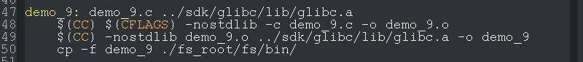
Build
There are limits in building program:
  In compiling, option “-nostdlib” must be specified.
  In linking, stationary lib “glibc.a” must be linked.

Slide 5
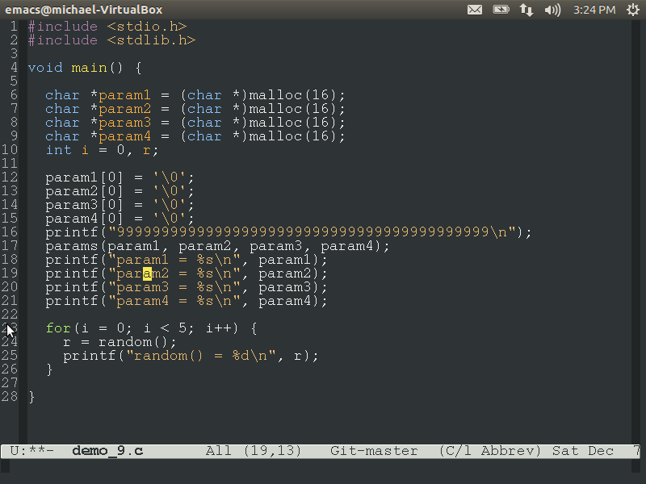
Program Entry
All user program must start with a main function, which should be defined as:
  No parameters accepted (SDK provide function to get program parameters).
  Return type have to be void.

Slide 6
SDK
SDK (glibc.a) defines some standard helper-functions.
All functions are declared in 3 header files:
  stdio.h
  stdlib.h
  string.h

Slide 7
SDK
  stdio.h
  void printf(const char *fmt, …);
  char inputc();

Slide 8
SDK
  stdio.h
  void *malloc(int size);
  void free (void *ptr);
  void exit (int code);
  void sleep (int msec);
  int rand ();
  void params (char *param1, char *param2, char *param3, char *param4);

Slide 9
SDK
string.h
  void *memcpy(void *dest, const void *src, unsigned int count);
  void *memmove(void *dest, const void *src, unsigned int count);
  int memcmp(const void *cs, const void *ct, unsigned int count);

Slide 10
SDK
  void *memset(void *s, int c, unsigned int count);
  unsigned int strlen(const char *s);
  int strcmp(const char *cs, const char *ct);
  char *skip_spaces(const char *str);
  char *strim(char *s);
  int atoi(const char *str);

Slide 11
System Call
SDK functions wrap the invoking of system-call.
But if that’s not enough, you may need to invoking system-call directly in you program.

Slide 12
System Call
8 system calls are defined now
System Call Number (SCN) and name of all system calls are listed below:
SCN | Name | SCN | Name
0 | reset | 4 | inputc
1 | print | 5 | exit
2 | brk | 6 | params
3 | sleep | 7 | random

Slide 13
System Call
Check syscall/syscall_*.c source files for details of parameter setting.

