Slide 1
User Guide
- Sparrow OS Design Document
赵凤阳/Michael Z
michael2012zhao@gmail.com

Slide 2
Content
Command Line
Commands List

Slide 3
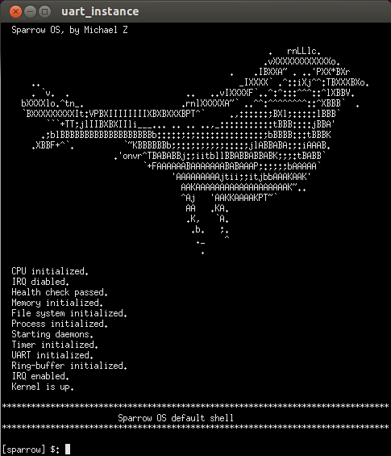
Command Line
If you start Sparrow successfully, you will see this screen.
This is the command line.

Slide 4
Commands
You interact with Sparrow by typing commands.
Kinds of commands has been defined now, let me introduce them one by one.

Slide 5
Command - help
help
  Print help information. If no command is specified, print all commands list.
  Usage: help [command]

Slide 6
Command - elf
elf
  Execute ELF format file in synchronous mode. Command line return to user until the excuted program exit.
  Usage: elf <file> [param1] [param2] [param3] [param4]

Slide 7
Command - elfs
elfs
  Execute ELF format file in synchronized mode. Same with “elf”.
  Usage: elfs <file> [param1] [param2] [param3] [param4]

Slide 8
Command - elfa
elfa
  Execute ELF format file in asynchronous mode. Command line return to user immediately after executed file is loaded.
  Usage: elfa <file> [param1] [param2] [param3] [param4]

Slide 9
Command - tree
tree
  Display tree view of file system.
  Usage: tree

Slide 10
Command - ls
ls
  Display tree view of file system. Same with “tree”.
  Usage: ls

Slide 11
Command - jiffies
jiffies
  Display jiffies/ticks since system start.
  Usage: jiffies

Slide 12
Command - cat
cat
  Dump content of specified file.
  Usage: cat <file>

Slide 13
Command - kmsg
kmsg
  Dump kernel log to screen.
  Usage: kmsg

Slide 14
Command - ps
ps
  Display live process information.
  Usage: ps

Slide 15
Command - kill
kill
  Terminate specified process by PID.
  Usage: kill <pid>

Slide 16
Command - reset
reset
  Restart the system.
  Usage: reset

Slide 17
Command - log
log
  Enable kernel log types and levels, or display enabled log if no parameter.
  Usage: log [log types] [log levels]
  Example: log ipq we261

Slide 18
Command - log
Supported log type and level
Type | Name
i | initialization
m | memory management
p | process management
q | interrupt(IRQ) handling
f | file system management
Level | Name
e | error
w | warning
n | information
0 | level 0
1 | level 1
2 | level 2
3 | level 3
4 | level 4
5 | level 5
6 | level 6
7 | level 7
8 | level 8
9 | level 9

