Slide 1



Vulnerabilities in Apple’s bluetooth daemon
Michael Esposito
Network Defense 2

Slide 2



CVE-2018-4087
Leads to arbitrary code execution on different daemons in iOS, tvOS and watchOS
Hijacks the session between each high-level daemon and bluetoothd
Allows a process to escape the tight sandbox of Apple devices
Timeline of discovery:
10/2017 - discovered
12/2017 - confirmed by Apple
2/2018 - security patch pushed

Slide 3
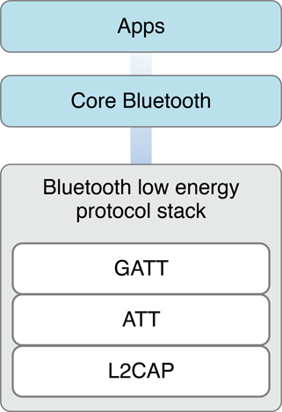
Thinking Outside the Sandbox
App permissions are tightly restricted in Apple OSes
Inter-process communication (IPC) is still necessary
Daemons use IPC to communicate with bluetooth stack
This vulnerability hijacks this IPC port and uses it to send messages to clients of bluetoothd

Slide 4
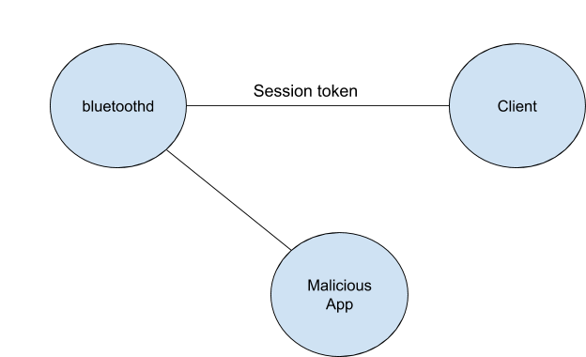
Attack Process
Client wants to make a session with bluetoothd
Upon successful join, client is given a session token
Session tokens given out using predictable pattern
With proper knowledge, attacker could send message to this port and register new clients
Attacker could leak IPC ports of all bluetoothd clients
Greatly increases attack surface!

Slide 5
Affected Processes
SpringBoard
mDNSResponder
aggregated
wifid
Preferences
CommCenter
iaptransportd
findmydeviced
routined
UserEventAgent
carkitd
mediaserverd
Bluetoothd
coreduetd
Number of privileged processes, very valuable to an attacker

Slide 6
Important Links
https://blog.zimperium.com/cve-2018-4087-poc-escaping-sandbox-misleading-bluetoothd/
https://blog.zimperium.com/new-crucial-vulnerabilities-apples-bluetoothd-daemon/

