Slide 1
SOC Design Lab
Lab4-0 – Caravel SOC Simulation
Jiin Lai

Slide 2
Background
Caravel SOC Introduction - Refer to
PPT: https://github.com/bol-edu/caravel-soc_fpga-lab/tree/main/caravel-soc-ppt
Youtube Channel: https://youtube.com/playlist?list=PL5CoDA0gtOHVeF4FkotwDY-buLVIoeGzf&si=teFjiOvwbZWLZboe

Slide 3
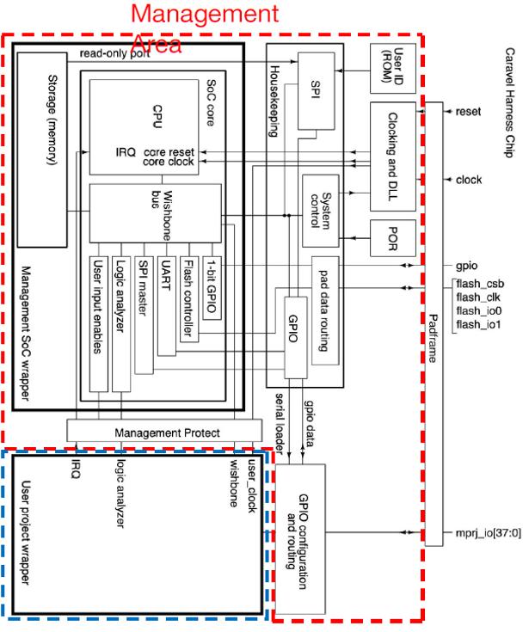
Caravel Simulation Verification System
Verilog testbench
counter_la_tb.v
Module counter_tb;
Initial beigin
wait(checkbits == 16’hAB40);
wait(checkbits = ..
End
Initial begin
RSB <= 1’b0;
RSB <= 1’b1;
end
Caravel uut( );
Spiflash #( .FILENAME(“counter_la.hex”} spiflash ( );
tbuart tburat ( );
endmodule

Slide 4

Bring up Caravel SOC Simulation
Refer to the Github to bring up Caravel SOC simulation
https://github.com/bol-edu/caravel-soc (iverilog)
Follow the following step to bring up the Toolchain
https://github.com/bol-edu/caravel-soc#toolchain-prerequisites
Follow the following step to use Xilinx XSIM
https://github.com/bol-edu/caravel-soc_fpga#run-xilinx-vivado-simulation-of-caravel-soc-fpga (Xsim)
git clone https://github.com/bol-edu/caravel-soc_fpga
Follow the link: https://github.com/bol-edu/caravel-soc_fpga#run-xilinx-vivado-simulation-of-caravel-soc-fpga
Execute the xsim example
Run the following example
counter_la, coutner_wb, gcd_la

Slide 5

Observe and Learn the following
Observe the following
spiflash access & code execution (observe CPU trace )
cpu wb cycles interaction with user project area.
cpu interface with user project with la
User project/RISC-V uses mprj pin, and interacts with Testbench
Learn the following
RISC-V tool chain
Caravel testbench structure
Caravel SOC design
RISC-V firmware development
User project integrates with Caravel SOC
GDB + GDBWave Debugging (caravel-soc, iverilog) - (optional )
Trace Verilog code with Vim + vtags (caravel-soc, iverilog) – ( optional )
Using CPU trace ( https://github.com/bol-edu/caravel-soc/tree/cpu-trace ) - caravel-soc, iverilog (optional)

Slide 6
You do not need to turn-in report This is for you to prepare Lab4-1, Lab4-2

