Slide 1
Guideline for HLS Cosim

Slide 2
Guideline for Writing a Test Bench
Separate the top function for synthesis from the test bench and header files.
If there are multiple kernel functions, group them in one top-level function for synthesis.
The test bench should execute the top-level function for multiple transactions, allowing different data values to be applied and verified. (test coverage)
You will use the same test bench for C/RTL Co-simulation. If you want to calculate II during the RTL simulation, you also need to provide multiple transactions to calculate II accurately.
Checking correctness of kernel run is important. The return value of function main() indicates the following:
Zero: Results are correct.
Non-zero value: Results are incorrect. The non-zero results indicate the type of failure.

Slide 3
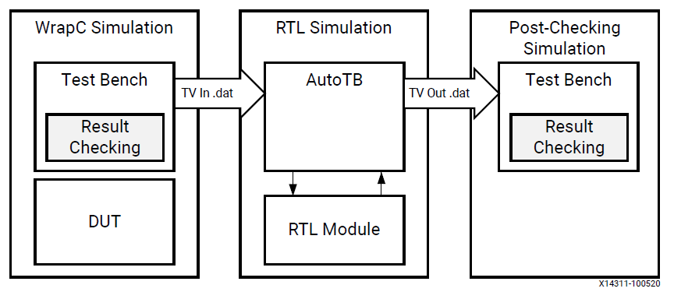
C/RTL Co-simulation
0. Different from Event-Driven Hardware Simulator
Phase#1: C simulation is executed to prepare the “input vectors” to the top-level function.
Phase#2: RTL simulation starts; it takes the input vectors and generates the “output vectors”
Phase#3: C simulation of the test bench main() function continues. It takes the “output vectors” returned from the RTL simulation and performs verification of the result.

Slide 4
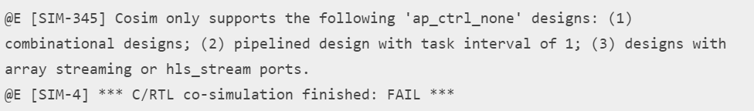
Requirement for Co-simulation
Interface Synthesis Requirement
Top-level function using ap_ctrl_chain or ap_ctrl_hs (can no use ap_ctrl_none)
Or design must be purely combinational (evaluate in one cycle)
Top function must have an initiation interval of 1. No handshake in the data argument. Input test vector are fed into RTL all at once
Interface must be all arrays streaming with axis or ap_hs
Provide sufficient FIFO depth to avoid stall or deadlock
Depth declared for the interface is too small. Create Deadlock
Certain unsupported Optimization for array or structs
Multiple transformation on array on the interface or array within structs
Vertical mapping, Reshape, Partition
Not support –
Horizontal mapping, Vertical mapping
Conditional access on the AXI4-Stream with register slice enabled
Mapping arrays to streams
Use Waveform Viewer or Co-simulation deadlock viewer
https://www.boledu.org/textbooks/hls-textbook/application-acceleration-development-flow/crtl-co-simulation#crtl-co-simlation
https://docs.xilinx.com/r/en-US/ug1399-vitis-hls/Interface-Synthesis-Requirements

Slide 5
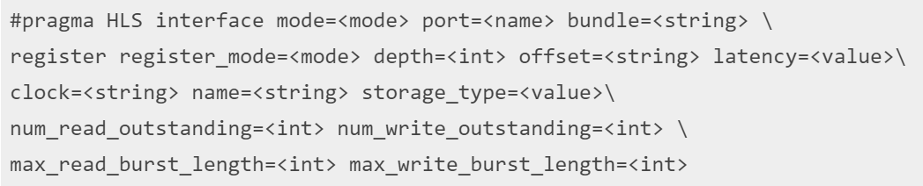
Provide Sufficient FIFO Depth to Prevent Co-sim Deadlock
m-axi
depth: Specifies the maximum number of samples for the test bench to process.

