Slide 1

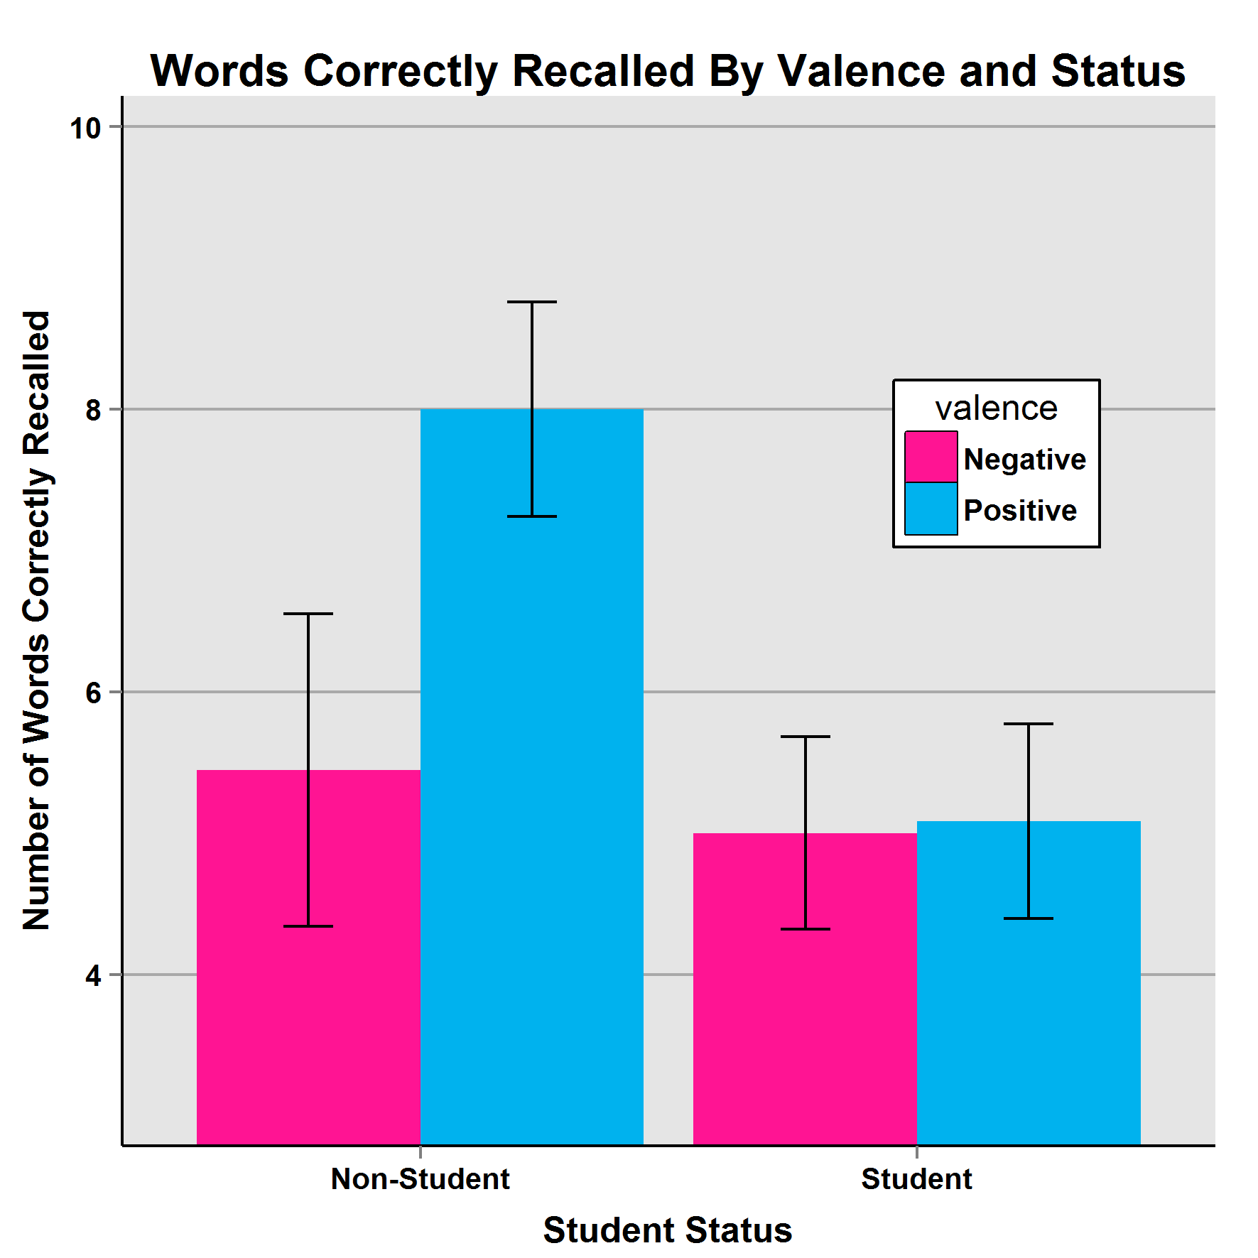
EMOTION AND RECALL
￼
Dominic B.I.A. Tzimisces & Michaela Montalvo
Eastern Oregon University
ABSTRACT
This study attempted to broadly delineate the effects of affect & arousal levels on recall when applied to participants watching YouTube clips. It was hypothesized that induced positive affect, combined with high arousal, would trigger the largest improvement in recall, whereas induced negative affect, combined with low arousal, would trigger the largest deficit in recall. The study exposed a split result. Although data showed no significant effects in either factor, the number of recalled words was significantly associated with student status. Students recalled less than non-students. This may have implications for the extra-credit-for participation paradigm.
INTRODUCTION
Previous researchers that have utilized affect induction via film in the service of memory studies often attempted to measure several items (for example, see Anderson & Shimamura, 2005), wherein researchers measured how much participants recalled film and contextual detail as well as words presented as the clip was shown. In such complex experiments, there is always the risk that the attempt to measure so many factors may confound or confuse the results. This study sought to avoid those concerns through a singular focus on word-recall, with the content of the film used for affect induction only.
METHODS
There were 43 participants, 23 students and 20 non-students (29 female & 14 male). Student participants were offered extra credit for currently enrolled psychology courses.
After informed consent all were assigned to a condition based on their birth month and asked to memorize as many of a 20-word set of neutrally valenced words prior to affect induction via film. Then, they watched a YouTube video which separated them into one of four conditions: Positive Affect/Low Arousal, Positive Affect/High Arousal, Negative Affect/Low Arousal, and Negative Affect/High Arousal.
Afterwards, they were instructed to write down however many words they recalled and email the list to the researchers, along with their condition number, month of birth, and sex.
RESULTS
Although there were no significant associations in the overall dataset between recall, valence, or arousal, there was a significant association between student status and number of words recalled: F(1,35)=5.172, p=0.03. Additionally, the relationship between non-students, valence, and recollection was noteworthy: F(1,17)=3.53, p=0.08.
DISCUSSION
This study was an attempt to partly replicate and further the findings of Anderson & Shimamura (2005), particularly the role valence plays in the formation of memories. Though the primary hypotheses were not supported, it is noteworthy that students, vice non-students, appeared to recall less. This anomaly, if replicated, may have implications for the pervasive use of undergraduate students in basic psychological research as the results appear to suggest, in some situations, students who receive compensation for participation may feel less beholden to remain attentive during the experiment as their “reward” is already a given, irrespective of conduct. The results from the non-student population tantalizingly suggest that valence may be a factor in recall. Further studies may focus on non-compen- sable participants to see if these findings hold.
SUMMARY
Although previous research suggested that affect and arousal have significant effects on what is recalled, the degree of detail of the recollection, and the contextual data associated with it, this quasi-experiment was not able to replicate the results. However, we were able to note the apparent significance of participant status on the number of recalled words. The data suggest that, in some situations, compensated students may not be as attentive to protocols as their non-compensated counterparts. As for the use of YouTube as an experimental tool, this study validated its use, with caveats.
VALENCE WORDS USED
Crawl
Breeze
Forth
Scab
Explore
Revert
Pack
Outcome
Manage
Lemon
Flipper
Tone
Inside
Have
Angel
Desires
Tape
Window
Match
Provide
REFERENCES
Anderson, C.A., Carnagey, N.L, & Eubanks, J. (2003). Exposure to violent media: The effects of songs with violent lyrics on aggressive thoughts and feelings. Journal of Personality and Social Psychology, 84, 960-971.
Anderson, L., & Shimamura, A. P. (2005). Influences of emotion on context memory while viewing film clips. The American Journal of Psychology, 118, 323-337.
Jhean-Larose, S., Leveau, N., & Denhiere, G. (2014). Influence of emotional valence and arousal on the spread of activation in memory. Cognitive Processing, 15, 515-522. doi:10.1007/s10339-014-0613-5
For additional information please contact:
Dominic Tzimisces or Michaela Montalvo
Psychology Department
Eastern Oregon University
dtzimisces@eou.edu or maupinm@eou.edu

