Slide 1


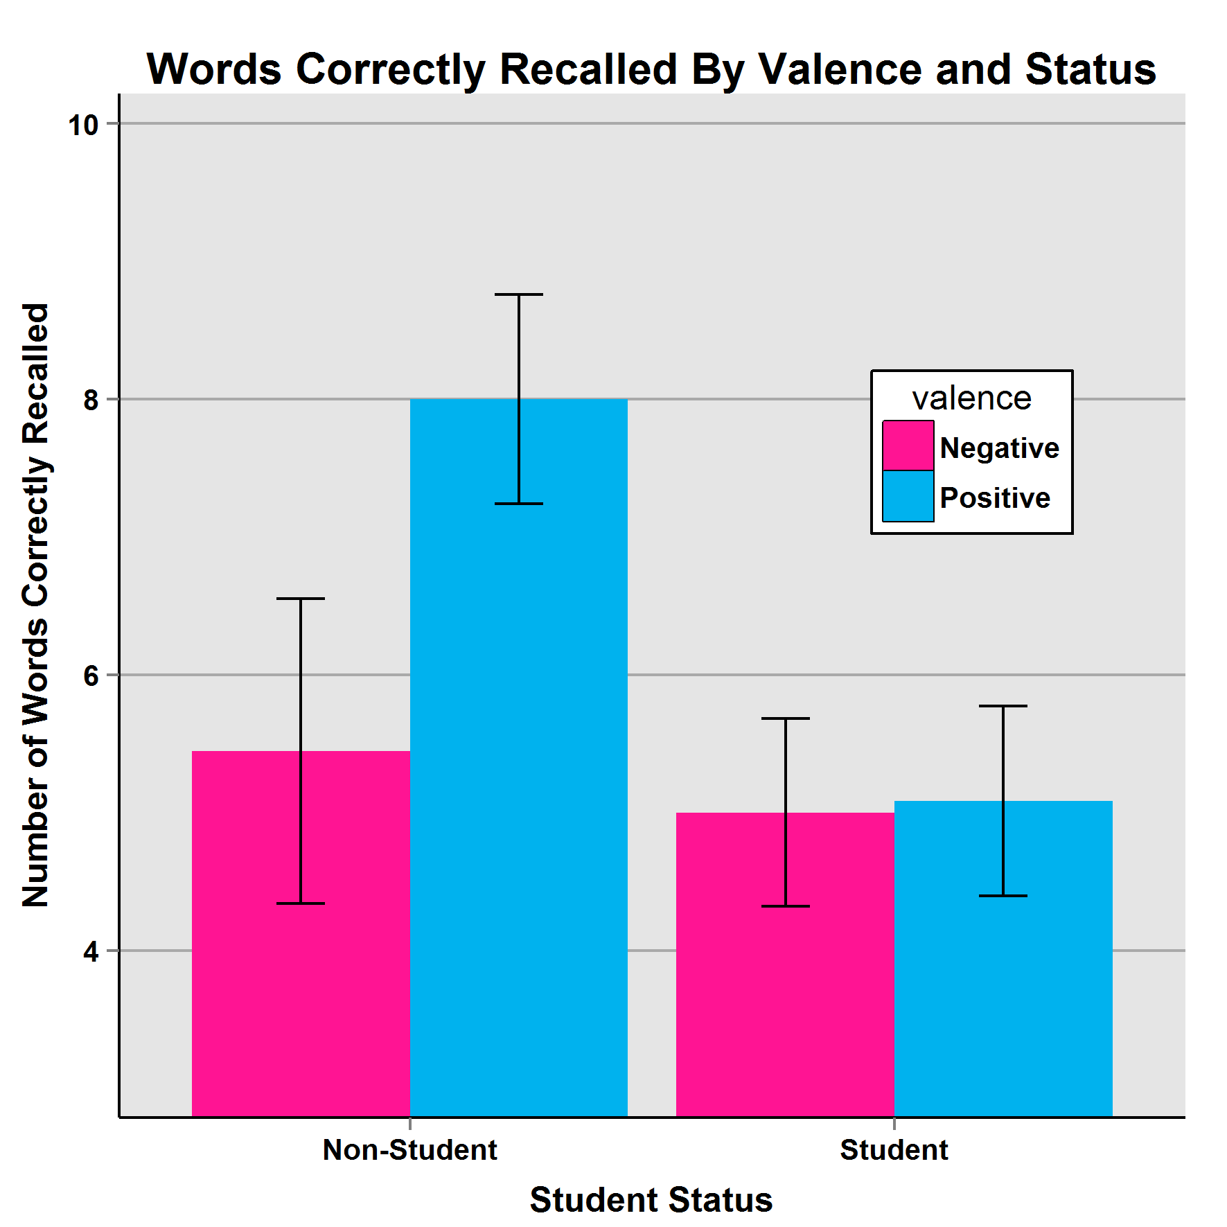
EMOTION AND RECALL
Dominic B.I.A. Tzimisces & Michaela Montalvo
Eastern Oregon University
Abstract
This study attempted to broadly delineate the effects of affect & arousal levels on recall when applied to participants watching YouTube clips. It was hypothesized that induced positive affect, combined with high arousal, would trigger the largest improvement in recall, whereas induced negative affect, combined with low arousal, would trigger the largest deficit in recall. The study exposed a split result. Although data showed no significant effects in either factor, the number of recalled words was significantly associated with student status. Students recalled less than non-students. This may have implications for the extra-credit-for participation paradigm.
Discussion
This study was an attempt to partly replicate and further the findings of Andeson & Shimamura (2005), particularly the role valence plays in the formation of memories. Though the primary hypotheses were not supported, it is note- worthy that students, vice non-students, appeared to recall less. This anomaly, if replicated, may have implications for the pervasive use of undergraduate students in basic psychological research as the results appear to suggest, in some situations, students who receive compensation for
participation may feel less beholden to remain attentive during the experiment as their “reward” is already a given, irrespective of conduct. The results from the non-student population tantalizingly suggest that valence may be a factor in recall. Further studies may focus on non-compen- sable participants to see if these findings hold.
Methods
There were 43 participants, 23 students and 20 non-students (29 female & 14 male). Student participants were offered extra credit for currently enrolled psychology courses. After informed consent all were assigned to a condition based on their birth month and asked to memorize as many of a 20-word set of neutrally valenced words prior to affect induction via film. Then, they watched a YouTube video which separated them into one of four conditions: Positive Affect/Low Arousal, Positive Affect/High Arousal, Negative Affect/Low Arousal, and Negative Affect/High Arousal. Afterwards, they were instructed to write down however many words they recalled and email the list to the researchers, along with their condition number and sex.
Introduction
Previous researchers that have utilized affect induction via film in the service of memory studies often attempted to measure several items (for example, see Anderson & Shimamura, 2005), wherein researchers measured how much participants recalled film and contextual detail as well as words presented as the clip was shown. In such complex experiments, there is always the risk that the attempt to measure so many factors may confound or confuse the results. This study sought to avoid those concerns through a singular focus on word-recall, with the content of the film used for affect induction only.
Summary
Although previous research suggested that affect and arousal have significant effects on what is recalled, the degree of detail of the recollection, and the contextual data associated with it, this quasi- experiment was not able to replicate the results. However, we were able to note the apparent significance of participant status on the number of recalled words. The data suggest that, in some situations, compensated students may not be as attentive to protocols as their non-compensated counterparts. As for the use of YouTube as an experimental tool, this study validated its use, with caveats.
Results
Although there were no significant associations in the overall dataset between recall, valence, or arousal, there was a significant association between student status and number of words recalled: F(1,35)=5.172, p=0.03. Additionally, the relationship between non-students, valence, and recollection was noteworthy: F(1,17)=3.53, p=0.08.

Slide 2
References
Aben, B., Stapert, S., & Blokland, A. (2012). About the distinction between working memory
and short-term memory. Frontiers in Psychology, 3, Article 301.
doi:10.3389/fpsyg.2012.00301
Altarriba, J. (2012). Emotion and mood: Over 120 years of contemplation and exploration in
The American Journal of Psychology. The American Journal of Psychology, 125,
409-422. doi:10.5406/amerjpsyc.125.4.0409
Anderson, L., & Shimamura, A. P. (2005). Influences of emotion on context memory while
viewing film clips. The American Journal of Psychology, 118, 323-337.
Baddeley, A. D. (2002). Is working memory still working? European Psychologist, 7, 85-97.
doi:10.1027//1016-9040.7.2.85
Baddeley, A. D., & Hitch, G. J. (1974). Working memory. In G. A. Bower (Ed.), Recent
advances in learning and motivation (Vol. 8, pp. 47-90). New York, NY: Academic
Press.
Bradley, M. M., & Lang, P. J. (1999). Affective norms for English words (ANEW): Instruction
manual and affective ratings. Technical Report C-1. Gainesville, FL: The Center for
Research in Psychophysiology, University of Florida.
Buchanan, T. W., & Adolphs, R. (2002). The role of the human amygdala in emotional
modulation of long-term declarative memory. In S. Moore & M. Oaksford (Eds.),
Emotional cognition: From brain to behavior (pp. 9-34). Amsterdam: John Benjamins
Publishing.
Cowan, N. (2001). The magical number 4 in short-term memory: A reconsideration of mental
storage capacity. Behavioral and Brain Science, 24, 87-185.
doi:10.1017/S0140525X01003922
Cowan, N. (2008). What are the differences between long-term, short-term, and working
memory? Progress in Brain Research, 169, 323-338.
doi:10.1016/S0079-6123(07)00020-9
Cowan, N. (2014). Working memory underpins cognitive development, learning, and education.
Educational Psychology Review, 26, 197-223. doi:10.1007/s10648-013-9246-y
Curci, A., Lanciano, T., Soleti, E., & Rime, B. (2013). Negative emotional experiences arouse
rumination and affect working memory capacity. Emotion, 13, 867-880. doi:10.1037/a0032492
Ford, J. H., Addis, D. R., & Giovanello, K. S. (2012). Differential effects of arousal in positive
and negative autobiographical memories. Memory, 20, 771-778.
doi:10.1080/09658211.2012.704049
Hamann, S. (2001). Cognitive and neural mechanisms of emotional memory. Trends in
Cognitive Science, 5, 394-400. doi:10.1016/S1364-6613(00)01707-1
Harmon-Jones, E., Gable, P. A., & Price, T. F. (2013). Does negative affect always narrow and
positive affect always broaden the mind? Considering the influence of motivational
intensity on cognitive scope. Current Directions in Psychological Science, 22, 301-307.
doi:10.1177/0963721413481353
Hockenbury, D. H., & Hockenbury, S. E. (2013). Psychology (6th ed., p. 232). New York, NY:
Worth Publishers.
Jhean-Larose, S., Leveau, N., & Denhiere, G. (2014). Influence of emotional valence and arousal
on the spread of activation in memory. Cognitive Processing, 15, 515-522.
doi:10.1007/s10339-014-0613-5
Kensinger, E. A., & Schacter, D. L. (2010). Memory and emotion. In M. Lewis (Ed.), Handbook
of emotions (3rd ed., pp. 601-617). New York, NY: Guilford Press.
Lindström, B. R., & Bohlin, G. (2012). Threat-relevance impairs executive functions: Negative
impact on working memory and response inhibition. Emotion, 12, 384-393. doi:10.1037/ a0027305
Mather, M., & Sutherland, M. (2011). Arousal-based competition in memory. Perspectives on
Psychological Science, 6, 114-133. doi:10.1177/1745691611400234
Mather, M., & Sutherland, M. (2012). The selective effects of emotional arousal on memory.
Psychological Science Agenda. Retrieved from
http://www.apa.org/science/about/psa/2012/02/emotional-arousal.aspx
McGuire, T. M., Lee, C. W., & Drummond, P. D. (2014). Potential of eye movement
desensitization and reprocessing therapy in the treatment of PTSD. Psychology Research
and Behavior Management, 7, 273-283. doi:10.2147/PRBM.S52268
Ranganath, C., & Blumenfeld, R. S. (2005). Doubts about double dissociations between short-
and long-term memory. Trends in Cognitive Science, 9, 374-380.
doi:10.1016/j.tics.2005.06.009
Rock, P. I., Roiser, J. P., Riedel, W. J., & Blackwell, A. D. (2014). Cognitive impairment in
depression: A systematic review and meta-analysis. Psychological Medicine, 44,
2029-2040. doi:10.1017/S0033291713002535
Sakaki, M., Fryer, K., & Mather, M. (2014). Emotion strengthens high-priority memory traces
but weakens low-priority memory traces. Psychological Science, 25, 387-395.
doi:10.1177/0956797613504784
Schweizer, S., & Dalgleish, T. (2011). Emotional working memory capacity in posttraumatic
stress disorder (PTSD). Behaviour Research and Therapy, 49, 498-504.
doi:10.1016/j.brat.2011.05.007
Spachtholz, P., Kuhbandner, C., & Pekrun, R. (2014). Negative affect improves the quality of
memories: Trading capacity for precision in sensory and working memory. Journal of
Experimental Psychology, 143, 1450-1456. doi:10.1037/xge0000012
Stevenson, R. A., Mikels, J. A., & James, T. W. (2007). Characterization of the Affective Norms
for English Words by discrete emotional categories. Behavior Research Methods, 39,
1020-1024. doi:10.3758/BF03192999
Storbeck, J., Davidson, N. A., Dahl, C. F., Blass, S., & Yung, E. (2015). Emotion, working
memory task demands and individual differences predict behavior, cognitive effort and
negative affect. Cognition and Emotion, 29, 95-117. doi:10.1080/02699931.2014.904222
Storbeck, J., & Watson, P. (2014). Verbal makes it positive, spatial makes it negative: Working
memory biases judgments, attention, and moods. Emotion, 14, 1072-1086.
doi:10.1037/a0037327
Talarico, J. M., Berntsen, D., & Rubin, D. C. (2009). Positive emotions enhance recall of
peripheral details. Cognition and Emotion, 23, 380-398.
doi:10.1080/02699930801993999
Velten, E., Jr. (1968). A laboratory task for induction of mood states. Behaviour Research and
Therapy, 6, 473-482. doi:10.1016/0005-7967(68)90028-4
Waring, J. D., & Kensinger, E. A. (2011). How emotion leads to selective memory:
Neuroimaging evidence. Neuropsychologia, 49, 1831-1842.
doi:10.1016/j.neuropsychologia.2011.03.007
Yang, H., Yang, S., & Isen, A. M. (2013). Positive affect improves working memory:
Implications for controlled cognitive processing. Cognition and Emotion, 27, 474-482.
doi:10.1080/02699931.2012.713325
Zhang, J-N, Xiong, K-L, Qiu, M-G, Zhang, Y, Xie, B., Wang, J.,…Zhang, J-J. (2013). Negative
emotional distraction on neural circuits for working memory in patients with posttraumatic stress disorder. Brain Research, 1531, 94-101.

