Slide 1
Predicting Delayed Flights
Mike Cantrell, PhD

Slide 2
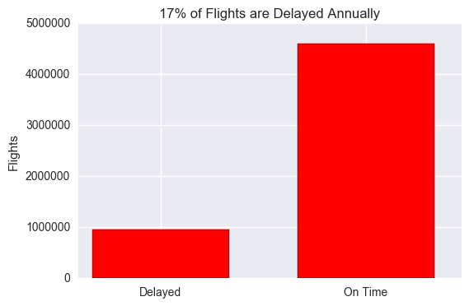
Data
One Year of Domestic Flights
5.5 Million Flights
Bureau of Transportation Statistics
Annual Cost of Delayed Flights
Passengers - $19 Billion
Airlines - $9 Billion

Slide 3
Predicting Delays Saves Money
What causes delays?

Slide 4
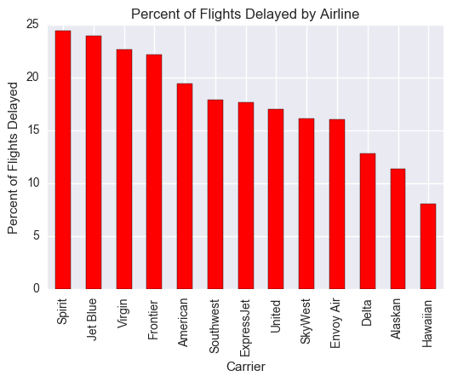
Some Factors Are Obvious

Slide 5
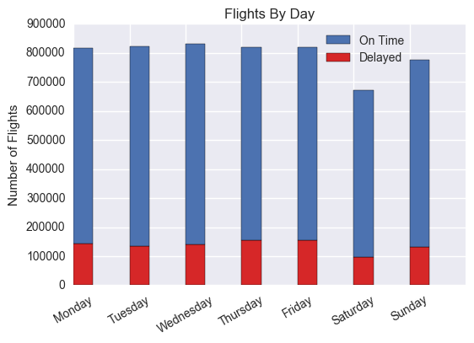
Some Features Are Less Predictive

Slide 6
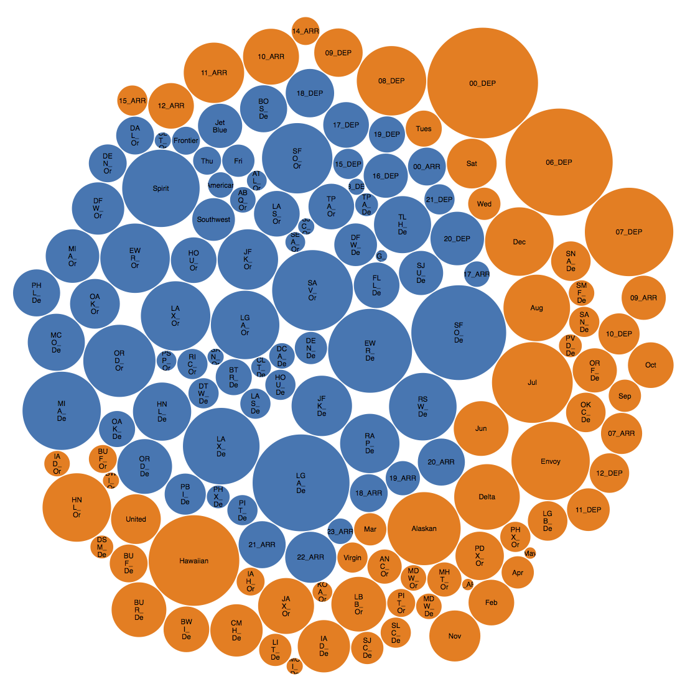
Positive Effect
Negative Effect
Airline
Origin
Destination
Month
Day of Week
Depart Time
Arrive Time
Congestion
Adjusted Congestion

Slide 7
Positive Effect
Negative Effect
Airline
Origin
Destination
Month
Day of Week
Depart Time
Arrive Time
Congestion
Adjusted Congestion

Slide 8
Positive Effect
Negative Effect
Airline
Origin
Destination
Month
Day of Week
Depart Time
Arrive Time
Congestion
Adjusted Congestion

Slide 9
Positive Effect
Negative Effect
Airline
Origin
Destination
Month
Day of Week
Depart Time
Arrive Time
Congestion
Adjusted Congestion

Slide 10
Positive Effect
Negative Effect
Airline
Origin
Destination
Month
Day of Week
Depart Time
Arrive Time
Congestion
Adjusted Congestion

Slide 11
Positive Effect
Negative Effect
Airline
Origin
Destination
Month
Day of Week
Depart Time
Arrive Time
Congestion
Adjusted Congestion

Slide 12
Positive Effect
Negative Effect
Airline
Origin
Destination
Month
Day of Week
Depart Time
Arrive Time
Congestion
Adjusted Congestion

Slide 13
Positive Effect
Negative Effect
Airline
Origin
Destination
Month
Day of Week
Depart Time
Arrive Time
Congestion
Adjusted Congestion
Can you their bubbles? (small)

Slide 14
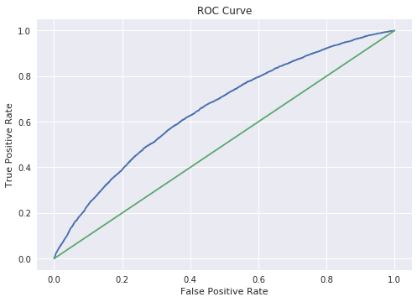
All 5.5 Million Flights
Benefit
Area Under Curve = 0.67
Cost

Slide 15
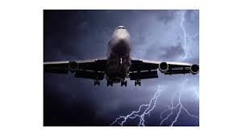
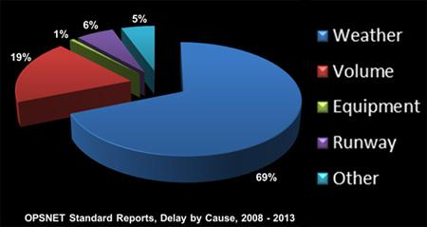
Weather Causes Lots of Flight Delays

Slide 16
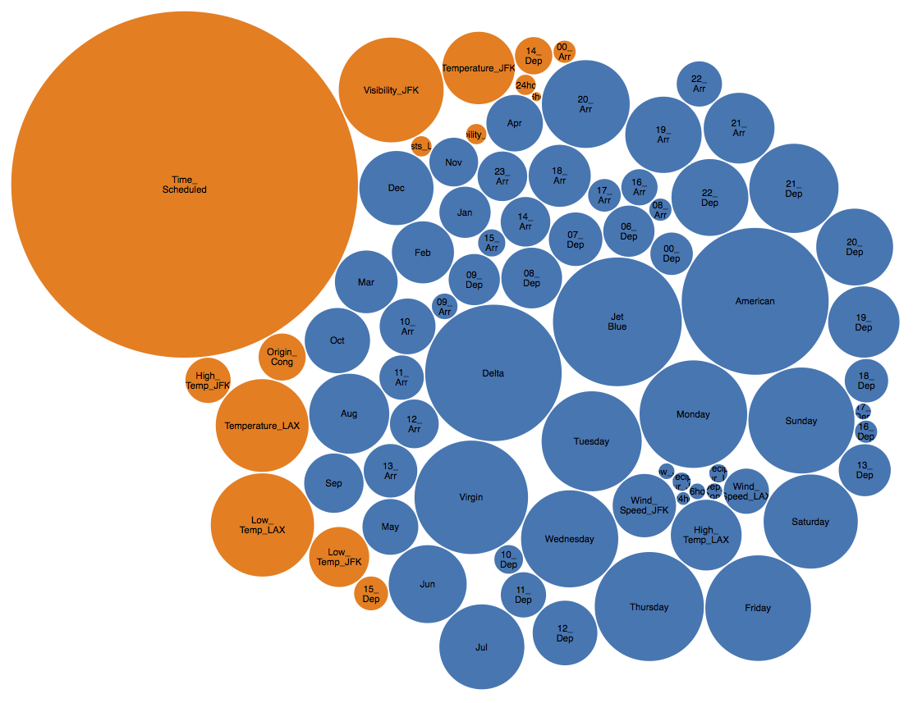
JFK → LAX
With Hourly Weather
Positive Effect
Negative Effect

Slide 17
JFK → LAX
With Hourly Weather
Positive Effect
Negative Effect

Slide 18
JFK → LAX
With Hourly Weather
Positive Effect
Negative Effect

Slide 19
JFK → LAX
With Hourly Weather
Positive Effect
Negative Effect

Slide 20
JFK → LAX
With Hourly Weather
Positive Effect
Negative Effect

Slide 21
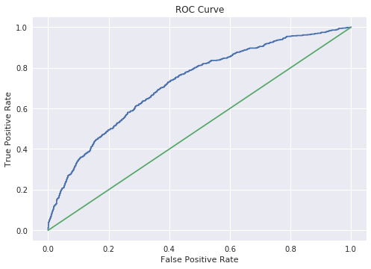
Flights From JFK to LAX With Hourly Weather
Benefit
Area Under Curve = 0.73
Cost

Slide 22
Weather Information Is Useful
Without Weather
With Weather

Slide 23
Summary
Future Work
Don’t fly out of Newark on a Friday at 5pm when the wind speed is high and the temperature is low.
Mechanical Information
Weather information on all airports, and in between
More computational power for crunching data
Create interactive predictor via D3 and Flask

Slide 24
Thanks!

