Slide 1

Predicting NBA Player Salary
Using Linear Regression
Michael Cantrell, PhD

Slide 2
Problem
Can future player salary be predicted by past player performance?
What should an aspiring basketball player do?

Slide 3
Feature Pool
Age -- Age of Player
Tm -- Team
Pos -- Position
G -- Games Played
GS -- Games Started
MP -- Minutes Played
FG -- Field Goals
FGA -- Field Goal Attempts
FGP -- Field Goal Percentage
3P -- 3-Point Field Goals
PA3 -- 3-Point Field Goal Attempts
PP3 -- 3-Point Field Goal Percentage
2P -- 2-Point Field Goals
2PA -- 2-Point Field Goal Attempts
PP2 -- 2-Point Field Goal Percentage
eFGP -- Effective Field Goal Percentage
FT -- Free Throws
FTA -- Free Throw Attempts
FTP -- Free Throw Percentage
ORB -- Offensive Rebounds
DRB -- Defensive Rebounds
TRB -- Total Rebounds
AST -- Assists
STL -- Steals
BLK -- Blocks
TOV -- Turnovers
PF -- Personal Fouls
PTS -- Points

Slide 4
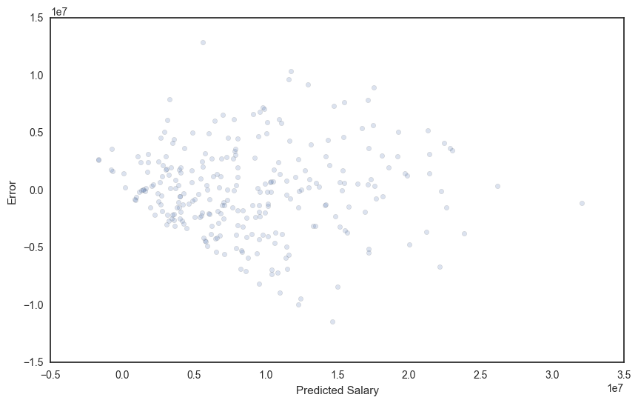
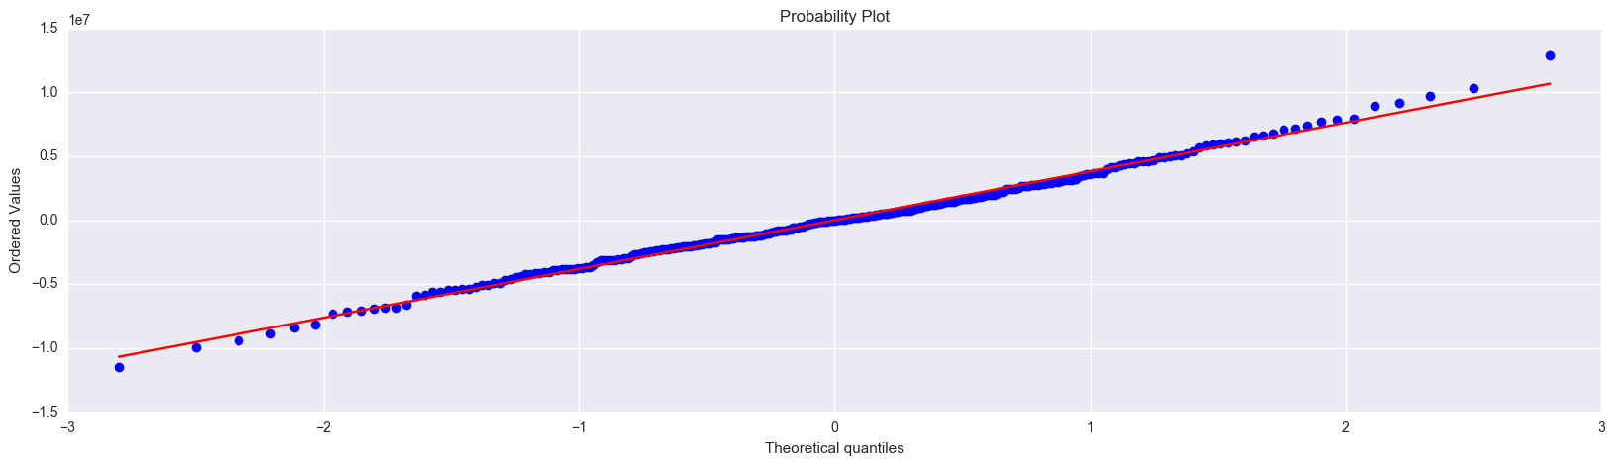
Linear Regression is Appropriate

Slide 5
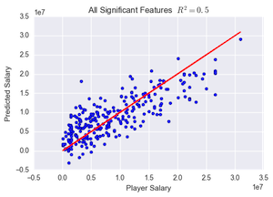

Slide 6
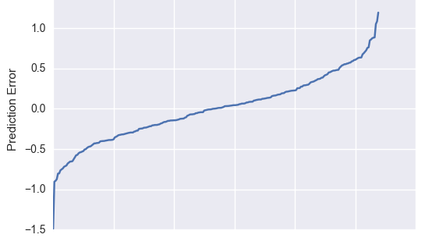
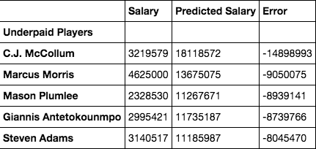
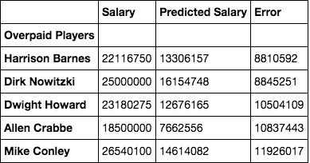
Predictive Error

Slide 7
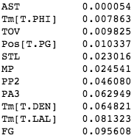
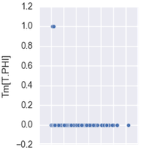
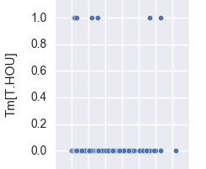
Is Team Really Predictive?

Slide 8
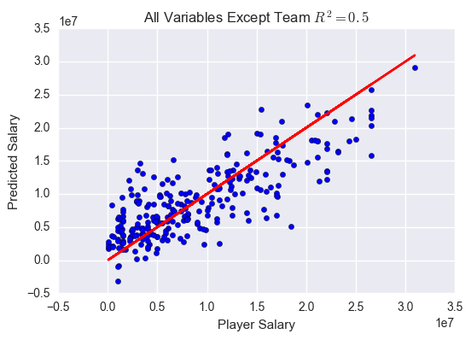

Slide 9
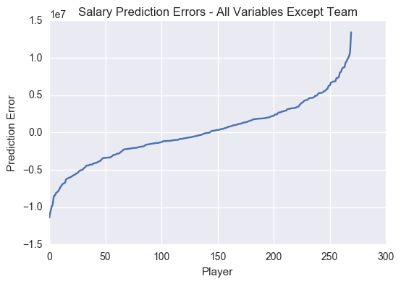
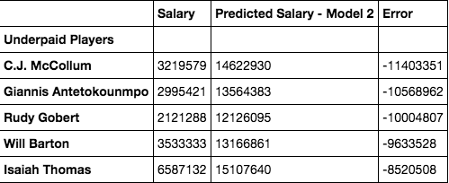
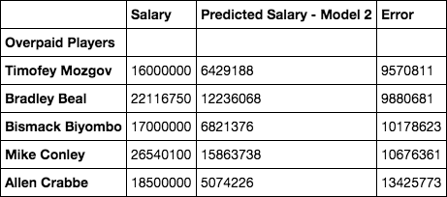
Predictive Error

Slide 10
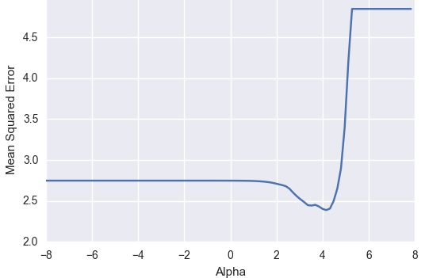
Lasso Regularization on All Features

Slide 11
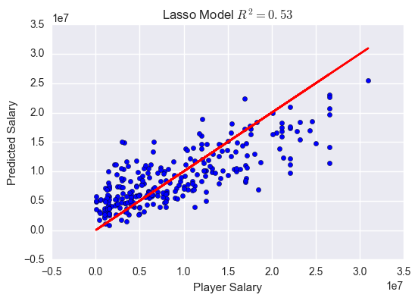

Slide 12
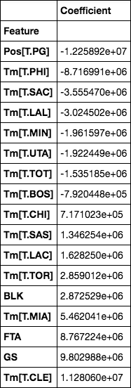
Lasso chose mostly Team Features

Slide 13
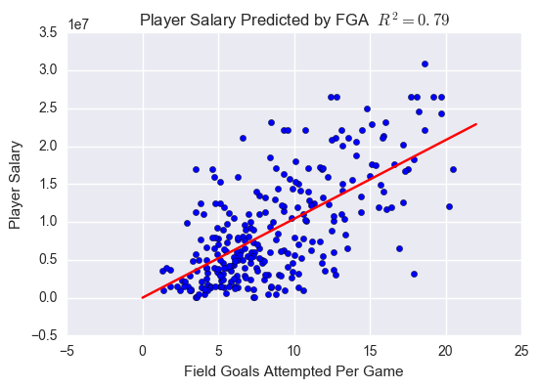
Players get paid to take shots???

Slide 14
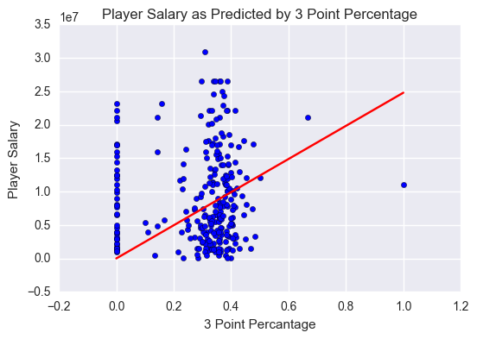
Percentages are meaningless???

Slide 15
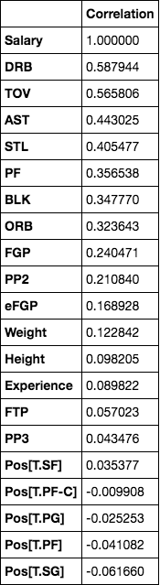
What players can improve

Slide 16
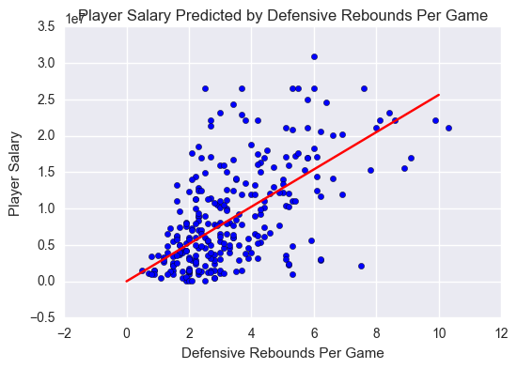
Defensive Rebounds DO Pay

Slide 17
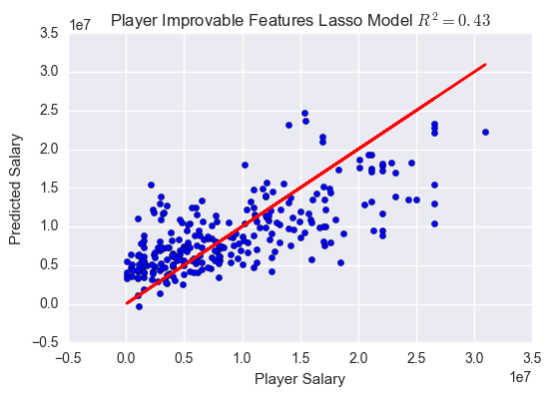

Slide 18
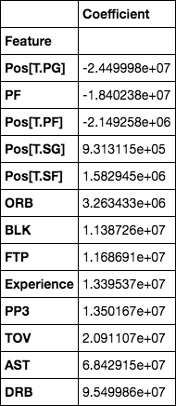
Lasso Coefficients Improvable Features

Slide 19
Conclusions
NBA Player Salaries fairly predictable: R² = 0.53
Team Membership, Field Goal Attempts suprisingly predictive
Meaningful stats also predictive: R² = 0.43
Most meaningful stats counter intuitive:
Defensive Rebounds > 3 Pointer Percentage

Slide 20

Thanks!

