Slide 1



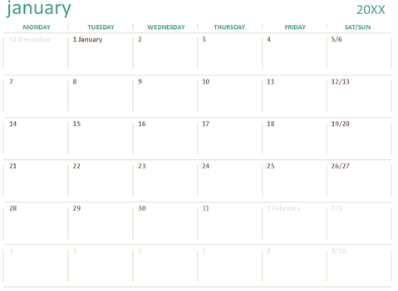


Browser
https://donutsproject.justforthedonuts.com
Project Donuts (MVP)
Project Insights
Team Insights
Help
Calendar
Backlog
Project Logs
Key Milestones
Milestone 1
Project Ideation
HTML Implementation
Milestone 1. Ideation Completion
Proposal Completion
Milestone 2
Styling Implementation
Calendar Page Implementation
Milestone 2. Calendar Page Completion

Slide 2


Browser
https:// donutsproject.justforthedonuts.com
Project Donuts (MVP)
Project Insights
Team Insights
Help
Calendar
Backlog
Project Logs
Harry Shen
Ida Putra
WIP
WIP
Calendar HTML Implementation
Backlog HTML Implementation
Calendar Styling Implementation
Calendar JS Implementation
Done
Done
Product Mockup

Slide 3
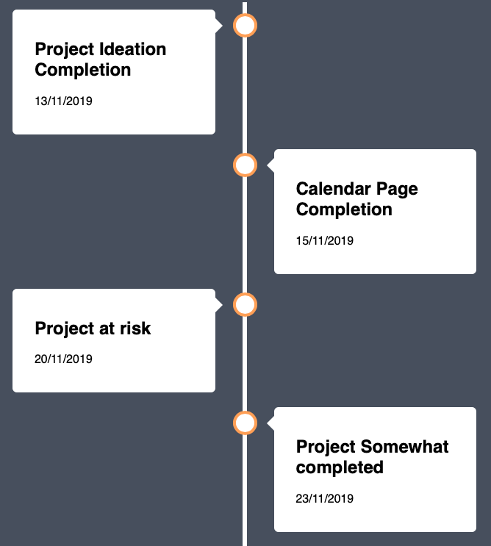
Browser
https:// donutsproject.justforthedonuts.com
Project Donuts (MVP)
Project Insights
Team Insights
Help
Calendar
Backlog
Project Events
Color coding the future/past events
Able to expand to display more details

