Slide 1

AI similarities using Linux bash script
Michael Chrisco

Slide 2
Project in a nutshell
Compare by classification on data from different origins.

Slide 3
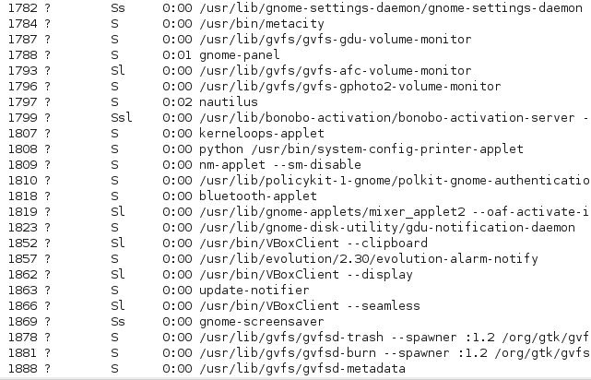
Project in a nutshell
Linux processes
Compare by classification on data from different origins.

Slide 4
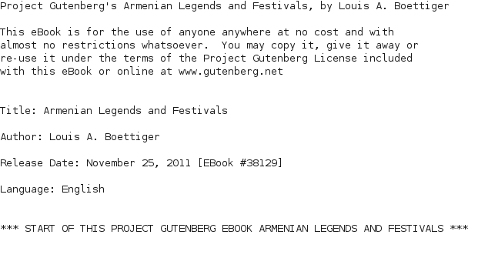
Project in a nutshell
Compare by classification on data from different origins.
Linux processes
Text documents (books)

Slide 5
Project in a nutshell
Compare by classification on data from different origins.
Linux processes
Text documents (books)
How to categorize different data by graphing the result.

Slide 6
Background
AI: to create and replicate actions that humans excel at.
Given a set of documents, how similar are the documents and what kind of preset data needs to be generated.
What can we learn with given data?

Slide 7
Project #1
Create concept script
given pre-made (human generated) data, make the computer come up with categorizations by itself.
Use k-means algorithm for the categorizations.

Slide 8
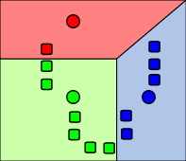
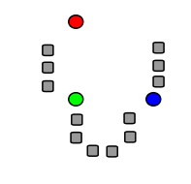
k-means clustering Algorithm
Given a set of observations, partition the points into sets based on the centriod (the center point of the observations).

Slide 9
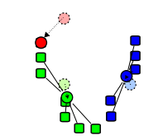
k-means clustering Algorithm
Given a set of observations, partition the points into sets based on the centriod (the center point of the observations).
Given set of points
Partitioning given means of points
Create centriods and redo algorithm on each partition

Slide 10
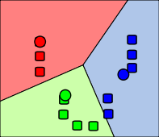
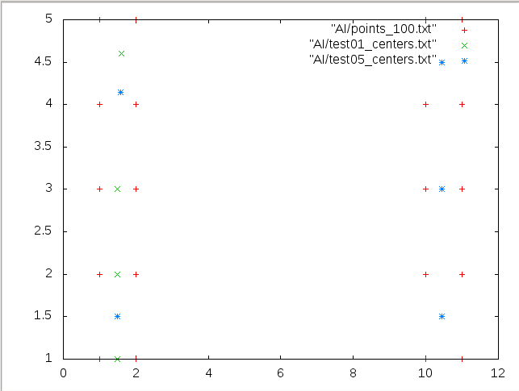
REsult of k-means
1) Centriods that represent the data
2) Partitioning of the data

Slide 11
code description for sample data
Run the Main.bash script which will execute the k-means.bash script and the plot.p script.
k-means script runs the k-means executable (C++ program) and plot the results using the linux tool gnuplot.
Result will be in AI/output.png
Given that the data itself is pre-made, the clusters should be around the datapoints to the left and to the right. 5 centroids will be displayed from the first run of the algorithm and 5 centroids from the last run.

Slide 12
Results

Slide 13
Applying to Linux Processes
1) Given “normal” operations in linux, what kind of information can we learn from the processes themselves?
2) What processes are not in the set of “normal” operations for the system?

Slide 14
Pre-processing data
Data (IE process names) are extracted using the ps -x command in linux 100 times. These are snapshots of the running system.

Slide 15
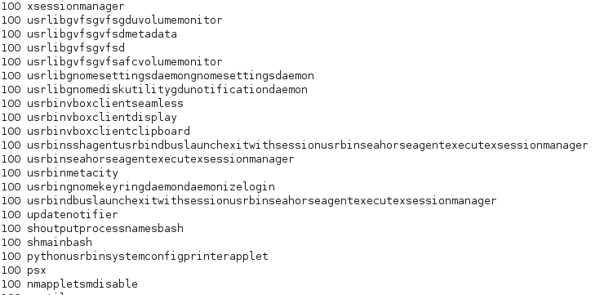
Bag of words
Using the 100 process names, one can create a “bag-of-words” model of the data.
“Bag-of-words” algorithm creates a list of unique words and word counts of each word.

Slide 16
Using separate snapshot of system
In order to see what processes are happening now on the system, create a new snapshot of the system (ps -x), and compare the bag-of-words of the new snapshot and the other “normal” processes. Use output of linux command diff to see what is different.
Can also tell what processes are not running now that should be running.

Slide 17
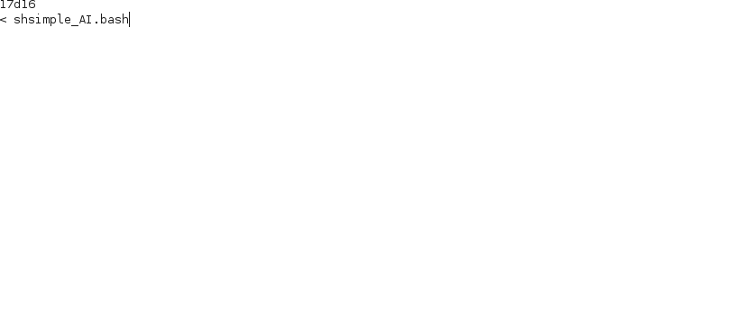
Results (part 1)
In this system, the only difference is simple_AI.bash was not run on the 100 other snapshots of the system.

Slide 18
Linux processes continued
What information might we gather by running a k-means Algorithm on the processes themselves?
  1) What do system processes vs occasional processes look like?
  2) Normal operations vs Strange operations that can be flagged by the system.

Slide 19
code description for snapshots
Preprocess data by using Main.bash to generate the 100 process snapshots in /documents folder.
Main.bash calls bag_of_words.bash which creates a bag of words from the 100 documents and puts the results in /Documents_BOW
Concatenate all Documents_BOW and run the bag_of_words.bash again on the set of data. This will create a master document MASTER_BOW.txt in /MASTER_BOW
Main.bash calls k_means.bash: Sets each process as the x value and the occurrence of each process in the 100 snapshots as the y value. Run the k_means executable on the data. Output goes to AI/output.png

Slide 20
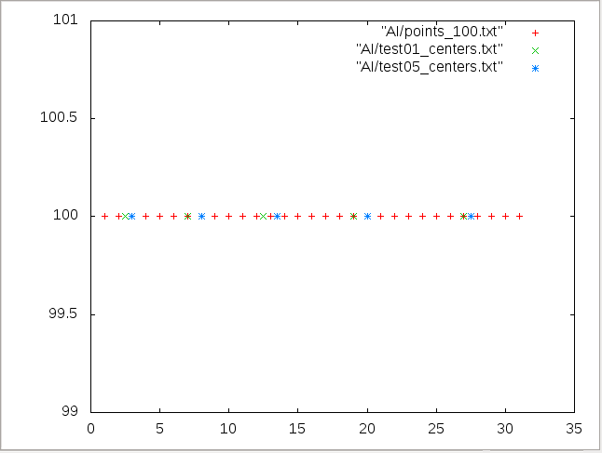
results from normal operation (only system processes)
All operations have 100 instances for all 100 snapshots.
All are system-necessary processes.

Slide 21
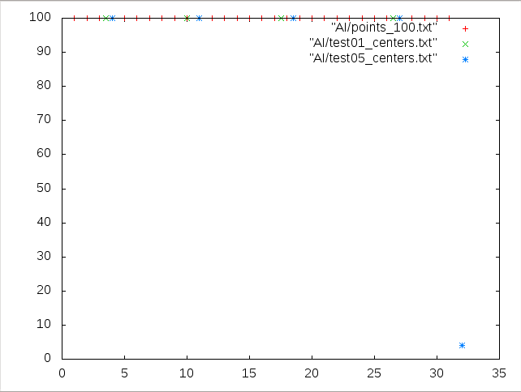
Occasional process result
Few instance program on the bottom, it has its own category separate from the system-necessary processes. Has its own centroid. Might need to be flagged if system is server.

Slide 22
Final project: document word classification
Given a set of books by authors, what information can be categorized by word occurrences?
Note: The bag of words now gets rid of capitalizations, punctuations, and special characters not associated with the words to make for more accurate data.

Slide 23
code description for document word classification
Main.bash calls bag_of_words.bash which creates a bag of words from the books in /documents folder and puts the results in /Documents_BOW
Concatenate all Documents_BOW and run the bag_of_words.bash again on the set of data. This will create a master document MASTER_BOW.txt in /MASTER_BOW
Main.bash calls k_means.bash: Sets each word as the x value and the occurrence of each word as the y value. Run the k_means executable on the data. Output goes to AI/output.png

Slide 24
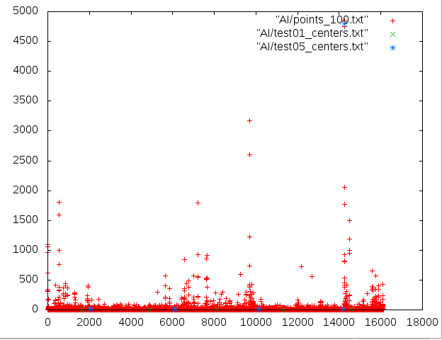
Final REsults

Slide 25
Future directions
Use the k-means algorithm to classify documents by preprocessing document differentiations (using Bayesian Filtering) instead of classification using word/word occurrences.
Flagging system based on normal linux operations.
Use data and bag of words on other AI algorithms such as LSA and PLSA.

Slide 26
What I learned
Learned to use awk, bash, and C++ to format, process, and create visual data in the Linux operating system.
Creating bash scripts that integrate other processes and commands to look into the system as it is running.
Additional information on the k-means algorithm and where it is applicable.

Slide 27
Sources
Pictures and description of k-means: http://en.wikipedia.org/wiki/K-means_clustering
k-means C++ implementation and information: http://people.sc.fsu.edu/~jburkardt/cpp_src/kmeans/kmeans.html
Bag of words description applied to the PLSA: http://people.csail.mit.edu/fergus/iccv2005/bagwords.html

Slide 28
Questions?

