Slide 1
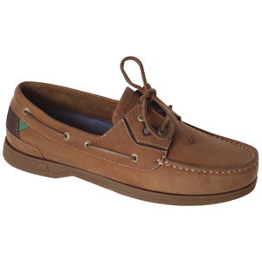
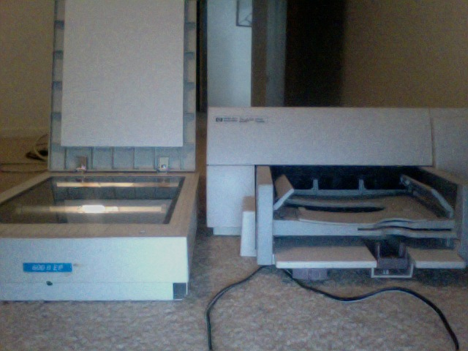

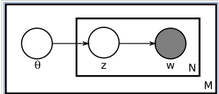
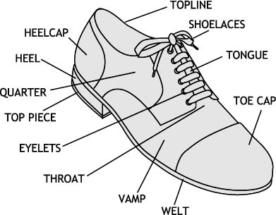
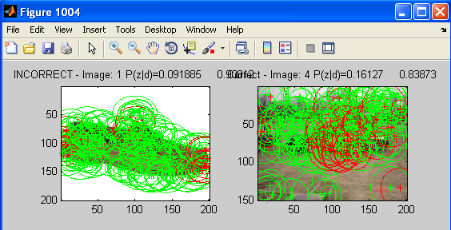
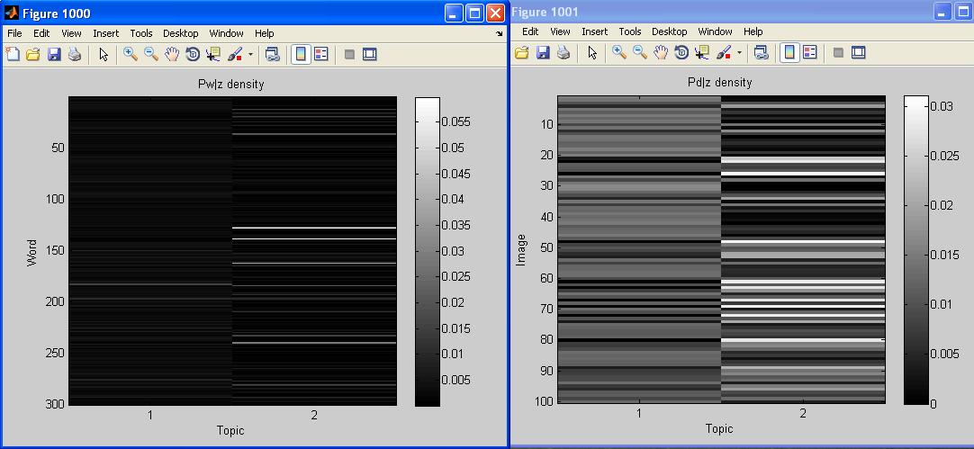
The PLSA Bag-of-words Classifier For Image Classification

Slide 2
Motivation
Image recognition and retrieval is an interesting problem.
Applicable to a wide range of applications
Can be used with augmented reality (Computers recognizing real time events based on the environment around them)

Slide 3
Problem Statement
Given an image, can the computer Categorize it?
Category: Shoe

Slide 4
Problem Statement
Given an image, can the computer Categorize it?
VS
Category: Shoe
Category: Face

Slide 5
Problem Continued
We want the system to be as accurate as possible.
We want the system to be universally applicable to objects (Not just applicable to shoes but to faces or other objects)

Slide 6
Related Work
Latent Semantic Analysis - Given the context of the words contained in the document, we will try and create meaning to the words.
These combinations of meanings in the documents are categorized into topics.
CNN -- Scientists don't know why, but one of Jupiter's two main cloud belts has disappeared -- again.
From: http://www.cnn.com/2010/TECH/space/05/20/jupiter.cloud.belt.missing/index.html?hpt=C1
Words: Scientists, Jupiter, cloud belts
Possible topics: Astronomy, Science

Slide 7
Related Work Cont...
Problems with LSA: Cannot count how multiple occurrences of meanings in a word.
Example: Dog: an animal, living being, mans best friend, ect...
This produces limitations when using unordered collection of words (Bag-of-Words model)
How to fix? Use probability!

Slide 8
Related Work Continued
Probabilistic Latent Semantic Analysis(PLSA)-Uses probability in the form of co-occurrence data
Algorithm: 0 is the document, Z is topic, w is words. The probability of P(z|0) is the topic distribution for document (topics associated), and P(w|z) is words associative.
Wikipedia commons

Slide 9
Methods
Using a test set of images, create a bag of words for 2 classifications: Object or Not Object.
Use the PLSA to classify the images given the words (parts of the image) associative with the over all image (document).
Recreate experiment by: Rob Fergus
using his method of image categorization
http://people.csail.mit.edu/fergus/iccv2005/bagwords.html

Slide 10
Implementations
Matlab code supplied by Yu Cao and Rob Fergus http://people.csail.mit.edu/fergus/iccv2005/bagwords.html
Recreate the results.
Create my own dataset and test to see results.
My dataset is Shoe or No Shoe

Slide 11
Implementation Cont...
Matlab code has several stages:
Randomly picks training set.
Preprocesses the images (height and width are all the same to normalize images)
Goes over the image and creates sections of the image using Caddy edge detector (IE points of interest).

Slide 12
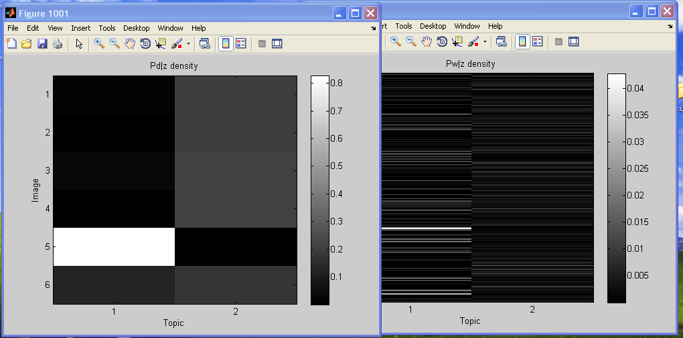
Implementation Cont...
SIFT algorithm creates categorization given appearance given points of interest. Creates a visual dictionary.
PLSA learns modal for testing images.
Tests PLSA visualizing the data that was processed.

Slide 13
Results: Recreation
Recreation of Rob Fergus's results were successful. The test showed a high Precision rate for most of the images.

Slide 14
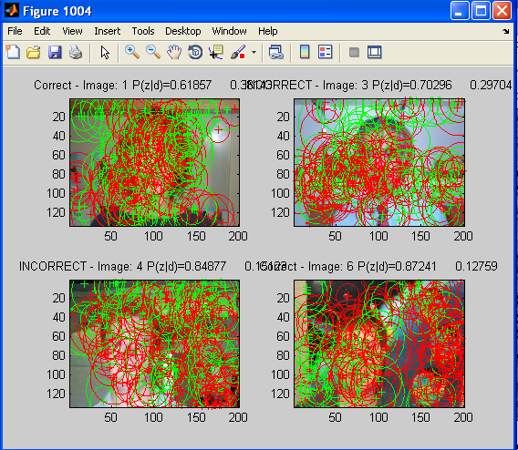
Recreation: Points of Interest
Here is an example of the points of interest given the images:
Took 2:30-3 hours

Slide 15
Results: My Own Study
Results from my own study were not very accurate. The precision of the results only produced one match for shoe where there should have been more:

Slide 16
My Study Cont....
Example of visual points of interest. Algorithm identified shoelaces, toes, and back of shoe in first pic but was still incorrect. Took 5-10 min.

Slide 17
Conclusion
Although the PLSA is a high performing Machine learning algorithm, in order to get best performance possible, a relatively big training set is needed.
This can be proven by looking at the Precision of my study VS the precision on the original study.
The big training set has the problem of taking exponential time complexity and is very slow at creating the PLSA for testing purposes.

Slide 18
Further Improvements
Create “visual tree” to recognize certain objects in different categorical areas and use it to streamline process.
Create another level of PLSA given tags and written descriptions of the images and create bigger repository of topics and human interaction.
Research in Multilayer pLSA for Multimodal Image Retrieval R. Lienhart, S. Romberg, E. Ḧorster

