Slide 1

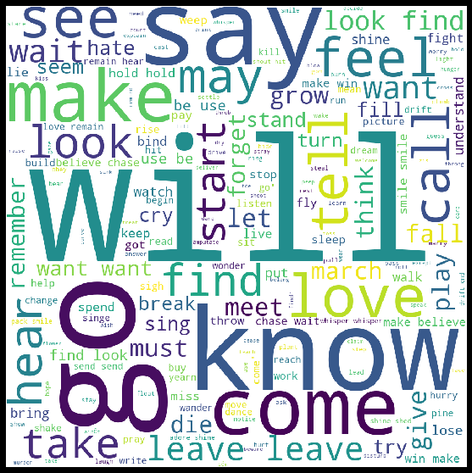
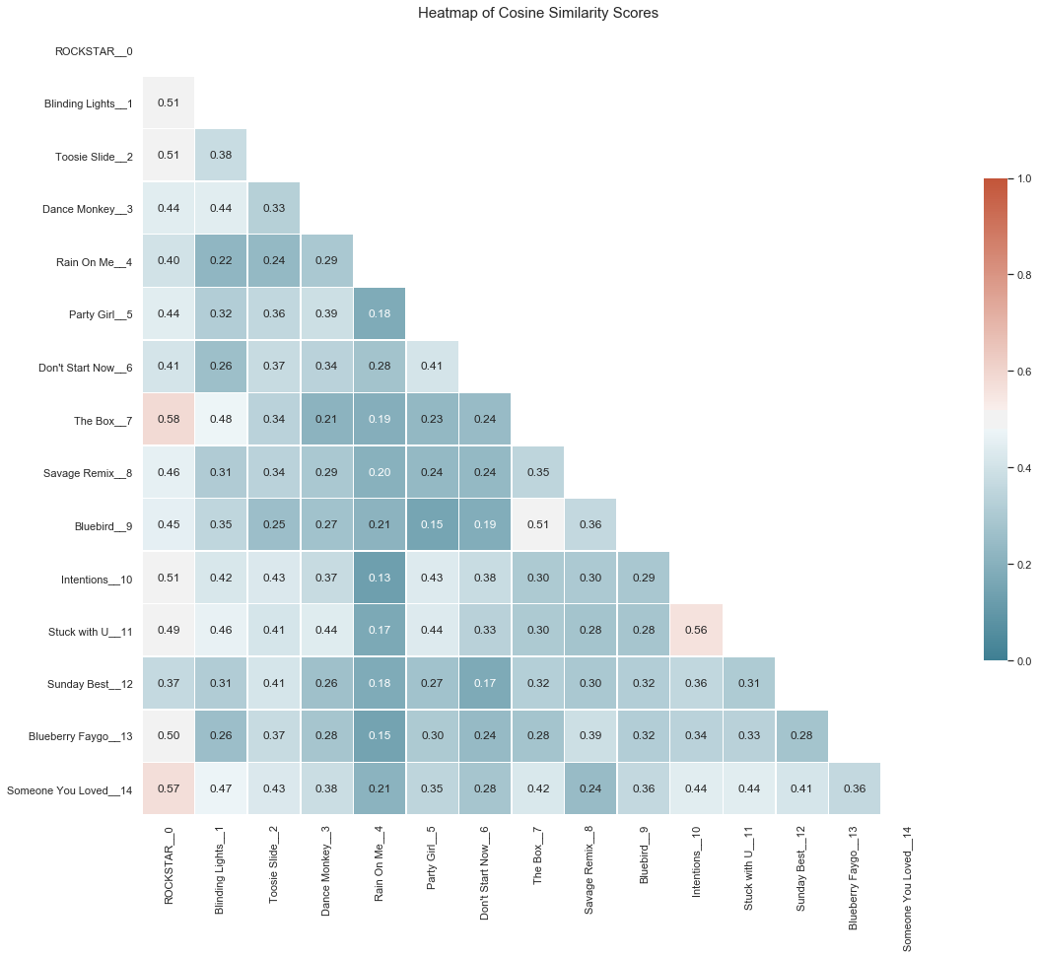
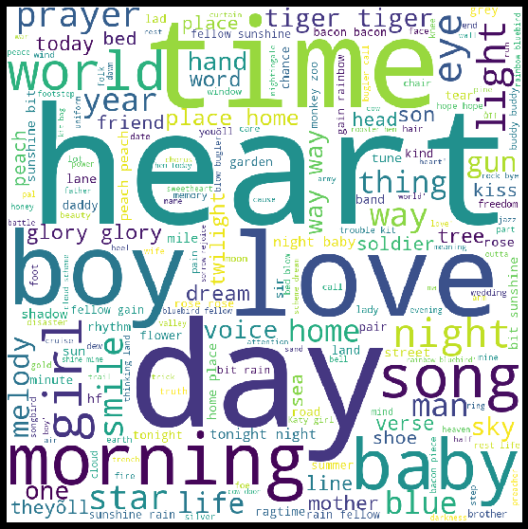
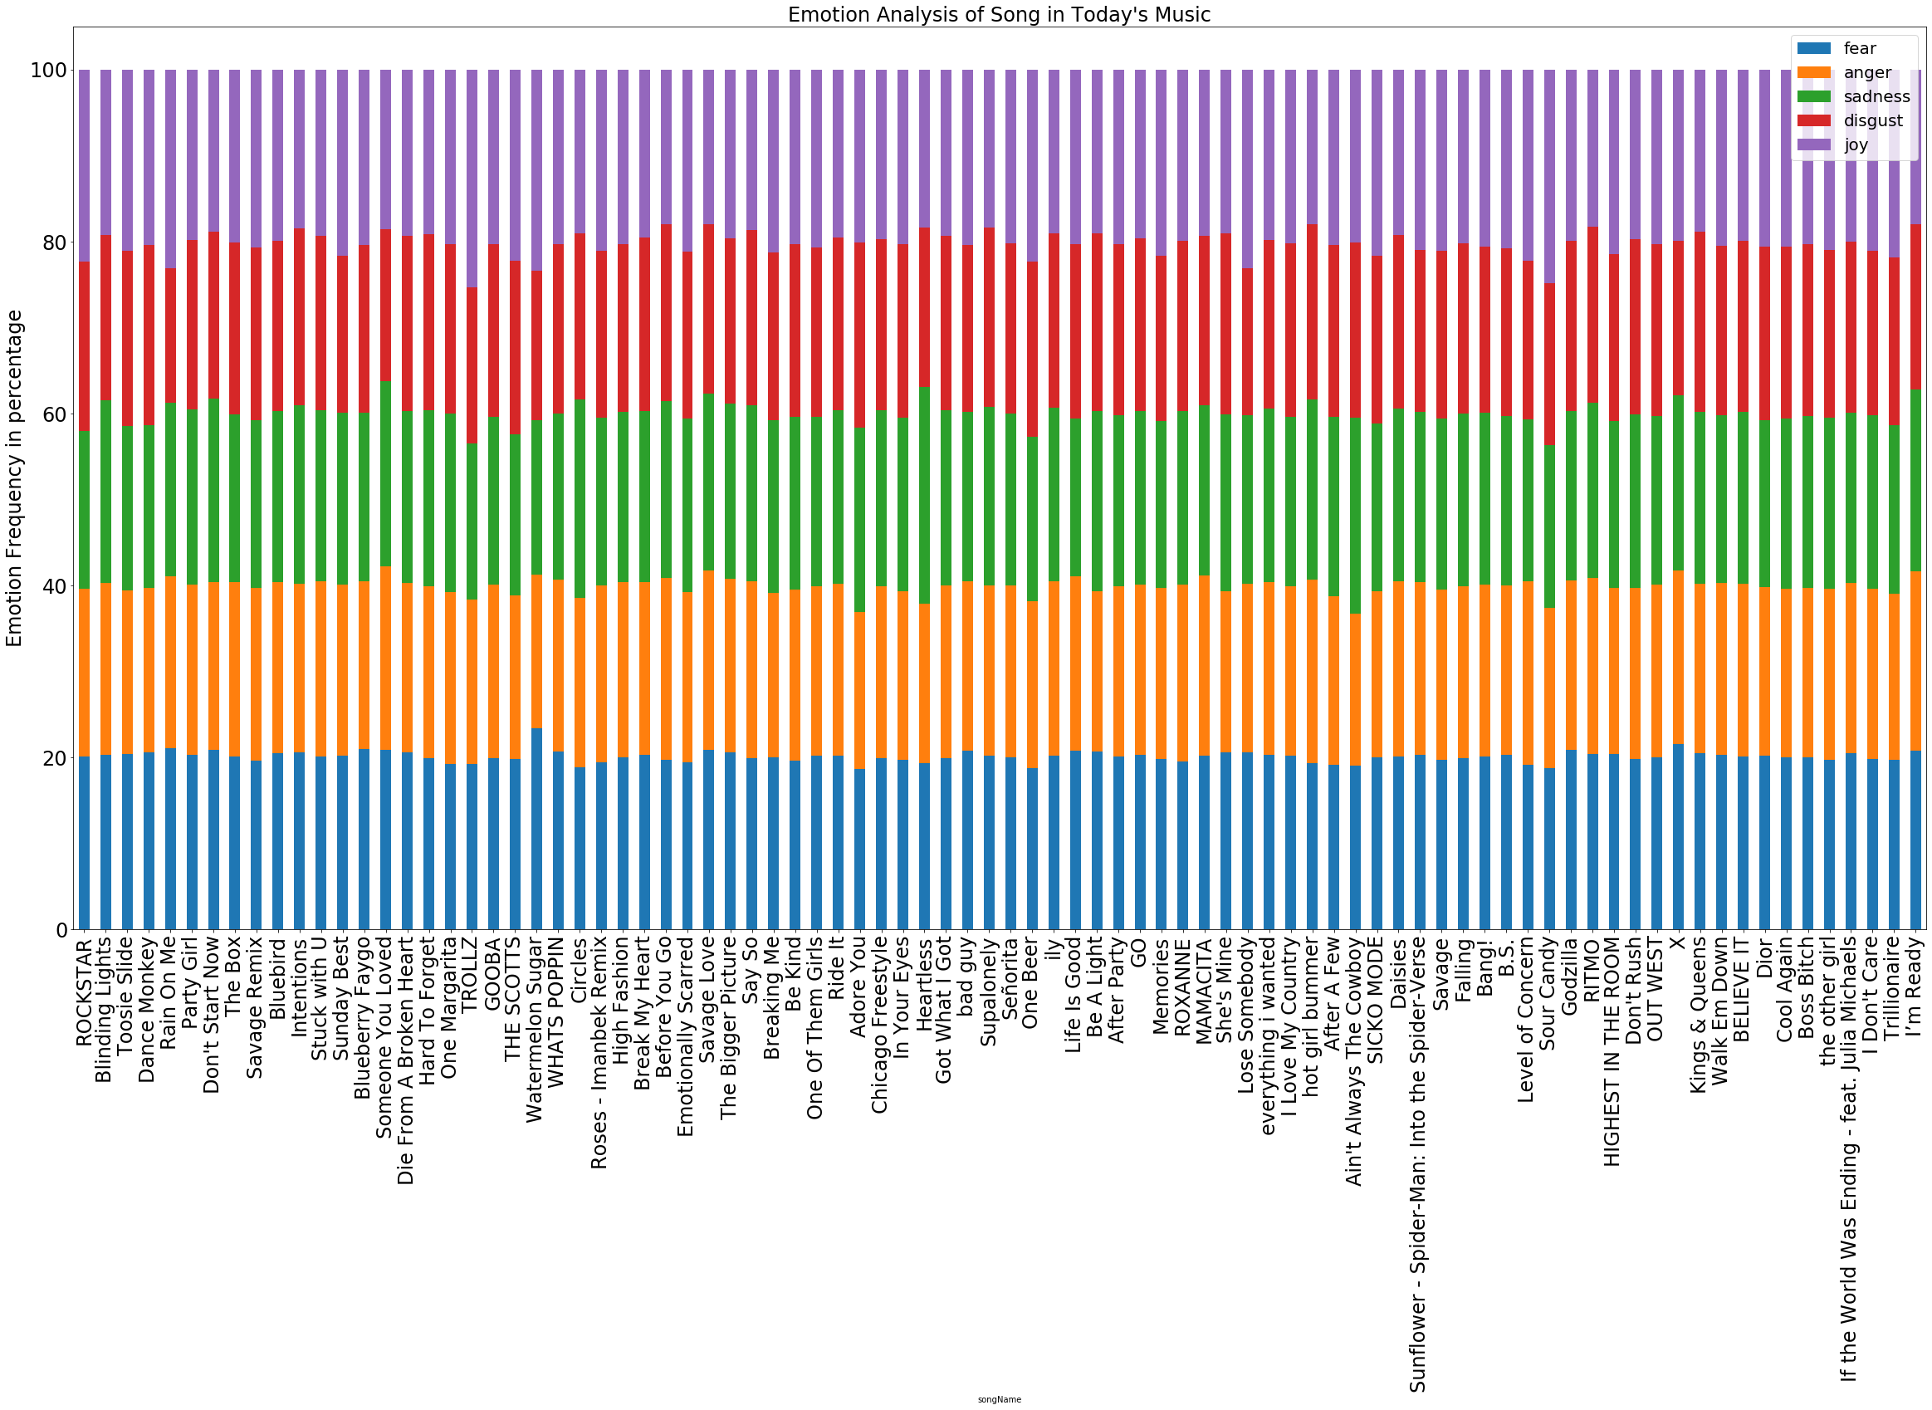
Music During Hard Times
Dighum-100: Theory and Methods in Digital Humanities
Instructor: Dr. Adam G. Anderson
Student: Michael Adrian Halim
Notes:
Welcome to my video presentation for my digital humanities 100 instructed by Dr. Adam G Anderson

Slide 2
Description
Notes:
My project will focus on the analysis of the top 100 music on different periods, specifically on periods where individuals are going through a hard time. With everything that is going on right now, coronavirus, and the protests, my first period is the Now Period, meaning it is the music people listen to today. The second period is the world war period, meaning it is the music people listen to during world war 2, in 1939 to 1945. To be more specific, I have chosen to analyze the songs specifically in 1943 because it is in the middle of the war. Last period is the Pandemic Period, meaning it is music people listen to during the 1918 pandemic. As we move on ahead, the three periods will each be referenced as Now, World, and Pandemic.

Slide 3
Research Questions
1. Is there a common correlation between word counts and songs being at the top of the chart at different periods?
2. Are the top-rated songs unique? Or are they like each other?
3. Are the songs people listen to during hard times considered as happy songs? If not, what are they considered to be?
4. How does the genre change over different hard times? (As I will be taking data from different moments in time, I might as well try to see the change in genres as time goes by with respect to the events that happened) Are your questions answerable with the methods you are proposing?
Notes:
Moving on to my research questions. These are the question that I will be analyzing in this project. First Question. Is there a common correlation between word counts and songs being at the top of the chart at different periods? My hypothesis is that there will be no such relation between word counts and the rating of the songs. Moreover, I would suspect that the Now period would have a higher word count compared to the other two periods. Second Question. Are the top-rated songs unique? Or are they like each other? My hypothesis is that these songs will be unique to each other. If they are not unique then they have a copyright problem. Third Question. Are the songs people listen to during hard times considered as happy songs? If not, what are they considered to be? My hypothesis is that yes, the songs will be considered as happy or joyous because we need to lift our spirits up to make us feel better. Last Question. How does the genre change over different hard times? My hypothesis is that there will be a shift in genre between the periods, especially from the two older periods to the now period because in the now period, we have rap and electro songs.

Slide 4
Tools and Methods
Notes:
(pause: 1)

Slide 5
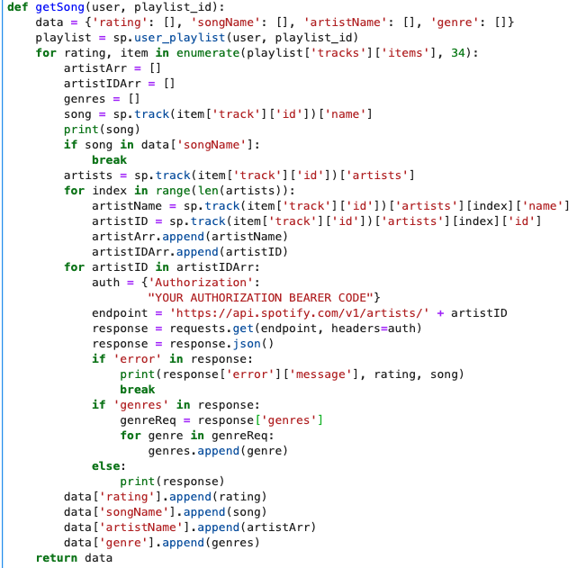

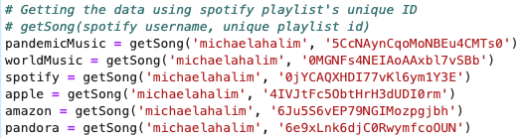
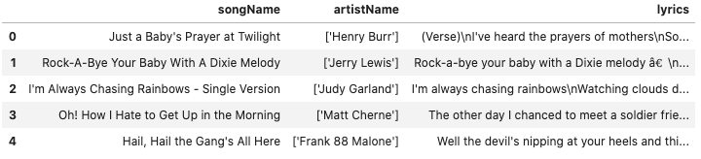
Spotipy
Notes:
Spotipy is a python library that allows you to connect with the Spotify Web API. Before being able to access the library, you need to make a client ID and client secret in the Spotify Web API. We can see the code on the left is used to create the data frame of a playlist from a username. The code in the middle is used to call the functions and the image on the bottom right shows an example of one of my data frames.

Slide 6
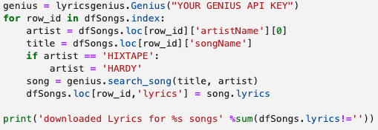
Lyricsgenius and Genius API
Notes:
Lyrics genius connects you with the data stored on genius’ website. You also must create a free account that authorizes access to the genius API. The code here will look for the song with a specific artist and title in genius’ data and assign it in the lyric's column.

Slide 7
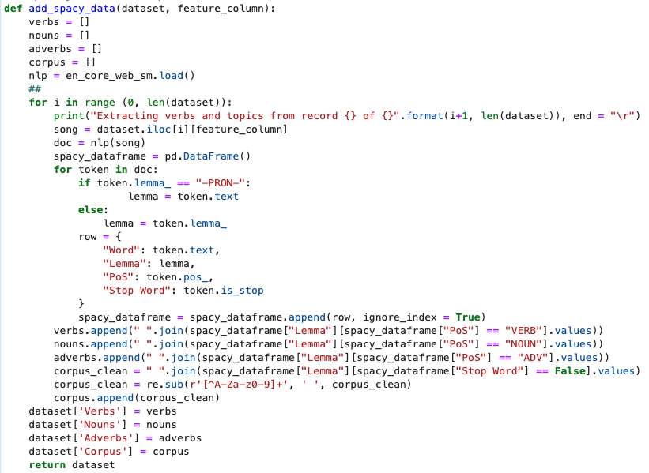
Spacy
Notes:
Spacy is a natural language processing tool that you can use to build advanced natural language understanding systems using both rule-based and machine learning approaches. In this project, I am using spacy to extract verbs and nouns from the lyric column. The function defined in this slide would tokenize my words as well as remove stop words to create a corpus of words for my analysis.

Slide 8
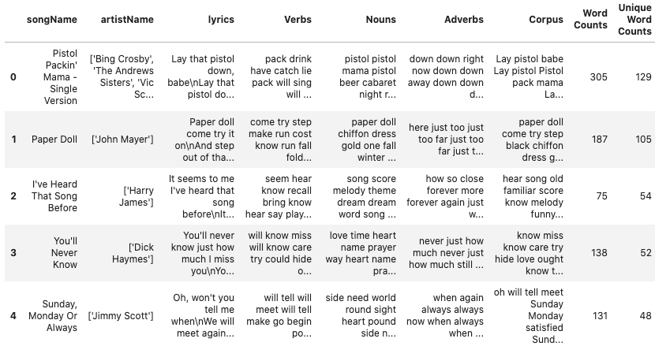
Notes:
This is a show of my dataset after calling in the spacy function. We can see that we have inserted new columns into our data frame. We now have a Verbs, Nouns, Adverbs, Corpus, Word Counts and Unique Word Counts column.

Slide 9
Results Visualization
Notes:
These are the results of visualization using Matpotlib, Word Cloud and Seaborn.

Slide 10
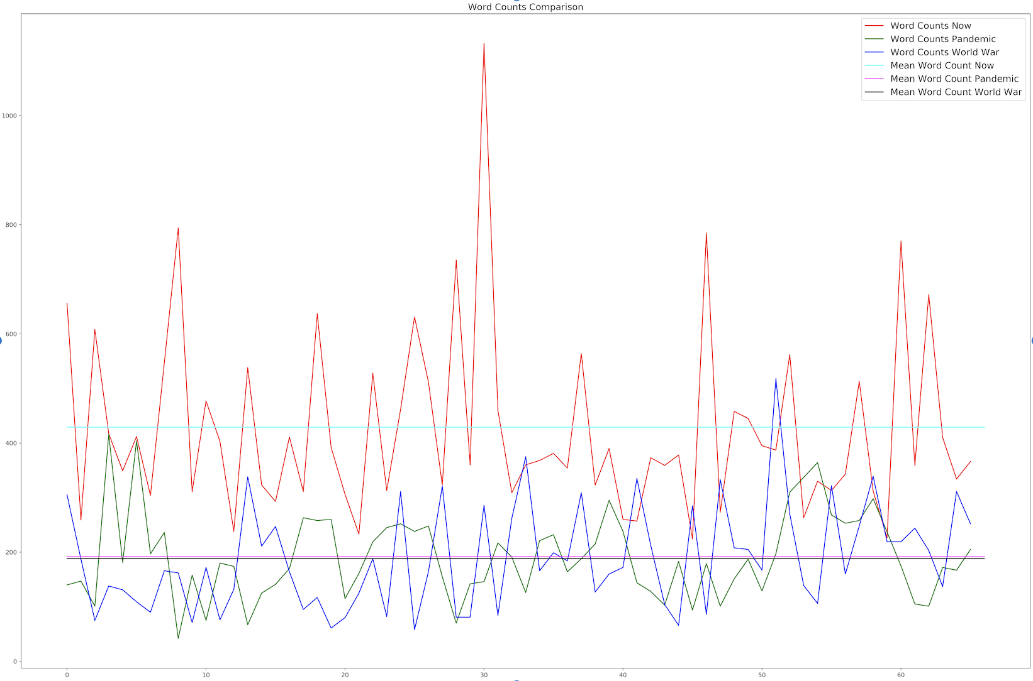
Notes:
This is a result of plotting the Word against their rating in each period. The red line is for the Now period. The green line is for the Pandemic period. The Blue line is for the World period.

Slide 11
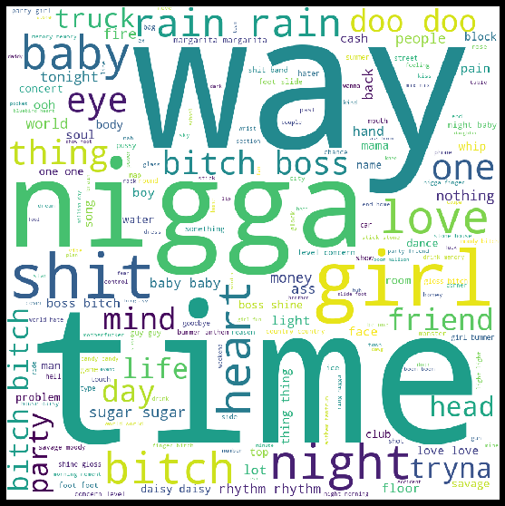
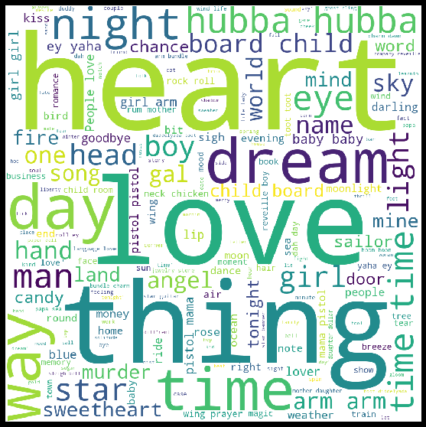
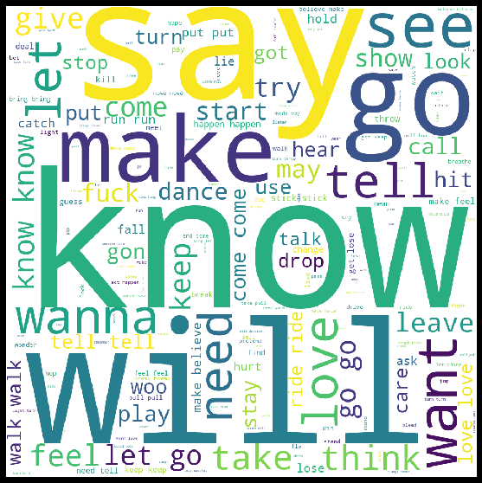
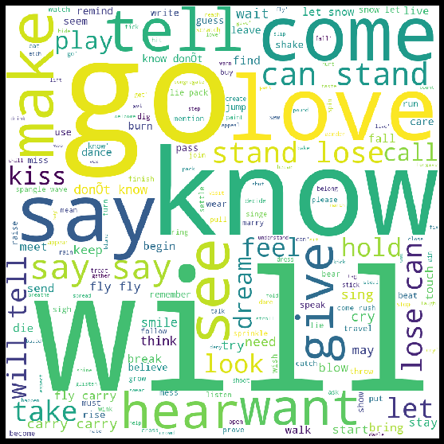
NOW PERIOD
PANDEMIC PERIOD
WORLD PERIOD
Notes:
These are the results of visualization using Word Cloud

Slide 12
Notes:
This is an example of result of plotting the heatmap of cosine similarity analysis values of the top 15 songs of the Now period using seaborn.

Slide 13
Notes:
This is an example of result of using NRC Lex to perform emotional sentiment analysis of the songs in the Now period.

Slide 14
Results Interpretation
Notes:
I will be answering my research questions and interpreting my results.

Slide 15
Question 1
Is there a common correlation between word counts and songs being at the top of the chart at different periods?
Notes:
Both of my hypothesis are true. We can see from our plot that there are no correlation that can be drawn out between higher rated song and a higher word count. We can also see that the Now period have a higher word count compared to the other two periods. This might be the case that a lot of songs that people listen to now contain a lot of repetition.

Slide 16
Question 2
Are the top-rated songs unique? Or are they like each other?
Notes:
I am just showing one of the results of my cosine similarity analysis because the other two heatmaps are relatively the same. From my results, I can say that all the top 15 songs when compared to each other are not similar if we are comparing in context with cosine similarity. In fact we only have 7 songs across the 3 heatmaps with a cosine similarity score of more than 0.54. This shows that each songs are unique.

Slide 17
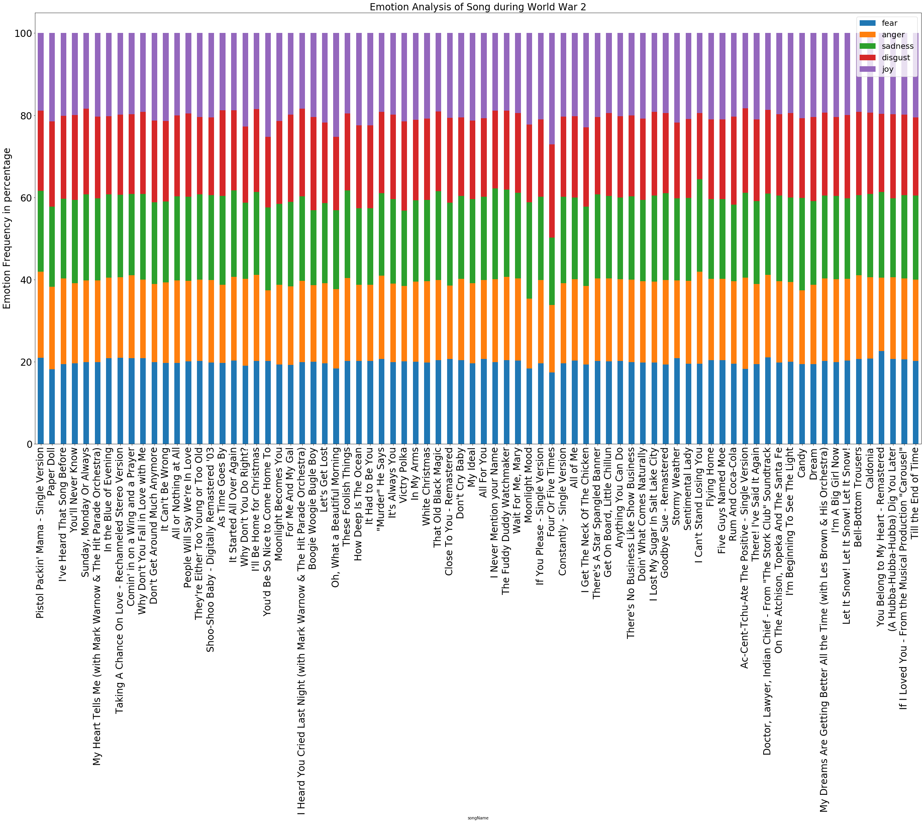
Question 3
Are the songs people listen to during hard times considered as happy songs? If not, what are they considered to be?
Notes:
I cannot really say that my hypothesis for this question is true or false because I believe that the emotional sentiment analysis tool that I am using does not provide me with the best result. We can see from one of the results of my Emotional analysis on the World period that all the emotions are distributed equally. It does not really show us which emotions is really conveyed in each period.

Slide 18
Music During Hard Times
Dighum-100: Theory and Methods in Digital Humanities
Instructor: Dr. Adam G. Anderson
Student: Michael Adrian Halim
Link to github: https://github.com/michaelahalim/DIGHUM-100
Link to Lucid Chart: https://app.lucidchart.com/invitations/accept/e2780f92-cd24-4648-8814-99afa99974a8
Link to Google Drive folder for video and pdf: https://drive.google.com/drive/folders/1tSgf6jFOH1SggAb_8ZTbK5qo9VlmugdB?usp=sharing
Acknowledgements
Thank you, Professor Anderson, for all your hard work and guidance in making this project possible. Thank you to all my fellow classmates for all the feedbacks and ideas you all have given me during the design phase of my project.

