Slide 1



AI Facilitator Assistant
Helping facilitators spot who needs them, and reply with warmth, faster.
HOPE-MOVE · People living with IIH 2025
HOPE-MOVE
1

Slide 2
Why we built it and what it does
People living with long-term conditions can quietly disengage between sessions; about 1 in 4 drop out, most going quiet in the first week. No facilitator can watch everyone, every week.
1 · SPOT
Who needs attention
Every participant, ranked each week, with the plain-language reasons why.
2 · SUPPORT
A warm draft reply
A ready-to-send message in the programme's voice: you review, edit, and send.
It surfaces and suggests. You decide and send.
HOPE-MOVE
2

Slide 3
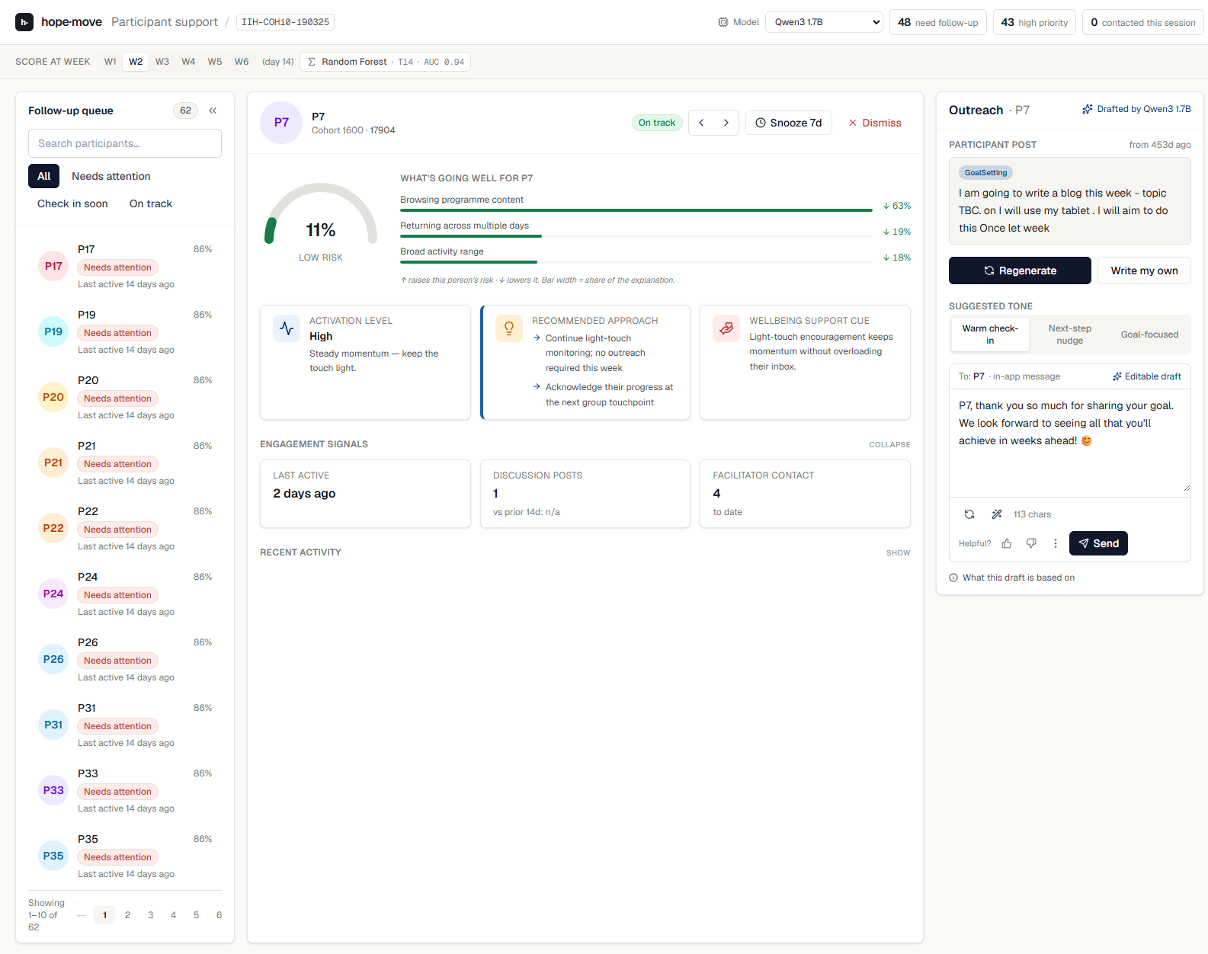
One place to see your whole cohort
Follow-up queue · participant detail · AI outreach, in a single weekly view (live data).
HOPE-MOVE
3

Slide 4
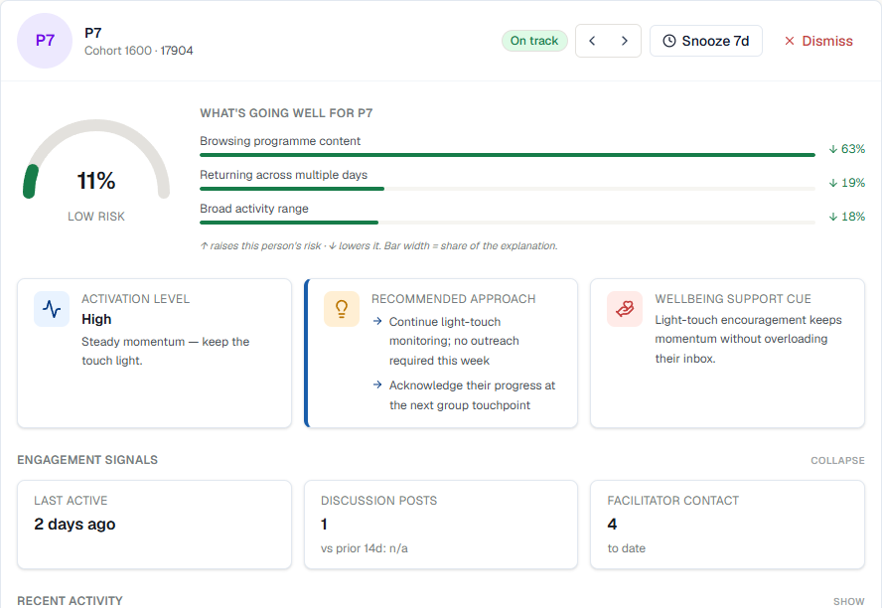
SPOT
See who needs you and why
• Everyone ranked each week: Needs attention · Check in soon · On track.
• A clear risk score with the reasons behind it.
• A recommended approach and wellbeing cue for outreach.
Risk comes from a Random Forest model, shown in plain language.
HOPE-MOVE
4

Slide 5
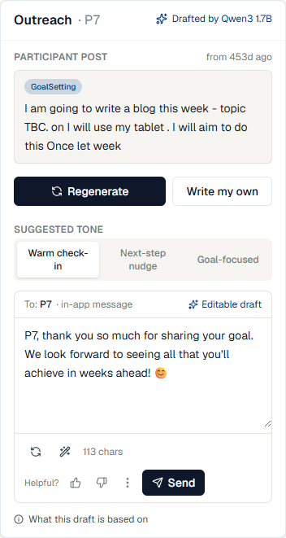
SUPPORT
Reply with warmth, faster
• Three warm tones, drafted from the participant's own post.
• Written by a fine-tuned small language model (here, Qwen3).
• Edit, polish, send: always your words, your call.
• Your feedback (kept / edited / rejected) trains better drafts.
The draft is a starting point, never sent on its own.
HOPE-MOVE
5

Slide 6
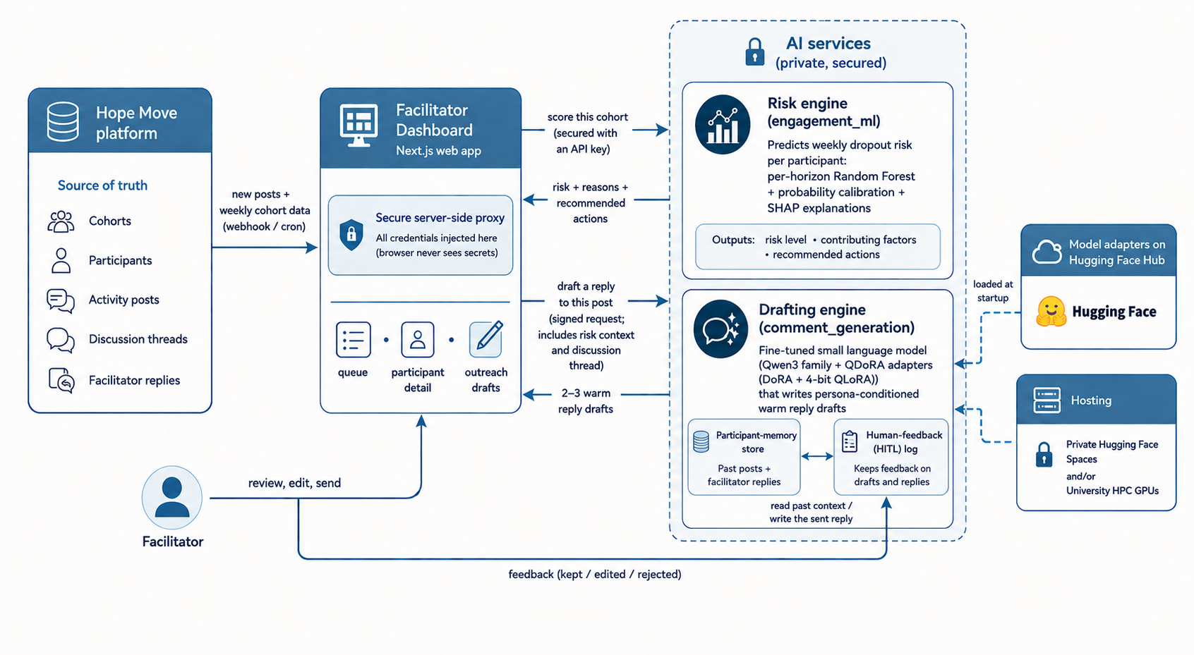
How it fits together
• Risk engine (engagement_ml): predicts weekly dropout with a Random Forest, ~0.93–0.95 AUC.
• Drafting engine (comment_generation): a fine-tuned small language model trained on real Hope replies.
• Safe by design: anonymised · private (secrets server-side) · safety layer · nothing sent without you.
Both produce suggestions only; a person always decides.
HOPE-MOVE
6

Slide 7
THE RESEARCH BEHIND IT
Three research threads
1. Why retention happens · 2. Predicting dropout · 3. Generating replies
HOPE-MOVE
7

Slide 8
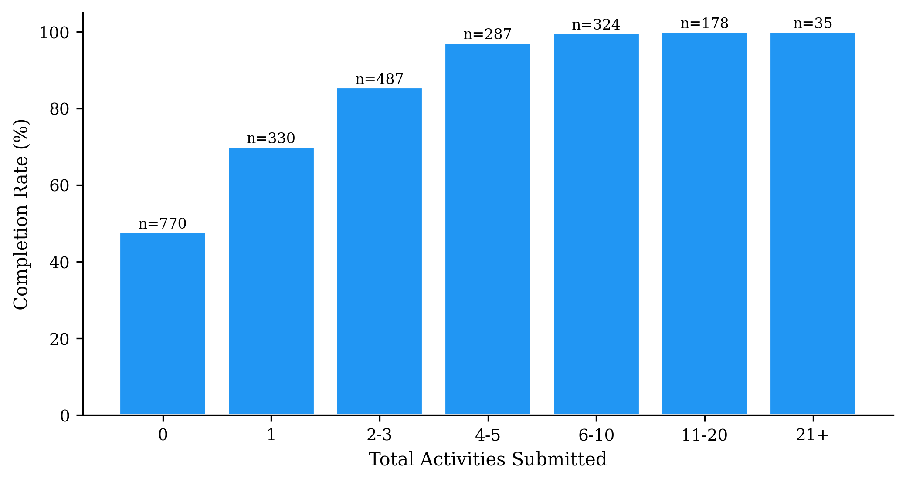
EVIDENCE BASE · COHORT STUDY
What keeps people engaged
• 2,411 participants across 7 health conditions.
• People who write complete at 89% vs 48% who don't (about 9× the odds).
• More early activity → higher completion (a clear dose-response).
• But 727 browsed and never wrote: exactly the gap we target.
HOPE-MOVE
Cohort study submitted to JMIR.
8

Slide 9
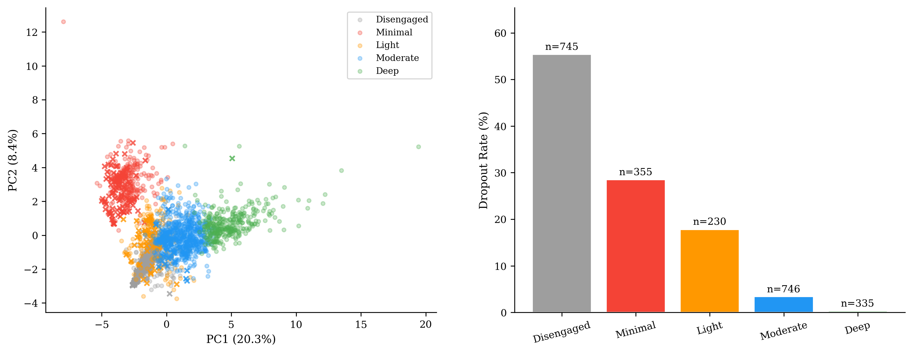
EVIDENCE BASE · WHO TO SUPPORT FIRST BASED ON TEXT ENGAGEMENT
Five engagement profiles
• Drop-out ranges from Disengaged (55%) down to Deep (0.3%).
• The 'Light' group (browses but barely writes) is the early-support target the dashboard surfaces.
HOPE-MOVE
9

Slide 10
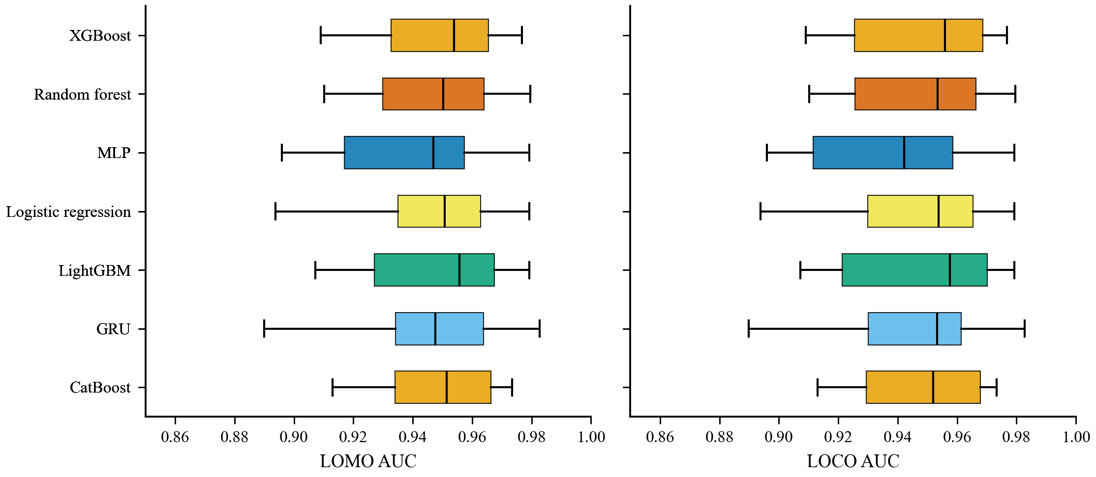
RISK ENGINE · MODEL SELECTION
Choosing the model
• Seven model families compared (LR, RF, XGBoost, LightGBM, CatBoost, GRU, MLP).
• Tested cold-start: held out whole courses (LOCO) and modules (LOMO) the model never saw.
• The top models are statistically tied (~0.95 AUC); overlap alone can't separate them.
• Random Forest deployed for its robustness, calibration, and interpretability.
Cold-start AUC across held-out courses (LOCO) and modules (LOMO); the boxes overlap heavily.
HOPE-MOVE
10

Slide 11
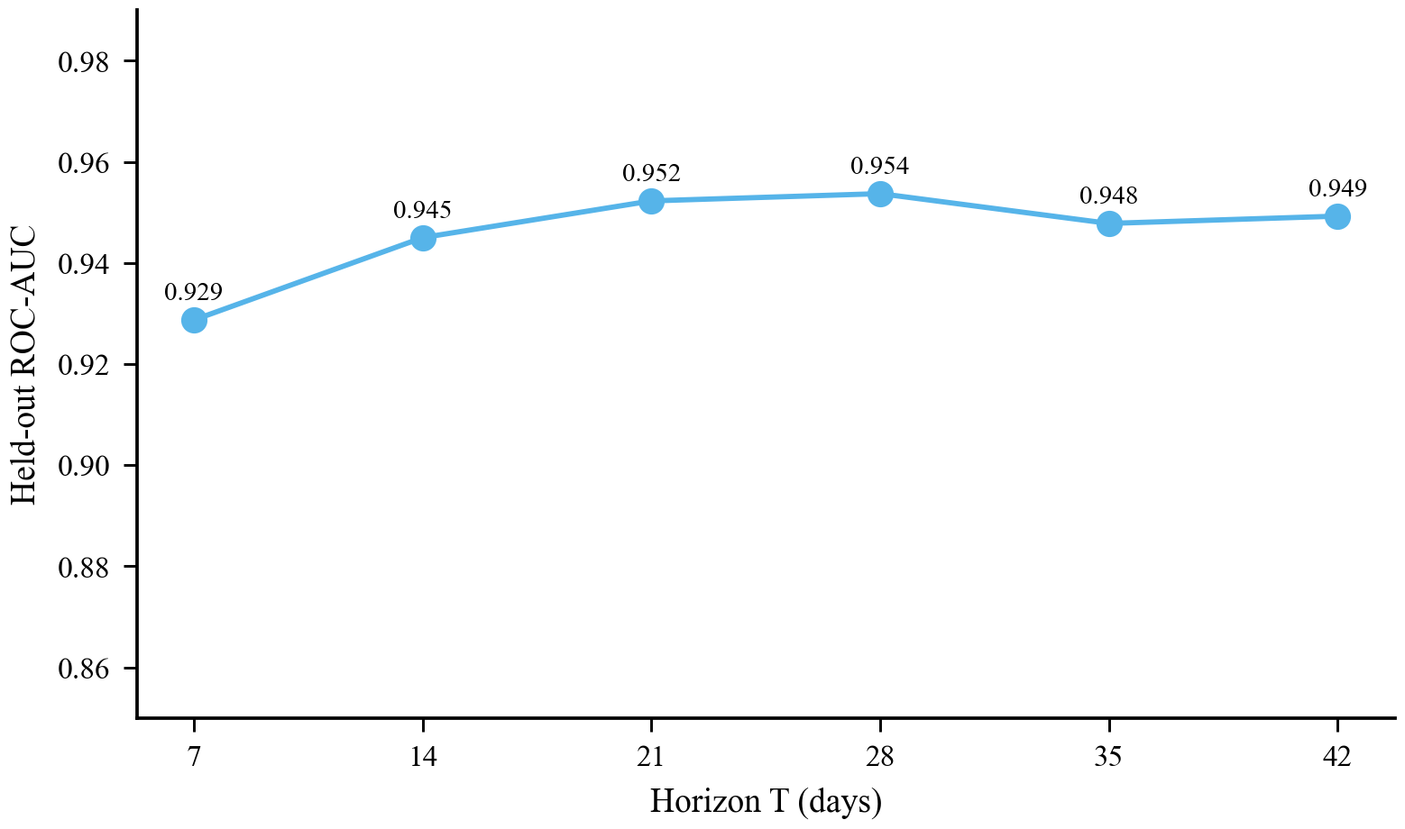
RISK ENGINE · PERFORMANCE
Predicting dropout early
• AUC 0.93 at week 1, rising to ~0.95, catching dropout early.
• Stable across the 6-week programme (a model per weekly horizon).
• Validated on unseen courses and modules (cold-start ≈ 0.95).
• Tuned for high recall (≥90%), so few at-risk people are missed.
HOPE-MOVE
Submitted to J. of Biomedical Informatics.
11

Slide 12
DRAFTING ENGINE · SMALL LANGUAGE MODELS
Drafting replies that sound like Hope
• 8 open models fine-tuned with QDoRA on 3,900+ real Hope (post→reply) pairs: programme data only, no synthetic augmentation.
• Qwen3.5-4B is the deployed default: top BERTScore (0.873).
• Qwen3-4B ties it within noise (~0.002) and has the best GoalSetting fidelity.
• Safety layer: crisis → MI policy → UK signposting · human feedback loop.
Also benchmarked on the activities sweep (n=771): SmolLM3-3B and Llama-3.2-3B as cross-family references. Both tables are in the NLP paper.
HOPE-MOVE
12

Slide 13
Thank you
HOPE-MOVE: AI to help facilitators keep people engaged and supported.
Michael Ajao-Olarinoye · Coventry University · funded by Innovate UK
HOPE-MOVE
13

