Slide 1
Walkthrough deck
Color-pattern diversity,
with and without history
Demo 8 · pavo + phylogeny + measurement error
EEB 187 · Wednesday May 20, 2026 · led by Rosamari
Companion to the 20-slide intro deck.

Slide 2
The hour ahead
three questions stacked on each other
We will ask, for our pavo color-pattern data:
1.
Is there structure in the standing diversity?
PCA + bivariate fits (Part 1, ahistorical)
2.
Is that structure real biology — or just shared ancestry?
phyloPCA + PGLS + K and λ (Part 2)
3.
Does the structure survive measurement noise?
5-image error stack → 100-iter Monte Carlo (Part 3)
EEB 187 · Demo 8 walkthrough · May 20 2026

Slide 3
Where we left off last week
Frédérich et al. 2026 — the headline result we'll test
Reef-fish color patterns evolve fast — much faster than Brownian motion predicts.
• Their question — do color patterns track phylogeny in 5 reef-fish families?
• Their method — 30 binary motif columns per species; one multivariate Blomberg's K.
• Their answer — weak phylogenetic signal in every family they tested (K ≈ 0.05–0.22).
• Their interpretation — convergence is rampant; you can't read color off the tree.
Today we ask the same question with continuous pavo statistics, variable-by-variable, on our own family — and we stress-test it under noise.
EEB 187 · Demo 8 walkthrough · May 20 2026

Slide 4
Our walkthrough family — Chaetodontidae
19 butterflyfish species · 5 genera · 1 error-species
Same code, same plots that every group will rerun on their own family.
• 19 species — across Chaetodon, Heniochus, Roa, Amphichaetodon, Prognathodes
• 1 image per species — exemplar.png — chosen by the picker for lateral, in-focus view
• 1 error-species — Heniochus_acuminatus, photographed 5 times — the noise stack for Part 3
• 6 pavo descriptors — m, A, Jc, Jt, m_dS, m_dL (full-rank, no algebraic dependencies)
• 4 FishBase traits — Troph, max depth, max length, vulnerability
• 1 pruned chronogram — tip labels matched to image directories by the picker
EEB 187 · Demo 8 walkthrough · May 20 2026

Slide 5
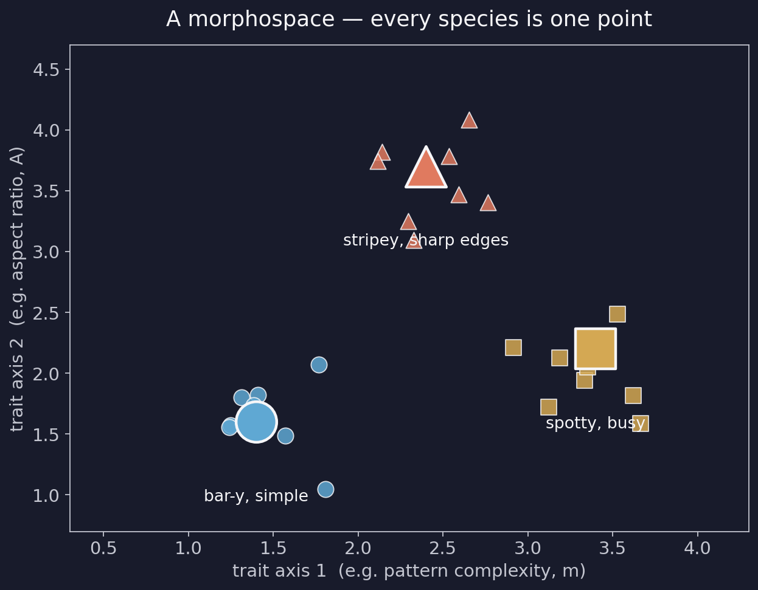
What is a morphospace?
the foundational idea behind today's analysis
Every species becomes one point in a space whose axes are trait values.
• Axes = traits (or combinations of traits)
• Points = species
• Close = similar pattern
• Far = different pattern
• Clusters = groups of species that look alike for the same reason
EEB 187 · Demo 8 walkthrough · May 20 2026

Slide 6
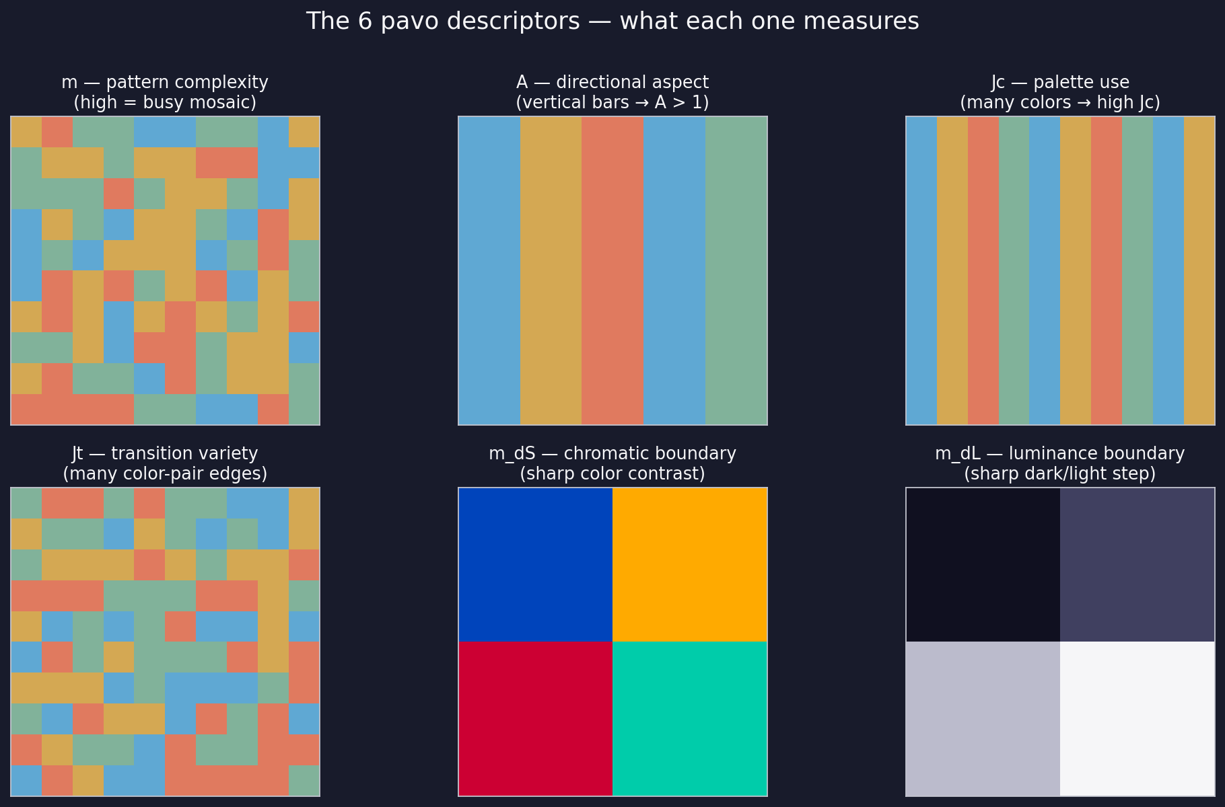
The 6 pattern descriptors we keep
pavo's classify() + adjacent() — six full-rank columns
m complexity (0 → 1 = mosaic)
A directional aspect
> 1 bar-y · < 1 stripe-y
Jc palette use
how much of the palette
the pattern uses
Jt transition variety
color-pair edges realized
m_dS chromatic boundary
sharp color contrasts
m_dL luminance boundary
sharp dark-light steps
EEB 187 · Demo 8 walkthrough · May 20 2026

Slide 7
Six dimensions → two — why we need PCA
You cannot plot 6 axes on a screen. PCA finds the 2 axes that capture the most variation.
• The problem — with 6 pavo variables, every species is a point in 6-D — invisible.
• Naïve fix — plot pairs of variables (Demo 6's pairs() plot). 15 sub-plots; brittle.
• PCA — rotates the 6-D cloud so the first axis captures the most variance, the second captures the most of what's left, and so on.
• Why centre + scale — our variables are on different units (proportions vs probabilities vs ratios). Without scaling, the variable with the biggest raw spread dominates the axes.
• How many PCs to read — look at the scree — it tells you when extra PCs stop carrying real signal.
EEB 187 · Demo 8 walkthrough · May 20 2026

Slide 8
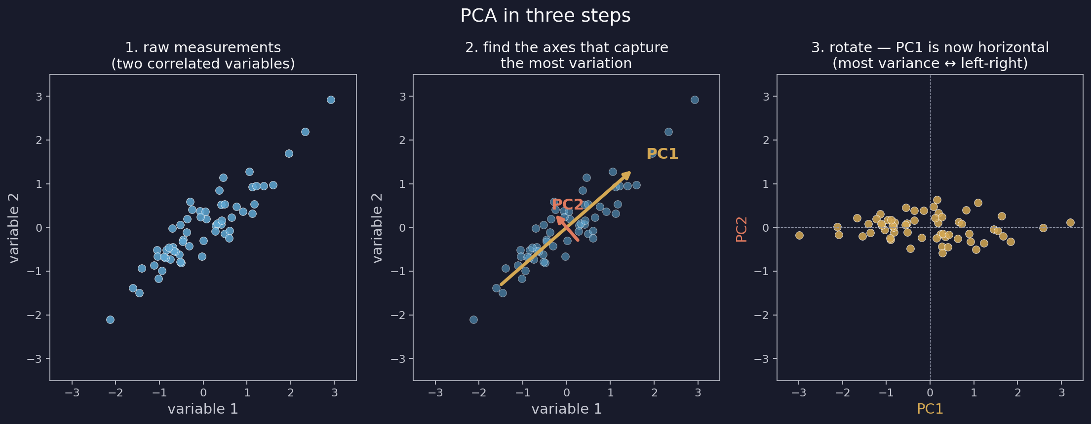
PCA in three steps
raw scatter → find the axes → rotate
Step 3 is the picture you'll read. PC1 horizontal, PC2 vertical, every species one point.
EEB 187 · Demo 8 walkthrough · May 20 2026

Slide 9
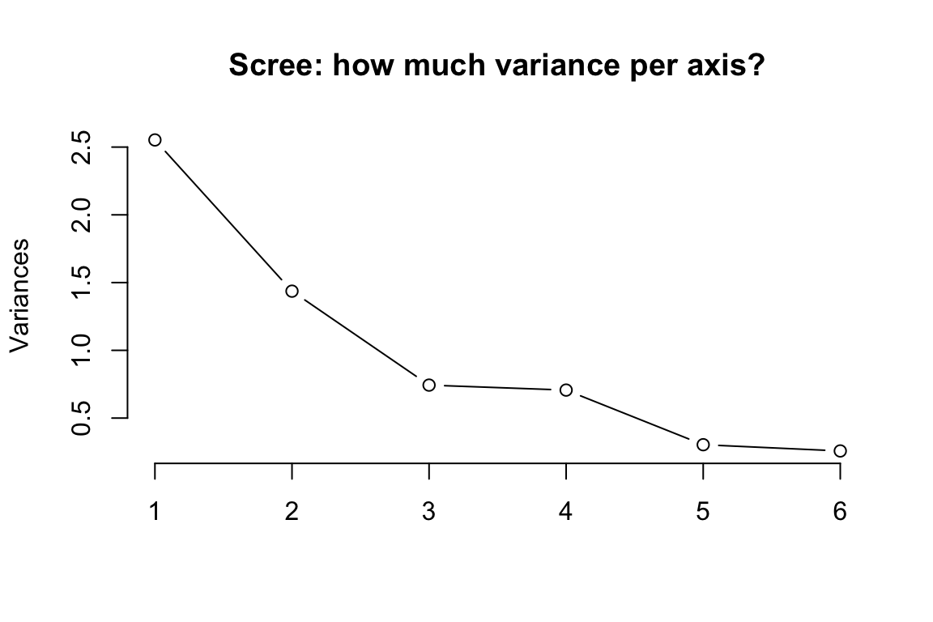
Reading the scree plot
how much variance does each PC actually carry?
• PC1 always wins — the math forces it.
• Question: — by how much does it win?
• Elbow — the bend where PCs stop carrying real signal.
• Our data — PC1 ≈ 42 %, PC2 ≈ 24 % — together about two-thirds of the variance.
• Verdict — two axes is a usable summary.
EEB 187 · Demo 8 walkthrough · May 20 2026

Slide 10
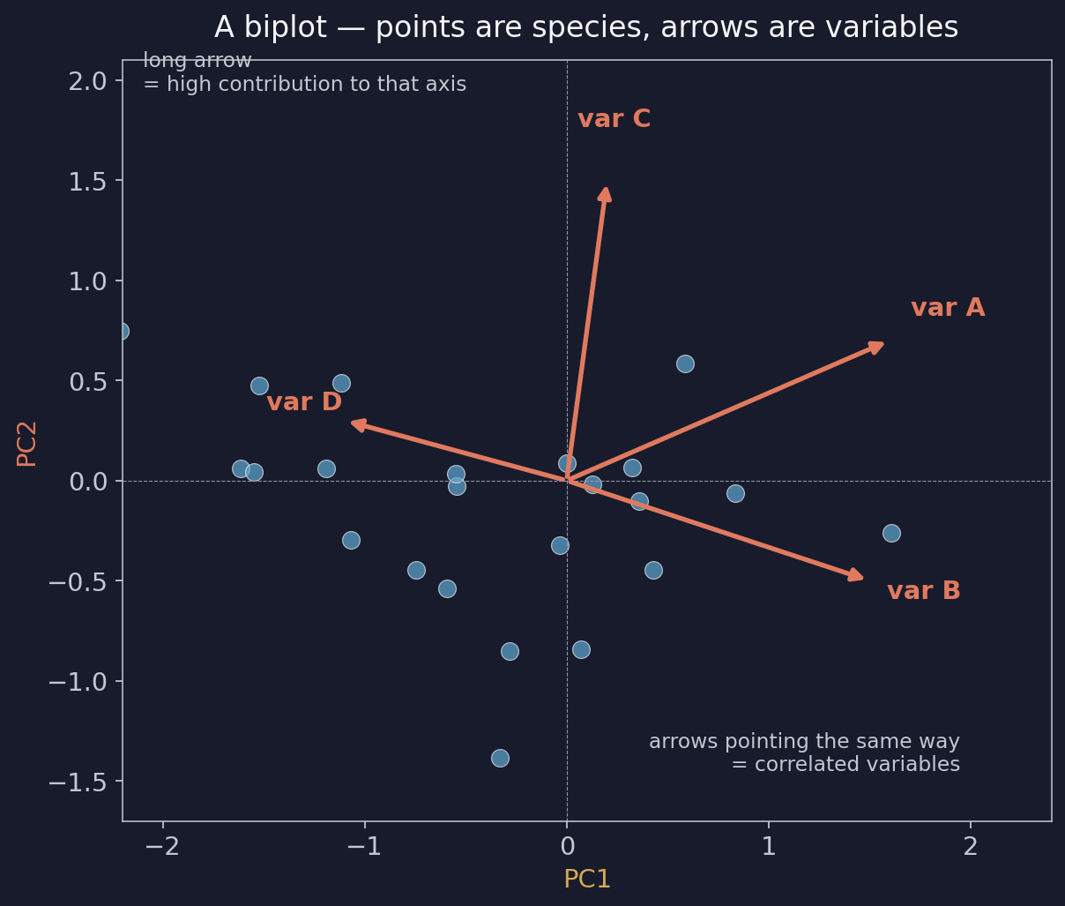
Reading the biplot — arrows are loadings
points are species; arrows are pavo variables
• Long arrow — high contribution to that axis.
• Short arrow — low contribution.
• Arrows same direction — those variables are correlated.
• Arrows opposite — they trade off.
• Arrow perpendicular to an axis — carries no information on that axis.
EEB 187 · Demo 8 walkthrough · May 20 2026

Slide 11
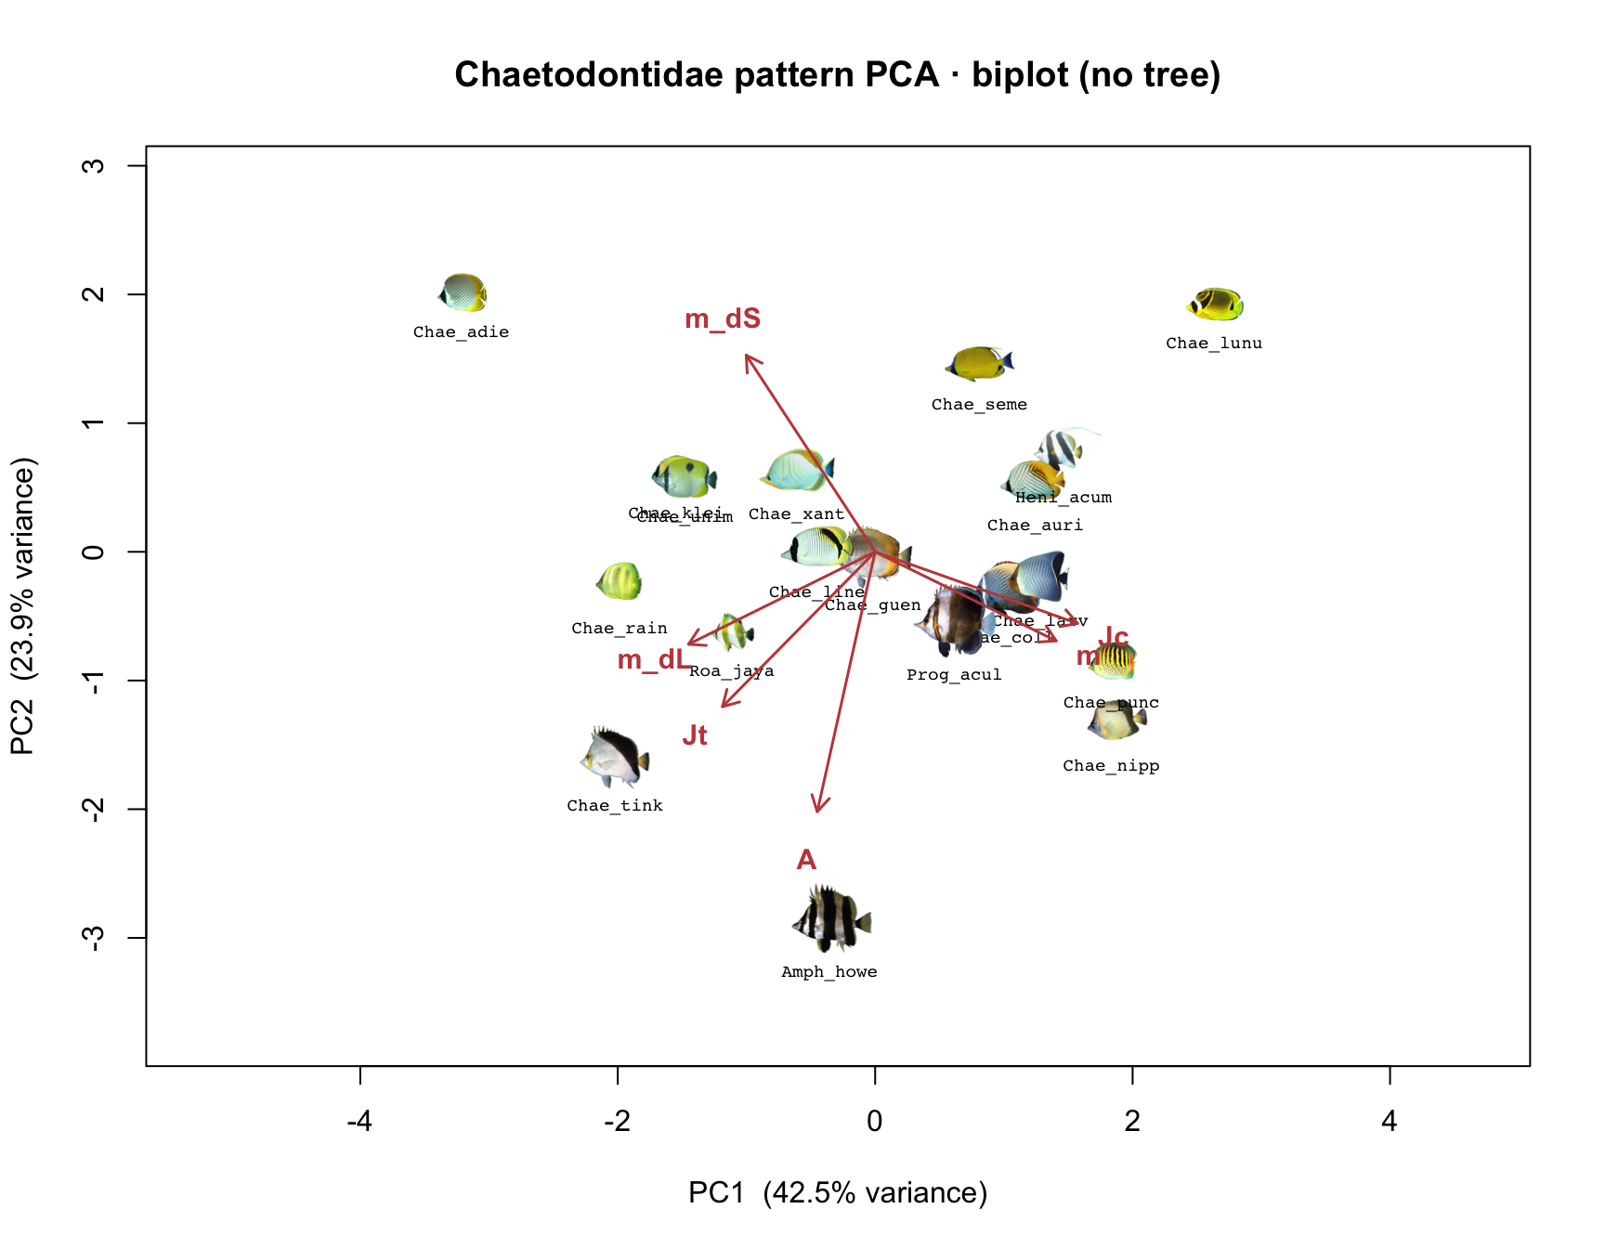
The Chaetodontidae biplot — our actual data
PC1 ≈ 42.5 % · PC2 ≈ 23.9 % · arrows are pavo variables
PC1 driven by m + Jc (busy patterns). PC2 driven by A + Jt + boundary metrics.
EEB 187 · Demo 8 walkthrough · May 20 2026

Slide 12
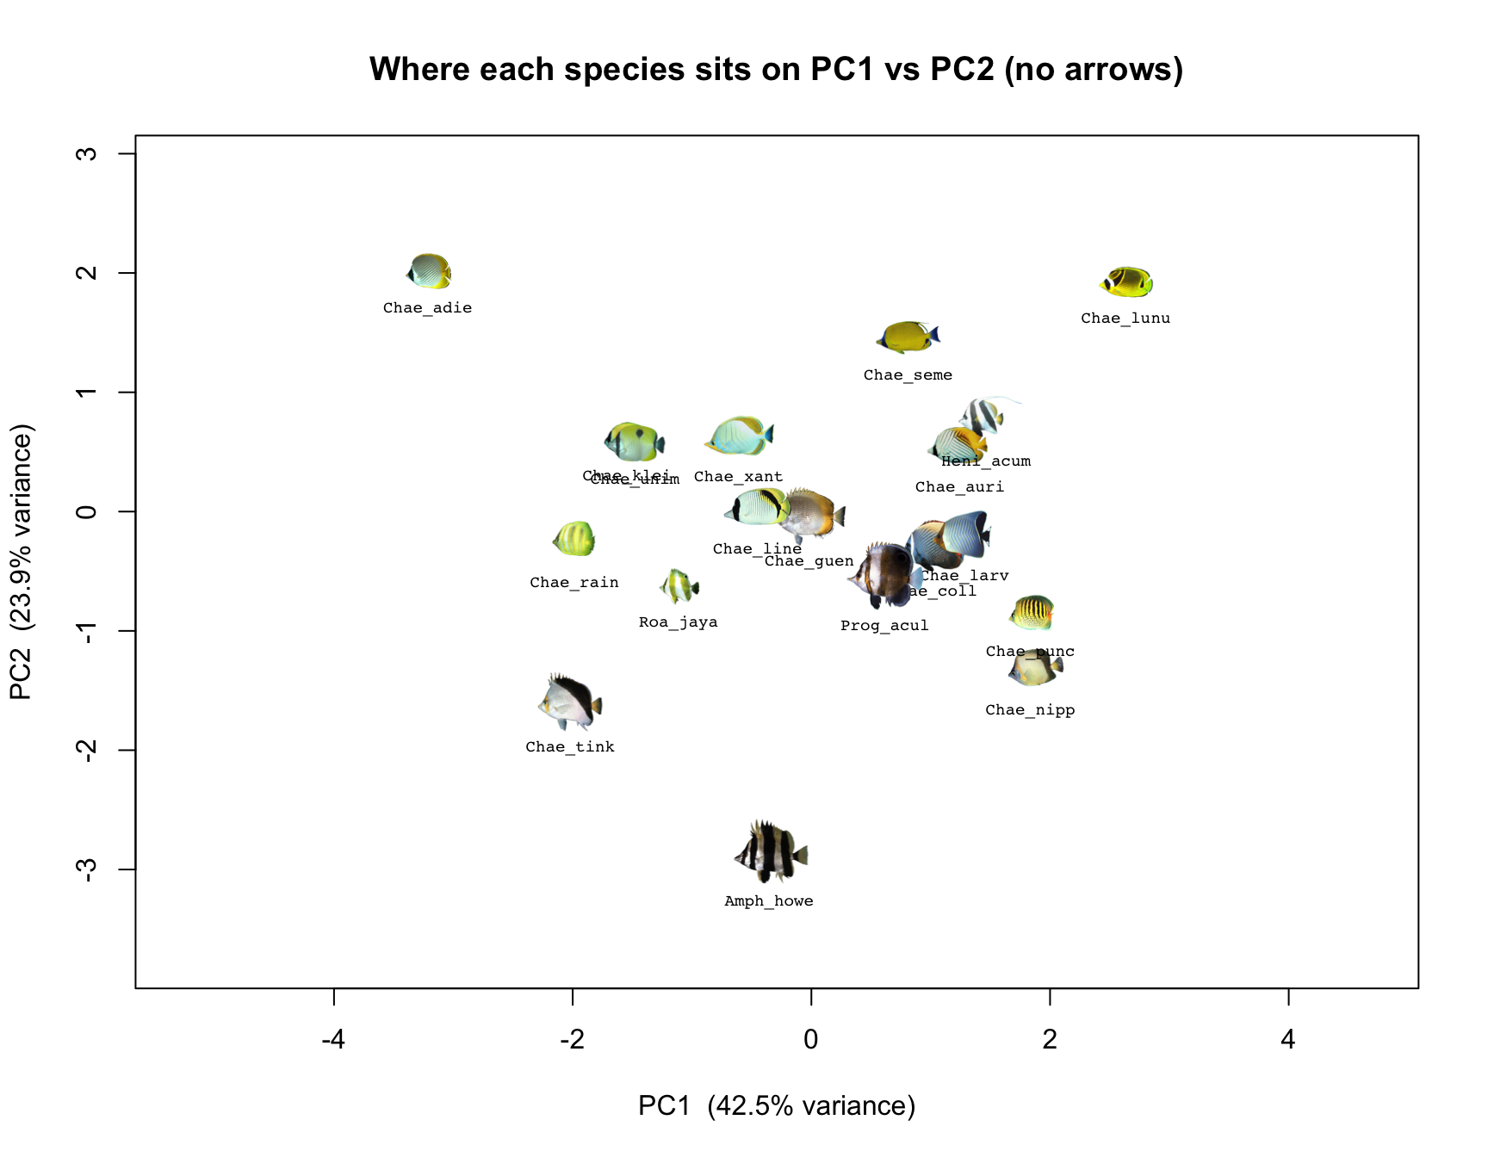
The Chaetodontidae morphospace
every thumbnail is one species; same pavo stats → same neighborhood
EEB 187 · Demo 8 walkthrough · May 20 2026

Slide 13
Does ecology predict pattern?
the question §1.8 of the worksheet sets up
If we tell you how a fish lives, can we predict what its color pattern looks like?
• Hypothesis — depth, diet, body size shape the visual world a fish lives in, so its pattern should evolve to match.
• If true — ecology variables predict pavo PC1 (or specific pavo variables).
• If false — color and ecology are decoupled — pattern is driven by other things (mate choice, lineage history, sensory drive in non-obvious ways).
• Frédérich 2026 says — for these families, color evolves fast enough that ecology and color are mostly decoupled. Today we test that on Chaetodontidae.
EEB 187 · Demo 8 walkthrough · May 20 2026

Slide 14
The two named tests in Part 1
ahistorical — we ignore the tree on purpose, just to see what's there
• m ~ Troph — do herbivores have less busy patterns than piscivores?
• A ~ log_depth — does pattern orientation change with depth and the light environment?
These are pretending each species is an independent observation. Part 2 will redo them with phylogenetic correction.
Workflow: lm() in R, exactly the same as Demo 6.
Output: slope, intercept, p-value, R-squared.
Read: is the slope distinguishable from zero? How much variance does it explain?
EEB 187 · Demo 8 walkthrough · May 20 2026

Slide 15
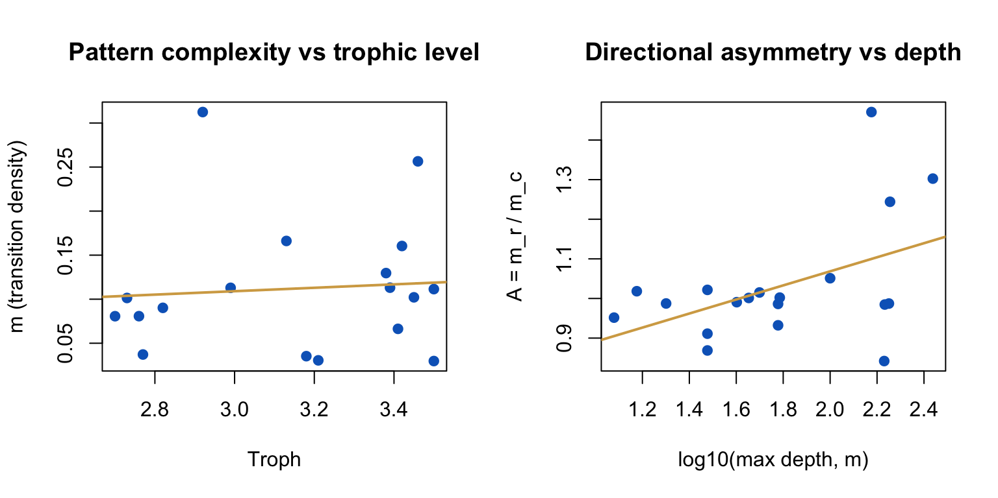
Ecology scatter — what we see ahistorically
both slopes weak in 19 butterflyfish species
• Trophic level → m — R² < 0.1, p > 0.3.
• Depth → A — also weak.
• Caveat — small sample. Bigger trees may show more.
• Bigger caveat — these tests don't know about phylogeny.
• Concept block 3 — fixes that.
EEB 187 · Demo 8 walkthrough · May 20 2026

Slide 16
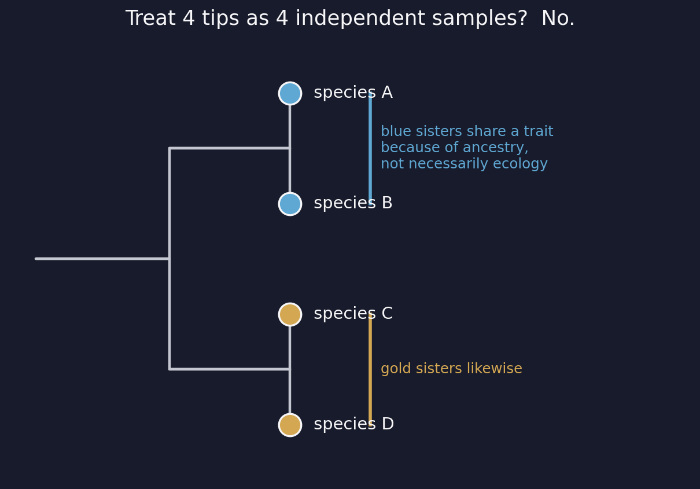
Why phylogeny matters
shared ancestry breaks the independence assumption
Closely related species share trait values because they share genes — not necessarily because of ecology.
• Naïve view — 4 tips = 4 independent samples.
• Reality — 2 sister pairs sharing ancestors.
• Consequence — the apparent correlation between blue and gold traits is partly inherited, not earned.
• Fix — downweight the sisters when fitting.
EEB 187 · Demo 8 walkthrough · May 20 2026

Slide 17
Two corrections we will apply
one for multivariate axes, one for bivariate fits
• phyloPCA — PCA that uses the tree's variance-covariance matrix to weight species.
• PGLS — generalized least squares where residuals can correlate via the tree — the bivariate-lm analog of phyloPCA.
• Plus — Blomberg's K and Pagel's λ on every pavo variable, to ask which traits carry phylogenetic signal at all.
All three use the same math machinery: invert the tree's variance-covariance matrix and downweight non-independent species.
If the tree is a flat star (no internal structure) every correction reduces to the ahistorical version.
EEB 187 · Demo 8 walkthrough · May 20 2026

Slide 18
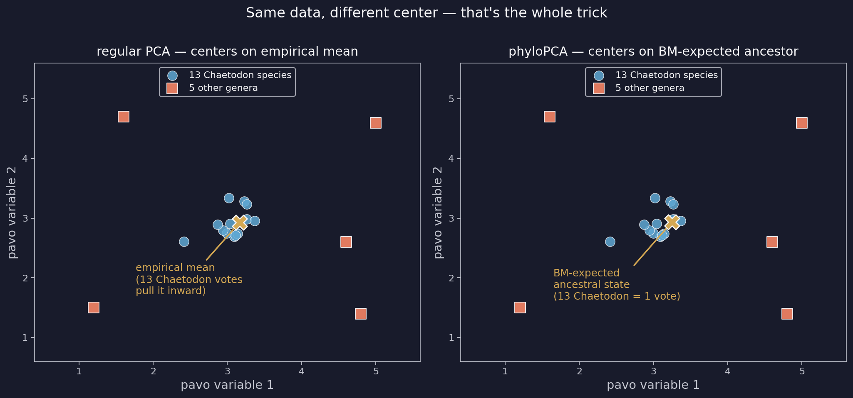
phyloPCA — what it does that regular PCA doesn't
same axes, different centering
Regular PCA centers on the empirical mean. phyloPCA centers on the BM-expected ancestral state.
13 bar-y Chaetodon = 13 votes for 'bar-y is one direction' under regular PCA. Under phyloPCA, 1 vote (the ancestor).
EEB 187 · Demo 8 walkthrough · May 20 2026

Slide 19
phyloPCA — unpacked
the consequence for loadings
• Regular PCA — rotates the cloud of 19 species treated as 19 independent points.
• phyloPCA — rotates the cloud of independent evolutionary changes — sister species get pulled toward each other in the variance-covariance step.
• So the new axes — describe directions of evolutionary change in pattern space, not just directions of current correlation.
• Loadings differ from regular PCA — when a variable's apparent strength came from a clade of similar species. phyloPCA strips out that inflation.
• Same math as PGLS — both invert the tree's variance-covariance matrix.
EEB 187 · Demo 8 walkthrough · May 20 2026

Slide 20
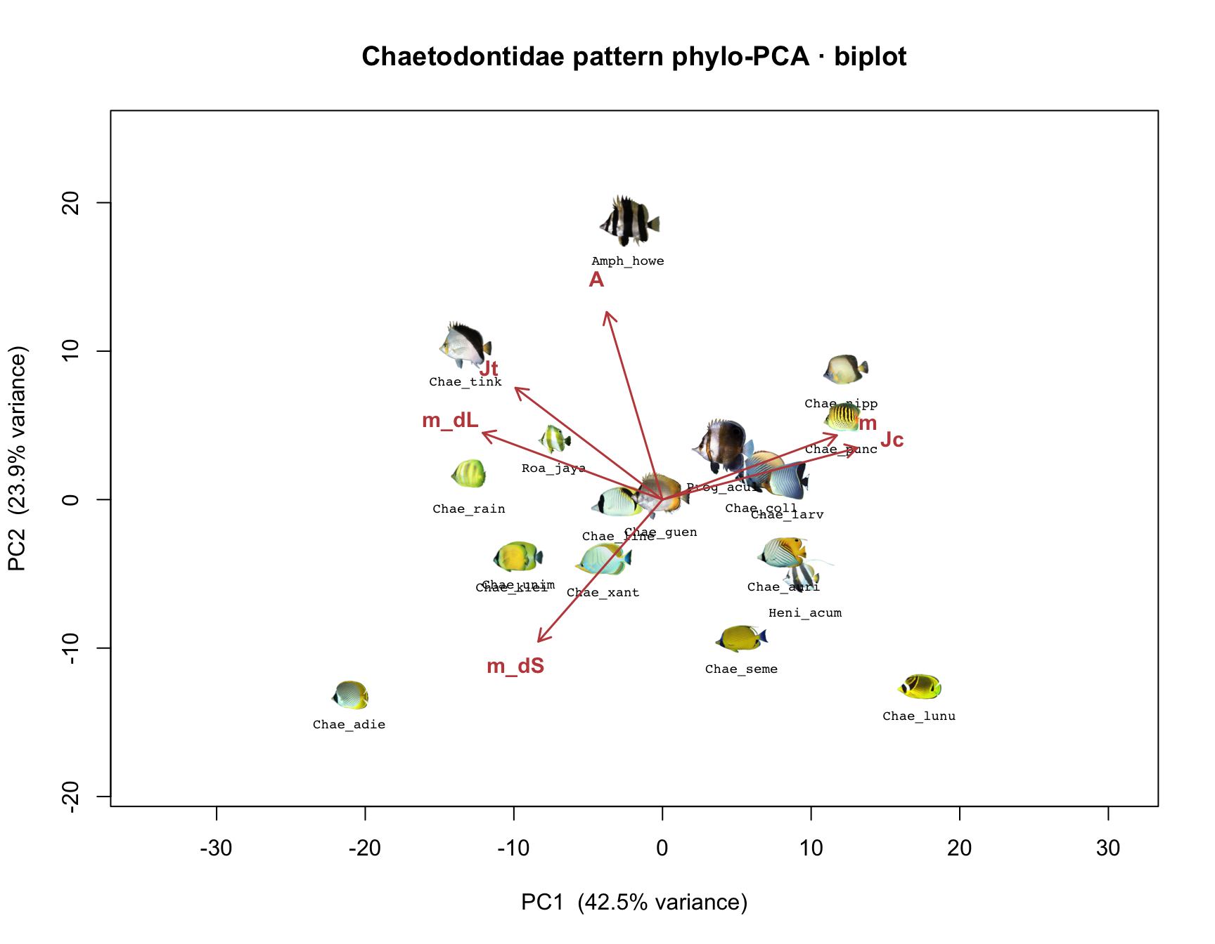
phyloPCA biplot for Chaetodontidae
the Chaetodon cluster vs the outer genera
• Cluster near origin — the dense Chaetodon clade.
• Splayed outward — Roa, Heniochus, Amphichaetodon, Prognathodes.
• This shape — is the multivariate fingerprint of phylogenetic structure in pattern space.
• Compare to slide 13 — regular PCA spread Chaetodon out; phyloPCA pulls them together.
EEB 187 · Demo 8 walkthrough · May 20 2026

Slide 21
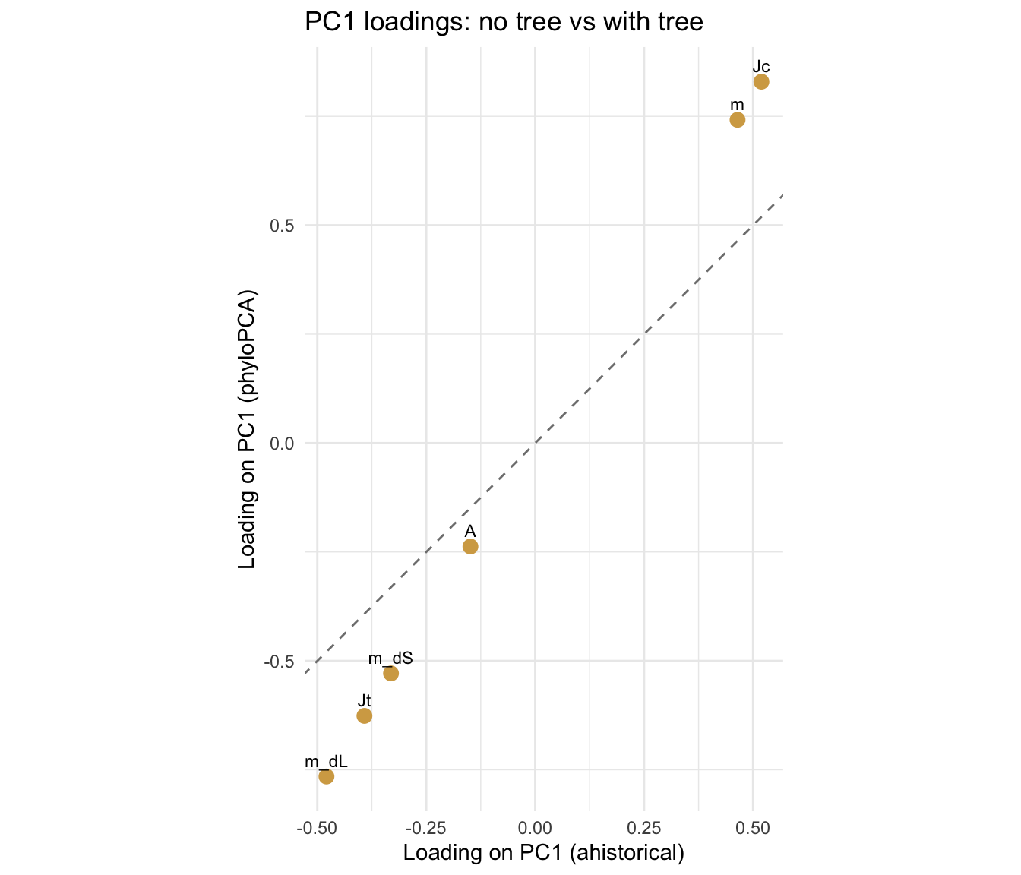
Did phylogeny change which variables matter?
PC1 loading — regular PCA vs phyloPCA
• On the dashed y = x line — phylogeny didn't change that variable's loading.
• Above the line — phyloPCA increased the loading — ancestry was masking it.
• Below the line — phyloPCA decreased the loading — ancestry was inflating it.
• Read variable-by-variable — not as a single number.
EEB 187 · Demo 8 walkthrough · May 20 2026

Slide 22
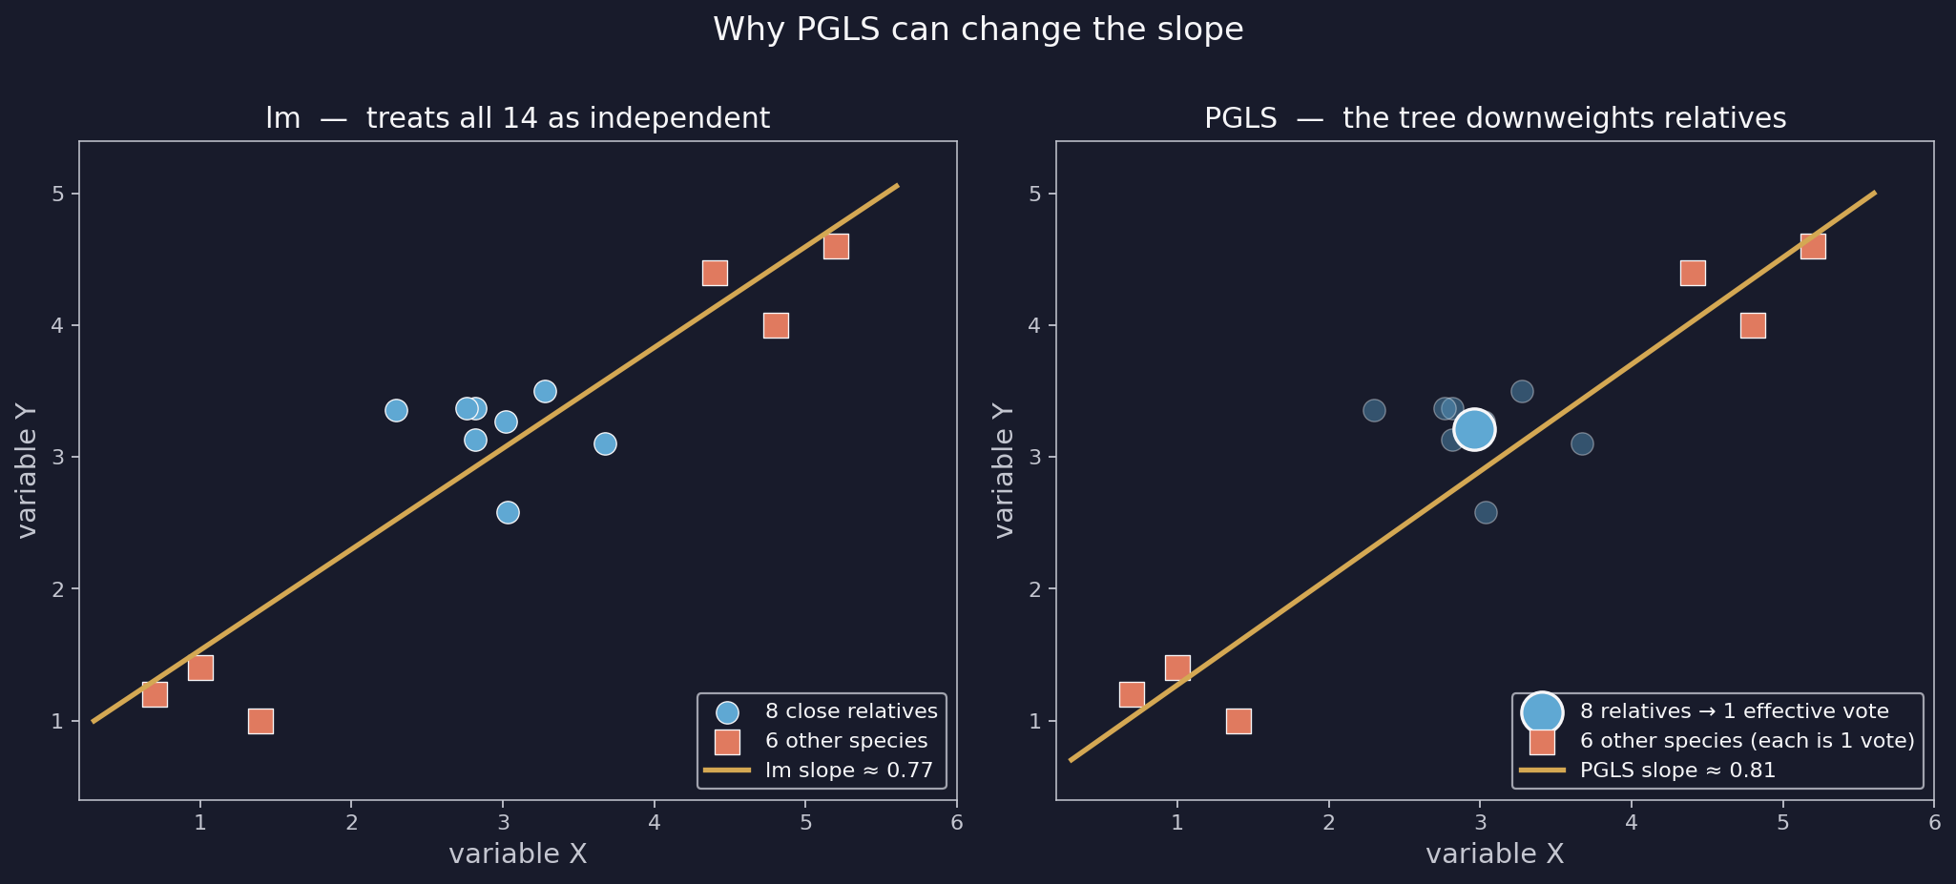
PGLS — bivariate fits with phylogenetic correction
same idea as phyloPCA, but for one X-Y relationship at a time
Same two fits as §1.6 — A ~ m and m_dL ~ m_dS — but the tree downweights non-independent species.
EEB 187 · Demo 8 walkthrough · May 20 2026

Slide 23
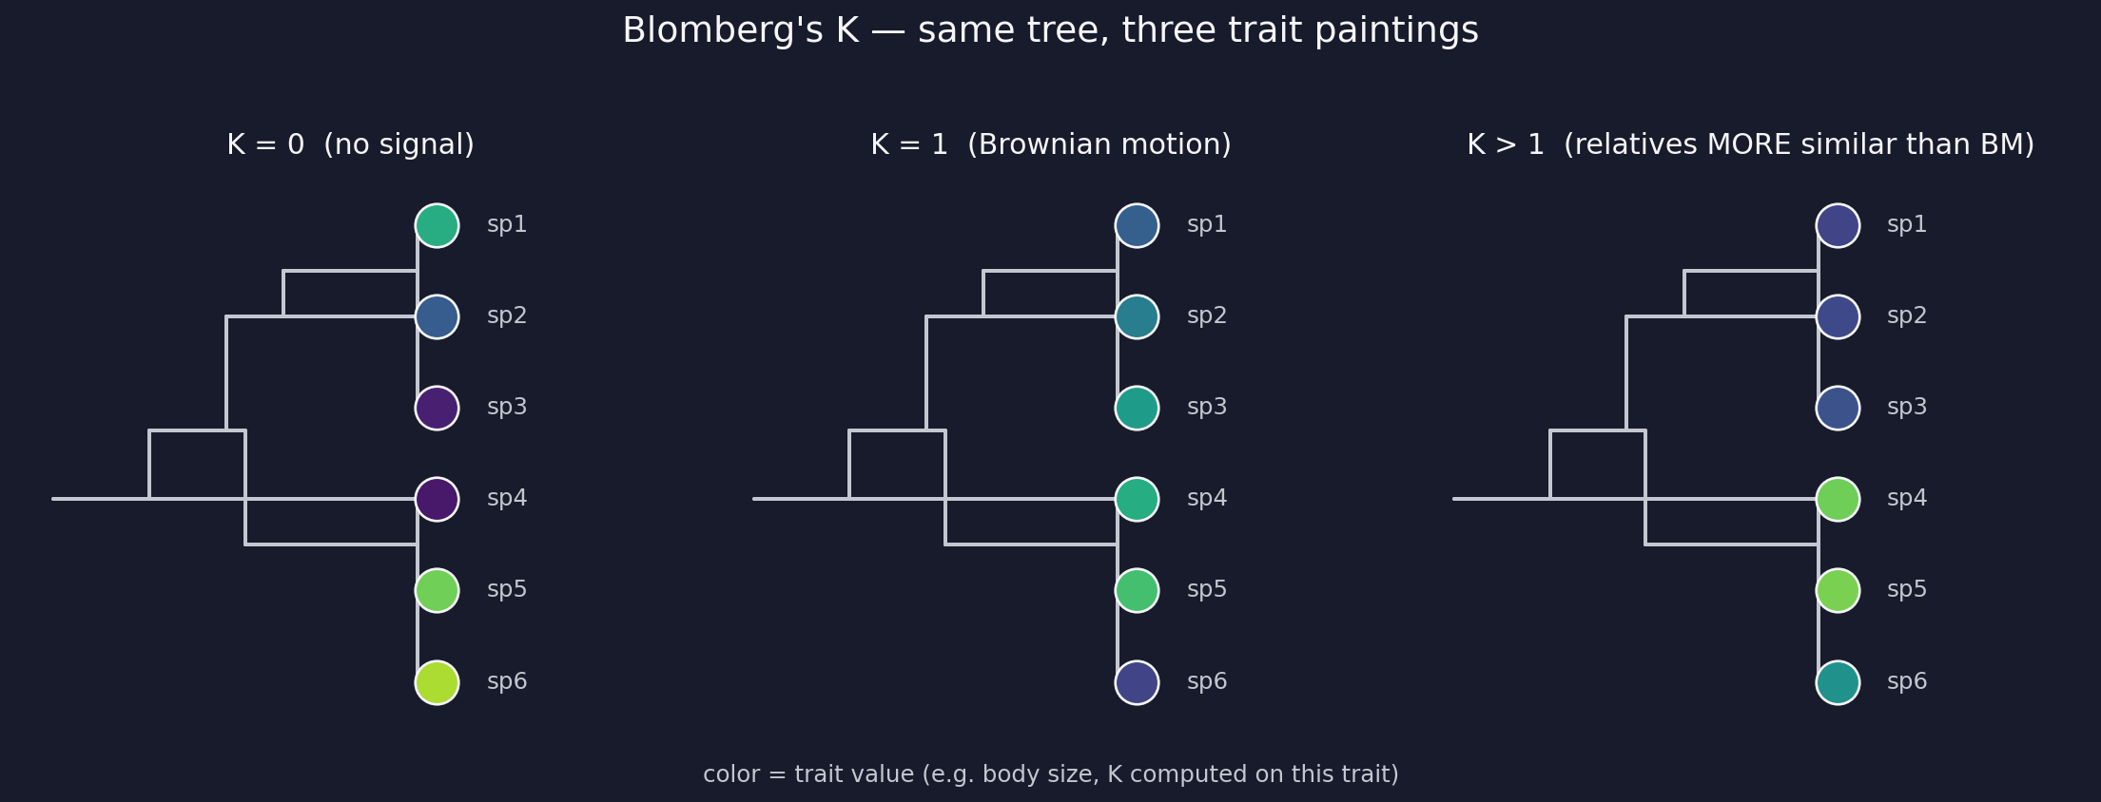
Blomberg's K — measuring phylogenetic signal
one number per trait
K compares how similar relatives actually are to how similar Brownian motion predicts they'd be.
• K = 0 — trait randomly distributed on tree — relatives no more similar than distant species.
• K = 1 — trait matches Brownian-motion expectation exactly.
• K > 1 — relatives MORE similar than BM predicts — active conservation.
EEB 187 · Demo 8 walkthrough · May 20 2026

Slide 24
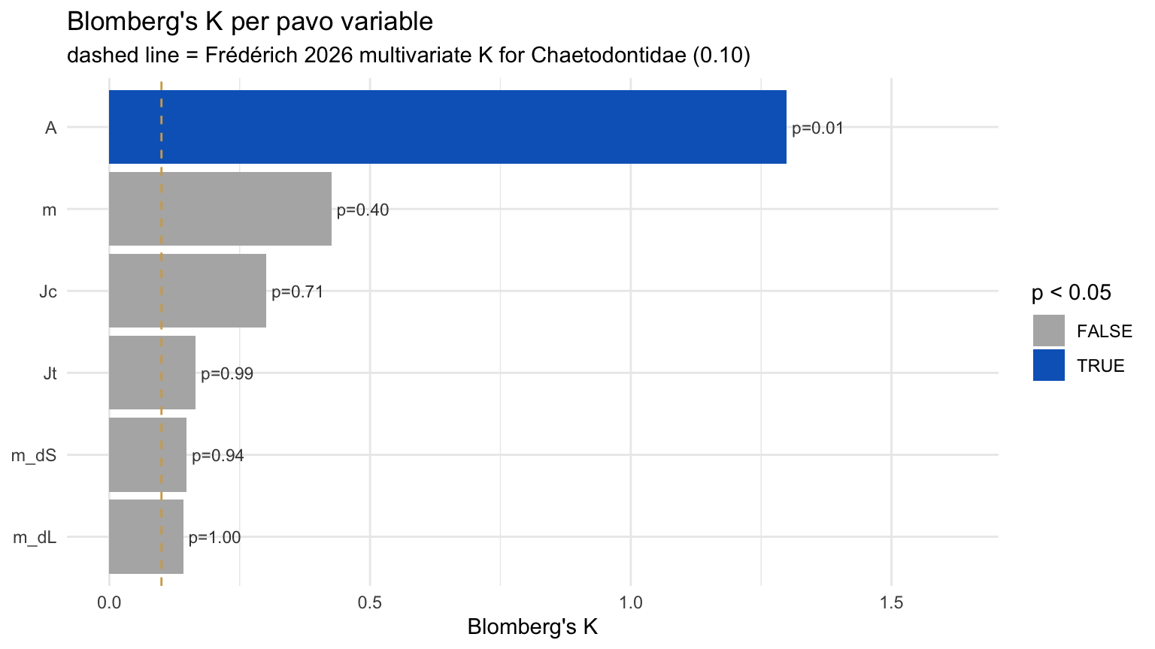
K per pavo variable in Chaetodontidae
one bar per variable — colored if p < 0.05
• A → K ≈ 1.3 — p ≈ 0.01. Relatives MORE similar than BM.
• The other 5 — K between 0.15 and 0.45, non-significant — labile.
• Take-home — pattern orientation is conserved in butterflyfishes; complexity, palette, and boundaries are not.
• Frédérich landmark — dashed line at K = 0.10 — not a target our bars should hit.
EEB 187 · Demo 8 walkthrough · May 20 2026

Slide 25
Where did the ecology data come from?
the species_traits.csv you've been using
The CSV in §1.8 was built by querying FishBase directly. Now you'll see the API call.
• FishBase — free, curated database of fish ecology and morphology. ~35,000 species.
• rfishbase — an R package that talks to it — species() and ecology() are the two key calls.
• Why teach this — any time you want to layer ecology onto a phylogeny, you'll use the same recipe.
• Pin to v3.1.10 — newer rfishbase depends on duckdb (C++ toolchain). 3.1.10 installs cleanly.
EEB 187 · Demo 8 walkthrough · May 20 2026

Slide 26
rfishbase in four moves
what worksheet §2.8 actually runs
FishBase uses 'Genus species' (space). Our bundle uses 'Genus_species' (underscore). Translate at the API boundary.
• 1. Convert keys — species_fb <- gsub("_", " ", species)
• 2. Pull traits with species() — Length, DepthRangeDeep, Vulnerability — all in one fields= call.
• 3. Pull diet with ecology() — FoodTroph + DietTroph; coalesce to Troph and average across multiple study rows per species.
• 4. Merge + re-key — merge sp + ec by Species, then gsub back to underscore form so it joins your bundle's species column.
Total: ~30 sec for a 19-species family. Cached for repeated runs.
EEB 187 · Demo 8 walkthrough · May 20 2026

Slide 27
Your turn — same recipe, your bundle
the §2.8 chunks run unchanged on whichever family you point at
rfishbase doesn't know which family you're in. It works on any vector of Genus_species strings.
• Same chunks, your data — after the in-class picker step, your species vector is your family's species — re-run §2.8 and rfishbase fetches FishBase data for them.
• Sanity-check vs CSV — the worksheet prints max |Δ| per trait. Near zero = your live pull reproduces the CSV. Differences usually mean FishBase has updated values.
• Watch missing values — not every species has all four traits. The missing-count line tells you which traits to drop from your PGLS / K calls.
• Network out? — fall back to the bundled CSV — it ships with every export and contains the same fields.
EEB 187 · Demo 8 walkthrough · May 20 2026

Slide 28
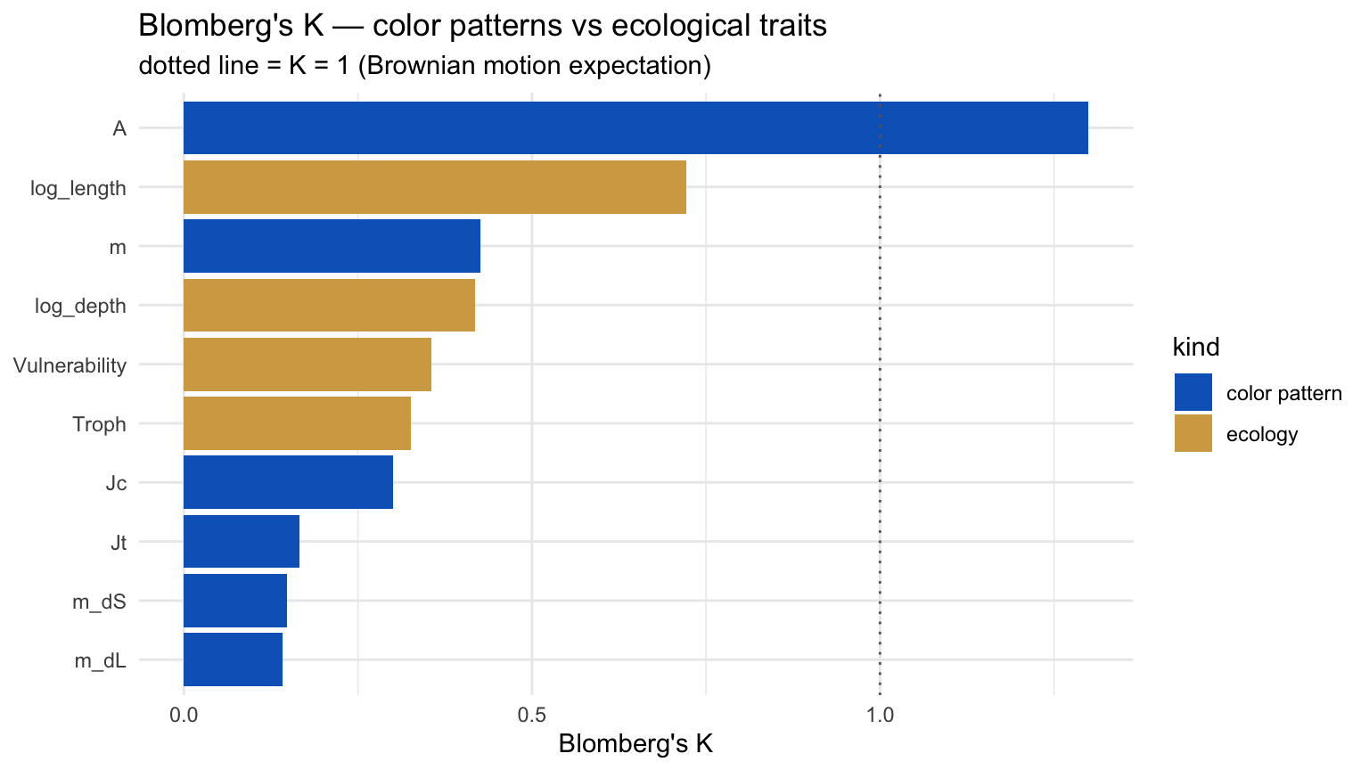
Color signal vs ecology signal
do close relatives share how they live more than how they look?
• Ecology bars above color bars — ecology is more phylogenetically conserved than pattern.
• Interpretation — close relatives are tied by how they live more than how they look.
• In our 19-tip sample — the bars overlap — sample size is the limiting factor.
• Your family — may show the pattern more sharply if it has deeper splits.
EEB 187 · Demo 8 walkthrough · May 20 2026

Slide 29
Part 2 take-home for Chaetodontidae
the result we'll stress-test in Part 3
Pattern orientation is conserved within butterflyfishes; everything else is evolutionarily labile.
• Conserved — A (pattern aspect ratio) — bar-y stays bar-y, stripe-y stays stripe-y.
• Labile — m, Jc, Jt, m_dS, m_dL — complexity, palette use, transition variety, and both boundary strengths.
• Bivariate story — after PGLS, m_dL ~ m_dS gains a significant positive slope; A ~ m stays flat.
• Matches Frédérich — qualitatively — color patterns largely evolve fast. The exception is A.
Part 3 asks: how much of that survives noisy measurements?
EEB 187 · Demo 8 walkthrough · May 20 2026

Slide 30
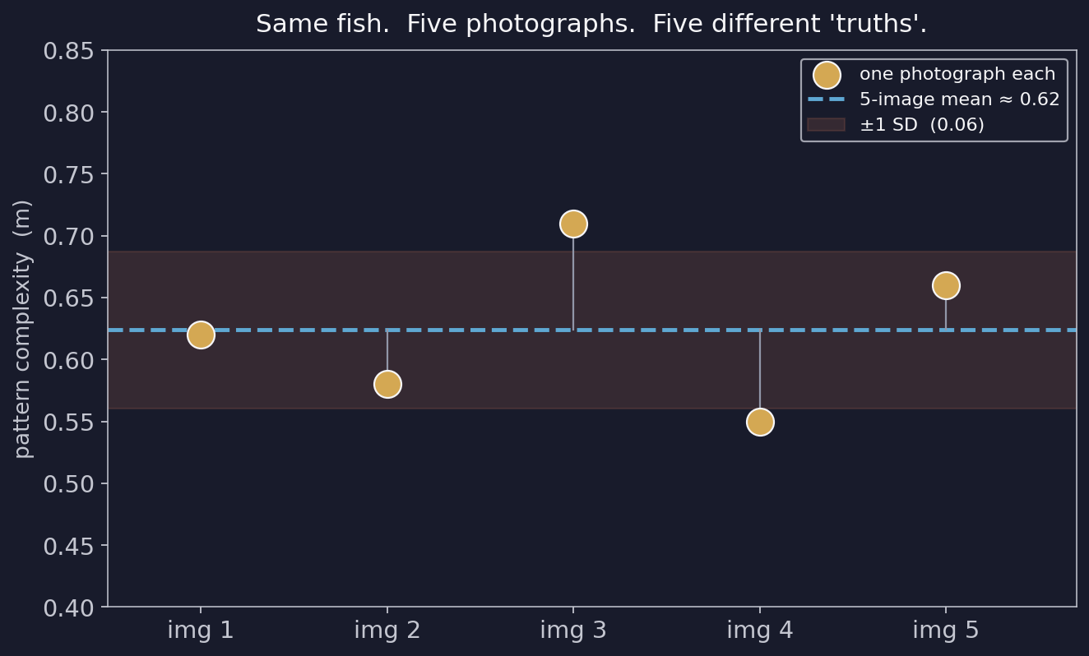
Why a single number is a lie
every pavo statistic came from one photograph
• Same fish — Same species, same individual.
• Different photos — Different angle, light, framing.
• Different pavo values — the 'truth' is a distribution.
• Part 3 — asks how much that distribution matters.
EEB 187 · Demo 8 walkthrough · May 20 2026

Slide 31
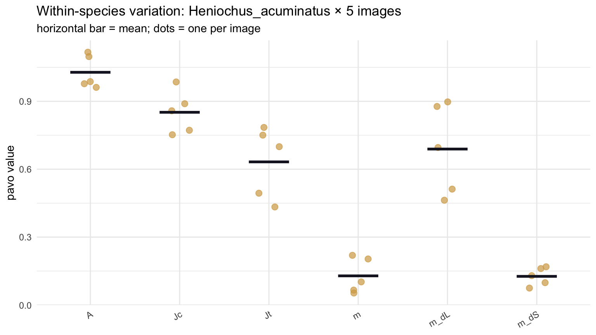
The 5-image error stack
one species photographed 5 times → 5 pavo values per variable
• Dots — one pavo value per photograph.
• Bar — the 5-photo mean.
• Tight clusters — pavo is reliable for that variable.
• Wide spread — that variable's Part-2 result is fragile.
• Simplifying assumption — treat the SD from this one species as the SD for every species.
EEB 187 · Demo 8 walkthrough · May 20 2026

Slide 32
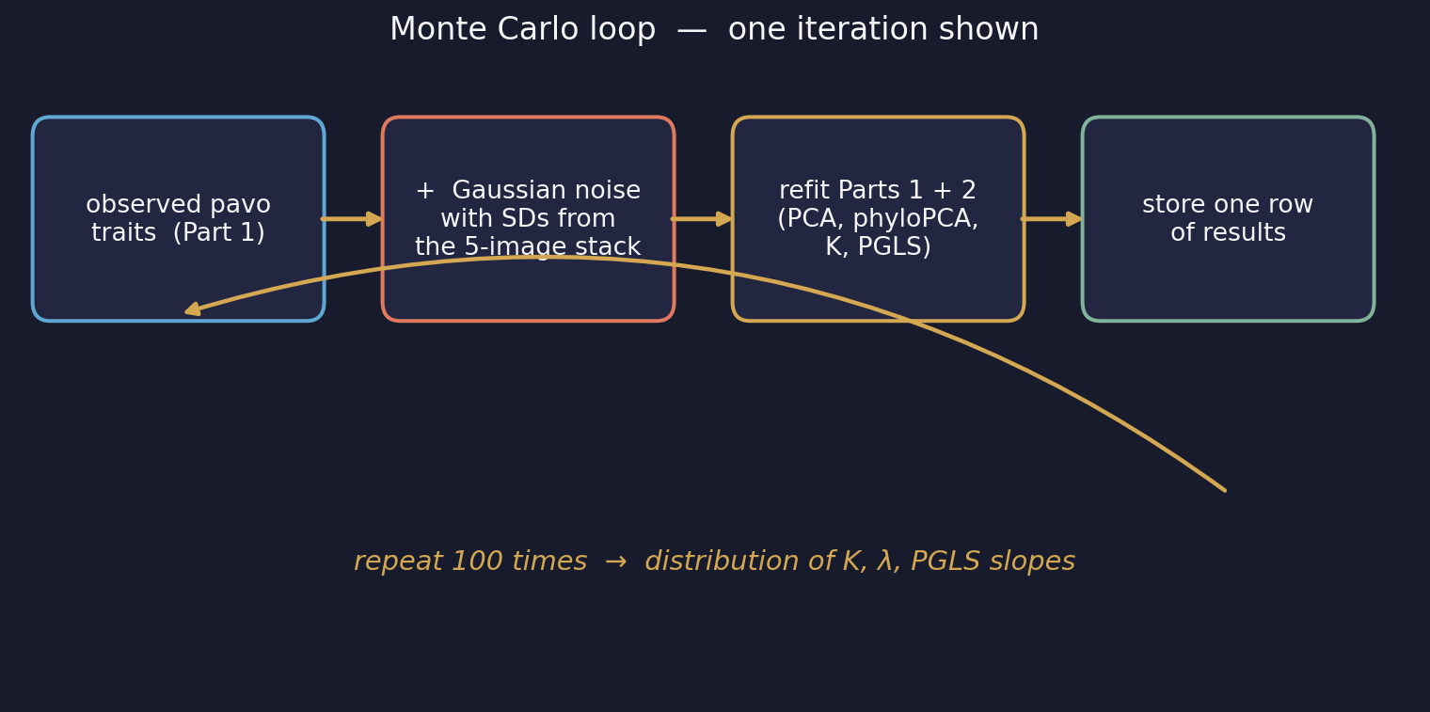
Monte Carlo — re-run everything under noise
100 iterations, each adding fresh Gaussian noise
• Each iteration — add Gaussian noise with the observed SDs to every tip; refit everything.
• Store — K, λ, PGLS slopes.
• After 100 iterations — you have 100 K values per pavo variable — a distribution, not a point.
• Time cost — ~1.5–2 min for n_iter = 100, ~3–5 min for n_iter = 200.
EEB 187 · Demo 8 walkthrough · May 20 2026

Slide 33
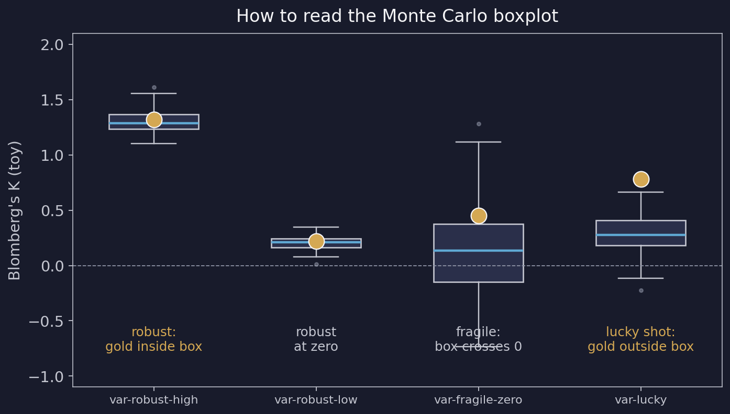
Reading the Monte Carlo boxplot
the gold dot is the observed value from Part 2
• Gold inside the box — robust — your Part 2 conclusion holds.
• Box centered at zero — no signal — fine if that was the claim.
• Box straddles zero — fragile — can't distinguish from no signal.
• Gold outside the box — you got lucky — a different photo would have given a different K.
• For PGLS slopes — the test is whether zero lies inside the 95 % CI.
EEB 187 · Demo 8 walkthrough · May 20 2026

Slide 34
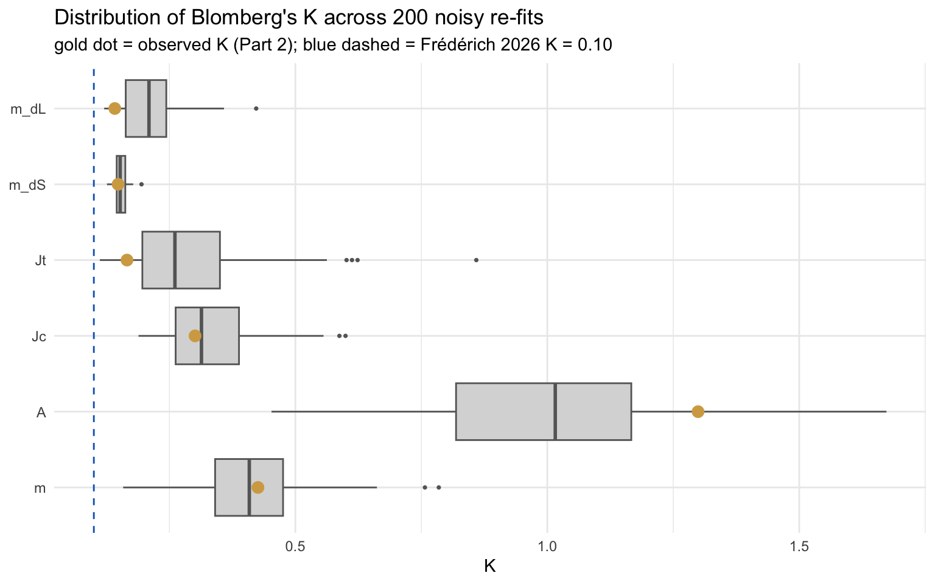
Chaetodontidae K under noise
100 Monte Carlo re-fits · gold dot = observed (Part 2)
• A's K stays high — robust under noise — pattern orientation really is conserved.
• Other 5 — boxes hover near zero — consistent with the non-significant point estimates.
• Verdict — the headline result from Part 2 survives realistic measurement error.
EEB 187 · Demo 8 walkthrough · May 20 2026

Slide 35
Part 3 take-home
what survives in Chaetodontidae
Once we admit one photograph isn't the truth, only A's signal still holds. Everything else stays labile.
• Robust under noise — A — high K, tight MC distribution, gold dot inside the box.
• Robust at no-signal — m, Jc, Jt, m_dS, m_dL — boxes near zero, gold dot inside.
• No PGLS slope flips — A ~ m stays flat under noise; m_dL ~ m_dS stays positive.
• Lesson for your family — if your headline relies on a variable with wide MC spread, soften the claim.
EEB 187 · Demo 8 walkthrough · May 20 2026

Slide 36
Now you build your own bundle
15 min on FishView · same login as Demo 7
Pick ≥ 15 species across ≥ 5 genera from your family
Star one exemplar image per species
Mark ONE species as the error-species → tick 5 images for it
Hit Export. Drop the ZIP next to your Chaetodontidae bundle.
The choices you make here ARE the analysis.
Frédérich-paper species are starred for Acanthuridae, Chaetodontidae, Pomacanthidae. The 4 Labrid groups + Balistoidea pick cold — your K estimates are the first for your clade.
EEB 187 · Demo 8 walkthrough · May 20 2026

Slide 37
What you turn in
BruinLearn · end of day Wednesday
1. Part 1 PCA scatter — your family
2. Part 2 K plot + one-line interpretation per pavo variable
3. Part 3 Monte-Carlo boxplot on K (or one PGLS slope)
4. One paragraph (≤ 250 words) — branch by family:
If your family is in Frédérich (Acanthuridae, Pomacanthidae):
compare your per-variable Ks to their published multivariate K.
If your family is NOT in Frédérich (4 Labrid groups, Balistoidea):
these are the first reported Ks for your clade — describe the pattern.
EEB 187 · Demo 8 walkthrough · May 20 2026

Slide 38
Tonight
prep page · ~20 minutes
1. Install R packages (one chunk on the prep page)
2. Download the Chaetodontidae walkthrough bundle
3. Run the readiness check until it prints PASS
4. Confirm your Demo 7 FishView login still works
michaelalfaro.github.io/eeb187-demos/demo8/demo8-prep.html
EEB 187 · Demo 8 walkthrough · May 20 2026

Slide 39
See you Wednesday.
Bring questions. We will move slowly.
EEB 187 · Demo 8 walkthrough · May 20 2026

